Slide 1
Intro to LabVIEW:
Programming for Symon
University of Houston
Len Trombetta

Slide 2
tutorials

Slide 3
Tutorials
The tutorial provided here will show you some useful LabVIEW programming constructs. If you follow the whole thing, you will be able to create the game “Symon” – a software version of the Milton Bradley game “Simon”.
National Instruments also provides a lot of help on their website:
Tutorials:
http://www.ni.com/academic/students/learn-labview/environment/
“Getting Started with LabVIEW” pdf:
http://www.ni.com/pdf/manuals/373427j.pdf

Slide 4
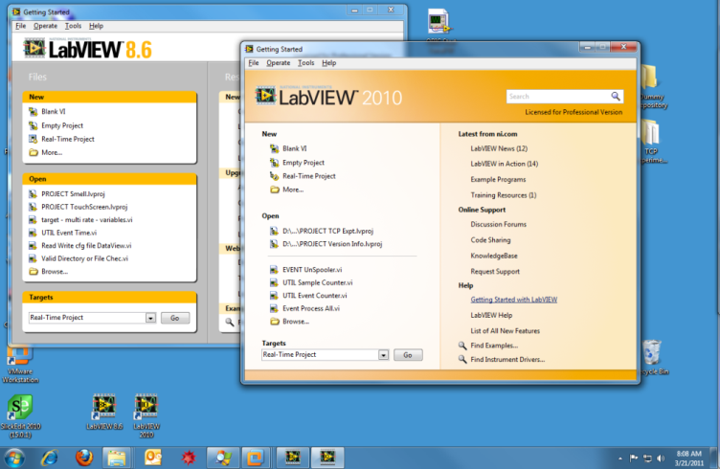
LabVIEW Programming Intro
Table of Contents
Boolean Control of LEDs
T/F Case Structure and Sequence
Local Variables
While Loop
Random Numbers; General Case Structure, For Loop
Array Build
Controls and Indicators; Read and Write
Other Stuff
Finer Points
Errors and De-Bugging

Slide 5
Boolean controls: software led

Slide 6
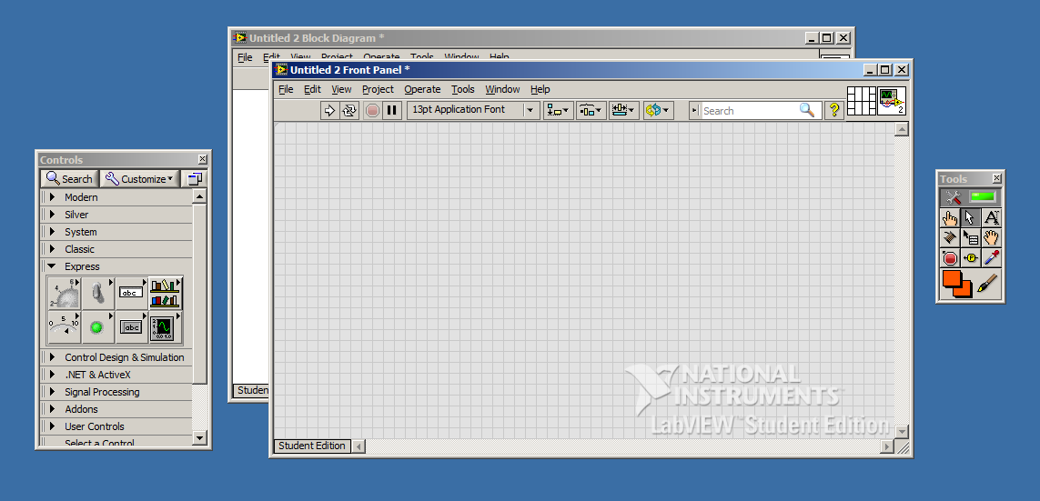
Controlling Software LEDs
When we open a new project, we get a front panel and a block diagram. We show here the control menu and the tools palette as well. The tools palette is accessed from the “View” menu.
Block Diagram
Front Panel
Control Menu
Tools Palette

Slide 7
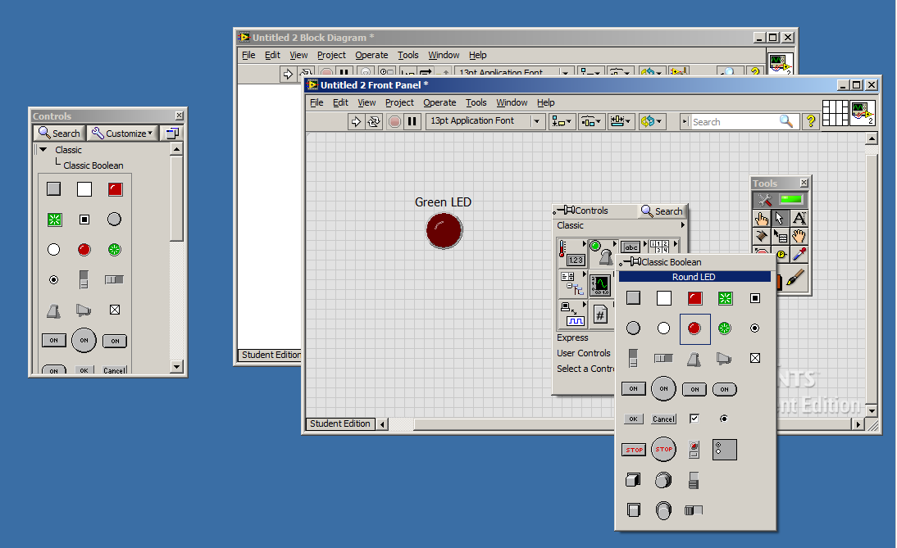
Controlling Software LEDs
You can also bring up the control panel by right-clicking on the front panel. Below we use it to chose an LED to put on the front panel.
Classic>Classic Boolean>Round LED
We also re-sized the LED and changed the label font.
Boolean: a control or variable whose value is either True or False.

Slide 8
Controlling Software LEDs
We can customize the LED by right-clicking on it and choosing Properties.
This LED will be green when it’s on and black when it’s off.
By right-clicking we can also choose to display or not to display the label.

Slide 9
Controlling Software LEDs
We want a button to turn the LED on. We’ve chosen one of several possibilities below.
Classic>Classic Boolean>Square Push Button.

Slide 10
Controlling Software LEDs
You can fancy it up if you like.
Modern>Decorations
Text Tool and font control
Right-click and hide label

Slide 11
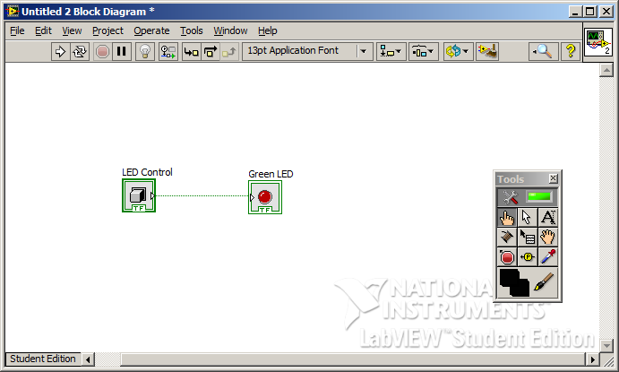
Controlling Software LEDs
On the block diagram we see that LabVIEW has created icons (terminals) representing the switch and the LED. We can simply wire these together. Then when the switch is ON it’s output is TRUE and the LED turns on. When the switch is OFF it’s output is FALSE and the LED turns off.
The connecting wire is green, indicating that this is Boolean data.
Wiring Tool

Slide 12
Controlling LEDs
Back at the front panel, we hit the “continuous run” button. (The white arrow is simply “run”: it will check one time to see if the button is or not, and then it will stop.)
That’s it! Now when we press the button, the LED will light. When we press again, it will go off.
Continuous Run

Slide 13
T/F Case structure Sequence

Slide 14
T/F Case and Sequence
To make Symon, we will want to turn a light on and then off again after a brief time. We illustrate the use of a T/F case structure and a sequence by configuring LabVIEW to do this when we push a button on the front panel.

Slide 15
T/F Case
We put the LED inside a case structure. By default this will be a T/F case structure. We wire the switch to the case structure, and wire a Boolean “T” (True) to the LED.
Right-click: Programming>Case Structure
After selecting Case Structure, simply draw a box around what you want inside the Case Structure.
Programming>Boolean>True Constant

Slide 16
T/F Case
When the switch is pressed, we want three things to happen…
LED on, then wait 1 second
LED off
Switch off
To do that, we use a Sequence inside the T/F case. This will allow us to have three things happen if the switch is True, i.e., “on”.

Slide 17
Sequence
The sequence shown below is a flat sequence, meaning things appear one after the other. We can change this to a stacked sequence, in which case the frames are on top of one another.
Programming>Structures>Flat Sequence Structure
Add Frames: Right-click on the frame edge, then “Add Frame After”
We have added two frames…
To change to stacked sequence, right-click on frame, then “Replace with Stacked Sequence”

Slide 18
Sequence
We add a wait statement, which pauses execution for 1000 ms.
Connecting wire is blue, indicating a numeric value.
Programming>Numeric> Numeric Constant
Programming>Timing>Wait (ms)

Slide 19
Local variables

Slide 20
Local Variables
In the remaining two frames, I want to turn off the LED, and then turn off the switch (otherwise when the program loops around again the switch is still on, and the LED keeps lighting). To do that, I need to write to the LED and the switch somehow. I do that with local variables.
Local variables create a “proxy” for another variable in the program. What you do to the local variable will be done to the original variable.

Slide 21
Local Variables
Here is the completed sequence. We created local variables for the LED and the switch by right-clicking on them, and choosing Create>Local Variable. We wired “False” to each one to turn them off.
Right-click Green LED, then Create>Local Variable
Programming>Boolean>False Constant
Right-click Green Switch, then Create>Local Variable

Slide 22
Local Variables
Now we run in continuous mode. When the switch is pressed, the TRUE case executes and the LED goes on. The program waits for 1000 ms, then turns off the LED, and then turns off the switch. If we did not turn off the switch, the LED would go back on when the program starts over.

Slide 23
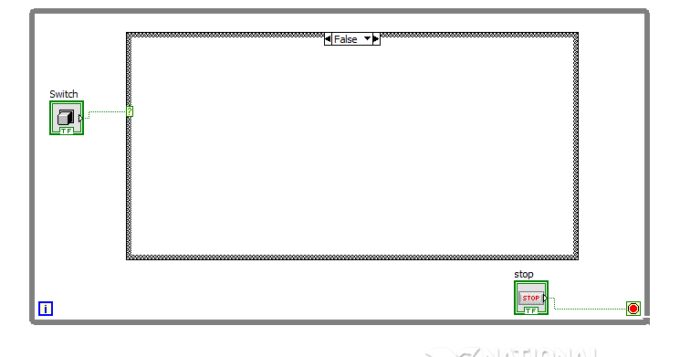
One Other Thing…
What happens when the switch is False (off)? Since we have not programmed anything into the False case, nothing happens!

Slide 24
While loop

Slide 25
While Loop
We introduce another useful structure: the While Loop. We often want an option to branch out of what we are doing (turning on the LED in this case) and do something else. To do that, we will have a button that gets us out of this part of the program when we press it.
Programming>Structures>While Loop

Slide 26
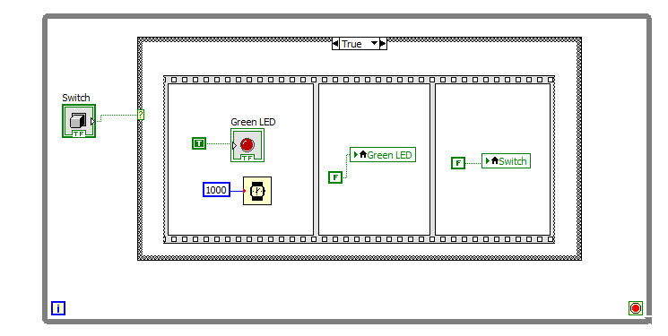
While Loop
We have enclosed our entire program in a While Loop. It will execute continuously until a “T” is received at the STOP terminal – so it executes “while” the STOP terminal is not “True”.
STOP terminal appears automatically with the While Loop. By right-clicking on it, you can set it to either “stop” or “continue” when a “T” is wired to it. The default is to stop when it sees True.

Slide 27
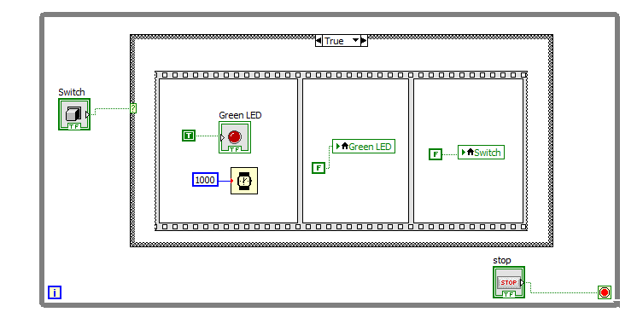
While Loop
We add a “STOP” button to the front panel. There is a corresponding terminal on the block diagram, which we have wired to the STOP terminal.
Modern>Boolean>Stop
The program runs continuously “while” the STOP terminal is False.

Slide 28
While Loop
That’s it! Now we hit the Run button (not Continuous Run). The program will execute until we hit the STOP button because it is inside a While Loop.

Slide 29
Random Number Generator General Case Structure For Loop

Slide 30
Random LEDs
In this section we will use a random number generator to randomly turn on one of four LEDs four times. This will make use of a general case structure and a For Loop.

Slide 31
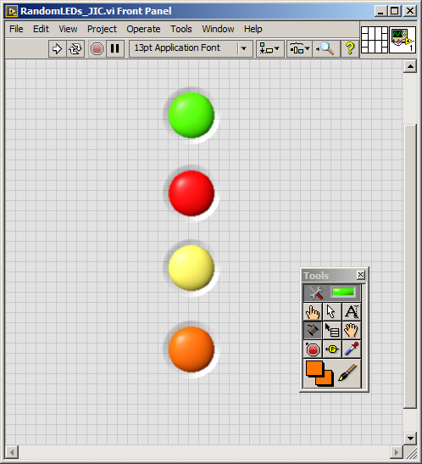
Random LEDs
We will assume that you have created four LEDs on the front panel: green, yellow, red, and orange.

Slide 32
Random LEDs
We begin with code that turns an LED on, and then off after 1000 ms. We enclose it in a sequence, but this time we choose Stacked Sequence. To do this, add a Flat Sequence, then right-click on it and change to Stacked Sequence.
We have used a local variable to write “F” to the LED to turn it off.
Frame 0: Turn on LED and wait 1000 ms.
Frame 1: Turn off LED.

Slide 33
Random LEDs
Now we put a case structure around our stacked sequence.
It comes up True/False, but we want to handle four cases (one for each LED). We can simply type in the cases we want (0, 1, 2, …for example), but it is easier to wire something to the terminal and let the case structure figure it out.
To do that, we add a random number generator. We multiply by 3.499, and Round to Nearest Integer.
Mathematics>Numeric
Orange wires indicate numeric values.
Generates a random number between 0 and 1

Slide 34
Random LEDs
When we wire the output of the calculation to the case structure, the case structure sees that we are connecting a numeric variable to its input, so it puts numeric values in the case fields.
…so numeric values are created here.
This will be a number…

Slide 35
Random LEDs
The output of our random number generator will vary from 0 to 3. So we create an LED on/off function for LEDs 0, 1, 2, and 3. To add cases, right-click on the top of the case structure and do Add Case After.
The figure shows the case for LED 2, but for Symon we will need three others as well (not shown here).
Right-click here to add cases.
When the output of the random number generator is 2, case 2 will execute.
Case 2, frame 0 lights the Red LED for 1 s and then turns it off (frame 1 not shown).

Slide 36
Random LEDs
We want Symon to light four LEDs randomly. So we enclose what we have so far in a For Loop.
Programming>Structures>For Loop
We want to do everything inside the For Loop four times (no pun intended!).
In each of four loops, a random number will be generated, and a corresponding LED will light.

Slide 37
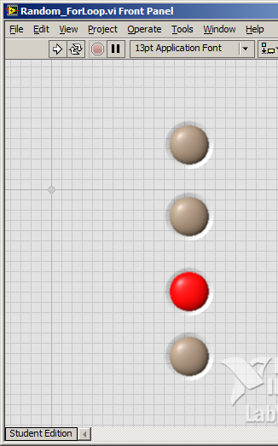
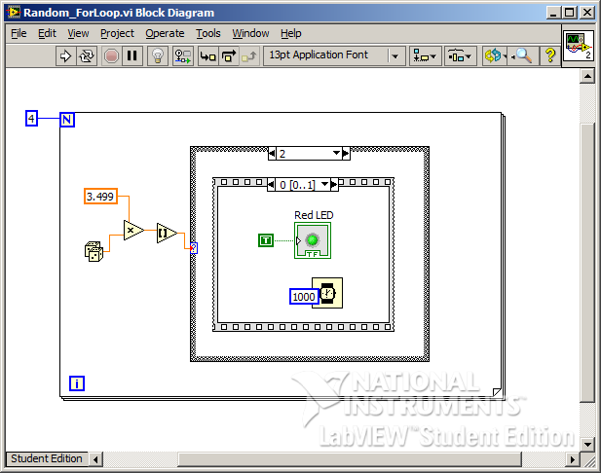
Random LEDs
That’s it!! This program will light one LED at random four times.

Slide 38
One More Thing…
With this construction, the LEDs will not light completely at random. Here’s why: The “dice” generate a random number between 0 and 1, and then we multiply by 3.499. (The Round to Nearest function will round 3.5 to 4, and we don’t have a case for 4.)
But the Round function will return 0 only half as often as it will return 1, 2, or 3. This happens because for 0 to 0.5, the Round function will return 0 but for 0.5001 to 1.499 it will return 1; for 1.5 to 2.5 it will return 2; for 2.5 to 3.499 it will return 3. These latter intervals are twice as big as the interval that returns 0.
So we will see the LED corresponding to 0 only half as often as the others. We will revisit this issue in a later presentation, but for now we just leave it as is.

Slide 39
Array build

Slide 40
Array Build
Building an array is useful in many circumstances. We use it here to keep track of Symon’s random choices, and of the user’s responses. The resulting arrays will be compared to see if they match!
An array, for our purposes, can be though of as a matrix of 1 or more dimensions. A one-dimensional array is a list of elements; a 2-D array is a table with rows and columns; a 3-D array can be thought of as cube with regularly spaced entries in three dimensions. A 4-D array is possible but difficult to picture!

Slide 41
Array Build
Starting from the previous project, we create an array indicator on the front panel that we can use to the see the result of the array build.
Modern>Array, Matrix, and Cluster>Array
Then we indicate the kind of things we want in the array. In our case, we want numeric indicators. We put the numeric indicator into the array by dragging it there.
Modern>Numeric>Numeric Indicator

Slide 42
Array Build
Each time the For Loop executes, we want to add the new random number to the existing array. We add Build Array…
This is the array we added on the front panel.
Programming>Array> Build Array
Drag down to add one layer to Build Array

Slide 43
Array Build
The new random number is generated here and sent to the lower terminal of the build array block.
The resulting array, with the new value added, is output here. We have connected it to our indicator.
But how do we access the new array to add the next value??

Slide 44
Array Build
Right-click on the frame of the For Loop and do Add Shift Register. Shift registers appear on both sides.
We have wired the output of the build array block to the shift register on the right, and the input to the shift register on the left.

Slide 45
Array Build
The array is now built, element by element, by sending the output to the shift register on the right. It then gets passed around to the other side the next time the loop executes, so we can add another element to it.
The output from here…
…shows up over here.
New elements are added to the array here.

Slide 46
Array Build
We need to initialize the array. Each time I run Symon, I want the array to start over with new values. Otherwise old values from previous runs keep building up in the array.
Programming>Array> Initialize Array

Slide 47
Array Build
The initialize array function is outside the For Loop. So it will be executed first, and only once (not each time the loop executes). It is passed to the array from outside.
Initialize all values to 0.
Array dimension is 0.

Slide 48
Controls and Indicators Read and write

Slide 49
Controls and Indicators
Here we show that an LED can be turned on and off manually from the front panel (by pressing it), or automatically under program control. We can use this in the Symon program to indicate which LEDs Symon has chosen to turn on (program control), as well as to register the user response (front panel control).

Slide 50
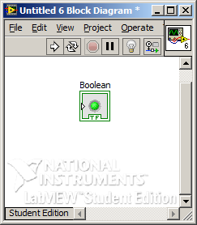
Controls and Indictors
Controls on the front panel are used to send information to the program on the block diagram. Indicators on the front panel show information generated by the program.
When we place an LED on the front panel, it is by default an indicator. It can be changed to a control by right-clicking…
An indicator has its wiring terminal on the left side.
If we wire a “T” to this terminal, the LED will light - it is indicating that the data wired to it is a Boolean True.

Slide 51
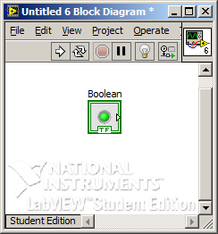
Controls and Indictors
Here we have changed the LED to a control. Now its wiring terminal is on the right.
A control has its wiring terminal on the right.
We can use the output of the control to cause something to happen depending on whether the LED is on or off.

Slide 52
Controls and Indictors
To demonstrate front panel action, we configure the LED as a control. We then create a local variable and set up a while loop with a front panel stop button. Inside the while loop we check to see if the LED is on or off, and indicate the result on the front panel…

Slide 53
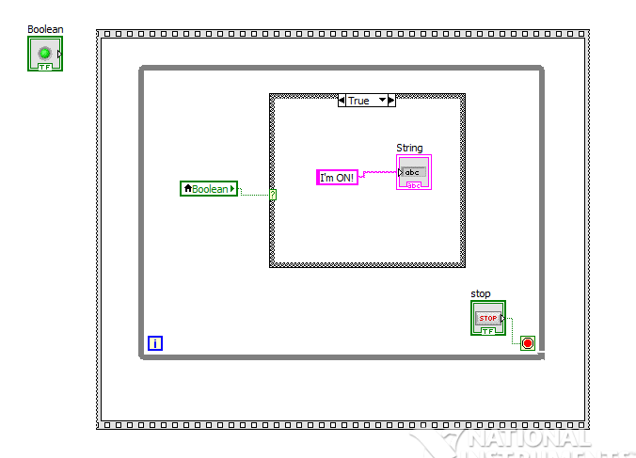
Controls and Indictors
Controls>String and Path> String Indicator
LED configured as “control”.
Programming>String> String Constant
Local variable.
We terminate this portion of the program by hitting the stop button on the front panel.

Slide 54
Read and Write
Note that the local variable is configured as “read”. Changing from “read” to “write” is done by right-clicking on the local variable.
“Read” means that we will be reading data (in this case a Boolean variable) from the local variable. The wiring terminal is on the right side.
“Write” means that we are writing to the local variable. We will use that feature later.

Slide 55
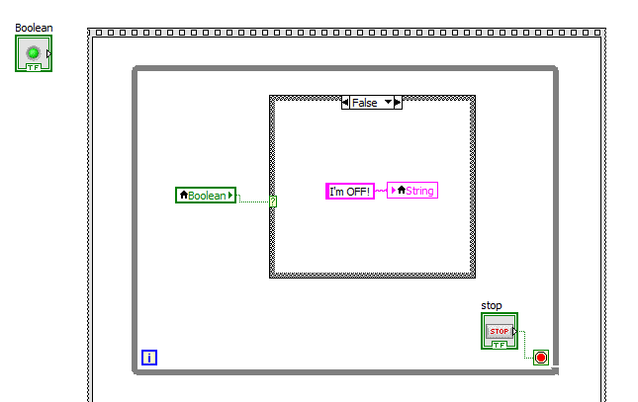
Read and Write
When the LED is turned on from the front panel, reading from the LED local variable will result in True, and the program will write “I’m ON!” to the string indicator on the front panel.
Case “True”
Case “False”
A second local variable is used in the False case to write “I’m OFF!” to the string indicator on the front panel.

Slide 56
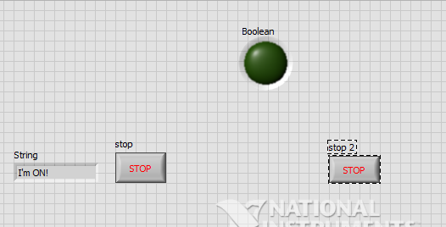
Controls and Indictors
We have added a second frame in the sequence. Inside it we put a random number generator, which we compare with the value 0.5. If the result is True, the LED goes on and if not, it goes off. We have also added a second stop button to terminate the program.

Slide 57
Controls and Indictors
To turn the LED on or off we created two more local variables (one for on and one for off). But note that in this case the local variable is configured as “write”. Depending on the random number generator, we are writing either T or F to the local variable to turn it on or off.
Local variable configured to “write”. The wiring terminal is now on the left.

Slide 58
Controls and Indictors
When we first run the program, we can turn the LED on and off manually on the front panel. When we hit the stop button on the left, the program will move to the next sequence where it will randomly turn the light on and off under program control. So we can control the LED either manually or via the program.

Slide 59
Other stuff…

Slide 60
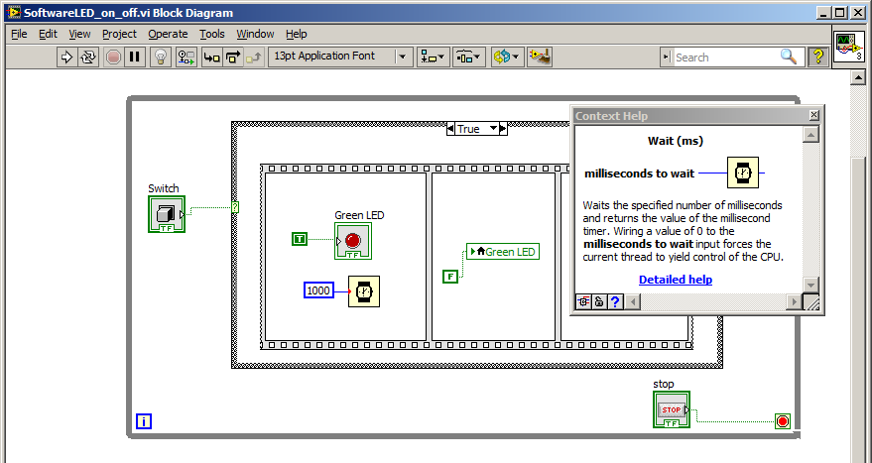
Finer Points
Bring up Context Help from the Help menu. When you hover over an item, information about that item comes up.

Slide 61
Finer Points
Change font size and color from here.
Add comments using the text tool “A”

Slide 62
Error Checking
LabVIEW has terrific de-bugging routines…
If your program has an error, the Run arrow will break. Click on it to see the error(s).
In this case the error is a bad wire.

Slide 63
De-Bugging
Before you Run, click the light bulb to have LabVIEW show you where data is flowing. It moves very slowly but you can see everything happening. You can also single-step through the program using Pause.

Slide 64
De-Bugging
You can put a “probe” on any wire in the circuit by right-clicking and choosing Probe. LabVIEW will give you a Probe Watch Window showing changes in the value of data on that wire.

Slide 65
The End

