Slide 1
The DMM
ECE 2100
Dr. Len Trombetta

Slide 2
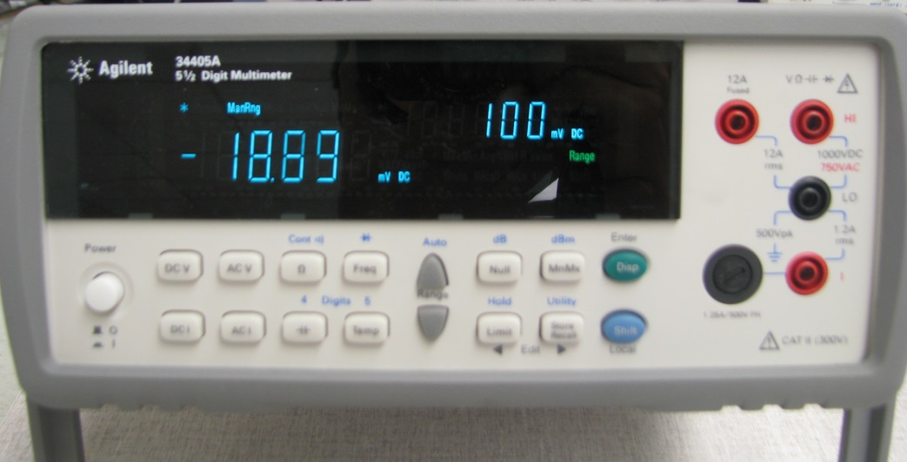
Meter Resistance
All meters add a resistance to the circuit they are connected to. The resistance varies from one meter to the next. For the Agilent 34405A in the lab…
dc voltage measurement: R_{m,V} = 10[MΩ] on all scales
dc current measurement: R_{m,A} = 20[Ω] at 10[mA]
= 2[Ω] at 100[mA]
= 0.5[Ω] at 1[A]

Slide 3

Meter Ranging
The secondary display shows the full-scale range.
The 34405A is auto-ranging: it will automatically choose the full-scale best suited to the measurement you are making. But…
This button (along with the “shift” key) will return the DMM to the auto-ranging mode.
Manual ranging: choose your own full-scale range.

Slide 4

RMS Measurements
Another way to characterize the amplitude of a periodic waveform is the rms (root-mean-square) amplitude:
When set for ac voltage or current measurement, the Fluke automatically provides rms.
If v(t) is a sine or cosine (sinusoid), then

