Slide 1
ECE 2100
Bode Plots
Figures from Sedra and Smith, Microelectronic Circuits 5 ed., Oxford Press

Slide 2
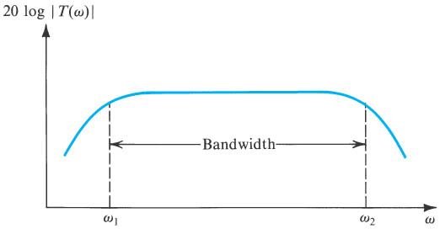
Amplifier Frequency Response: Bode Plots
This figure shows a typical frequency response plotted as gain (in dB) vs. frequency. T(ω) is the transfer function. Normally we will plot vs. log(ω).
Figure 1.21 Typical magnitude response of an amplifier. |T(v)| is the magnitude of the amplifier transfer function—that is, the ratio of the output V_{o}(v) to the input V_{i}(v).

Slide 3
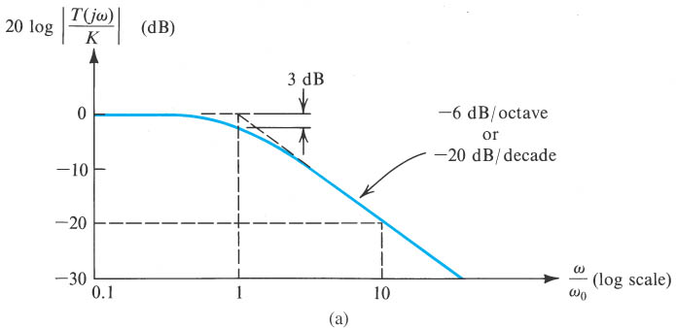
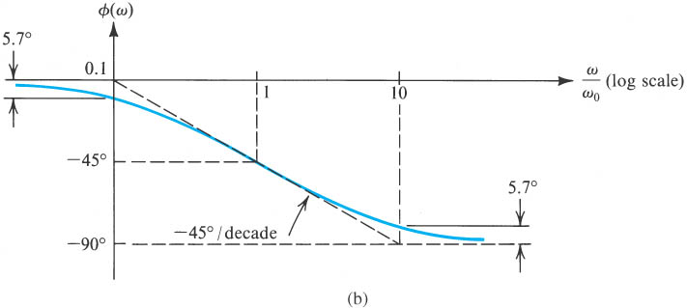
ω₀ = 1/RC
Low-pass network
Figure 1.23 (a) Magnitude and (b) phase response of STC networks of the low-pass type.

Slide 4
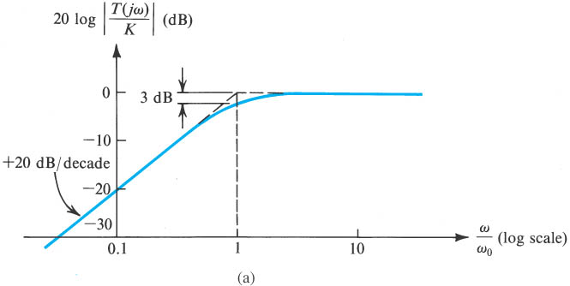
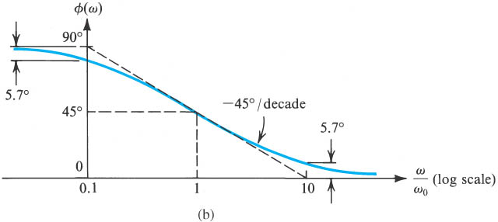
High-pass network
Figure 1.24 (a) Magnitude and (b) phase response of STC networks of the high-pass type.

Slide 5
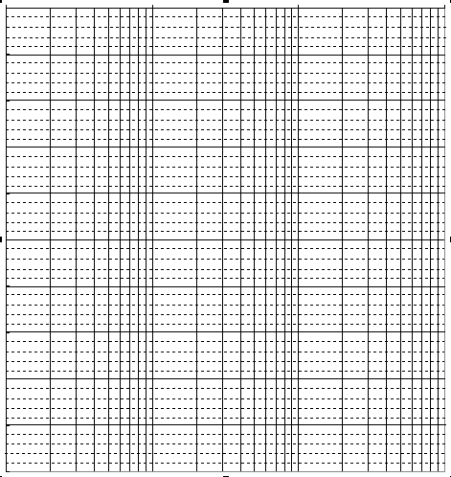
Log Scales???
10
8
+2
6
4
2
0
1
10
100
1000
x2
Equal increments on the vertical (linear) axis represent equal additions (+2 in the sample shown); equal increments on the horizontal (log) axis represent equal multiples (x2 in the sample shown).

Slide 6


