Slide 1
The Function Generator and the Oscilloscope
ECE 2100
Dr. Len Trombetta

Slide 2
Sinusoid Basics
General form of the sinusoid:
V_{m} is the amplitude
f is the frequency
φ is the phase
2V_{m} = V_{pp} (peak-to-peak)
v(t) = V_{m} sin(2πf t + φ) [V]
We usually write ω = 2πf, and ω is the angular frequency. But note that what you set on the function generator is f, not ω.
v(t)
V_{m}
V_{pp}
t
In the ECE curriculum, you will be using sinusoids…EVERYWHERE!

Slide 3
Sinusoid Basics
A sinusoid may also have a dc offset.
v(t) = V_{m} sin(2πf t) [V] + V_{dc}
v(t)
0
V_{dc}
t

Slide 4
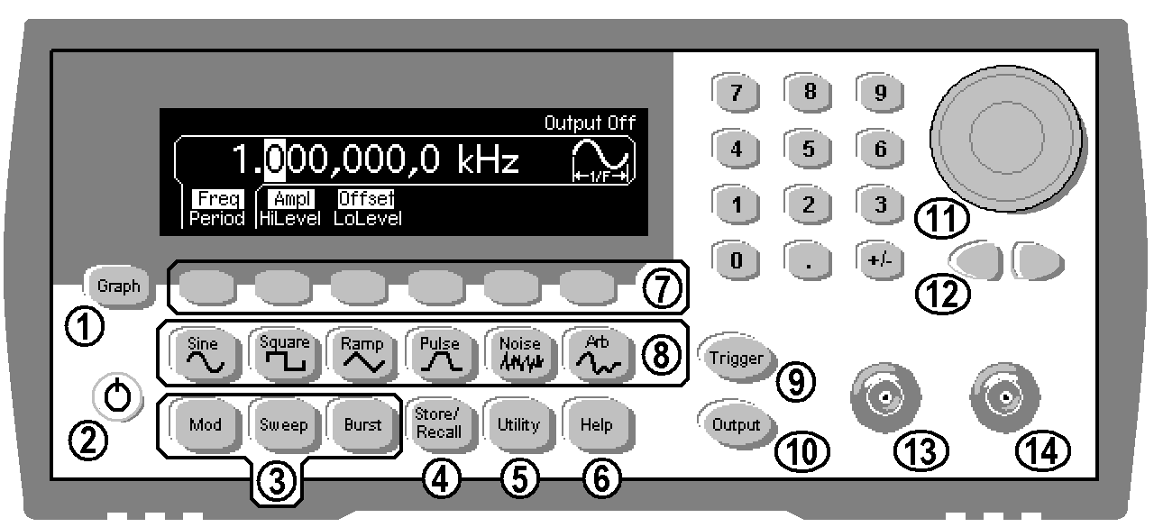
Function Generator
Let’s explore basic function generator properties...
Power

Slide 5
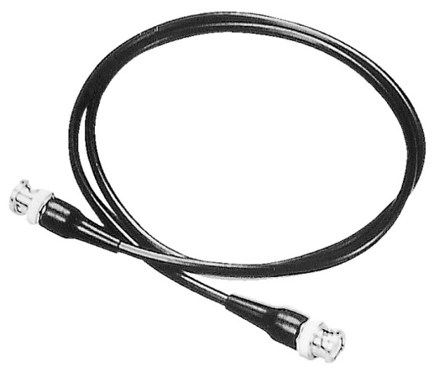
Displays and Output
The frequency will be displayed here…
…and the amplitude here.
You won’t get an output until you press “Output”.
scope
BNC to BNC
We connect Output to the oscilloscope using a BNC-to-BNC cable.

Slide 6
Amplitude
v(t) = V_{m} sin(2πf t) [V]
v(t)
To adjust the amplitude:
V_{m}
t
Use the keypad and the Vpp button…
…or…
…the wheel and the “ten’s place” buttons.

Slide 7
Frequency
v(t) = V_{m} sin(2πf t) [V]
v(t)
To adjust the frequency:
T = 1/f
t
Use the keypad and the Hz, kHz, or MHz button…
T
…or…
…the wheel and the “ten’s place” buttons.

Slide 8
Waveform (Function)
A ramp with a 50% asymmetry is a triangle wave…

Slide 9
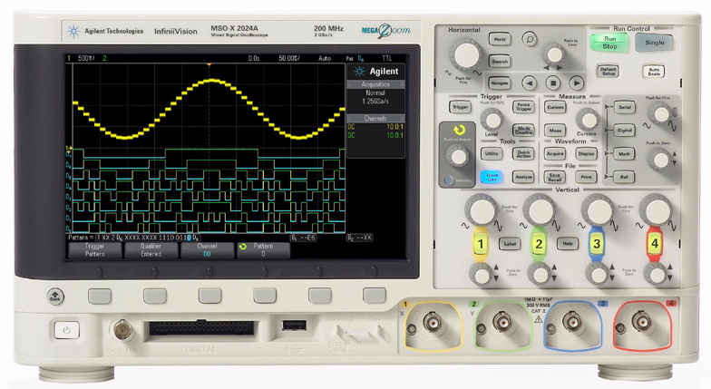
Oscilloscope
The oscilloscope displays input signal as voltage vs. time.
voltage
time
Power
From Function Generator
(You don’t have these inputs.)

Slide 10
Home Depot Theory Revisited
The FG and the OScope have tons of features, many of which we will not need in this course. You may never use some of them, but you never know, so…
Based on the Home Depot Theory of lab practice, you should explore these features on your own so that you know what’s available.

Slide 11
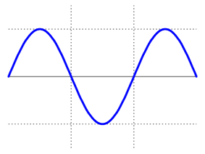
Activity
Default Setup
Channel 1
Connect the function generator to the oscilloscope input channel 1 using a BNC-to-BNC cable. Press “Default Setup”, and “Channel 1”. You may or may not get a reasonable display… let’s explore further.

Slide 12
Activity
Make sure the Offset is 0.
You won’t get an output until you press “Output”.
scope
You may still not get a reasonable display…

Slide 13
Scale Factors
Vertical scale factor (in Volts/Div)
Horizontal scale factor (in sec/Div)
scale factor adjustments
20 mV/
500 uS/
f = 1/T
T
V_{pp}
You may have to adjust your horizontal and vertical scale factors to get a good “picture”.

Slide 14
Activity
20 mV/
500 uS/
T
V_{pp}
1. Set the function generator for a 60 [kHz] sinusoid with an amplitude of 1.5 [V].
2. Adjust the horizontal and vertical scale factors so that you get a reasonable display – something easy to look at!
3. Change the scale factors to see how the display is changed on the ‘scope.
4. Calculate the period from the frequency set on the FG. Convince yourself that the signal frequency and amplitude are those stated on the function generator display.

Slide 15
dc Offset
v(t) = V_{m} sin(2πf t) [V] + V_{dc}
To adjust the offset: be sure the instrument displays “Offset” and not “LoLevel”.
v(t)
Use the keypad and the Vpp button…
V_{dc}
0
t
…or…
…the wheel and the “ten’s place” buttons.

Slide 16
Activity
Set a 1.0 [V] offset on your function generator.
v(t)
Does your scope reflect the new signal? That depends on “coupling”…
V_{dc}
0
t

Slide 17
Coupling
Whether or not you observe the dc component on the scope depends on the coupling.
coupling options
1. Select whichever channel your signal is connected to.
2. Toggle through the coupling options:
dc: dc AND ac components are displayed.
ac: only the ac component is displayed.

Slide 18
Still not getting a good picture???
This is a “triggering” problem. We’ll cover this at a later date. For now…
Use the Magic Button

Slide 19
For Lab III…
You’ll want to know about a few things to do Lab IV:
T-Connector
The Op Amp (operational amplifier): You’ll learn about this in Electronics (ECE 3355/3155)
RMS values: an alternative measure of amplitude

Slide 20
The “T” Connector
output connected to BNC “T”
The three BNC connectors are in parallel, effectively providing two FGEN outputs. Typically one will go to the scope and the other will be your circuit input.
scope
circuit input

Slide 21
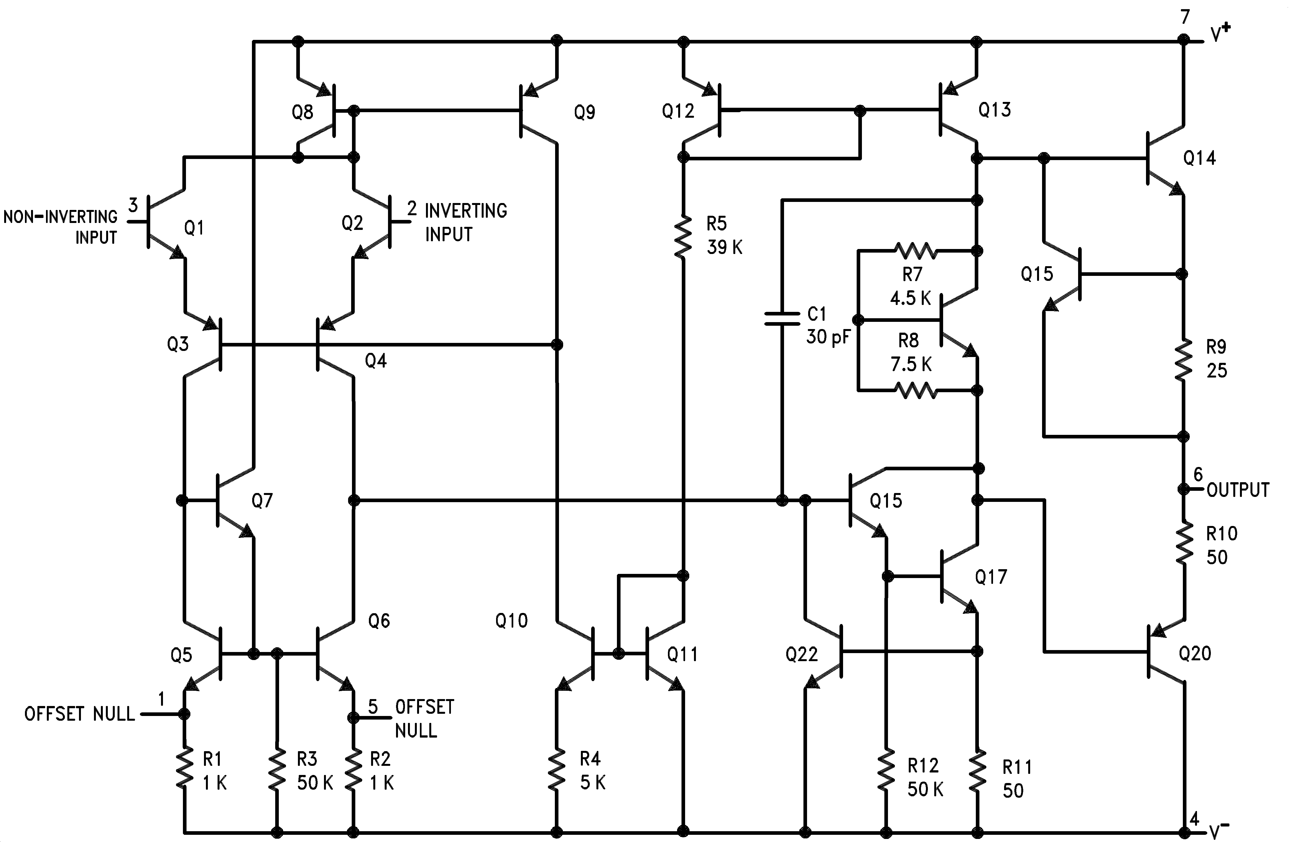
For Lab IV you will need to wire an Op Amp:
LM741: a generic operational amplifier. This figure is from the data sheet, which we will take a look at in class.

Slide 22
The Op Amp
The op amp has certain limitations:
It will not output currents larger than about 20 [mA].
This will not be a problem for Lab IV because the output current will be less than that value.
There is a limitation on how high a frequency you can apply to the input and still get an output.
This will not be a problem in Lab IV for parts 1 – 9. However, in part 10 we will explore this issue using a LabVIEW .vi to perform a frequency sweep, and to measure the op amp output as a function of frequency.

Slide 23
Triggering
Trigger
Trigger Level
We will go into more detail later but for now, to get a stable trace:
1. Press the input channel you’re using; press Trigger.
2. Source: Whatever channel you’re using to input
3. Trigger Type: Edge
4. Adjust trigger level knob for a stable trace.

Slide 24
Triggering 101
Trigger Menu
Trigger Level
When the oscilloscope is properly triggered, the image is “stable” because it is displayed the same way each time it sweeps across the screen. If the triggering is not correct, the image looks garbled , like it is “running” across the screen.

Slide 25
External Triggering
SYNC
An external trigger signal is provided by the SYNC output of the function generator. This provides a square wave of 1Vpp amplitude at the frequency of the MAIN waveform. So as long as your signal is coming from MAIN, the scope knows exactly when to trigger!

