Slide 1
Measurement Basics I
ECE 2100
Prep for Lab I
  Current, Voltage, Resistance Measurements
  Accuracy, Precision, Significant Figures
Choose your seat and your lab partner…these will be the same for the semester.

Slide 2
Accuracy, Precision, and Significant Figures*
Definitions:
Accuracy: the degree to which a measurement is free from error
  Is the meter calibrated correctly?
  Is it working correctly? Is it broken??
Resolution: The smallest difference that can be measured
  Usually the right-most digit on a digital multimeter
*See N.E.R.D. documentation

Slide 3
Accuracy, Precision, and Significant Figures
Range: The difference between the largest and smallest possible measurement
  For our multimeters, the smallest measurement is 0, so range is the maximum measureable value.
Precision: the degree of refinement of the measurement
Precision = Range / Resolution
The 34405A has a dc voltage resolution of 10⁵. For example, on the 1 V scale, the resolution is 0.1 mV. On the 100 mV scale, the resolution is 1 μV. So range/resolution = 10⁵.

Slide 4
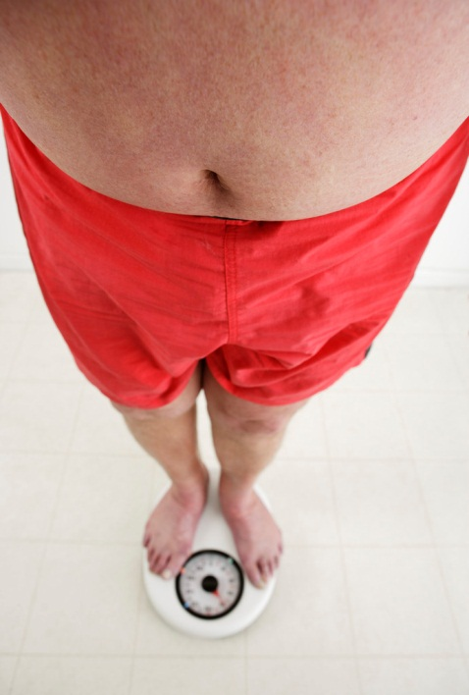
Trombetta’s Weight
Dr. T. gets on the scale…
…and it reads 94.226535 lbs.
Is this accurate?
Is this precise?
(not actually Trombetta)

Slide 5
Dr. T. gets a new scale…
…and it reads 183.2 lbs.
Is this accurate?
Is this precise?
(still not actually Trombetta)

Slide 6

Significant Figures
The number of significant figures reflects the measurement precision.
  How many sig figs should I include?
  How do I …add/subtract/multiply/divide numbers with different sig figs?
In any report, formal or informal, always use an appropriate number of significant figures. The graders will be looking for this.

Slide 7
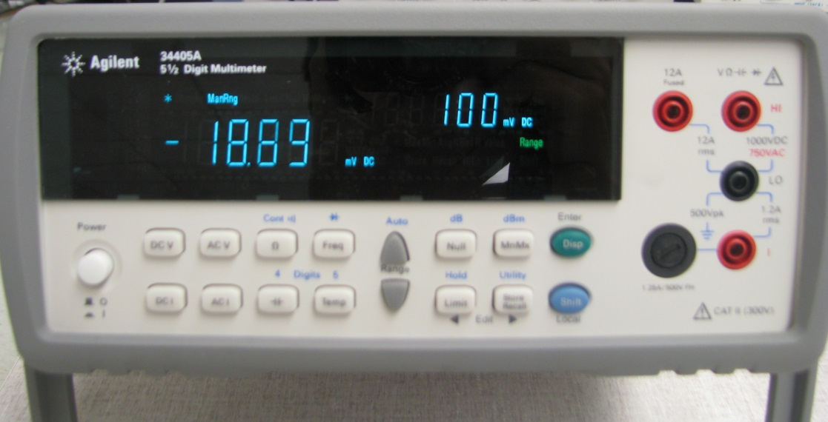
Doubtful Digits
The last digit (maybe two) on a digital meter will bounce around. These are the “doubtful digits”.
Rule: Retain one “doubtful digit”. This determines how many significant figures you will use.
If the measured value is “noisy”, fewer significant figures will be used.

Slide 8
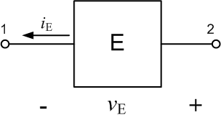
How Many Sig Figs?
Voltage measurement gives v_{E} = 1.354 [V] (4 sig figs)
Current measurement gives i_{E} = 0.21 [A] (2 sig figs)
Power absorbed = v_{E} i_{E}
= (1.354)(0.21)
= 0.28 [W] (2 sig figs)

Slide 9
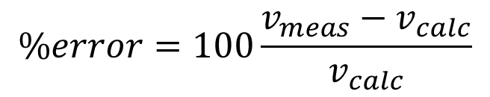
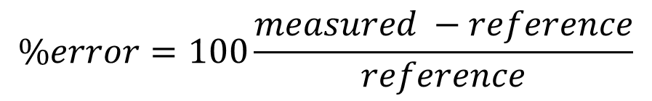
Percent Error when Considering a Measurement in the Laboratory
$$\%error=100\frac{measured −reference}{reference}$$
Often in laboratory measurements, the thing you are testing is the accuracy of your measurement process. In that case,
$$\%error=100\frac{v_{meas}−v_{calc}}{v_{calc}}$$
You need to:
Develop a “feel” how much error is expected.
Know when to suspect a measurement’s validity.

Slide 10
We will look at a simple circuit…
We will measure v_{O} and i_{P}. This will require…
The Breadboard
The Power Supply
The Multimeter
  Voltage
  Current
  Resistance
Resistors
i_{P}

Slide 11
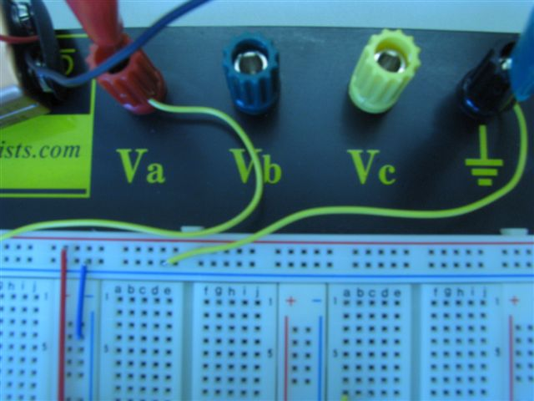
The Breadboard
Groups of five holes are connected together…
…but they are NOT connected to these groups…or to these.
Where a red line is indicated, the groups of five are connected together. Similarly for blue; but, red is not connected to blue.

Slide 12

The Power Supply
Course Adjust
Fine Adjust
Current Limit
Three adjustable dc sources:
0 – 30 [V] (two of these)
2 – 6.5 [V]

Slide 13
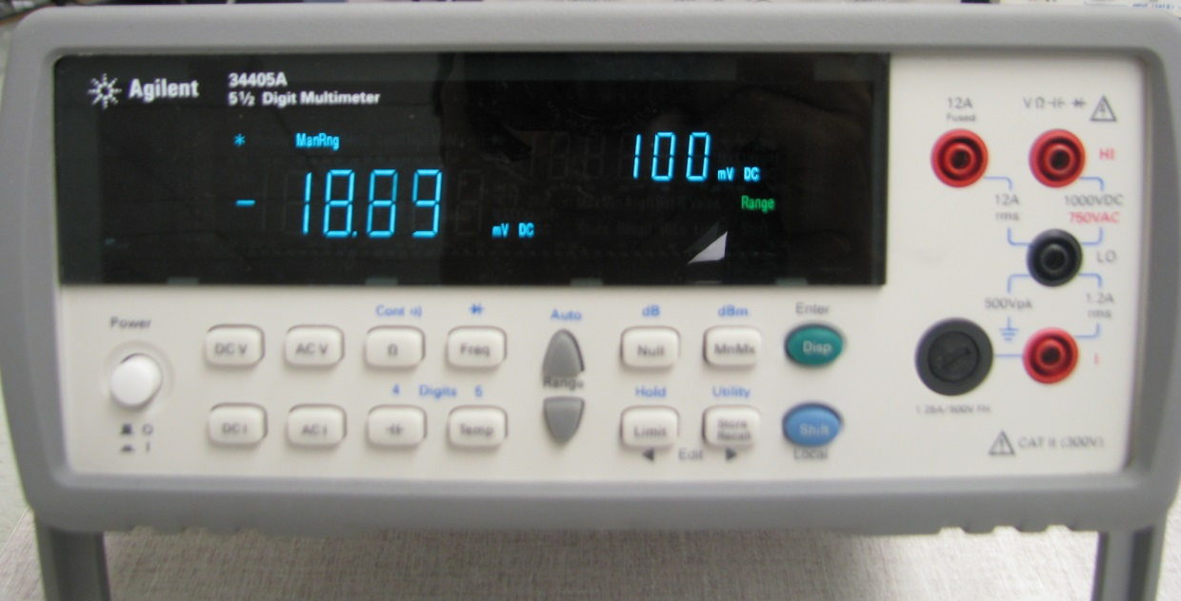

The Multimeter
A
V, Ω
common
power
dc:
V
A
Ω
Can be set for
dc or ac voltage
dc or ac current
resistance
some other things…
multimeter probes

Slide 14
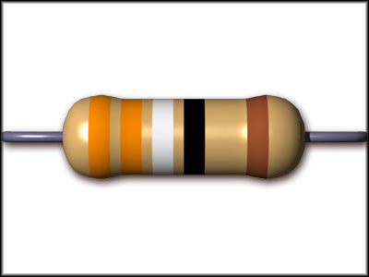
Resistors
Properties:
Value (resistance)
  Determined by measurement or color code (next slide)
Power Rating
  What is the largest power dissipation before damage or danger?
  Your lab kit: power rating is ¼ [W]
Tolerance
  What is the largest likely variation from the stated resistance value?
  Your lab kit resistors: 5 %

Slide 15
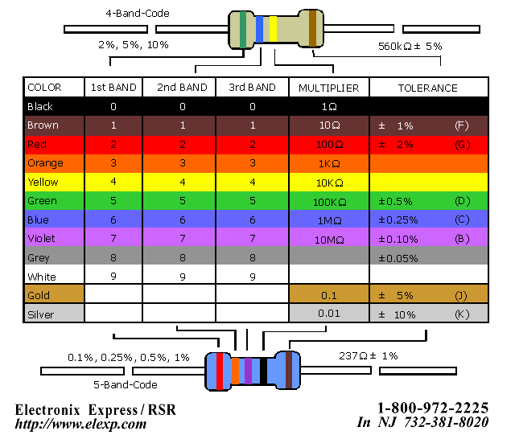
Color Code
We have the 4-band code
Big
Brown
Rats
On
Yellow
Garbage
Bins
Very
Gaily
Whistle

Slide 16

Resistance Measurement
Ohms function
V, Ω
probes
common
Does polarity matter? Reverse the leads and see.
Measure at least four of your resistors. What is the error in the resistance for each of these?

Slide 17
We will look at a simple circuit…
Build this circuit and measure v_{o}. Specifications:
R₁ is within 10x R₂
R₁ and R₂ are above 1 [kΩ]
v_{P} ~ 5 [V]

Slide 18

dc Voltage Measurement
measurement of v_{o}
V, Ω
common
dc V function
Does polarity matter? Reverse the leads and see.

Slide 19
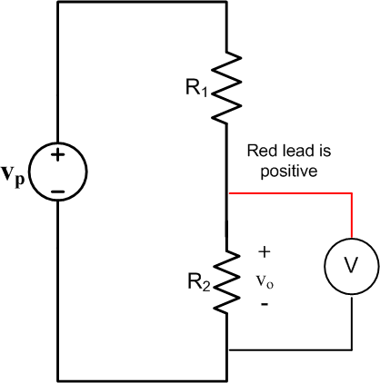
Schematic of Voltage Measurement
Important: voltage is measured across a device.

Slide 20

dc Current Measurement
Note that the circuit has to be “broken” so that the ammeter is in series with the current we are measuring.
measurement of i_{R}
common
dc Ammeter function
1.2 [A]
Does polarity matter? Reverse the leads and see.

Slide 21
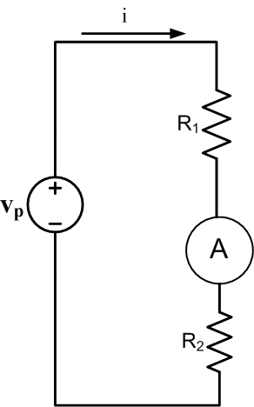
Schematic of Current Measurement
Important: current is measured through a device.

