Slide 1
Lab VI: Measuring Phase Shift
ECE 2100
Dr. Len Trombetta

Slide 2
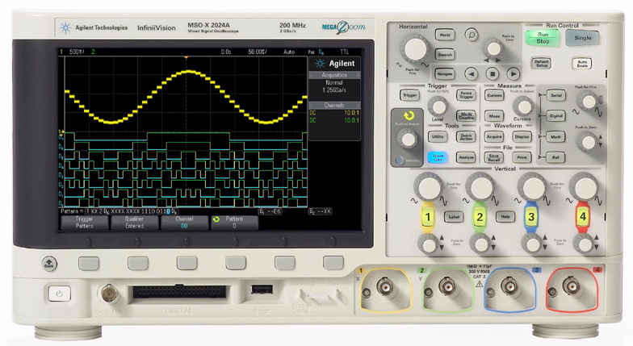
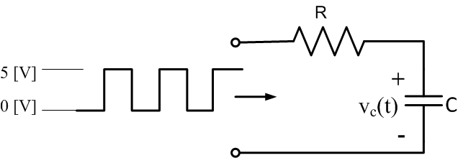
Time Constant Experiment
When you get to the lab, set up this circuit. Use a square-wave input to show the RC charge/discharge curves.
C = 0.022 [μF]
R = 47 [kΩ]

Slide 3
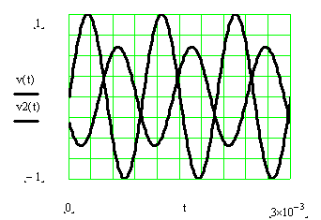
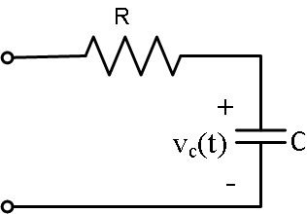
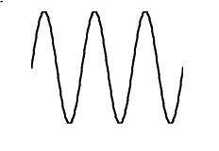
Phase Shift Measurement
input
output
Now change the input signal to a sinusoid.
C = 0.022 [μF]
R = 47 [kΩ]

Slide 4
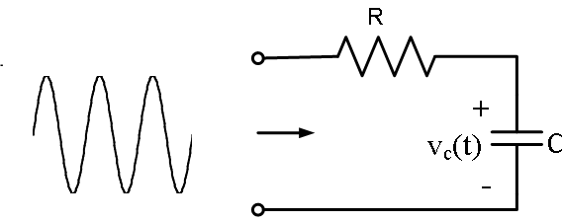
The Idea…
Previous lab:
- Time domain measurement of an RC time constant.
- Apply a square wave to simulate the on/off action of a switch.
This lab:
- Apply a sinusoid to find frequency domain properties.
- Measure phase difference between input and output.

Slide 5
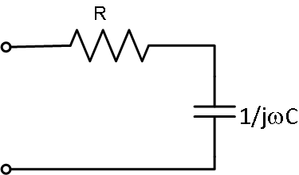
Phasor Analysis
+
+
V_{in}
V_{out}
-
-
$${\overline{V}}_{out}={\overline{V}}_{in}\frac{1/jωC}{R+1/jωC}$$
$$={\overline{V}}_{in}\frac{1}{1+jωRC}$$
What happens to the output at very high and very low frequencies? Is there a phase change? Observe this on the scope.

Slide 6
Phase Difference
$$v_{in}=Vinsin⁡\left(2πft\right)$$
$$v_{out}=Voutsin⁡\left(2πft+∆φ\right)$$
Input and output are not in phase. We want to measure the phase difference $∆φ$.
We cannot measure the absolute phase of either waveform - we can only measure the phase difference.

Slide 7
The Measurement
You can use the vertical cursors to help with this.
Δt
T
Because one full period (T) of the input (and output) sinusoids corresponds to 360 [deg], we have:
$$\frac{∆φ}{360}=\frac{∆t}{T}$$

Slide 8
What about the sign?
$$v_{in}=Vinsin⁡\left(2πft\right)$$
$$v_{out}=Voutsin⁡\left(2πft+∆φ\right)$$
In this case, the output is shifted to the right: this is a negative phase shift ($∆φ$<0). We say that the output is lagging the input, because it is coming later in time.

Slide 9
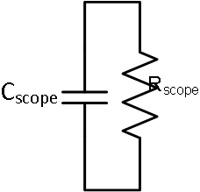
The Scope Probe
Problem: The oscilloscope input impedance distorts the measurement of v_{c}(t), just as a voltmeter distorts the measurement of a dc voltage. The distortion is a function of frequency.
Thevenin Equivalent of the oscilloscope input
C_{scope} ~ 20 [pF]
R_{scope} ~ 1 [MΩ]

Slide 10
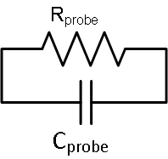
The Solution…
We can compensate for this effect by using a “scope probe” between the circuit output and the scope.
+
+
v_{in}
v_{meas}
-
-
Scope Probe
Circuit
Scope
Connect your circuit to the oscilloscope using the scope probe. What happens to the signal?

Slide 11
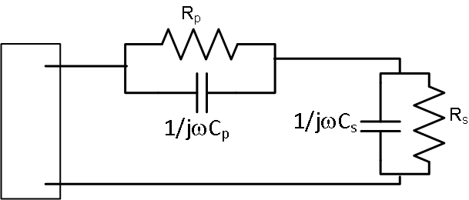
Analysis
+
+
V_{out}
V_{meas}
-
-
R_{p}, C_{p}: scope probe resistance and capacitance
R_{s}, C_{s}: oscilloscope input resistance and capacitance
V_{out}: circuit output; this is what we want to measure
V_{meas}: input to scope; this is what shows up on the display

Slide 12
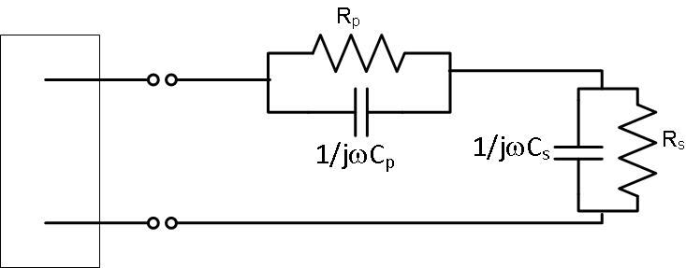
Analysis
+
+
circuit
V_{out}
V_{meas}
-
-
$$\frac{R\frac{1}{jωC}}{R+\frac{1}{jωC}}=\frac{R}{1+jωCR}$$
Note that R in parallel with 1/jωC is:
$${\overline{V}}_{meas}={\overline{V}}_{out}\frac{\frac{Rs}{1+jωCsRs}}{\frac{Rs}{1+jωCsRs}+\frac{Rp}{1+jωCpRp}}$$
$${\overline{V}}_{meas}={\overline{V}}_{out}\frac{1}{1+\frac{Rp}{Rs}\frac{1+jωCsRs}{1+jωCpRp}}$$
Now, let’s design a scope probe that will be useful…

Slide 13
+
+
circuit
V_{out}
V_{meas}
-
-
$${\overline{V}}_{meas}={\overline{V}}_{out}\frac{1}{1+\frac{Rp}{Rs}\frac{1+jωCsRs}{1+jωCpRp}}$$
From the last slide:
If we design the probe so that C_{p}R_{p} = C_{s}R_{s}, then…
$${\overline{V}}_{meas}={\overline{V}}_{out}\frac{1}{1+\frac{Rp}{Rs}}$$
If we also make R_{p} = 9 R_{s} and C_{p} = 1/9 C_{s}, then C_{s}R_{s} = C_{p}R_{p} and
$${\overline{V}}_{meas}={\overline{V}}_{out}\frac{1}{10}$$
What have we accomplished?

Slide 14
+
+
circuit
V_{out}
V_{meas}
-
-
$${\overline{V}}_{meas}={\overline{V}}_{out}\frac{1}{10}$$
Making a probe like this is useful because…
(i) The error in v_{meas}(t) does not depend on frequency, whereas it did without the scope probe.
(ii) The input impedance of the scope (looking from the circuit output) is…
$\frac{Rs}{1+jωCsRs}+\frac{Rp}{1+jωCpRp}$=10$\frac{Rs}{1+jωCsRs}$
…which is 10 X higher than it was without the scope probe.

Slide 15
Bottom Line
+
+
V_{out}
V_{meas}
-
-
We have increased the input impedance of the scope by 10X. This means less distortion in the measurement. It’s like having a voltmeter with 10X more resistance.
We have removed frequency dependence in the error, i.e., we no longer have a frequency-dependent distortion in the amplitude and phase measurements.
We have paid a price for this: our signal has been reduced by a factor of 10X. In other words, our measurement is 10X less sensitive.

Slide 16
Scope Probe Calibration
Scope input capacitance can vary from scope to scope.
Probe gets connected here
Calibration: Connect the probe to the calibration port, and adjust the screw on the side of the probe until the square wave is “clean”. Do this with the plastic screwdriver in your lab kit.

Slide 17
The “Probe” Setting
vertical scale indicator changes according to probe ratio.
500 mV/
Probe button cycles among allowable probe ratios. Choose 10:1.
Choose the input you want to adjust.
This changes the vertical scale indicator, so that you don’t have to do the 10X multiplication to get the right amplitude.

Slide 18
Summary
If the scope probe is properly adjusted, it compensates for the input impedance of the oscilloscope. It removes the frequency dependence in the measurement error, and reduces the error by increasing the input impedance of the scope by 10X. But it also reduces the sensitivity of the measurement by 10X. Usually, this is a good tradeoff.

Slide 19
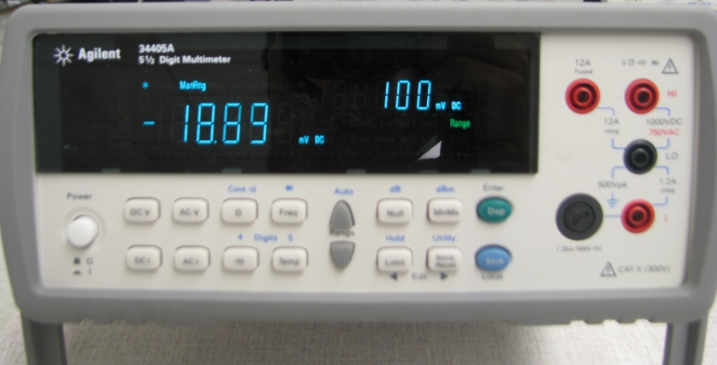
RMS Measurements
Another way to characterize the amplitude of a periodic waveform is the rms (root-mean-square) amplitude:
When set to measure ac voltage or current, the Agilent automatically displays rms.
If v(t) is a sine or cosine (sinusoid), then

