Slide 1
Single Time Constant Measurement
ECE 2100
Dr. Len Trombetta

Slide 2
Capacitors
There are many different types of capacitors. Your lab kit has ceramic and electrolytic capacitors.
electrolytic
ceramic
These can have large capacitance values and support large voltages. The dielectric is an electrolyte (ionic fluid). The polarity must be positive at the longer lead (not shown in figure).
These can have small values, and the value is more stable over large voltage and frequency ranges. Polarity is not important. The dielectric is a ceramic.
http://en.wikipedia.org/wiki/Capacitor

Slide 3
Capacitor Types
Why so many capacitor types? The various capacitors types trade off performance :
Capacitance
Usable voltage range
Variation in capacitance with temperature or frequency
Leakage current (how long it will hold a charge)

Slide 4
Capacitor Values
The electrolytic caps usually just state the value, e.g., 100 μF
The ceramic caps are more like resistor codes. For example:
pF = 10⁻¹² F
104Z
151J
nF = 10⁻⁹ F
Ignore the letter and interpret the numbers as you would the resistor code. This is the value in pF.
μF = 10⁻⁶ F
Examples:
104Z: 10 x 10⁴ pF
151J: 15 x 10¹ pF
= 10⁵ x 10⁻¹² F
= 150 x 10⁻¹² F
= 10⁻⁷ F = 0.1 μF
= 150 pF = 0.15 nF

Slide 5
Capacitor Tolerance
Most capacitor codes will not state a tolerance, but it is usually around 20%. If you need an accurate value, use the meters in S385 near the TA bench.

Slide 6
Pre-Lab
We will do the Pre-Lab in class. Write answers to the Activities in your Lab Notebook.
This is the same RC as in the first part of your lab, except that the output is across C, whereas in the lab handout it is across R.

Slide 7
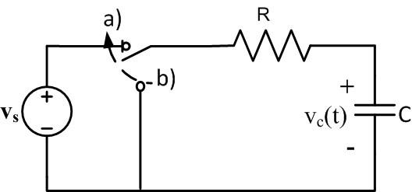
The Analysis Part I: Charging
Assuming the switch was at b) for a long time and moved to a) at t = 0, find the voltage v_{c}(t) for t ≥ 0. This is the step response.

Slide 8
The Plot Part I
$v_{c}\left(t\right)=$ $V_{s}(1−e^{−t/RC}$)
Answer:
Activity 1: Plot the function v_{c}(t) vs. t in your lab notebook. See below for details. Use your calculator to find actual points on the graph– don’t just sketch by “eyeball”. Use these parameters:
V_{s} = 5 [V] R = 47 [kΩ] C = 0.022 [μF]
Choose a horizontal scale factor so that you have at least 10 time constants (10 τ = 10 RC) across the paper (see below).
v_{c}(t)
Paper in landscape position
Put your first plot in this side
t~5τ
t~5τ
t

Slide 9
What’s the 10τ thing?
$v_{c}\left(t\right)=$ $V_{s}(1−e^{−t/RC}$)
When t = 5τ in the equation above, the voltage v_{C}(t) has (almost) completely stopped changing – we are in “steady state”. So to be sure we are plotting for a long enough time to see the whole charging function, we need to plot from 0 to at least 5τ.
For the second function (coming up next) we need to plot for another 5τ to see the complete discharge function.
v_{c}(t)
Paper in landscape position
Put your first plot in this side
t~5τ
t~5τ
t

Slide 10
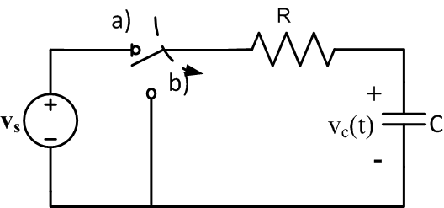
The Analysis Part II: Discharging
t = t₁
Now assume that the switch stayed in position a) until time t₁, which was a long time. If it then moves to position b), find the voltage v_{c}(t) for t ≥ t₁. This is the natural response.

Slide 11
The Plot Part II
Answer:
$v_{c}\left(t\right)=$ $V_{s}e^{−(t−t1)/RC}$
t ≥ t₁
Activity 2: Plot the function v_{C}(t) on the same graph (see below):
V_{s} = 5 [V] R = 47 [kΩ] C = 0.022 [μF]
t₁ = wherever you stopped the first plot – this should be 5τ.
This plot should be a continuation of the first one...
v_{c}(t)
Plot the function above here.
t = 0
t
t = t₁

Slide 12
Graphical Analysis
Look at your second graph (the “discharge” curve), which is described by
$v_{c}\left(t\right)=$ $V_{s}e^{−(t−t1)/τ_{c}}$
Activity 3:
i) Substitute t – t₁ = τ_{c} into this equation. Then
What value does e⁻¹ have? Compare this with 3/8.
What is the value of v_{c}(t) at this time?
$v_{c}=$ $V_{s}e^{−1}$
ii) Find this point on your graph and label it.
iii) Find the corresponding point on the first graph (the “charging” curve) by substituting t = τ_{c} into the charging equation.

Slide 13
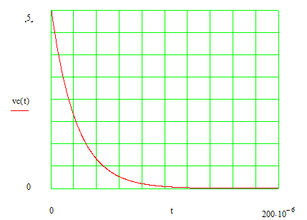
The Measurement…
The screen has 8 divisions vertically, so if we could get the discharge curve to cover the entire screen, like this…
Oscilloscope Screen
$v_{c}=$ $V_{s}e^{−1}$
$≅{\frac{3}{8}V}_{s}$
$$t≅τ_{c}$$
…we could simply locate the point where the curve crosses the value 3/8. The corresponding time would then by t = τ_{c}.

Slide 14
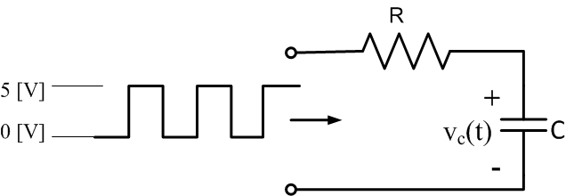
The Experiment
Now imagine the switch moving back and forth from a to b, over and over, staying in each position long enough to arrive at “steady state” – in other words, for 5 time constants in each position. We can accomplish this be applying a square wave to the circuit input.
Activity 4: Apply a square wave going from 0 to 5 [V] to the input of the circuit. Connect the output to the scope. Use the “T” connector on the lab bench to view the input and the output on the scope. Compare what you see on the scope to the plot in your lab notebook - they should be the same!
Function Generator
Scope

Slide 15
dc Offset
To have a square wave that goes from 0 to 5[V] instead of -2.5[V] to +2.5[V], you will need to use the dc offset.
Remember that the dc offset you actually get on the scope will be twice what is stated on the function generator. Verify that you have 0 to 5[V] by examining the scope screen and looking at the vertical sensitivity.

Slide 16
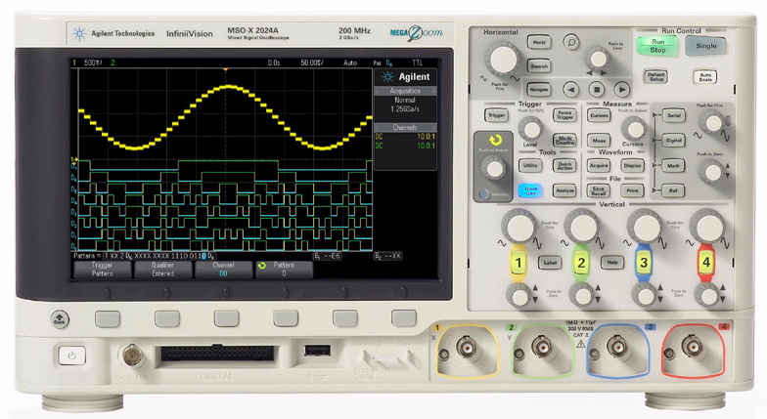
The Technique
But how do we get the curve to be exactly 8 divisions tall?
The vertical scale has a feature called “fine”…
Get close to full-screen and then adjust using “Fine”.
Select or de-select “Fine”
Select CH1 (or CH 2)

Slide 17
Let’s Do It!
Activity 5: Using the response on the oscilloscope that you got in Activity 4, isolate the discharge curve, and measure the time constant.
Use the fine vertical scale adjustment to get the curve to cover the entire 8 divisions on the screen.
Make sure your square wave period is at least 10 time constants so that you have a full charge or discharge cycle.
What would the corresponding point on the charging curve be?

Slide 18
An Alternative
We don’t have to do it that way. We have an equation, which is “plotted” on the screen. If we measure any value of v_{c}(t₀) and the corresponding time t₀, we can solve for the time constant.
$v_{c}\left(t0\right)=$ $V_{s}e^{−t0/{\text{τ}}_{c}}$
➔
${\text{τ}}_{c}$=$−t_{0}/ln\left(\frac{v_{c}\left(t_{0}\right)}{V_{s}}\right)$
$$v_{c}\left(t_{0}\right)$$
$$t_{0}$$

Slide 19
And Another Thing…
You may find it convenient to use the external triggering (EXT TRIG) feature of the scope for this lab (or any one, for that matter). You can review the “ECE2100_FnGen_Scope” presentation posted on the class web site.

Slide 20
Things You Should Know
How to set amplitude, offset, and period using the function generator.
How to read amplitude, offset, and period directly from the scope factors (not using the “measurement” function).
How to use “coupling” (ac, dc).
How to use the trigger menu.
How to use the “fine” adjust to get a full-screen waveform.

