Slide 1
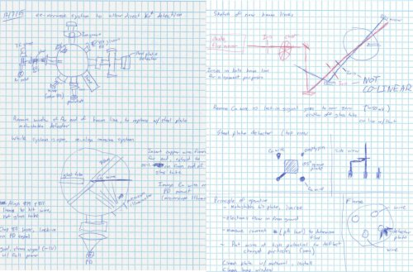
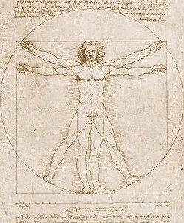
The Lab Notebook
ECE 2100
http://www.google.com/imgres?imgurl=http://...
http://www.google.com/imgres?imgurl=http:/...
Dr. Len Trombetta

Slide 2
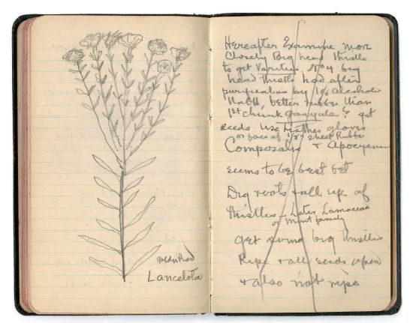
The Lab Notebook
The Goal: To format the lab experiments as research projects
The Method: All lab work, including Pre-Labs and the project, are done in the Lab Notebook
From Thomas Edison’s journal

Slide 3
Inside Cover/Front/Spine
Write your name, the class number (ECE 2100), the semester, and your section xxxxx.

Slide 4
Format
We will format the notebook like the lab handouts.
New page for each experiment/project
Date each page at the bottom
The lab handouts posted on the website are there only to show you what you need to do. You will turn in the lab notebooks to the TA, not the handouts.
Report results and answers in your notebook in the order they appear in the handout.

Slide 5
Title Page
Title Page (first page of each new experiment)
Experiment # and Title
Name of Lab Partner
Research Question(s)

Slide 6
Other Sections
Procedure and Results
Conclusion Questions
You do not need to copy the questions and instructions from the lab handout into the notebook, but do indicate which section you are on so the grader knows where you are.

Slide 7
Other Rules
All circuit diagrams, designs, charts, tables, figures… should be copied into the notebook.
When reporting measurement results, use an appropriate number of significant figures.
All variables and parameters (voltage, current, resistance) MUST be clearly labeled on a diagram.
If anything changes (new data, corrected data, re-drawn diagrams…) indicate this clearly in the notebook and show where the new work can be found.
Remember that the TA has to grade these. Work neatly and carefully. Put a line through things you don’t want graded.

Slide 8
Showing Your Work
In deciding how much work to show, treat the notebook like a quiz or exam: show enough to convince the grader that you know what you are doing.
Simple calculations that can be done immediately on a calculator do not need to be shown.

