Slide 1
ECE 2201
Circuit Analysis
Lecture Set #1
Voltage, Current, Energy and Power
Version 31
Dr. Dave Shattuck
Associate Professor, ECE Dept.

Slide 2
What are Current and Voltage?

Slide 3
Overview
In this part, we will cover:
Definitions of current and voltage
Hydraulic analogies to current and voltage
Reference polarities and actual polarities
Notes:
You can click on the blue text to jump to the subject that you want to learn about now.

Slide 4
Current: Formal Definition
Current is the net flow of charges, per time, past an arbitrary “plane” in some kind of electrical device.
We will only be concerned with the flow of positive charges. A negative charge moving to the right is conceptually the same as a positive charge moving to the left.
Mathematically, current is expressed as…
Charge, typically in Coulombs [C]
Current,
typically in
Amperes [A]
Time, typically in seconds [s]
Notes:
Current is the time rate of change of charge. The implication is that these charges are going past some plane somewhere. Pay attention to the units. An ampere is defined as a Coulomb per second.

Slide 5
The Ampere
The unit of current is the [Ampere], which is a flow of 1 [Coulomb] of charge per [second], or:
1[A] = 1[Coul/sec]
Remember that current is defined in terms of the flow of positive charges.
One [coulomb] of positive charges per [second] flowing from left to right
- is equivalent to -
one [coulomb] of negative charges per [second] flowing from right to left.
Notes:
In circuits, we can think in terms of positive charges, even though most of the time the charge carriers are electrons, which are negatively charged. We just pretend that we have positive charges flowing the other way.

Slide 6
What is the Deal with the Square Brackets [ and ]?
The unit of current is the [Ampere], which is a flow of 1 [Coulomb] of charge per [second], or:
1[A] = 1[Coul/sec]
Remember that current is defined in terms of the flow of positive charges.
In these notes, we place units inside square brackets ([ and ]). This is done to make it clear that the units are indeed units, to try to avoid confusion. This step is optional. Showing units is important. Using the square brackets is not important, and is not required.
Notes:
The square brackets are optional. You do not need to use them. Most people do not.

Slide 7
Hydraulic Analogy for Current
It is often useful to think in terms of hydraulic analogies.
The analogy here is that current is analogous to the flow rate of water:
Charges going past a plane per time
– is analogous to –
volume of water going past a plane in a pipe per time.
Notes:
It is easier to think about water, which we can see, than it is to think about electrons, which we cannot see. In this analogy, current is analogous to the flow rate of water.

Slide 8
Water flow ≈ Current
So, if we put a plane (a screen, say) across a water pipe, and measure the volume of water that moves past that plane in a [second], we get the flow rate.
In a similar way, current is the number of positive charges moving past a plane in a current-carrying device (a wire, say) in a [second].
The number of charges per second passing the plane for each [Ampere] of current flow is called a [Coulomb], which is about 6.24 x 10¹⁸ electron charges.
Notes:
{This should be an animated graphic showing flow from left to right, through a pipe or a wire.}

Slide 9
Voltage: Formal Definition
When we move a charge in the presence of other charges, energy is transferred. Voltage is the change in potential energy, per charge, as we move between two points; it is a potential difference.
Mathematically, this is expressed as…
Energy, typically in Joules [J]
Voltage,
typically in
Volts [V]
Charge, typically in Coulombs [C]
Notes:
Voltage is the rate of change of energy with movement of a charge. Voltage is the potential to do work.

Slide 10
What is a [Volt]?
The unit of voltage is the [Volt]. A [Volt] is defined as a [Joule per Coulomb].
Remember that voltage is defined in terms of the energy gained or lost by the movement of positive charges.
One [Joule] of energy is lost from an electric system when a [Coulomb] of positive charges moves from one potential to another potential that is one [Volt] lower.

Slide 11
Hydraulic Analogy for Voltage
Hydraulic analogy: voltage is analogous to height. In a gravitational field, the higher that water is, the more potential energy it has.
The voltage between two points
– is analogous to –
the change in height between two points, in a pipe.
Notes:
Again, we are used to the idea that a thing that is high, has more energy than that thing when it is lower. The difference in energy is called a change in potential energy. In circuits, this same concept is called voltage.

Slide 12
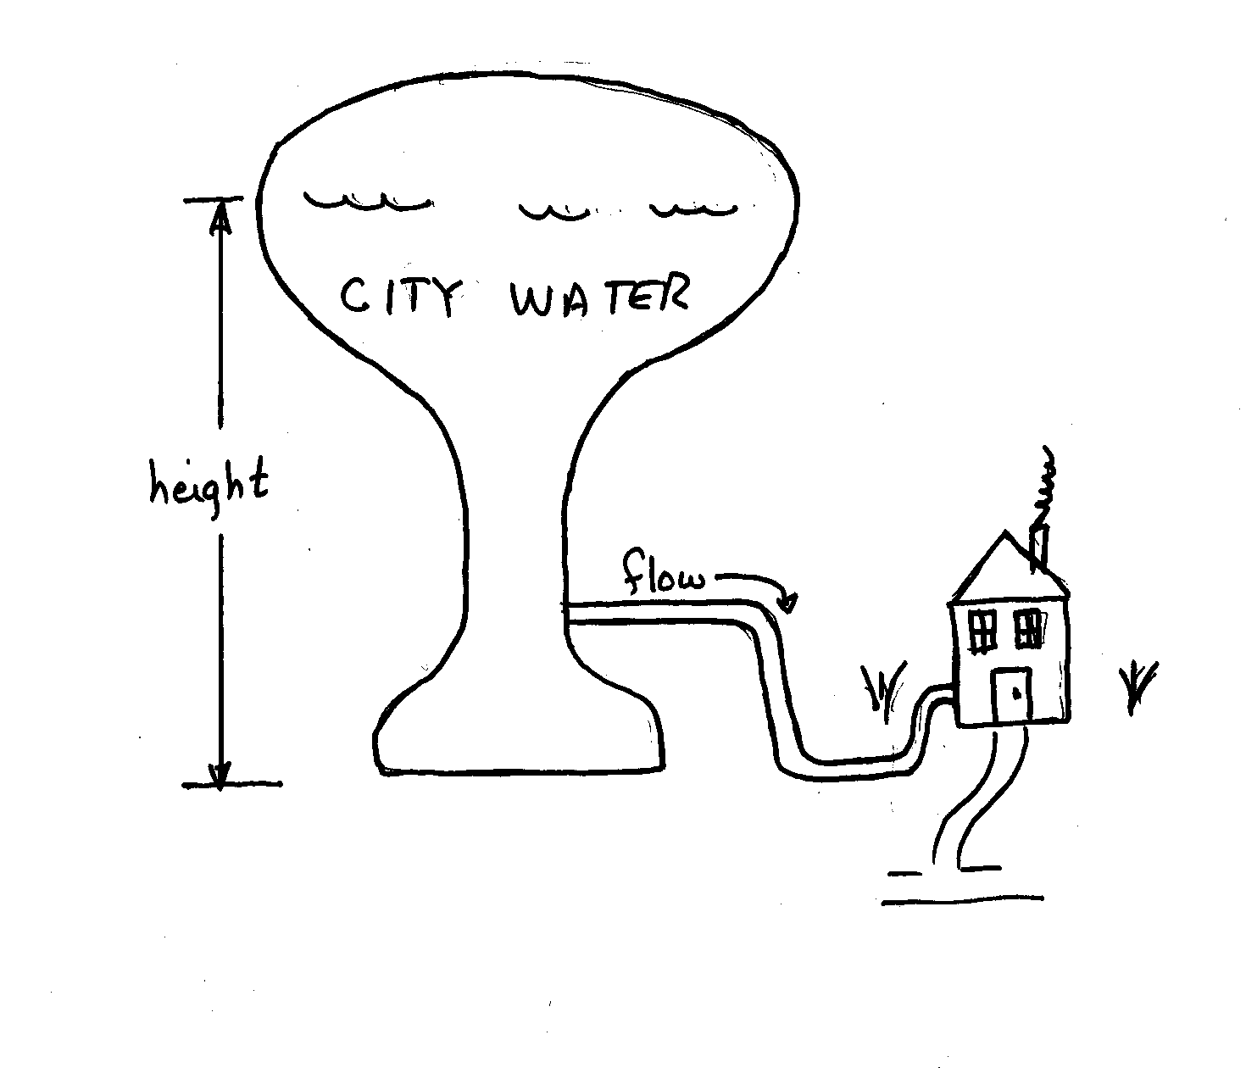
Hydraulic Analogy:
Voltage and Current
height ~ voltage
flow rate ~ current

Slide 13
Hydraulic Analogy With Two Paths
Water is flowing through the pipes.
There is a height difference across these pipes.
We can extend this analogy to current through and voltage across an electric device…

Slide 14
Current Through…
If we have two pipes connecting two points, the flow rate through one pipe can be different from the flow rate through the other. The flow rate depends on the path.
Notes:
Remember, say Current Through something.

Slide 15
…Voltage Across
No matter which path you follow, the height is the same across those two points. The height change does not depend on the path.
Notes:
Remember, say Voltage Across something.

Slide 16
Polarities
It is extremely important that we know the polarity, or the sign, of the voltages and currents we use. Which way is the current flowing? Where is the potential higher? To keep track of these things, two concepts are used:
Reference polarities, and
Actual polarities.

Slide 17

Reference Polarities
The reference polarity is a direction chosen for the purposes of keeping track. It is like picking North as your reference direction, and keeping track of your direction of travel by saying that you are moving in a direction of 135 degrees. This only tells you where you are going with respect to north, your reference direction.

Slide 18
Actual Polarity
The actual polarity is the direction something is actually going. We have only two possible directions for current and voltage.
If the actual polarity is the same direction as the reference polarity, we use a positive sign for the value of that quantity.
If the actual polarity is the opposite direction from the reference polarity, we use a negative sign for the value of that quantity.

Slide 19
Relationship between
Reference Polarity and Actual Polarity
The actual polarity is the direction something is actually going. The reference polarity is a direction chosen for the purposes of keeping track. We have only two possible directions for current and voltage.
Thus, if we have a reference polarity defined, and we know the sign of the value of that quantity, we can get the actual polarity.
Example: Suppose we pick our reference direction as ‘up’. The distance we go ‘up’ is
–5[feet]. We know then, that we have moved an actual distance of +5[feet] down.
The reference polarity is up.
The actual polarity is down.

Slide 20
Reference Polarities
Reference polarities do not indicate actual polarities. They cannot be assigned incorrectly. You can’t make a mistake assigning a reference polarity to a variable.
Always assign reference polarities for the voltages and currents that you name, or define. Without this step, these variables remain undefined. All variables must be defined if they are used in an expression.
Notes:
It is not wrong to assign a reference polarity in the opposite direction from the actual direction. It just means that our actual value will be negative.

Slide 21
Polarities for Currents
For current, the reference polarity is given by an arrow.
The actual polarity is indicated by a value that is associated with that arrow.
In the diagram below, the currents i₁ and i₂ are not defined until the arrows are shown.
Use lowercase variables for current. Uppercase subscripts are preferred.

Slide 22
Polarities for Voltages
For voltage, the reference polarity is given by a variable v with a subscript, and a + sign and a – sign, at or near the two points involved.
The actual polarity is indicated by the sign of the value of that variable v, or by the sign of the value that is placed between the + and - symbols.
In the diagram below, the voltages v₁ and v₂ are not defined until the + and – symbols are shown.
Use lowercase
variables for voltage.
Uppercase subscripts
are preferred.

Slide 23
Defining Voltages
For voltage, the reference polarity is given by a variable v with a subscript, and a + sign and a – sign, at or near the two points involved.
In the diagram below, the voltages v₁ and v₂ are not defined until the + and – symbols are shown.
In this case,
v₁ = 5[V]
and
v₂ = -5[V].
These four labels all mean the same thing.

Slide 24

Why bother with reference polarities?
Students who are new to circuits often question whether this is intended just to make something easy seem complicated. It is not so; using reference polarities helps.
The key is that often the actual polarity of a voltage or current is not known until later. We want to be able to write expressions that will be valid no matter what the actual polarities turn out to be.
To do this, we use reference polarities, and the actual polarities come out later.
Notes:
Reference polarities are just to keep track, before we know the actual polarity.

Slide 25
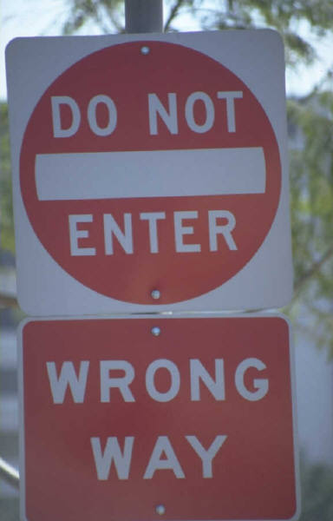

Part 2
Energy, Power, and Which Way They Go

Slide 26
Overview of this Part
In this part of this lecture set, we will cover the following topics:
Definitions of energy and power
Sign Relationships for power direction
Which way do the energy and power go?
Hydraulic analogy to energy and power, and yet another hydraulic analogy

Slide 27


Energy
This is the definition found in most dictionaries, although it is dangerous to use nontechnical dictionaries to define technical terms. For example, some dictionaries list force and power as synonyms for energy, and we will not do that!
Energy is the ability or the capacity to do work.
It is a quantity that can take on many forms, among them heat, light, sound, motion of objects with mass.
Notes:
Several forms of energy are symbolized by these pictures. Light and heat are two forms of energy. Two forms of the generation of electric energy are symbolized by the nuclear power plant, and the hydroelectric power plant.

Slide 28
Joule Definition
The unit for energy that we use is the [Joule], abbreviated as [J].
A [Joule] is a [Newton-meter].
In everything that we do in circuit analysis, energy will be conserved.
One of the key concerns in circuit analysis is this: Is a device, object, or element absorbing energy or delivering energy?
Go back to Overview slide.

Slide 29
Power
Power is the rate of change of the energy, with time. It is the rate at which the energy is absorbed or delivered.
Again, a key concern is this: Is power being absorbed or delivered? We will show a way to answer this question.
Mathematically, power is defined as:
Energy, typically in Joules [J]
Power,
typically in
Watts [W]
Time, typically in seconds [s]
Notes:
Power is the rate of change of energy with time. Be careful; the same letter, w, is used for the units of power, and the symbol for energy. This is one reason I put units inside square brackets.

Slide 30
Watt Definition
A [Watt] is defined as a [Joule per second].
We use a capital [W] for this unit.
Light bulbs are rated in [W]. Thus, a 100[W] light bulb is one that absorbs 100[Joules] every [second] that it is turned on.

Slide 31
Power from Voltage and Current
Power can be found from the voltage and current, as shown below. Note that if voltage is given in [V], and current in [A], power will come out in [W].
Go back to Overview slide.

Slide 32
Sign Relationships
To determine whether power and energy are delivered or absorbed, we will introduce sign relationships.
A sign relationship is the relationship between reference polarities for voltage and current, for something.
As in all reference polarity issues, you can’t choose reference polarities wrong. You just have to understand what your choice means.
Notes:
A sign convention is a relationship between reference polarities for voltage and current.

Slide 33
Passive Sign Relationship – Definition
The passive sign relationship is when the reference polarity for the current is in the direction of the reference voltage drop, for something.
Another way of saying this is that when the reference polarity for the current enters that thing at the positive terminal for the reference polarity for the voltage, we have used the passive sign relationship.
Notes:
The passive sign relationship is shown in both examples here.

Slide 34
Passive Sign Relationship – Discussion of the Definition
The two circuits below have reference polarities which are in the passive sign relationship.
Notice that although they look different, these two circuits have the same relationship between the polarities of the voltage and current.
Notes:
A sign convention is a relationship between reference polarities for voltage and current.

Slide 35
Active Sign Relationship – Definition
The active sign relationship is when the reference polarity for the current is in the direction of the reference voltage rise, for something.
Another way of saying this is that when the reference polarity for the current enters that thing at the negative terminal for the reference polarity for the voltage, we have used the active sign relationship.
Notes:
The active sign relationship is shown in both examples here.

Slide 36
Active Sign Relationship – Discussion of the Definition
The two circuits below have reference polarities which are in the active sign relationship.
Notice that although they look different, these two circuits have the same relationship between the polarities of the voltage and current.
Notes:
A sign convention is a relationship between reference polarities for voltage and current.

Slide 37
Sign Relationship –
Discussion of the Definition
What is the sign convention for v_{Z} and i_{Z}?
The answer is: This is a bad question. We cannot answer without knowing which circuit we are talking about,
Circuit 1 or Circuit 2.
Notes:
A sign convention is a relationship between reference polarities for voltage and current, for something. We need to know which thing we are talking about.

Slide 38
Using Sign Relationships for Power Direction – Subscripts
We will use the sign relationships that we just defined in several ways in circuit analysis. For now, let’s just concentrate on using it to determine whether power is absorbed, or power is delivered.
We might want to write an expression for power absorbed by a device, circuit element, or other part of a circuit. It is necessary for you to be clear about what you are talking about. A good way to do this is by using appropriate subscripts.
Notes:
A sign relationship is a relationship between reference polarities for voltage and current.

Slide 39
Using Sign Relationships for Power Direction – The Rules
We will use the sign relationships to determine whether power is absorbed, or power is delivered.
When we use the passive sign relationship to assign reference polarities, vi gives the power absorbed, and –vi gives the power delivered.
When we use the active sign relationship to assign reference polarities, vi gives the power delivered, and –vi gives the power absorbed.
Notes:
A sign relationship is a relationship between reference polarities for voltage and current.

Slide 40
Using Sign Relationships for Power Direction – The Rules
We will use the sign relationships to determine whether power is absorbed, or power is delivered.
When we use the passive sign relationship to assign reference polarities, vi gives the power absorbed, and –vi gives the power delivered.
When we use the active sign relationship to assign reference polarities, vi gives the power delivered, and –vi gives the
power
absorbed.
Passive Relationship
Active Relationship
Power absorbed
p_{ABS} = vi
p_{ABS} = -vi
Power delivered
p_{DEL} = -vi
p_{DEL} = vi
Notes:
A sign relationship is a relationship between reference polarities for voltage and current.

Slide 41
Example of Using the Power Direction Table – Step 1
We want an expression for the power absorbed by this Sample Circuit.
Determine which sign relationship has been used to assign reference polarities for this Sample Circuit.
Passive Relationship
Active Relationship
Power absorbed
p_{ABS} = vi
p_{ABS} = -vi
Power delivered
p_{DEL} = -vi
p_{DEL} = vi

Slide 42
Example of Using the Power Direction Table – Step 2
We want an expression for the power absorbed by this Sample Circuit.
Determine which sign relationship has been used.
Next, we find the cell that is of interest to us here in the table. It is highlighted in red below.
This is the active sign relationship.
Passive Relationship
Active Relationship
Power absorbed
p_{ABS} = vi
p_{ABS} = -vi
Power delivered
p_{DEL} = -vi
p_{DEL} = vi

Slide 43
Example of Using the Power Direction Table – Step 3
We want an expression for the power absorbed by this Sample Circuit.
Determine which sign relationship has been used.
Find the cell that is of interest to us here in the table. This cell is highlighted in red.
Thus, we write p_{ABS.BY.CIR} = -v_{S}i_{S} .
Go back to Overview slide.
Passive Relationship
Active Relationship
Power absorbed
p_{ABS} = vi
p_{ABS} = -vi
Power delivered
p_{DEL} = -vi
p_{DEL} = vi
This is the active sign Relationship.

Slide 44
Example of Using the Power Direction Table – Note on Notation
We want an expression for the power absorbed by this Sample Circuit.
Determine which sign relationship has been used.
Find the cell that is of interest to us here in the table. This cell is highlighted in red.
Thus, we write p_{ABS.BY.CIR} = -v_{S}i_{S .}
Go back to Overview slide.
In your power expressions, always use lowercase variables for power. Uppercase subscripts are preferred. Always use a two-part subscript for all power and energy variables. Indicate whether abs or del, and by what.

Slide 45

Hydraulic Analogy
The hydraulic analogy here can be used to test our rule for finding the direction that power goes. Imagine a waterfall. A real waterfall, and a schematic waterfall are shown here.

Slide 46
Hydraulic Analogy for Power Directions – Test
The hydraulic analogy here can be used to test our rule for finding the direction that power goes. Imagine a waterfall.
Flow direction
Height
The water flow is in the direction of the drop in height. Thus, this is analogous to the passive sign relationship. Thus, if we wrote an expression for power absorbed, we would write:
p_{ABS} = vi
Since the values are positive, the power absorbed will be positive.
Does this make sense?
Notes:
Think about this, and decide whether it makes sense to you before going to the next slide.

Slide 47
Hydraulic Analogy for Power Directions – Answer
The power absorbed will be positive. Does this make sense?
Yes, but only if we understand a key assumption. In circuits, when we say energy absorbed, we mean the energy absorbed from the electrical system, and delivered somewhere else.
In this hydraulic analogy, energy is being lost from the water as it falls. This energy is being delivered somewhere else, as sound, heat, or in other forms. We call this energy absorbed. Thus, the power absorbed is positive.
Flow direction
Height
Notes:
It may not have seemed correct to you. Many students look at this situation, and say that power is being delivered. It is being delivered out of the hydraulic system. However, from the viewpoint of the hydraulic system, power is being lost, or absorbed.

Slide 48


Power Directions Assumption #1
So, a key assumption is that when we say power delivered, we mean that there is power taken from someplace else, converted and delivered to the electrical system. This is the how this approach gives us direction.
For example, in a battery, this power comes from chemical power in the battery, and is converted to electrical power.
Remember that energy is conserved, and therefore power will be conserved as well.
Positive power delivered by something means that power from somewhere else enters the electrical system as electrical power, through that something. In this diagram, the red power (nonelectrical) is being changed to the blue power (electrical).

Slide 49
Power Directions Assumption #2
So, a key assumption is that when we say power absorbed, we mean that there is power from the electrical system that is converted to nonelectrical power. This is the how this approach gives us direction.
For example, in a lightbulb, the electrical power is converted to light and heat (nonelectrical power).
Remember that energy is conserved, and therefore power will be conserved as well.
Positive power absorbed by something means that power from the electrical system leaves as nonelectrical power, through that something. In this diagram, the blue power (electrical) is being changed to the red power (nonelectrical).

Slide 50
Power Directions Terminology – Synonyms
There are a number of terms that are synonyms for power absorbed. We may use:
Power absorbed by
Power consumed by
Power delivered to
Power provided to
Power supplied to
Power dissipated by
There are a number of terms that are synonyms for power delivered. We may use:
Power delivered by
Power provided by
Power supplied by

Slide 51
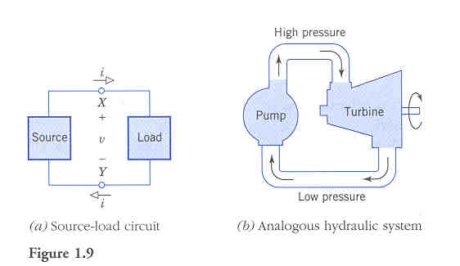
Another Hydraulic Analogy
Another useful hydraulic analogy that can be used to help us understand this is presented by A. Bruce Carlson in his textbook, Circuits, published by Brooks/Cole. The diagram, Figure 1.9, from page 11 of that textbook, is duplicated here.

Slide 52
Another Hydraulic Analogy – Details
In this analogy, the electrical circuit is shown at the left, and the hydraulic analog on the right.
As Carlson puts it, “The pump (source) forces water flow (current) through pipes (wires) to drive the turbine (load). The water pressure (potential) is higher at the inlet port of the turbine than at the outlet.”
Note that the Source is given with reference polarities in the active sign relationship, and the Load with reference polarities in the passive sign relationship. As a result, in this case, since all quantities are positive, the Source delivers power, and the Load absorbs power.

Slide 53
Another Point on Terminology
We always need to be careful of our context. When we say things like “the Source delivers power”, we implicitly mean “the Source delivers positive power”.
Note that the Source is given with reference polarities in the active sign relationship, and the Load with reference polarities in the passive sign relationship. As a result, in this case, since all quantities are positive, the Source delivers power, and the Load absorbs power.

Slide 54
Another Point on Terminology
At the same time, it is also acceptable to write expressions such as p_{ABS.BY.SOURCE} = -5000[W]. This is the same thing as saying that the power delivered is 5000[W].
However, unless the context is clear, it is ambiguous to just write p = 5000[W]. Your answer must be clear, because the direction is important!
Note that the Source is given with reference polarities in the active sign relationship, and the Load with reference polarities in the passive sign relationship. As a result, in this case, since all quantities are positive, the Source delivers power, and the Load absorbs power.

Slide 55
Why bother with Sign Relationships?
Students who are new to circuits often question whether sign relationships are intended just to make something easy seem complicated. It is not so; using sign conventions helps.
The key is that often the direction that power is moving is not known until later. We want to be able to write expressions now that will be valid no matter what the actual polarities turn out to be.
To do this, we use sign relationships , and the actual directions come out later when
we plug values in.
Go back to Overview slide.
Notes:
Sign conventions will help. Try them!

Slide 56
Sample Problem
The components of a cell phone are shown in Figure 1. Assume that the charge carriers are electrons.
Find the power absorbed by the battery at t = 3[ms].
Find the energy delivered by the charger during the third [millisecond], counting [milliseconds] starting at t = 0.
Determine whether the electrons flowing through the charger at t = 3[ms] are gaining or losing energy. Explain your answer.

Slide 57
The components of a cell phone are shown in Figure 1. Assume that the charge carriers are electrons.
Find the power absorbed by the battery at t = 3[ms].

Slide 58
The components of a cell phone are shown in Figure 1. Assume that the charge carriers are electrons.
Find the energy delivered by the charger during the third [millisecond], counting [milliseconds] starting at t = 0.

Slide 59
The components of a cell phone are shown in Figure 1. Assume that the charge carriers are electrons.
Determine whether the electrons flowing through the charger at t = 3[ms] are gaining or losing energy. Explain your answer.

