Slide 1
ECE 2201
Circuit Analysis
Lecture Set #2
Circuit Elements, Ohm’s Law, Kirchhoff’s Laws
Version 45
Dr. Dave Shattuck
Associate Professor, ECE Dept.

Slide 2
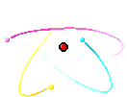
Circuit Elements

Slide 3
Overview of this Part
In this part, we will cover the following topics:
What a circuit element is
Independent and dependent voltage sources and current sources
Resistors and Ohm’s Law

Slide 4
Circuit Elements
In circuits, we think about basic circuit elements that are the “building blocks” of our circuits. This is similar to what we do in Chemistry with chemical elements like oxygen or nitrogen.
A circuit element cannot be broken down or subdivided into other circuit elements.
A circuit element can be defined in terms of the behavior of the voltage and current at its terminals.

Slide 5
The 5 Basic Circuit Elements
There are 5 basic circuit elements:
Voltage sources
Current sources
Resistors
Inductors
Capacitors
Notes:
We will introduce capacitors and inductors in a later lecture set. We can cover a great deal of important concepts with just three elements.

Slide 6
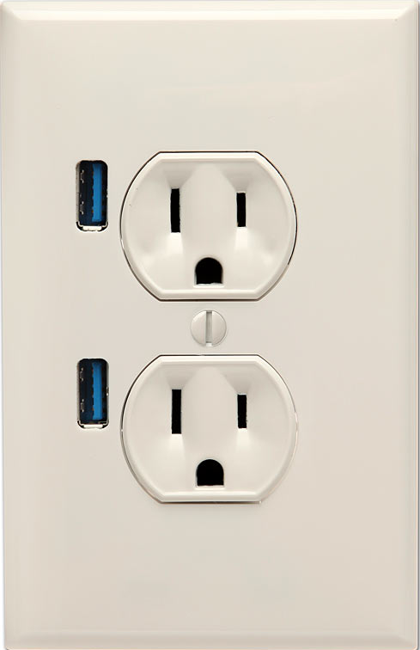
Voltage Sources
A voltage source is a two-terminal circuit element that maintains a voltage across its terminals.
The value of the voltage is the defining characteristic of a voltage source.
Any value of the current can go through the voltage source, in any direction. The current can also be zero. The voltage source does not “care about” current. It “cares” only about voltage.
Notes:
A wall socket can sometimes be thought of as a voltage source.

Slide 7
Voltage Sources –
Ideal and Practical
A voltage source maintains that voltage across its terminals no matter what you connect to those terminals.
We often think of a battery as being a voltage source. For many situations, this is fine. Other times it is not a good model. A real battery will have different voltages across its terminals in some cases, such as when it is supplying a large amount of current. As we have said, a voltage source should not change its voltage as the current changes.

Slide 8
Voltage Sources –
Ideal and Practical
A voltage source maintains that voltage across its terminals no matter what you connect to those terminals.
We often think of a battery as being a voltage source. For many situations, this is fine. Other times it is not a good model. A real battery will have different voltages across its terminals in some cases, such as when it is supplying a large amount of current. As we have said, a voltage source should not change its voltage as the current changes.
We sometimes use the term ideal voltage source for our circuit elements, and the term practical voltage source for things like batteries. We will find that a more accurate model for a battery is an ideal voltage source in series with a resistor. More on that later.

Slide 9
Voltage Sources – 2 kinds
There are 2 kinds of voltage sources:
Independent voltage sources
Dependent voltage sources, of which there are 2 forms:
  Voltage-dependent voltage sources
  Current-dependent voltage sources

Slide 10
Voltage Sources – Schematic Symbol for Independent Sources
The schematic symbol that we use for independent voltage sources is shown here.
This is intended to indicate that the schematic symbol can be labeled either with a variable, like v_{B}, or a value, with some number and units. An example might be 1.5[V]. It could also be labeled with both.

Slide 11
Voltage Sources – Schematic
Symbols for Dependent Voltage Sources
The schematic symbols that we use for dependent voltage sources are shown here, of which there are 2 forms:
  Voltage-dependent voltage sources
  Current-dependent voltage sources

Slide 12
Notes on Schematic
Symbols for Dependent Voltage Sources
The symbol μ is the coefficient of the voltage v_{X}. It is dimensionless. For example, it might be 4.3 v_{X}. The v_{X} is a voltage somewhere in the circuit.
The schematic symbols that we use for dependent voltage sources are shown here, of which there are 2 forms:
  Voltage-dependent voltage sources
  Current-dependent voltage sources
The symbol ρ is the coefficient of the current i_{X}. It has dimensions of [voltage/current]. For example, it might be 4.3[V/A] i_{X}. The i_{X} is a current somewhere in the circuit.

Slide 13

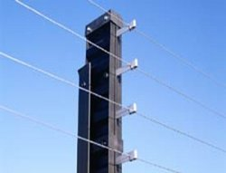
Current Sources
A current source is a two-terminal circuit element that maintains a current through its terminals.
The value of the current is the defining characteristic of the current source.
Any voltage can be across the
current source, in either polarity.
It can also be zero. The current
source does not “care about”
voltage. It “cares” only about
current.
Notes:
A wall socket can also be thought of as a current source, but in most situations is not as good a model. We will learn why later. A more appropriate current source example is an electric fence.

Slide 14
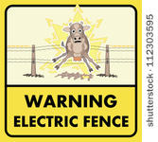

Current Sources - Ideal
A current source maintains a current through its terminals no matter what you connect to those terminals.
While there will be
devices that reasonably
model current sources,
these devices are not
as familiar as batteries.

Slide 15
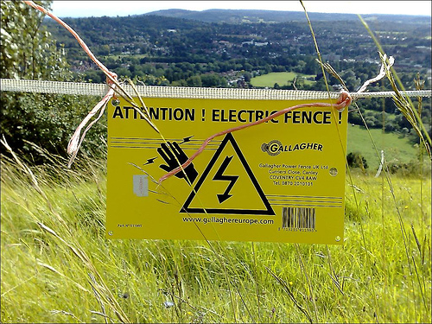
Current Sources - Ideal
A current source maintains a current through its terminals no matter what you connect to those terminals.
While there will be devices that reasonably model current sources, these devices are not as familiar as batteries.
We sometimes use the term
ideal current source for our
circuit elements, and the term
practical current source for
actual devices. We will find
that a good model for these
devices is an ideal current
source in parallel with a
resistor. More on that later.

Slide 16
Current Sources – 2 kinds
There are 2 kinds of current sources:
Independent current sources
Dependent current sources, of which there are 2 forms:
  Voltage-dependent current sources
  Current-dependent current sources

Slide 17
Current Sources – Schematic Symbol for Independent Sources
The schematic symbol that we use for independent current sources is shown here.
This is intended to indicate that the schematic symbol can be labeled either with a variable, like i_{A}, or a value, with some number and units. An example might be 3.3[mA]. It could also be labeled with both.

Slide 18
Current Sources – Schematic
Symbols for Dependent Current Sources
The schematic symbols that we use for dependent current sources are shown here, of which there are 2 forms:
  Voltage-dependent current sources
  Current-dependent current sources

Slide 19
Notes on Schematic
Symbols for Dependent Current Sources
The symbol g is the coefficient of the voltage v_{X}. It has dimensions of [current/voltage]. For example, it might be 16[A/V] v_{X}. The v_{X} is a voltage somewhere in the circuit.
The schematic symbols that we use for dependent current sources are shown here, of which there are 2 forms:
  Voltage-dependent current sources
  Current-dependent current sources
The symbol β is the coefficient of the current i_{X}. It is dimensionless. For example, it might be 53.7 i_{X}. The i_{X} is a current somewhere in the circuit.

Slide 20
Voltage and Current Polarities
Previously, we have emphasized the important of reference polarities of currents and voltages.
Notice that the schematic symbols for the voltage sources and current sources indicate these polarities.
The voltage sources have a “+” and a “–” to show the voltage reference polarity. The current sources have an arrow to show the current reference polarity.
Notes:
As with any other voltage or current, the voltage and current for our sources must have defined polarities.

Slide 21
Dependent Voltage and
Current Sources – Coefficients
Some textbooks use symbols other than the ones we have used here (μ, β, ρ, and g). There are no firm standards. We hope this is not confusing.
Notes:
We will show units for the coefficients of dependent sources in these modules, for clarity.

Slide 22
Dependent Voltage and
Current Sources – Units of Coefficients
There are two different approaches to the use of units with the coefficients ρ and g.
  Assume that ρ always has units of [V/A], which is the same thing as Ohms [Ω]. Assume that g always has units of [A/V], which is the same thing as Siemens [S]. The values for these coefficients are always shown without units.
  Always show units for the coefficients ρ and g, somewhere in a given problem.
In these notes, we will follow Approach 2, and always show units.
As always, when in doubt, show units.
Notes:
We will show units for the coefficients of dependent sources in these modules, for clarity.

Slide 23
Showing Units of Coefficients
In these notes, we will always show units for the values of the coefficients ρ and g, somewhere in a given problem. General practice in electrical engineering is that variables should not have units. Rather, when we substitute in a value for a variable, the units must be given with that value.
For example, there are missing units, and an incomplete subscript, in the following expressions:
    v_{X} = 1.5
    p_{del} = 25 i_{Q}
    i_{X} = 15
For example, all of these expressions are fine:
    v_{X} = 120[V]
    i_{Q} = 35[A]
    p_{ABS.BY.OBJ} = 24.5[kW]
    p_{DEL.BY.CEL} = v_{Q}(13[A])
    p_{ABS.BY.BOX} = v_{X}i_{X}
Notes:
In electrical engineering, it is convention have units for values, but not for variables.

Slide 24
Showing Units in ECE 2201
In this course, we show units for numbers that have units, but do not show units for variables.
In this course, on quizzes, exams and homework, we will always show units in four places:
In solutions.
In intermediate solutions. (That is, for solutions to quantities we find along the way.)
In plots.
In circuit diagrams. (We also call these schematics.)
Notes:
In electrical engineering, it is convention have units for values, but not for variables.

Slide 25
UPPERCASE vs lowercase – Part 1
In this course, we use UPPERCASE variables for quantities that do not change with time. For example, resistance, capacitance, and inductance are assumed to be constant in this course, and so are represented as UPPERCASE variables.
For example, we will have things such as
    R_{X} = 120[Ω] and C₂₃ = 4.76[F].
Notes:
In electrical engineering, it is convention have units for values, but not for variables.

Slide 26
UPPERCASE vs lowercase – Part 2
In this course, we use lowercase variables for quantities that do change with time. For example, voltage, current, energy, and power are assumed to be able to change with time, and so are represented as lowercase variables, with UPPERCASE subscripts.
For example, we will have things such as
    v_{X} = 120[V] and p_{ABS.BY.TRUCK} = 4.76[W].
Notes:
In electrical engineering, it is convention have units for values, but not for variables.

Slide 27
UPPERCASE vs lowercase – Part 3
For units, the distinction between lowercase and UPPERCASE depends on the units that you are using. For example, [seconds] are abbreviated as [s], and for conductance units [Siemens], we abbreviate with [S].
For example, we will have things such as
    t_{ONSET} = 120[s] and G_{WIRE} = 4.76[S].
Notes:
In electrical engineering, it is convention have units for values, but not for variables.

Slide 28

Why do we have these dependent sources?
Students who are new to circuits often question why dependent sources are included. Some students find these to be confusing, and they do add to the complexity of our solution techniques.
However, there is no way around them. We need dependent sources to be able to model amplifiers, and amplifier-like devices. Amplifiers are crucial in electronics. Therefore, we simply need to understand and be able to work with dependent sources.

Slide 29

Resistors
A resistor is a two terminal circuit element that has a constant ratio of the voltage across its terminals to the current through its terminals.
The value of the ratio of voltage to current is the defining characteristic of the resistor.
In many cases a light bulb can be modeled with a resistor.

Slide 30
Resistors – Definition and Units
A resistor obeys the expression
where R is the resistance.
If something obeys this expression, we can think of it, and model it, as a resistor.
This expression is called Ohm’s Law. The unit ([Ohm] or [Ω]) is named for Ohm, and is equal to a [Volt/Ampere].
IMPORTANT: use Ohm’s Law only on resistors. It does not hold for sources.
R
+
-
v
To a first-order approximation, the body can modeled as a resistor. Our goal will be to avoid applying large voltages across our bodies, because it results in large currents through our body. This is not good.

Slide 31
Schematic Symbol for Resistors
The schematic symbol that we use for resistors is shown here.
This is intended to indicate that the schematic symbol can be labeled either with a variable, like R_{X}, or a value, with some number, and units. An example might be 33[Ω]. It could also be labeled with both.

Slide 32
Resistor Polarities
Previously, we have emphasized the important of reference polarities of current sources and voltages sources. There is no corresponding polarity to a resistor. You can flip it end-for-end, and it will behave the same way.
However, even in a resistor, direction matters in one sense; we need to have defined the voltage and current in the passive sign relationship to use the Ohm’s Law equation the way we have it listed here.

Slide 33
Getting the Sign in Ohm’s Law from the Sign Relationship
If the reference current is in the direction of the reference voltage drop (Passive Sign Relationship), then…
If the reference current is in the direction of the reference voltage rise (Active Sign Relationship), then…

Slide 34
The Sign in Ohm’s Law Determines the Sign Relationship
If the Ohm’s Law equation has no minus sign, then the voltage and current are in the Passive Sign Relationship.
If the Ohm’s Law equation has a minus sign, then the voltage and current are in the Active Sign Relationship.

Slide 35
Why do we have to worry about the sign in Ohm’s Law?
It is reasonable to ask why the sign in Ohm’s Law matters. We may be used to thinking that resistance is always positive.
Unfortunately, this is not true. The resistors we use, particularly the electronic components we call resistors, will always have positive resistances. However, we will have cases where a device will have a constant ratio of voltage to current, but the value of the ratio is negative when the passive sign relationship is used. Such a device will have negative resistance.
It will provide positive power.
Such a device can be obtained using
dependent sources.

Slide 36
Why do we have to worry about the sign in Everything?
This is one of the central themes in circuit analysis. The polarity, and the sign that goes with that polarity, matters. The key is to find a way to get the sign correct every time.
This is why we need to define reference polarities for every voltage and current.
This is why we need to take care about what relationship we have used to assign reference polarities (passive sign relationship and active sign relationship).
An analogy: Suppose I was going to give you $10,000. This would probably be fine with you. However, it will matter a great deal which direction the money flows. You will care a great deal about the sign of the $10,000 in this transaction.
If I give you -$10,000, it means that you are giving $10,000 to me. This would probably not be fine with you!

Slide 37
Kirchhoff’s Laws

Slide 38
Overview of this Part
In this part, we will cover the following topics:
Some Basic Assumptions
Kirchhoff’s Current Law (KCL)
Kirchhoff’s Voltage Law (KVL)
Notes:
You can click on the blue text to jump to the subject that you want to learn about now.

Slide 39
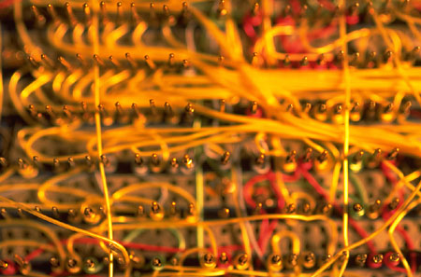
Some Fundamental Assumptions – Wires
Although you may not have stated it, or thought about it, when you have drawn circuit schematics, you have connected components or devices with wires, and shown this with lines.
Wires can be modeled pretty well as resistors. However, their resistance is usually negligibly small.
We will think of wires as connections with zero resistance. Note that this is equivalent to having a zero-valued voltage source.
This picture shows wires used to connect electrical components. This particular way of connecting components is called wirewrapping, since the ends of the wires are wrapped around posts.

Slide 40
Some Fundamental Assumptions – Nodes
A node is defined as a place where two or more components are connected.
The key thing to remember is that we connect components with wires. It doesn’t matter how many wires are being used; it only matters how many components are connected together.

Slide 41
How Many Nodes?
To test our understanding of nodes, let’s look at the example circuit schematic given here.
How many nodes are there in this circuit?
Notes:
Think about your answer before going on to the next slide.

Slide 42
How Many Nodes – Correct Answer
In this schematic, there are three nodes. These nodes are shown in dark blue here.
Some students count more than three nodes in a circuit like this. When they do, it is usually because they have considered two points connected by a wire to be two nodes.
Notes:
The nodes are the darker blue shapes. The shape is unimportant to us; we can draw the circuit in many ways. The key here, for example, is that a voltage source, a current source, and a resistor called R_{F} are connected to the bottom node.

Slide 43
How Many Nodes – Wrong Answer
Wire connecting two nodes means that these are really a single node.
In the example circuit schematic given here, the two red nodes are really the same node. There are not four nodes.
Remember, two nodes connected by a wire were really only one node in the first place.
Notes:
Remember, two nodes connected by a wire were not really two nodes at all. It is all one node.

Slide 44
Some Fundamental Assumptions – Closed Loops
A closed loop can be defined in this way: Start at any node and go in any direction and end up where you start. This is a closed loop.
Note that this loop does not have to follow components. It can jump across open space. Most of the time we will follow components, but we will also have situations where we need to jump between nodes that have no connections.

Slide 45
How Many Closed Loops
To test our understanding of closed loops, let’s look at the example circuit schematic given here.
How many closed loops are there in this circuit?
Notes:
Think about your answer before going on to the next slide.

Slide 46
How Many Closed Loops –
An Answer
There are several closed loops that are possible here. We will show a few of them, and allow you to find the others.
The total number of closed loops that follow components and defined voltages in this circuit is 13. The number of closed loops as we defined that term, is infinity.
Finding the number will not turn out to be important. What is important is to recognize closed loops when you see them.

Slide 47
Closed Loops – Loop #1
Here is a loop we will call Loop #1. The path is shown in red.

Slide 48
Closed Loops – Loop #2
Here is Loop #2. The path is shown in red.

Slide 49
Closed Loops – Loop #3
Here is Loop #3. The path is shown in red.
Note that this path is a closed loop that jumps across the voltage labeled v_{X}. This is still a closed loop.

Slide 50
Closed Loops – Loop #4
Here is Loop #4. The path is shown in red.
Note that this path is a closed loop that jumps across the voltage labeled v_{X}. This is still a closed loop. The loop also crossed the current source. Remember that a current source can have a voltage across it.

Slide 51
A Not-Closed Loop
The path is shown in red here is not closed.
Note that this path does not end where it started.

Slide 52
Some Fundamental Assumptions -Closed Surfaces
A closed surface can be defined in this way: Start drawing a line at any place, move in any direction and end up where you start. This boundary thus drawn will be called a closed surface.
We will note that the nodes we defined earlier are closed surfaces. All nodes are closed surfaces, but not all closed surfaces are nodes.

Slide 53
Other Closed Surfaces
A closed surface can be defined in this way: Start drawing a line at any place, move in any direction and end up where you start. This boundary thus drawn will be called a closed surface.
The dark blue shape in the diagram at the right is a closed surface, but it is not a node. Closed surfaces can enclose components, devices, or elements.

Slide 54

Kirchhoff’s Current Law (KCL)
With these definitions, we are prepared to state Kirchhoff’s Current Law:
The algebraic (or signed) summation of currents through any closed surface must equal zero.

Slide 55
Kirchhoff’s Current Law
(KCL) – Some notes.
The algebraic (or signed) summation of currents through any closed surface must equal zero.
This law essentially means that charge does not build up at a connection point, and that charge is conserved.
This law is often stated as applying to nodes. It applies to any closed surface. For any closed surface, the charge that enters must leave somewhere else. A node is just a small closed surface. A node is the closed surface that we use most often. But, we can use any closed surface, and sometimes it is really necessary to use closed surfaces that are not nodes.

Slide 56
Current Polarities
Again, the issue of the sign, or polarity, or direction, of the current arises. When we write a Kirchhoff Current Law equation, we attach a sign to each reference current polarity, depending on whether the reference current is entering or leaving the closed surface. This can be done in different ways.

Slide 57
Kirchhoff’s Current Law (KCL)
– a Systematic Approach
The algebraic (or signed) summation of currents through any closed surface must equal zero.
For most students, it is a good idea to choose one way to write KCL equations, and just do it that way every time. The idea is this; if you always do it the same way, you are less likely to get confused about which way you were doing it in a certain equation.
For this set of material, we will always assign a positive sign to a term that refers to a reference current that leaves a closed surface, and a negative sign to a term that refers to a reference current that enters a closed surface.

Slide 58
Kirchhoff’s Current Law (KCL)
– an Example
For this set of material, we will always assign a positive sign to a term that refers to a current that leaves a closed surface, and a negative sign to a term that refers to a current that enters a closed surface.
In this example, we have already assigned reference polarities for all of the currents for the nodes indicated in darker blue.
For this circuit, and using my rule, we have the following equation:
Notes:
The node that we are using here is highlighted in darker blue.

Slide 59
Kirchhoff’s Current Law (KCL) – Example Done Another Way
Some prefer to write this same equation in a different way; they say that the current entering the closed surface must equal the current leaving the closed surface. Thus, they write :
Compare this to the equation that we wrote in the last slide:
These are the same equation. Use either method.

Slide 60
Kirchhoff’s Voltage Law (KVL)
Now, we are prepared to state Kirchhoff’s Voltage Law:
The algebraic (or signed) summation of voltages around any closed loop must equal zero.

Slide 61
Kirchhoff’s Voltage Law
(KVL) – Some notes.
The algebraic (or signed) summation of voltages around any closed loop must equal zero.
This law essentially means that energy is conserved. If we move around, wherever we move, if we end up in the place we started, we cannot have changed the potential at that point.
This applies to all closed loops. While we usually write equations for closed loops that follow components, we do not need to. The only thing that we need to do is end up where we started.

Slide 62
Voltage Polarities
Again, the issue of the sign, or polarity, or direction, of the voltage arises. When we write a Kirchhoff Voltage Law equation, we attach a sign to each reference voltage polarity, depending on whether the reference voltage is a rise or a drop as we move across it. The application of the sign can be done in different ways.

Slide 63
Kirchhoff’s Voltage Law
(KVL) – a Systematic Approach
The algebraic (or signed) summation of voltages around a closed loop must equal zero.
For most students, it is a good idea to choose one way to write KVL equations, and just do it that way every time. The idea is this: If you always do it the same way, you are less likely to get confused about which way you were doing it in a certain equation.
(At least we will do this for planar circuits. For nonplanar circuits, clockwise does not mean anything. If this is confusing, ignore it for now.)
For this set of material, we will always go around loops clockwise. We will assign a positive sign to a term that refers to a reference voltage drop, and a negative sign to a term that refers to a reference voltage rise.

Slide 64
Kirchhoff’s Voltage Law
(KVL) – an Example
For this set of material, we will always go around loops clockwise. We will assign a positive sign to a term that refers to a voltage drop, and a negative sign to a term that refers to a voltage rise.
In this example, we have already assigned reference polarities for all of the voltages for the loop indicated in red.
For this circuit, and using our rule, starting at the bottom, we have the following equation:

Slide 65
Kirchhoff’s Voltage Law (KVL) – Notes
As we go up through the voltage source, we enter the negative sign first. Thus, v_{A} has a negative sign in the equation.
For this set of material, we will always go around loops clockwise. We will assign a positive sign to a term that refers to a voltage drop, and a negative sign to a term that refers to a voltage rise.
Some students like to use the following handy mnemonic device: Use the sign of the voltage that is on the side of the voltage that you enter. This amounts to the same thing.

Slide 66
Kirchhoff’s Voltage Law
(KVL) – Example Done Another Way
Some textbooks, and some students, prefer to write this same equation in a different way; they say that the voltage drops must equal the voltage rises. Thus, they write the following equation:
Compare this to the equation that we wrote in the last slide:
These are the same equation. Use either method.

Slide 67
How many of these equations do I need to write?
This is a very important question. In general, it boils down to the old rule that you need the same number of equations as you have unknowns.
Speaking more carefully, we would say that to have a single solution, we need to have the same number of independent equations as we have variables.
At this point, we are not going to introduce you to the way to know how many equations you will need,
or which ones to write. It is assumed that
you will be able to judge whether you have
what you need because the circuits will be
fairly simple. Later we will develop
methods to answer this question specifically and efficiently.

Slide 68
How many more laws are we going to learn?
This is another very important question. Until, we get to inductors and capacitors, the answer is, none.
Speaking more carefully, we would say that most of the rules that follow until we introduce the other basic elements, can be derived from these laws.
At this point, you have the tools to solve many, many circuits problems. Specifically, you have Ohm’s Law, and Kirchhoff’s Laws. However, we need to be able to use these laws efficiently and accurately.
We will spend some time in ECE 2201
learning techniques, concepts and
approaches that help us to
do just that.

Slide 69
How many f’s and h’s are there in Kirchhoff?
This is another not-important question. But, we might as well learn how to spell Kirchhoff. Our approach might be to double almost everything, but we might end up with something like Kirrcchhooff.
We suspect that this is one reason why people typically abbreviate these laws as KCL and KVL. This is pretty safe, and seems like a pretty good idea to us.

Slide 70
Example #1
Let us do an example to test out our new found skills.
In the circuit shown here, find the voltage v_{X} and the current i_{X}.

Slide 71
Example #1 – Step 1
The first step in solving is to define variables we need.
In the circuit shown here, we will define v₄ and i₃.

Slide 72
Example #1 – Step 2
The second step in solving is to write some equations. Let’s start with KVL.

Slide 73
Example #1 – Step 3
Now let’s write Ohm’s Law for the resistors.
Notice that there is a sign in Ohm’s Law.

Slide 74
Example #1 – Step 4
Next, let’s write KCL for the node marked in violet.
Notice that we can write KCL for a node, or any other closed surface.

Slide 75
Example #1 – Step 5
We are ready to solve.
We have substituted into our KVL equation from other equations.

Slide 76
Example #1 – Step 6
Next, for the other requested solution.
We have substituted into Ohm’s Law, using our solution for i_{X}.

Slide 77
Example Problem #2
How many nodes are there in this circuit?

Slide 78
Example Problem #3
Let’s do another example. Find the voltage v_{X}, the currents i_{X} and i_{Q}, and the power absorbed by each of the dependent sources.

Slide 79
Example Problem #4
Let’s do another example. Find the voltage v_{X}.

Slide 80
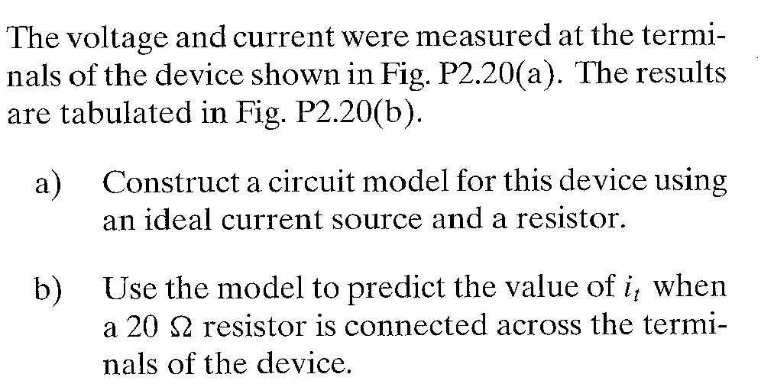
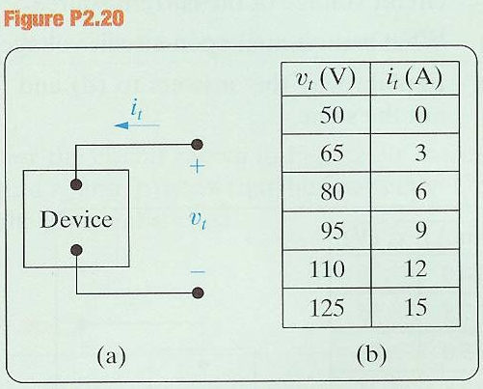
Example #5 – Problem 2.20
This problem is taken from one edition of the Nilsson and Reidel text, “Electric Circuits”.
For part a), they mean a current source in parallel with a resistance.

