Slide 1
ECE 2202
Circuit Analysis II
Lecture Set #9
Phasor Analysis
Version 19
Dr. Dave Shattuck
Associate Professor, ECE Dept.
Shattuck@uh.edu
713 743-4422

Slide 2
Lecture Set 9
Phasor Analysis

Slide 3
Overview of this Lecture Set
Phasor Analysis
In this lecture set, we will cover the following topics:
Review of Phasor Analysis
Notation Issues
Previous Example Solution
Numerical Example Solution

Slide 4
Textbook Coverage
This material is introduced in different ways in different textbooks. Approximately this same material is covered in your textbook in the following sections:
Electric Circuits 7th Edition by Nilsson and Riedel: Sections 9.5 through 9.9
Electric Circuits 10th Edition by Nilsson and Riedel: Sections 9.4 through 9.9

Slide 5
Review of Phasor Analysis
A phasor is a transformation of a sinusoidal voltage or current. Using phasor analysis, we can solve for the steady-state solution for circuits that have sinusoidal sources.
Phasor analysis is so much easier, that it is worth the trouble to understand the technique, and what it means.

Slide 6
Sinusoidal Steady-State Solution
The steady-state solution is the part of the solution that does not die out with time.
Our goal with phasor transforms to is to get this steady-state part of the solution, and to do it as easily as we can. Note that the steady state solution, with sinusoidal sources, is sinusoidal with the same frequency as the source.
Thus, all we need to do is to find the amplitude and phase of the solution.

Slide 7
The Transform Solution Process
In the transform solution process, we transform the problem into another form. The solution process uses complex numbers, but is otherwise straightforward. The solution obtained is a transformed solution, which must then be inverse transformed to get the answer. We will use a transform called the Phasor Transform.

Slide 8
Table of Phasor Transforms
The phasor transforms can be summarized in the table given here. In general, voltages transform to voltage phasors, currents to current phasors, and passive elements to their impedances.
Component | Time Domain Quantity | Phasor Domain Quanity
Voltages
Currents
Resistors
Inductors
Capacitors

Slide 9
Phasor Transform Solution Process
So, to use the phasor transform method, we transform the problem, taking the phasors of all currents and voltages, and replacing passive elements with their impedances. We then solve for the phasor of the desired voltage or current, using analysis as with dc circuits, but with complex arithmetic. Finally, we inverse transform. The frequency, ω, must be remembered, since it is not a part of the transformed solution.

Slide 10
Solution in the Phasor Domain
When we solve the transformed problem, in the phasor domain, we can use almost any of the techniques that we used in dc circuit analysis.
We can do series or parallel combinations of impedance, as we did with resistances.
We can use the voltage divider rule and the current divider rule.
We can write Node-Voltage Method and Mesh-Current Method equations.
We can use Thévenin's Theorem and Norton’s Theorem.
All of these work as before, but here we use complex numbers.
This process can use almost any of our dc circuit analysis techniques.

Slide 11
Notation Issues – 1
To be able to use phasor analysis properly, it is important to keep the distinctions between the time domain and the phasor domain clear. The quantities in the phasor domain are related to quantities in the time domain, but they are not equal to each other.

Slide 12
Notation Issues – 2
In these lecture notes, we use bold-face variables for phasors, as do most texts. Our rule here is that when writing by hand we should put a bar over the variable for phasors, and add an m to the subscript.
We use upper-case variables, and lower-case subscripts for phasors, and lower-case variables for time domain voltages and currents. Again, this is commonly used in textbooks and in practice.
v_{X}(t)
i_{X}(t)
V_{xm}(ω)
I_{xm}(ω)

Slide 13
Notation Issues – 3
We do not use bold-face for impedances and admittances, and use bold-face only for phasors. We use upper-case variables for these impedances and admittances. Again, this is commonly used in textbooks and in practice. The case chosen for the subscripts for impedances and admittances varies, both here and in practice.
R
L
C
Z_{R}
Z_{L}
Z_{C}

Slide 14


Notation Issues – 4
It is important not to mix the notations in a single expression. We would not write something like the expression below. It would imply that these domains and expressions are equal. They are not. This is called mixed-domains, and is considered a serious error, since it implies a lack of understanding of the difference between the two domains.
It is important not to mix domains in a single circuit diagram. Stay with a single domain for any single schematic.
Rong!!! Mixed Domains
-379 points!

Slide 15
Notation Issues – 5
A correct version of the equation from the previous slide is given here. This is correct since the voltage is in the phasor domain. In general, we can say that there should be no j’s in the time domain, and no t’s in the phasor domain.
Correct, No Mixed Domains
R
L
C
No j’s
Z_{R}
Z_{L}
Z_{C}
No t’s

Slide 16
Previous Example Solution – 1
Problem Statement: Imagine the circuit here has a sinusoidal source. What is the steady state value for the current i(t)?
Solution: Let us look again at this circuit, which we solved in the previous part.
We used the phasor analysis technique.
The first step was to transform the problem into the phasor domain.
Phasor Domain diagram.
Note that the time variable, t, does not appear anywhere in this diagram.

Slide 17
Previous Example Solution – 2
Problem Statement: Imagine the circuit here has a sinusoidal source. What is the steady state value for the current i(t)?
Next, we replace the phasors with their complex numbers,
Phasor Domain diagram.
where I_{m} and θ are the values we want, specifically, the magnitude and phase of the current.

Slide 18
Previous Example Solution – 3
Problem Statement: Imagine the circuit here has a sinusoidal source. What is the steady state value for the current i(t)?
We examine this circuit. We have two impedances in series. We can combine the two impedances in series in the same way we would combine resistances. We can then write the complex version of Ohm’s Law,
where I_{m} and θ are the unknowns.

Slide 19
Previous Example Solution – 4
Problem Statement: Imagine the circuit here has a sinusoidal source. What is the steady state value for the current i(t)?
Let’s take the magnitude of the left and right hand sides. We get

Slide 20
Previous Example Solution – 5
Problem Statement: Imagine the circuit here has a sinusoidal source. What is the steady state value for the current i(t)?
Let’s take the phase of the left and right hand sides. The phase is the phase of the numerator, minus the phase of the denominator. We get

Slide 21
Previous Example Solution – 6
Problem Statement: Imagine the circuit here has a sinusoidal source. What is the steady state value for the current i(t)?
Thus, the phasor current is

Slide 22
Previous Example Solution – 7
Problem Statement: Imagine the circuit here has a sinusoidal source. What is the steady state value for the current i(t)?
To get the answer, we take the inverse phasor transform, and get

Slide 23
Previous Example Solution – 8
Problem Statement: Imagine the circuit here has a sinusoidal source. What is the steady state value for the current i(t)?
To get the answer, we take the inverse phasor transform, and get

Slide 24
Numerical Example Solution – 1
Let us solve a problem a slightly more difficult problem, and this time let us use numbers. Problem Statement: What is the steady state value for the voltage v_{X}(t)?

Slide 25
Numerical Example Solution – 2
Notice that all components have been transformed to the phasor domain, including the current, i_{X}, that the dependent source depends on.

Slide 26
Numerical Example Solution – 3
There are only two essential nodes, so the node voltage method looks like a good way to solve this problem. While there are other approaches, we will take this path. We can write the node-voltage equations,

Slide 27
Numerical Example Solution – 4
Now, we can substitute I_{x,m} back into this equation, and we get
which is one equation in one unknown.

Slide 28
Numerical Example Solution – 5
We can solve. We collect terms on each side, and get
We note that 1/j = -j. Next, to combine these terms, we divide magnitudes and subtract phases to get

Slide 29
Numerical Example Solution – 6
Now, we need to solve for V_{a,m}. We get
Next, we note that we can get V_{x,m} from V_{a,m} by using the complex version of the voltage divider rule, since Z_{R2} and Z_{C2} are in series.

Slide 30
Numerical Example Solution – 7
Using the complex version of the voltage divider rule, we have

Slide 31
Numerical Example Solution – 8
The final step is to inverse transform. We need to remember that the frequency was 50[rad/s], and we can write,

Slide 32

What if I have a calculator that does the complex arithmetic for me?
If you have a calculator that makes the work easier for you, this is a good thing. Remember, we do not get extra credit as engineers for doing things the hard way.
The only caution is that you should understand what your calculator is doing for you, so that you can use its results wisely. To get to this point, most students need to work a few problems by hand. After that, use the fastest and easiest method that gives you the right answer, every time.

Slide 33
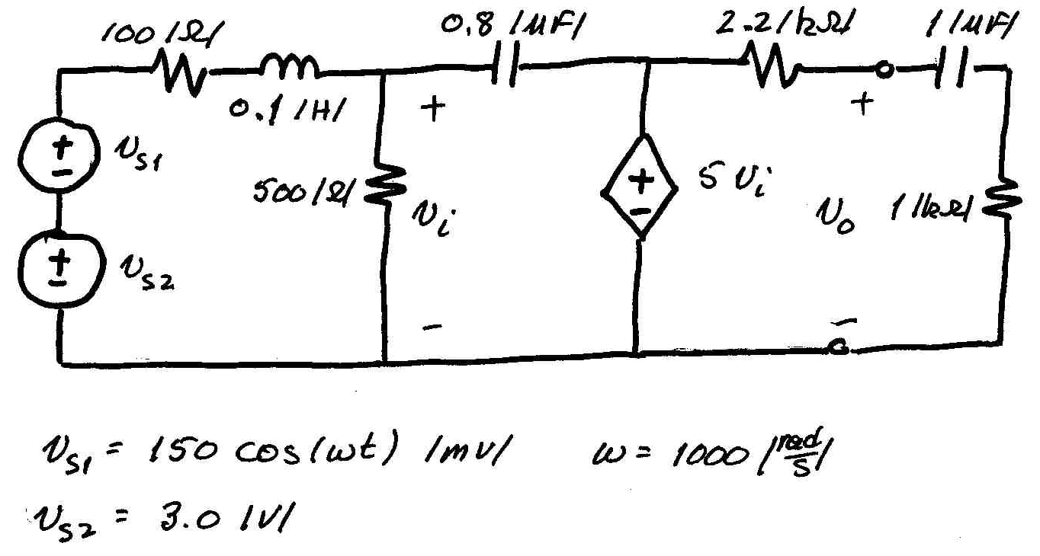
Sample Problem #1
The circuit shown below is in steady-state. Note that the source v_{S2} is a dc source, and the source v_{S1} is an ac source. Find the output voltage v_{O}(t), as a function of time.

Slide 34
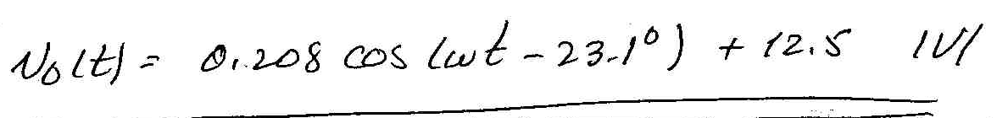
Sample Problem #1, with solution
The circuit shown below is in steady-state. Note that the source v_{S2} is a dc source, and the source v_{S1} is an ac source. Find the output voltage v_{O}(t), as a function of time.
Solution:

Slide 35
Sample Problem #2
The circuit below is operating in steady-state.
a) Find the non-zero angular frequency or frequencies ω for which the current i_{X} and the voltage v_{S} are in phase.
b) Find the amplitude of i_{X} for the solution(s) you found in part a).

Slide 36
Sample Problem #2
The circuit below is operating in steady-state.
a) Find the non-zero angular frequency or frequencies ω for which the current i_{X} and the voltage v_{S} are in phase.
b) Find the amplitude of i_{X} for the solution(s) you found in part a).
Solution:
a) ω = 3.59[krad/s]
b) 9.615[A]

Slide 37
Sample Problem #3
The circuit shown had been in steady-state until the switch opened at t = 0. Then for a time after that, the circuit was not in steady state. Find the value of the voltage v_{X}(t) at the time 20[ms] after the switch opened.

Slide 38
Sample Problem #3
The circuit shown had been in steady-state until the switch opened at t = 0. Then for a time after that, the circuit was not in steady state. Find the value of the voltage v_{X}(t) at the time 20[ms] after the switch opened.
Solution:
v_{X}(20ms] = -10.7[mV]

