Slide 1
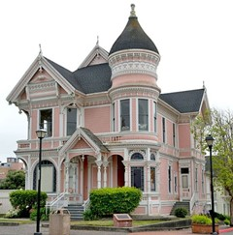
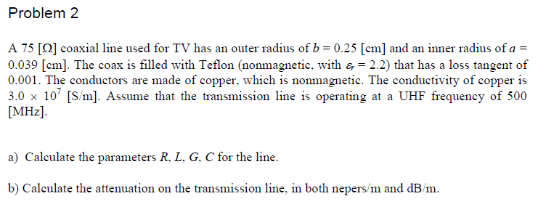
Blast From the Past!
,
here
Final Exam
Spring 2009

Slide 2
Blast From the Past!
,
here
Solution
Part (a)

Slide 3
Blast From the Past!
,
here
Part (a)
R = 3.827 [Ω/m]
L = 3.716×10⁻⁷ [H/m]
G = 2.070 ×10⁻⁴ [S/m]
C = 6.588×10⁻¹¹ [F/m]

Slide 4
Blast From the Past!
,
here
Part (b)
γ = 0.033243+j15.543 [1/m]
α = 0.033247 [nepers/m]
Attenuation = 0.289 [dB/m]

