Slide 1
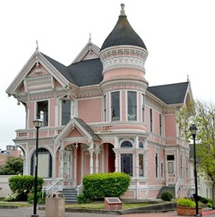
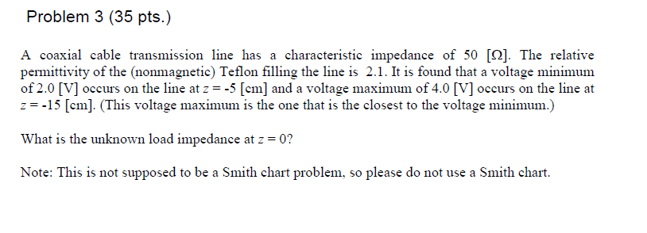
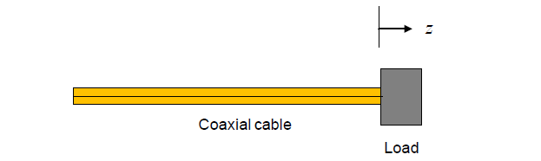
Blast From the Past!
,
here
Exam 1
Fall 2018

Slide 2
Blast From the Past!
Solution
.
For the phase of the load reflection coefficient φ, we have:
We have
(We can add any multiple of 2π to the final answer for φ.)
.
Hence

Slide 3
Blast From the Past!
.
We then have
so
Therefore

