Slide 1

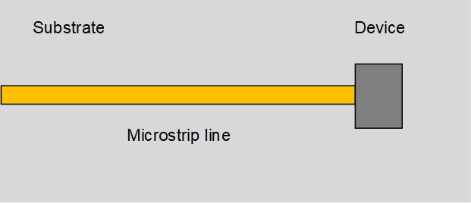
Blast From the Past!
,
here
Exam 1
Spring 2013
Problem 3 (40 pts.)
A transmission line is connected to a certain device on a printed circuit board, operating at 10.0 GHz (a top view is shown below). The device is located at z = 0. The microstrip line has a characteristic impedance of 50 [Ω]. The effective relative permittivity of the microstrip line is 1.5.

Slide 2
Blast From the Past!
,
here
Exam 1
Spring 2013
(a) By probing the line, it is found that the voltage on the line has a maximum magnitude of 1.5 volts and a minimum magnitude of 0.5 volts. A voltage minimum occurs at a distance of 0.75 [cm] from the device. Determine the input impedance of the device. Do the calculation exactly (do not use the Smith chart).

Slide 3
Blast From the Past!
,
here
Exam 1
Spring 2013
Part (a)
At 10.0 GHz we have:
Therefore:
(any multiple of 2π can be added on)

Slide 4
Blast From the Past!
,
here
Exam 1
Spring 2013
(b) Assume now that a new device is connected to the end of the line, which has an input impedance of Z_{in} = 100+j100 [Ω]. An open-circuited stub line having characteristic impedance of 50 [Ω] and an effective permittivity of 1.5 is added at a distance d from the load. Find the distance d and the length of the open-circuited stub line (in cm) to obtain a perfect match seen by an incoming wave that arrives from a generator on the left (not shown). Use the shortest distance d possible. Use the Smith chart to do all calculations. (A Smith chart is included at the end of this problem.)

Slide 5
Blast From the Past!
,
here
Exam 1
Spring 2013
Part (b)
At 10.0 GHz we have:
From the Smith chart:
Stub

Slide 6
,
here
Part (b)
Calculation for d

Slide 7
,
here
Part (b)
Calculation for l_{s}
Note:
We are using the Smith chart as an admittance calculator here.

Slide 8
Blast From the Past!
,
here
Exam 1
Spring 2013
(c) As a continuation of part (b), what is the SWR on the main line between the device and the open-circuited stub? What is the SWR on the open-circuited stub line? What is the SWR on the main line to the left of the open-circuited stub? Do the calculations exactly (do not use the Smith chart).
Stub

Slide 9
Blast From the Past!
,
here
Exam 1
Spring 2013
Part (c)
SWR between device and stub:
Stub

Slide 10
Blast From the Past!
,
here
Exam 1
Spring 2013
Part (c)
SWR on stub:
Stub

Slide 11
Blast From the Past!
,
here
Exam 1
Spring 2013
Part (c)
SWR on feed line:
Stub

