Slide 1
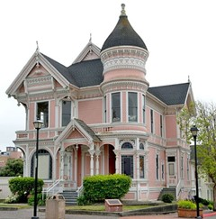
Blast From the Past!
,
here
Exam 2
Spring 2018
Problem 3 (30 pts)
Consider the following plane wave that is traveling in air:
(a) Find the polarization (linear, circular, or elliptical) and handedness (left-handed or right-handed) for the wave.
(b) Find the axial ratio of this wave.
(c) Find the magnetic field vector for this plane wave.

Slide 2
We can rotate the coordinates so that we have
Blast From the Past!
.
Part (a)
At x = 0 we then have
Plotting these two points in the complex plane, we see that E_{z} leads E_{y}. Therefore the wave rotates from the z axis towards the y axis in time. Since the propagation direction is the positive x axis, the wave is left-handed. The angle between the two phasors is not 90º. Also, the magnitudes are not equal. Thus we have

Slide 3
We can rotate the coordinates so that we have
Blast From the Past!
,
.
Part (b)
(in rotated coordinates)
Factoring out a (1-j3) term, we have:
Hence

Slide 4
We can rotate the coordinates so that we have
Blast From the Past!
,
.
(in rotated coordinates)
Part (b)
We then have
Since ξ > 0, this confirms that the wave is LH. But we already knew this from Part (a).
This gives us

Slide 5
We can rotate the coordinates so that we have
Blast From the Past!
,
.
(in original coordinates)
Part (c)
Each electric field component of the plane wave has a corresponding magnetic field component, whose amplitude is related by η₀.
Wave traveling in +x direction:
Hence, we have:

