Slide 1

Blast From the Past!
,
here
Exam 2
Fall 2022
Note:
The effective conductivity accounts for both the actual conductivity and the polarization loss.

Slide 2
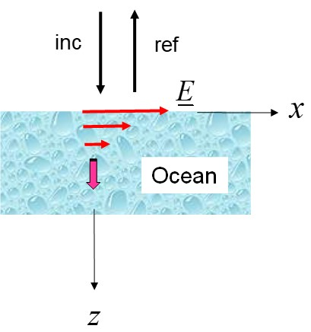
Blast From the Past!
,
here
Exam 2
Fall 2022

Slide 3
Blast From the Past!
,
here
Part (a)
so
Note:
σ_{eff} is called σ_{d} in the class notes, when modeling a dielectric material.
This gives us:

Slide 4
Blast From the Past!
,
here
Part (b)
The loss tangent is:
Hence, we have

Slide 5
Blast From the Past!
,
here
Part (c)
The wavenumber of the seawater is:
Hence, we have
Therefore,
Multiply by 8.686 to convert to dB/m:

Slide 6
Blast From the Past!
,
here
Part (d)

