Slide 1
Blast From the Past!
,
here
Final Exam
Spring 2012
Problem 5 (20 pts)
Suppose we wish to communicate between a base-station antenna and a cell-phone antenna that is located on a user’s cell phone. Assume that the cell-phone antenna is modeled as a simple resonant dipole antenna. The cell phone operates at 2.0 [GHz]. The base station antenna is radiating a total power of 60 [W]. Assume that the base-station antenna is modeled as a (lossless) vertical resonant dipole antenna. The person is at a distance of r = 2.0 [km] from the base station.
a) Determine how much power the cell-phone antenna will deliver to a 50 [Ω] load, which models the receiver circuit inside the phone. Assume that user holds the phone so that the cell-phone antenna is vertical.
b) How would the answer change if the user holds the phone so that the cell-phone antenna is now at an angle of 45º with respect to vertical?
c) How would the answer change if the user holds the phone so that the cell-phone antenna is now horizontal?
d) How would the answer change if the cell-phone antenna is horizontal, but the base-station now radiates 60 [W] using circular polarization instead of vertical polarization? Assume that the directivity of the CP base-station antenna is still the same as it was for the vertical base-station antenna.

Slide 2
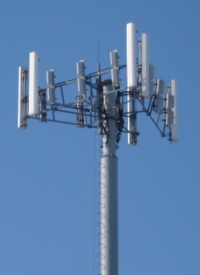


Blast From the Past!
,
here
Final Exam
Spring 2012

Slide 3
Blast From the Past!
,
here
Equivalent Circuit
+
+
-
-

Slide 4
Blast From the Past!
,
here
a) Determine how much power the cell-phone antenna will deliver to a 50 [Ω] load, which models the receiver circuit inside the phone. Assume that user holds the phone so that the cell-phone antenna is vertical.
If we have a conjugate matched load (Z_{L} = 73 [Ω]):
where

Slide 5
Blast From the Past!
.
b) How would the answer change if the user holds the phone so that the cell-phone antenna is now at an angle of 45º with respect to vertical?
The received voltage changes by a factor of
The received power thus changes by a factor of

Slide 6
Blast From the Past!
.
c) How would the answer change if the user holds the phone so that the cell-phone antenna is now horizontal?
The received voltage changes by a factor of
The received power thus changes by a factor of

Slide 7
Blast From the Past!
.
d) How would the answer change if the cell-phone antenna is horizontal, but the base-station now radiates 60 [W] using circular polarization instead of vertical polarization? Assume that the directivity of the CP base-station antenna is still the same as it was for the vertical base-station antenna.
For the incident power density, we now consider only the componet of the incident wave that is horizontally polarized. This carries 1/2 of the total incident power density.

