Slide 1
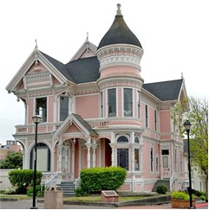
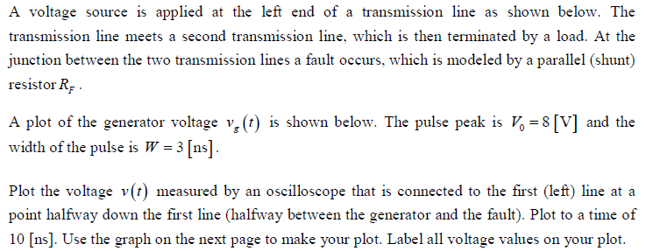
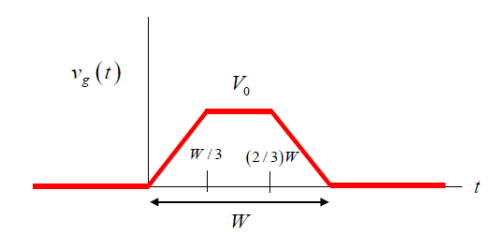
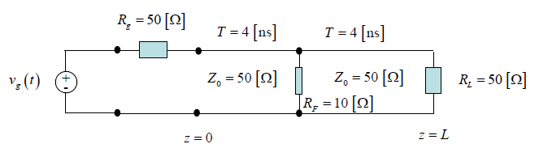
Blast From the Past!
,
here
Exam 1
Fall 2021

Slide 2
Blast From the Past!
,
here
Line #1 sees a load of 50 [Ω] in parallel with 10 [Ω], which gives 8.333 [Ω].
Load seen by line #1
8.333 [Ω] load

Slide 3
Blast From the Past!
,
here
Load seen by line #1

Slide 4
Part (a)
Blast From the Past!
Plot of voltage
5.0
4.0
0.0
-2.857
-5.0

