Slide 1
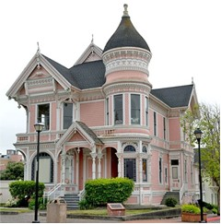
Blast From the Past!
,
here
Exam 1
Fall 2022

Slide 2
Blast From the Past!
Solution
Keeping the first two terms, we have:
Oscilloscope

Slide 3
Blast From the Past!
,
here

