Slide 1
Blast From the Past!
,
here
Exam 1
Fall 2018
+
-

Slide 2
Blast From the Past!
,
here
Subtract
We don’t need to make this second bounce diagram. We can just make an oscilloscope trace from the original bounce diagram and then shift it in time.

Slide 3
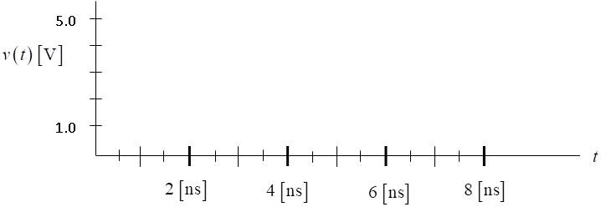
Blast From the Past!
,
here
Original
8/3=2.667
2.0
22/9 = 2.444
64/27 = 2.370
Subtract
Shifted
8/3=2.667
2.0
22/9 = 2.444
64/27 = 2.370

Slide 4
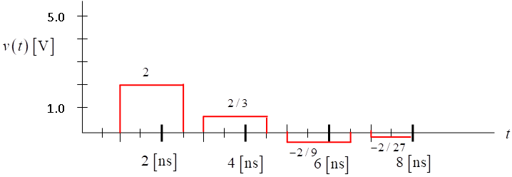
Blast From the Past!
,
here
Incident
Reflected from load
Reflected second time from load
Reflected from generator
+
-

