Slide 1
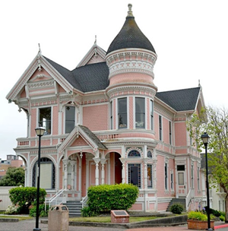
Blast From the Past!
,
here
Exam 1
Fall 2020

Slide 2
Blast From the Past!
,
here
Exam 1
Fall 2020
Note:
This problem corresponds to a coaxial cable transmission line that is shorted circuited at z = 0.

Slide 3
Blast From the Past!
In the phasor domain we have
To find the electric field we use Amperes’ law:
so
We have
Keeping only the terms that survive, we have
so

Slide 4
Blast From the Past!
The Poynting vector is:
Hence, we have
or

Slide 5
Blast From the Past!
We then have
This gives us the complex power flowing down through the surface as
Hence,

