Slide 1
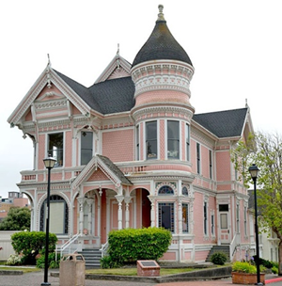
Blast From the Past!
,
here
Exam 1
Fall 2018

Slide 2
Blast From the Past!
,
here
Note:
So

Slide 3
Blast From the Past!
,
here
We then have:
The complex power flowing through S is then:

Slide 4
Blast From the Past!
,
here
The unit normal to the surface is:
Hence, we have:

