Slide 1
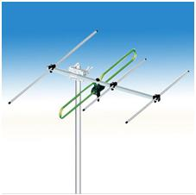
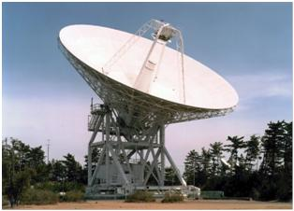
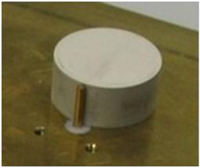
ECE 3317
Applied Electromagnetic Waves
Prof. David R. Jackson
Fall 2024
Notes 21
Antenna Properties

Slide 2
Antenna Radiation
We consider here the radiation from an antenna.
S = Poynting vector
r
"far field"
+
-
(phasor electric field)
The far-field radiation acts like a plane wave going in the radial direction.
The shape of the pattern in the far field is only a function of (θ, φ).

Slide 3
Antenna Radiation (cont.)
How far do we have to go to be in the far field?
Sphere of minimum diameter D that encloses the antenna.
+
-

Slide 4
Antenna Radiation (cont.)
The far-field has the following form:
Example: vertical dipole
TM_{z}
Depending on the type of antenna, either or both polarizations may be radiated
(e.g., a vertical wire antenna radiates only E_{θ} polarization).
Example: horizontal loop antenna
TE_{z}

Slide 5
Antenna Radiation (cont.)
The power density in the far field is:
or

Slide 6
Antenna Radiation (cont.)
The far field always has the following form:
In decibels (dB):

Slide 7

Antenna Radiation (cont.)
A normalized far-field pattern is usually shown vs. the angle θ (for a fixed angle φ =φ₀) in polar coordinates.
The subscript “m” denotes the beam maximum.
An “elevation cut”
30°
30°
60°
60°
0º dB
-9
-6
-3
0
120°
120°
150°
150°

Slide 8
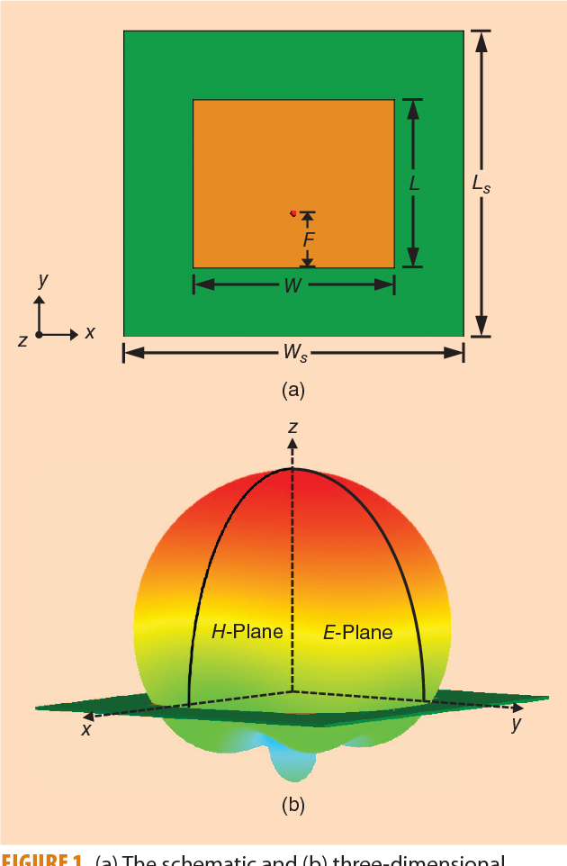
Antenna Radiation (cont.)
E-plane and H-plane
E-plane
Example: Microstrip antenna
Current flow
H-plane
Feed
E-plane:
the plane containing the E vector.
H-plane:
the plane containing the H vector.
Note:
For the vertical dipole antenna, every elevation cut is an E plane.

Slide 9
Radiated Power
The Poynting vector in the far field is
The total power radiated (in Watts) is then given by
Hence, we have

Slide 10
Directivity
The directivity of the antenna in the directions (θ, φ) is defined as
The directivity (in a particular direction) is the ratio of the actual power density radiated in that direction to the power density that would be radiated in that direction if the antenna were an isotropic radiator (radiates equally in all directions).
In dB,
Note: The directivity is sometimes referred to as the “directivity with respect to an isotropic radiator.”

Slide 11
Directivity (cont.)
The directivity is then directly expressed in terms of the far field pattern:
Usually, the directions are chosen to corresponds to the main beam direction:

Slide 12
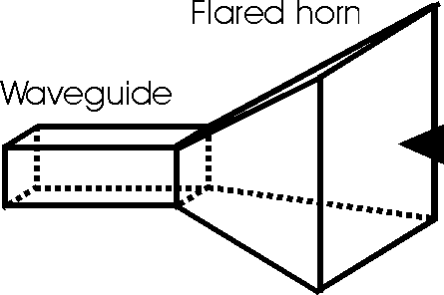
Directivity (cont.)
30°
30°
30°
30°
60°
60°
60°
60°
0 dB
0 dB
-9
-6
-3
-9
-6
-3
120°
120°
120°
120°
150°
150°
150°
150°
Antenna with moderate directivity
(e.g., dipole)
Antenna with high directivity
(e.g., horn or dish)

Slide 13
Directivity (cont.)
Two Common Cases: Dipole Antennas
Short dipole wire antenna (l << λ₀): D = 1.5
Resonant half-wavelength dipole wire antenna (l = λ₀ / 2): D = 1.643
Wire dipole antenna
Short dipole
30°
30°
60°
60°
Feed
0 dB
-9
-6
-3
120°
120°
150°
150°

Slide 14
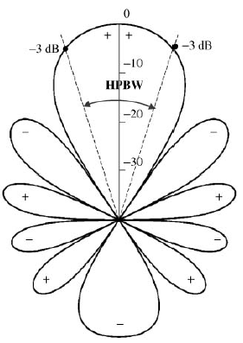
Beamwidth
The beamwidth measures how narrow the beam is
(the narrower the beamwidth, the higher the directivity).
HPBW = half-power beamwidth
At the “half-power” points:
The power density is down by a factor of 1/2.
The field is down by a factor of 1/√2 = 0.707.
In dB, we are down by 3 dB.

Slide 15
Sidelobe Level
The sidelobe level measures how large the sidelobes are.
In this example the sidelobe level is about -13 dB.
Main beam
Sidelobe level
Sidelobes

Slide 16
Gain and Efficiency
The radiation efficiency of an antenna is defined as
P_{rad} = power radiated by the antenna
P_{in} = power input to the antenna
The gain of an antenna in the directions (θ, φ) is defined as
In dB, we have

Slide 17
Gain and Efficiency (cont.)
The gain tells us how strong the radiated power density is in a certain direction, for a given amount of input power.
Recall that
Therefore, in the far field:

Slide 18
Input Impedance
The antenna acts like a load impedance during transmit.
At resonance, the input reactance X_{in} is zero (the desired situation).
Note: We usually want a match between the input impedance and the characteristic impedance Z₀ of the feeding transmission line, to avoid reflection.

Slide 19
Input Impedance (cont.)
At resonance:
Dipole:
Monopole:

Slide 20
Receive Antenna
The Thévenin equivalent circuit of an antenna being used as a receive antenna is shown below.
The Thevenin impedance is the same as the input impedance of the antenna.
+
-
+
-

Slide 21
Receive Antenna (cont.)
The power received by an optimum conjugate-matched load:
Load
+
ANT
-
P_{rec} = P_{L} = power absorbed by load
For a resonant dipole wire antenna:

Slide 22
Receive Antenna (cont.)
We can find the power received using an effective area.
Receive circuit: Assume an optimum conjugate-matched load:
P_{rec} = P_{L} = power absorbed by load
+
ANT
-

Slide 23
Receive Antenna (cont.)
We have the following general formula*:
G = G(θ,φ) = gain of antenna in direction (θ,φ)
(Usually, we assume that (θ,φ) is in the main beam direction.)
*A derivation is given in the following book: C. A. Balanis, Antenna Engineering, 3rd Ed., 2016, Wiley.

Slide 24
Receive Antenna (cont.)
Effective area of a lossless resonant half-wave dipole antenna:
Assuming normal incidence (θ = 90º):
Assume lossless antenna:
e_{r} = 100%
(G = D)
Hence:
Note:
The dipole will receive more power at a lower frequency (larger l), assuming the same incident power.

Slide 25
Example with Wire Antennas
Example
Find the received power P_{rec} in the example below, assuming that the receiver is connected to an optimum conjugate-matched load.
f = 1 [GHz] (λ₀ = 0.29979 [m])
P_{in} = 10 [W]
r = 1 [km]
Assume lossless antennas:
e_{r} = 100%
(G = D)
z
Transmit antenna (TX)
Receive antenna (RX)
r
x
Resonant dipoles

Slide 26
Example with Wire Antennas (cont.)
Gain of RX
Gain of TX
Hence:
The result is:

Slide 27
Receive Antenna (cont.)
Effective area of dish (reflector) antenna
In the maximum gain (main beam) direction:
Now it is the effective area that we know, and from this we can calculate the gain.
A_{phy} = physical area of dish
e_{ap} = “aperture efficiency”
The aperture efficiency is usually less than 1 (less than 100%).

Slide 28
Gain of Dish Antenna
Dish antenna: Obtaining a higher gain means having a larger dish.

Slide 29
Example with Dish Antenna
Example
A microstrip antenna on a CubeSat with a gain of 8 (9.03 dB) transmits with an input power of 1 [W] at 10.0 GHz from a distance of 50,000,000 [km] (near Mars).
How much power will be received by the NASA Deep Space Network dish at Goldstone, CA, which has a diameter of 70 [m]? Assume an aperture efficiency of 0.75 (75%).
Express answer in Watts and in dBm (dB relative to a milliwatt).

Slide 30
Example with Dish Antenna (cont.)
Example (cont.)
Parameters:

