Slide 1
ECE 3355 Electronics
Lecture Notes
Set 2 – Version 52
Introduction to Electronics and Amplifiers
Dr. Dave Shattuck
Dept. of ECE, Univ. of Houston

Slide 2
Circuit Analysis Tools
In this course, we will need to have our Circuit Analysis (ECE 2201 and 2202) tools well in hand. We will need:
Loop and Node analysis
Thévenin’s and Norton's Theorems
Defining equations for Inductors and Capacitors
RL and RC circuit analysis
AC circuit analysis, phasors

Slide 3
Introduction to Engineering
What is engineering?
  Answer: Engineering is Problem Solving.
What is electrical engineering?
  Answer: Problem solving using electricity, electrical tools and concepts.
What is science?
  Answer: Science is knowledge gaining.
So, how can you tell an electrical engineer from a physicist?

Slide 4
Introduction to Engineering
How can you tell an electrical engineer from a physicist? -- Answer: By the goals they work towards.
An engineer's goal is to solve problems.
A scientist's goal is to learn.
However, an engineer needs to learn to be able to solve problems, and a scientist needs to solve problems to learn, so the situation gets muddled. Remember that the difference is in the goals, not in the actions.

Slide 5
Introduction to Engineering
One key way to distinguish engineers and scientists: examine their approach to things.
A case in point: Engineering approximations.

Slide 6
Engineering Approximations
Is 1 picovolt equal to zero volts?
  Answer: No. It is never exactly equal to zero. But usually it can be ignored, and therefore can be set equal to zero.
Does 1 picovolt ever matter?
  Answer: Sometimes, but rarely. At the input to an amplifier with a gain of 10¹⁵ it does.
Isn't it wrong to approximate?
  Answer: No! Not if you get an answer that is accurate enough, faster.
Isn't it sloppy to approximate?
  Answer: No! Not if you get an answer that is accurate enough, faster.

Slide 7
Engineering Approximations
Isn't an engineer who doesn't approximate a better engineer?
  Answer: No! Usually, an engineer who doesn't approximate is a worse engineer.
What is the answer to a question that Dr. Dave asks, that starts with “Isn't”?
  Answer. No!
The engineering value system works like this: The fastest, legal and ethical method that gives me an answer which is accurate enough, is the best method.

Slide 8

Engineering Approximations
The engineering value system works like this: The fastest, legal and ethical method that gives me an answer which is accurate enough, is the best method.
Tell the chicken joke.

Slide 9
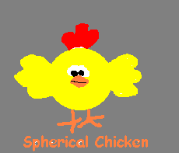
Engineering Approximations
The engineering value system works like this: The fastest, legal and ethical method that gives me an answer which is accurate enough, is the best method.
One goal of this course is to move you further along the road to thinking like an engineer. This will not be easy.

Slide 10
Introduction to Electronics
Read Chapter 1 in Sedra and Smith, 8th Edition. We will cover most of this material, although not always in the same order or with the same emphasis. Having more than one approach to the same material will hopefully help you to understand it better.

Slide 11

Introduction to Electronics
Why do we study Electronics?
  Answer: Because it is a required part of the curriculum.
OK. Why is Electronics a required part of the curriculum?
  Answer: Because electronic solutions to problems are reliable, flexible, easy to apply, and cheap.

Slide 12
Signals
Electronics is largely a field where we process signals. Therefore, we need to understand what we mean by the word “signal”.
Signals are a means of conveying information. Signals are inherently time varying quantities, since information is unpredictable, by definition. There is no such thing as a “dc signal,” or a “constant signal”, strictly speaking.

Slide 13


Signals
Example of information: Phone conversation.
Example of no information: Phone conversation between me and my grandmother. This conversation is completely predictable.

Slide 14
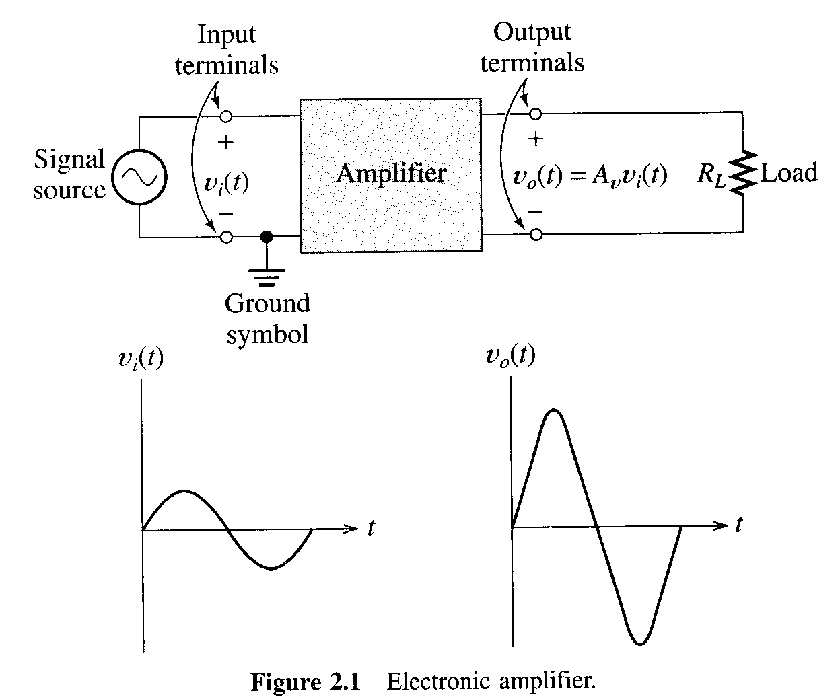
Signals
Electronics is largely a way to process signals. We use voltage or current to represent signals. As the signal changes with time, so does the voltage or the current.
Picture taken from Hambley, 1st Edition

Slide 15
Analog and Digital Signals
Signals are a means of conveying information. Signals are inherently time varying quantities, since information is unpredictable, by definition.
We can have analog and digital signals.
Analog signals are signals that can take on a continuum of values, continuously with time.
Digital signals are signals that take on discrete values, at discrete points in time.

Slide 16
Analog and Digital Signals
Analog signals are signals that can take on a continuum of values, continuously with time. Digital signals are signals that take on discrete values, at discrete points in time.
Most real signals are analog. Digital signals seem to be moving into more and more areas. Which is better, analog or digital?
Answer: It depends. Despite great debate, the answer depends on the application, the state of the art, and sometimes $. Eventually, most signals must be analog, but the choice of when and how to convert is the kind of thing an engineer is paid to decide.

Slide 17
Amplifiers
Amplifiers form the basis for much of this course. It makes sense that we try to understand them.
The key idea is that amplifiers give us power gain.

Slide 18
Amplifiers
Amplifiers form the basis for much of this course. It makes sense that we try to understand them.
The key idea is that amplifiers give us power gain.
How do we get an amplifier? How do we do it?

Slide 19
Amplifiers
How do we get an amplifier? How do we do it?
It requires a new kind of component. We invariably use the transistor. (Another type of device that would work is the vacuum tube.) We will study the physics of this “transistor” device later.

Slide 20
Amplifiers
Amplifiers require a new kind of component. We invariably use the transistor. We wish to consider the concept of how it works. Two key points:
We amplify signals, which are time varying quantities.
The amplified signals have more power. We need to get the power from somewhere. We get the power from what we call dc power supplies.

Slide 21
Lake Erie Model of Amplifiers
It is useful (I hope) to go to a mechanical analogy at this point. Consider the Lake Erie model of the amplifier, drawn on the board.
Note that without the lake (the constant potential power supply), the amplifier cannot work. That is where the power comes from.
We amplify signals, which are time varying quantities.

Slide 22
Lake Erie Model of Amplifiers
It is useful (I hope) to go to a mechanical analogy at this point. Consider the Lake Erie model of the amplifier, drawn on the board.
Note that without the lake (the constant potential power supply), the amplifier cannot work. That is where the power comes from.
We amplify signals, which are time varying quantities.
The amplified signals have more power. We need to get the power from somewhere. We get the power from what we call dc power supplies.

Slide 23
Lake Erie Model of Amplifiers
It is useful (I hope) to go to a mechanical analogy at this point. Consider the Lake Erie model of the amplifier, drawn on the board.
Note that without the lake (the constant potential power supply), the amplifier cannot work. That is where the power comes from.
We amplify signals, which are time varying quantities.
The amplified signals have more power. We need to get the power from somewhere. We get the power from what we call dc power supplies.
We need an electronic valve control. That is what a transistor, or vacuum tube, provides.

Slide 24
Notation
Note that we are beginning to make a big distinction between things that vary (signals) and things that stay the same (power supplies). We will use a shorthand notation to make these distinctions easy to convey. In fact, we use a variety of commonly accepted conventions in electronics. A set of conventions that we will use follows.

Slide 25
Notation
The reference point for voltages is usually defined, and called ground, or common. Ground is the more common term, although it may have no relationship to the potential of the earth.
Below we show some common symbols for common or ground.

Slide 26
Notation
v_{A}, V_{A}, v_{a}, V_{a} – all of these refer to the voltage at point A with respect to ground. Notice that there is a polarity defined by this notation. This notation also means that we do not have to label the + and – signs on a circuit schematic to define the voltage. Once point A is labeled, the voltages v_{A}, V_{A}, v_{a}, and V_{a}, are defined.
A
+
v_{A}
-

Slide 27
Notation
v_{AB}, V_{AB}, v_{ab}, V_{ab} - refer to the voltage at point A with respect to point B . Notice that there is a polarity defined by this. This notation also means that we do not have to label the + and – signs on a circuit schematic to define the voltage. Once points A and B are labeled, the voltages v_{AB}, V_{AB}, v_{ab}, and V_{ab}, are defined.
A
+
v_{AB}
-
B

Slide 28
Notation
Current polarities are shown with an arrow. Thus, current polarities must be defined, and the easiest way to do this is with an arrow on the circuit schematic.
i_{A}

Slide 29
Notation
v_{A} is the total instantaneous quantity (lowercase_{UPPERCASE}).
V_{A} is the dc component, nonvarying part of a quantity (UPPERCASE_{UPPERCASE}).
v_{a} is the ac component, varying part of a quantity (lowercase_{lowercase}).
The total instantaneous quantity is equal to the sum of the dc component and the ac component. That is, it is true that v_{A} = V_{A} + v_{a}.
A
+
v_{A}
-

Slide 30
Notation
v_{A} is the total instantaneous quantity (lowercase_{UPPERCASE}).
V_{A} is the dc component, nonvarying part of a quantity (UPPERCASE_{UPPERCASE}).
v_{a} is the ac component, varying part of a quantity (lowercase_{lowercase}).
BACKGROUND: Any quantity as a function of time can be broken down to a sum of a dc component (the average value or the mean value) and an ac component (a time-varying signal with zero mean). This is important to us in particular because signals are ac and power supplies are dc.

Slide 31
Notation
V_{a} is the phasor quantity (UPPERCASE_{lowercase}). (You don’t need bars.)
V_{AA} - Power supply, dc value, connected to terminal a . Note that the double subscript would otherwise have no value, since the voltage at any point with respect to that same point is zero.
Generally, lowercase variables refer to quantities which can/do change, and uppercase variables to constant quantities.
V_{a,rms} refers to an rms phasor value.

Slide 32
Definitions
The Phoenician says that:
Voltage gain A_{v} is the ratio of the voltage at the output to the voltage at the input.

Slide 33
Definitions
The Phoenician says that:
Current gain A_{i} is the ratio of the current at the output to the current at the input.

Slide 34
Definitions
The Phoenician says that:
Power gain A_{p} is the ratio of the power at the output to the power at the input.

Slide 35
Notation
The Phoenician says that:
A dB (deciBel) is a popular, logarithmic relationship for these gains.
Voltage gain in dB is 20(log₁₀|A_{v}|).
Current gain in dB is 20(log₁₀|A_{i}|).
Power gain in dB is 10(log₁₀|A_{p}|).
Some people try to explain the factors of 10 and 20. These explanations are true, but bizarre, and somewhat beside the point. We simply need to know them.

Slide 36
Definitions
Voltage gain in dB is 20(log₁₀|A_{v}|).
Current gain in dB is 20(log₁₀|A_{i}|).
Power gain in dB is 10(log₁₀|A_{p}|).
The key is to get these values, especially the power gain, to be greater than 1 (or 0[dB]). Thus, we move to amplifiers next.
Target for End of 2nd lecture

Slide 37

Basic Amplifier Concepts
Section 1.4
It has been said, "The signal amplifier is obviously a two-port network." Is this obvious? Maybe, it will be more obvious if we define "port." Let's try.
An alcoholic beverage.
Sailor talk for left.
A city where sailors park
their boats, and look for
alcoholic beverages.
Two terminals of interest.

Slide 38
Basic Amplifier Concepts
Section 1.4
The signal amplifier is a two-port network, where a port is…
Two terminals of interest.

Slide 39
Basic Amplifier Concepts
An amplifier has a pair of terminals for the input voltage or current, and a pair for the output voltage or current. The following figures are taken from the Hambley text. The figure in the next slide is now Figure 1.15 in the 2nd Edition of Electronics, by Allan R. Hambley, Prentice-Hall, Inc., ISBN 0-13-691982-0.

Slide 40
Basic Amplifier Concepts

Slide 41
Amplifier Models
Section 1.5 in Sedra and Smith, 8th Edition
Amplifiers are represented in circuit models as dependent sources. There are four kinds of these, and any can be used. (Review question: Can the source transformation theorem be used with dependent sources? Ans: Yes.) Thus, there are four versions of ideal amplifier equivalent circuits. The following figures are taken from the Hambley text, Figs. 1.17, 1.28, 1.29, and 1.30.
These diagrams are similar to those in Table 1.1 on page 28 of the 8th Edition of Sedra and Smith. However, in that table, they ground the input and output in all such amplifier models. While this is commonly the case, it is not always the case. We will use the Hambley approach in this course.

Slide 42
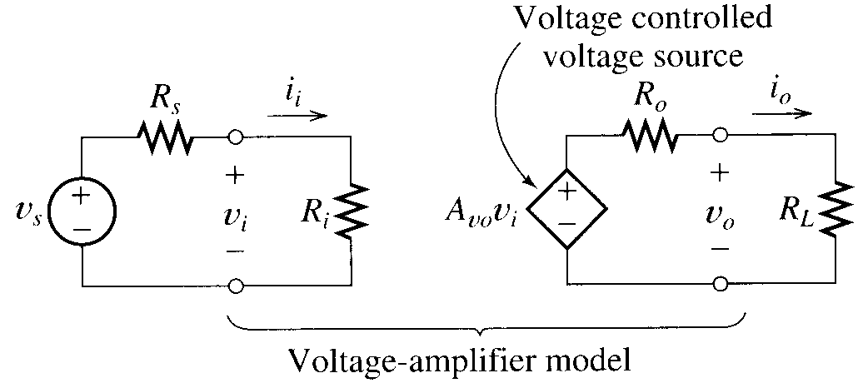
Amplifier Models
This is the voltage amplifier, shown with a source and a load.

Slide 43
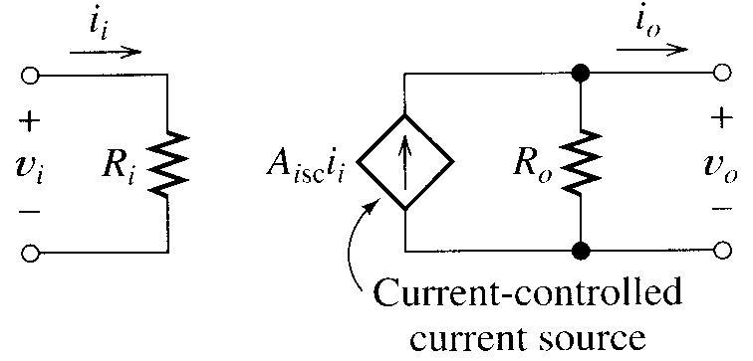
Amplifier Models
This is the current amplifier, shown without a source and a load.

Slide 44
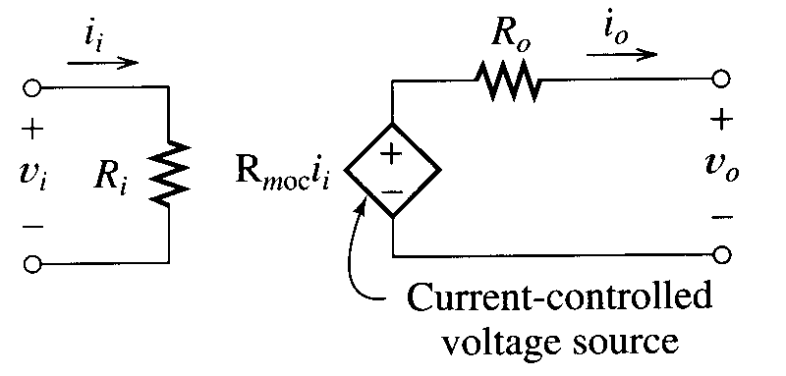
Amplifier Models
This is the transresistance amplifier, shown without a source and a load.

Slide 45
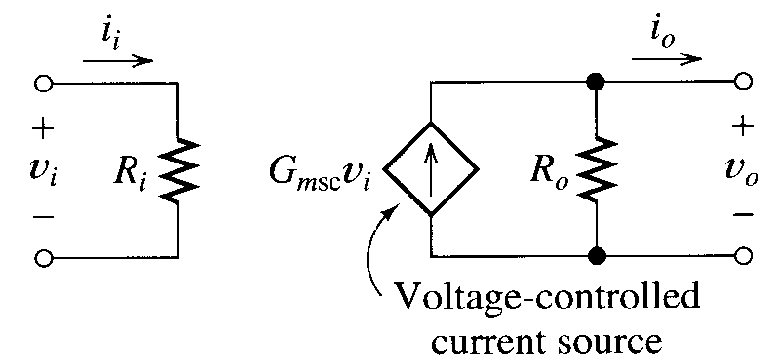
Amplifier Models
This is the transconductance amplifier, shown without a source and a load.

Slide 46
Amplifier Models
There are two things that always happen when you use an amplifier.
1) You have a source.
2) You have a load.
The source can be represented as a Thévenin or Norton equivalent. The load can be represented as a resistance/impedance.

Slide 47
Amplifier Models
There are two things that always happen when you use an amplifier.
1) You have a source.
2) You have a load.
The key issue is going to be the relationship between the source and the input of the amplifier, and between the load and the output of the amplifier.

Slide 48
Amplifier Models
There are two things that always happen when you use an amplifier.
1) You have a source.
2) You have a load.
We will define two kinds of gains, one with load and source connected, and one without. We will call the first one the loaded gain, and the other one the no-load gain.

Slide 49
Basic Amplifier Concepts
There are two things that always are there in an amplifier, even if we sometimes neglect them. The Phoenician says that:
1) Input resistance is the Thévenin resistance seen looking into input port, with the load in place.
2) Output resistance is the Thévenin resistance seen looking into the output port, with the source in place.
Note: We can restate both of the above with “impedance” inserted for “resistance” as well.

Slide 50
Basic Amplifier Concepts
In these lecture notes, as in many other places, we will use the terms “resistance” and “impedance” in a way that may appear to indicate that they are synonyms. They are not. It is assumed that you will know what we mean, that you understand when each term should be used, and that it is possible to transform to and from the phasor domain as needed.

Slide 51
Ideal Amplifiers
Let’s be careful about our use of the word “ideal”. The word ideal will mean different things depending on what word the adjective is modifying. Specifically:
An ideal amplifier will be an amplifier where
R_{i} = 0 or ∞
and
R_{o} = 0 or ∞.

Slide 52
Ideal Amplifiers
Let’s be careful about our use of the word “ideal”. The word ideal will mean different things depending on what word the adjective is modifying. Specifically:
The ideal gain for an amplifier model (in other words, the situation is ideal, but the amplifier is not ideal) will be where
R_{S} = 0 or ∞
and
R_{L} = 0 or ∞.

Slide 53
Ideal Amplifiers
So, for example, for an ideal voltage amplifier,
R_{i} = ∞
and
R_{o} = 0.
(Prove to yourself that this will maximize the signal gain for a voltage signal at the input, and a voltage signal at the output.)

Slide 54
Ideal Amplifiers
To take the other case, for example, for any non-ideal voltage amplifier the ideal gain occurs when,
R_{L} = ∞
and
R_{S} = 0.
(Prove to yourself that this will maximize the signal gain for a voltage signal at the input, and a voltage signal at the output.)

Slide 55
Circuit Models for Amplifiers
Table 1.1 on page 28 of the 7th Edition of the Sedra and Smith text summarizes the characteristics of ideal amplifiers.
Amplifier Type
Input Impedance
Output Impedance
Gain Parameter
Voltage
∞
0
A_{vo}
Current
0
∞
A_{is}
Trans-conductance
∞
∞
G_{m}
Trans-resistance
0
0
R_{m}
Notes:
The symbols for the Gain Parameter varies from textbook to textbook.

Slide 56
Example
For the amplifier situation given on the board:
a) Find ideal voltage gain of the amplifier, and the actual voltage gain, v_{o}/v_{s}, both in dB.
b) Find the power gain, p_{load}/p_{source} in dB.
c) Find the actual transconductance, i_{o}/v_{s}. Note that the transconductance is defined, even for a voltage amplifier.
d) Convert the voltage amplifier to a transconductance amplifier.
e) Find the transconductance for the converted amplifier.

Slide 57
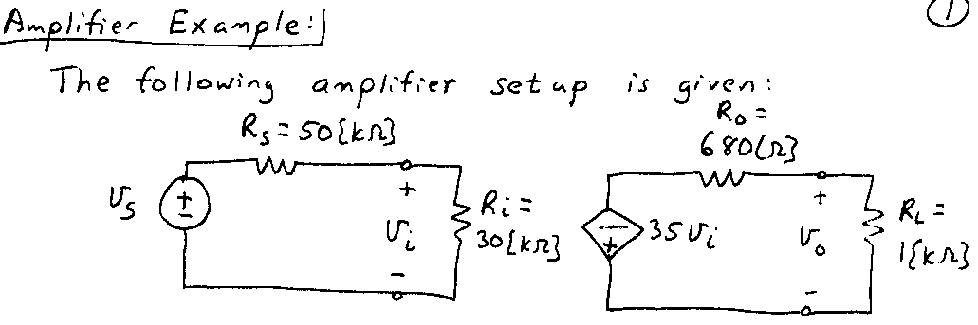
Example
The circuit for the amplifier example is:
i_{o}
Target for End of 3rd lecture

Slide 58
Amplifier Saturation
Let’s reconsider the Lake Erie Model. What will happen if I keep turning the valve, even when it is all the way closed?
Ans: It will break, silly.
Yes, yes. But what effect will it have?
Ans: No effect. The valve can't be more closed. A similar thing occurs for all the way open. It will stop affecting the flow in either case.

Slide 59
Amplifier Saturation
With amplifiers, we call this saturation. The output voltage will not go higher than the higher power supply voltage, and will not go lower than the lower power supply voltage. If the input is large enough to make this happen, the amplifier stops obeying the models we have given.

Slide 60
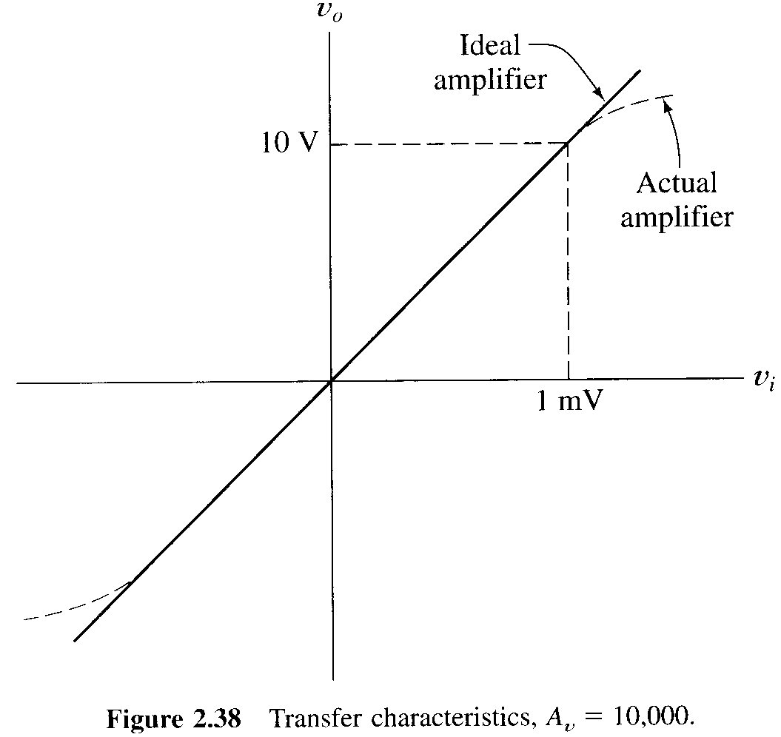
Amplifier Saturation
With amplifiers, we call this saturation. The output voltage will not go higher than the higher power supply voltage, and will not go lower than the lower power supply voltage.
A typical case is given in the following diagram, taken from the Hambley text, first edition.

Slide 61
Amplifier Saturation

Slide 62
Amplifier Saturation
The Phoenician says: A transfer characteristic is a plot of the output versus the input. It is usually, but not always, output voltage versus input voltage. It could be output current versus input voltage, etc.

Slide 63
Amplifier Saturation
The saturation levels are close to, but generally not quite at, the power supply levels. Outside the linear region between the saturation levels, the amplifier will not act like an amplifier anymore.

Slide 64
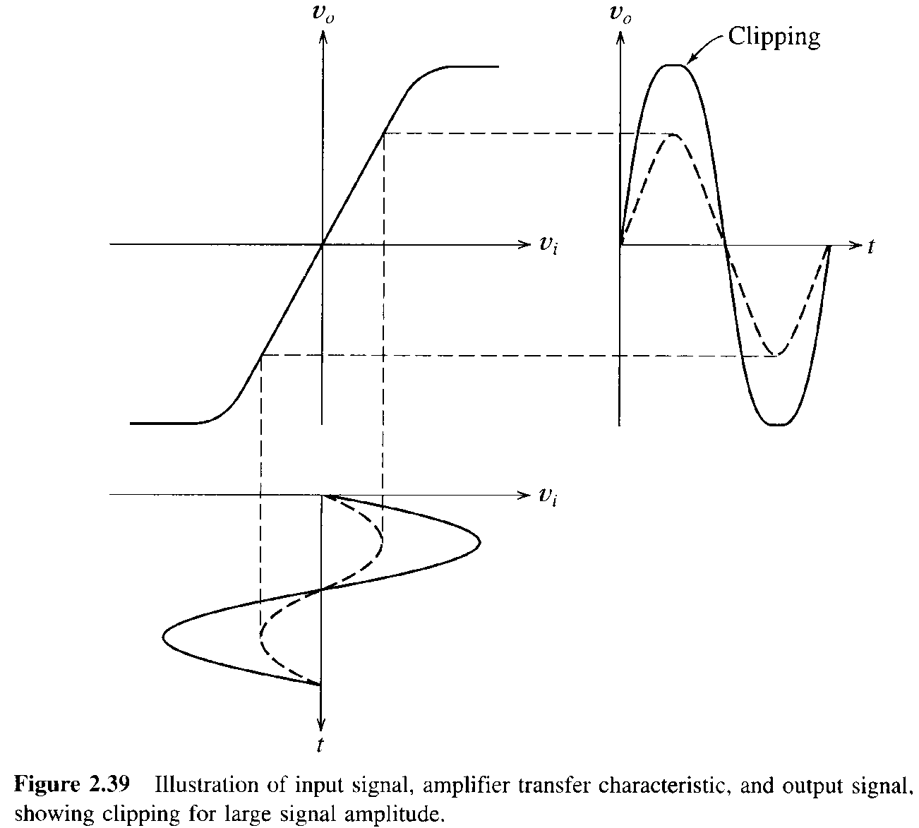
Amplifier Saturation
This diagram shows what happens to signals when an input which is too large is applied. In this case, the output is distorted. This form of distortion is called clipping.

Slide 65

Amplifier Saturation

Slide 66
Amplifier Saturation
Take care with our notation, starting immediately. I believe that Hambley made an error in his choice of axis labels for the transfer characteristic. The behavior being portrayed here is a total quantity, that includes signals and, in general, non-signals. So, the transfer characteristics should be labelled as v_{O} and v_{I}. The signals versus time, however, are signals, and are labelled appropriately (v_{o} and v_{i}). Here is a corrected version. Sedra and Smith follows this approach.

Slide 67
Amplifier Saturation
Look at this transfer characteristic. Because the plot is a straight line, we call it a linear amplifier. Actually, the amplifier is linear only in the range where the line is straight. This is our first glimmer of the subject of nonlinear circuits, which is our next topic.

Slide 68

BIASING - a Fundamental Concept
Many nonlinear networks can be treated as linear if used (or analyzed) only in areas of their characteristic curves where they are linear. Typically these areas are not at zero values of voltage or current. To get the device into this area, we apply a dc component of voltage or current to get it into that area. This is called biasing.

Slide 69
BIASING
We will look at this now in terms of amplifiers. Later, we will generalize to the idea of biasing for devices as well. So, we will return to this concept when we study diodes (two terminal device), and again when we study transistors (three terminal device).

Slide 70
BIASING
Once biased into a region with straight line characteristic curves, a nonlinear amplifier can be treated as a linear amplifier. Then, all the linear circuit analysis techniques that we used in the Circuit Analysis (ECE 2201 and 2202) courses will be applicable, as long as we use small enough signals so that we don't leave this special area. Note again that this is a concept tied into the notion of signals, or voltages and currents that are changing with time.

Slide 71
BIASING
These small enough signals are defined as small signals. The Phoenician tries to be clear when he/she can.
The dc component that we add is called the quiescent point, or Q point, since it is the value for no signal (when nothing happens, and all is quiet). The region around the quiescent point in the characteristic curve where the network remains linear is called the operating region.

Slide 72
BIASING
We can apply a bias to obtain an operating region around a quiescent point, or Q point, so that the response to small signals is approximately linear.
Watch for these key words. Many problems require that you know the meaning of the words to be able to solve problems.

