Slide 1
ECE 3355 Electronics
Lecture Notes
Set 3 – Version 34
Frequency Response and Bode Plots
Dr. Dave Shattuck
Dept. of ECE, Univ. of Houston

Slide 2
Fourier's Theorem
Fourier's Theorem says that any physically realizable signal can be represented by, and is equivalent to, a summation of sinusoids of different frequencies, amplitudes and phases.
Any physically realizable signal translates to any voltage or current, as a function of time, that we can produce or measure.
Repeat after me: 4-E-A.

Slide 3
Fourier's Theorem
Fourier's Theorem has profound implications, and represents a significant paradigm shift for electrical engineering.
We can think of any signal in terms of its frequency components, which are the amplitudes of the sine waves at that frequency. We can find of the response of an amplifier to sinusoids and predict the response to any signal.

Slide 4

Fourier's Theorem
Fourier's Theorem has profound implications, and represents a significant paradigm shift for electrical engineering.
We can think of any signal in terms of its frequency components, which are the amplitudes of the sine waves at that frequency. We can find of the response of an amplifier to sinusoids and predict the response to any signal.
What’s a paradigm?

Slide 5

What are paradigms?
About 20 cents.
Get it? “Pair a dimes?” Okay, so it is not very funny…

Slide 6

Fourier's Theorem
Fourier's Theorem has profound implications, and represents a significant paradigm shift for electrical engineering.
We can think of any signal in terms of its frequency components, which are the amplitudes of the sine waves at that frequency. We can find of the response of an amplifier to sinusoids and predict the response to any signal.
What’s a paradigm? A paradigm is a way of thinking about something. A paradigm shift is a change in a way of thinking about something.

Slide 7
Fourier's Theorem
Fourier's Theorem has profound implications, and represents a significant paradigm shift for electrical engineering.
We can think of any signal in terms of its frequency components, which are the amplitudes of the sine waves at that frequency. We can find of the response of an amplifier to sinusoids and predict the response to any signal.
All of this is made more important by the power of phasor analysis, which makes the analysis of sinusoids relatively easy and quick.

Slide 8
Frequency Response Notation
To agree with the text, we will use the notation of uppercase variables with lowercase subscripts for phasors. I will not use bold face for the variables when I am writing by hand but will use it for the text in these notes, to agree with the textbook.
The phasor of v_{a} will be V_{a}.

Slide 9
Frequency Spectrum
A frequency spectrum of a signal is the plot of the amplitude of each frequency component, plotted vs frequency. We can also plot the phase vs frequency. This is often useful, but in other situations, it can be ignored. It depends.
We can also plot the frequency response of a circuit to signals versus frequency, and this will be our emphasis in this course. Let us define some more terms.

Slide 10
Transfer Function
The Phoenician says: The Transfer Function is the ratio of the output phasor to the input phasor for a circuit. This is also called the frequency response of the circuit.

Slide 11
Transfer Function
Note that H(ω) is a ratio of two complex quantities, so must be complex as well.
Thus, H(ω) must have a magnitude and a phase. By the rules of complex arithmetic, we have these relationships.
We will find it useful to plot |H(ω)| vs ω, and also, but less often, useful to plot ∠H(ω) vs ω.

Slide 12
Transfer Function
The Transfer Function is the ratio of the output phasor to the input phasor for a circuit. This is also called the frequency response of the circuit. Let us consider a plot of the magnitude of the frequency response as a function of ω.

Slide 13
Passband and Bandwidth
We often call the relatively flat area where the circuit or amplifier is usually used, the passband. The value in this area is called the passband response, or the passband gain. The range of ω where this passband is located is called the bandwidth.

Slide 14
Passband and Bandwidth
We often call the relatively flat area where the circuit or amplifier is usually used, the passband. The value in this area is called the passband response, or the passband gain. The range of ω where this passband is located is called the bandwidth.
Each of these values can be defined quantitatively. We often plot |H(ω)| in dB. Then, we get the 3dB bandwidth, which is the range of ω where the response is constant within 3[dB] of the passband response.

Slide 15
3dB Bandwidth
Stated explicitly, we identify a value which represents the gain in the passband. We express this gain in dB, and then subtract 3[dB] from that value.
The place where the response intersects this value (passband gain – 3[dB]) at the top of the passband, we call ω_{H}.
The place where the response intersects this value (passband gain – 3[dB]) at the bottom of the passband, we call ω_{L}.
The difference between these two values is the 3dB bandwidth, or

Slide 16
Filters
We often use circuits with responses that we categorize as a filter. This is where we have a response as a function of frequency with a specific characteristic.
lowpass filter - passes lower frequencies, and attenuates higher frequencies.
highpass filter - passes higher frequencies, and attenuates lower frequencies.
bandpass filter - attenuates higher frequencies, and attenuates lower frequencies.

Slide 17
Filter Example
But, how do we get a circuit which filters on the basis of frequency? Let's do an example problem. I will pick a lowpass RC circuit.
a) Find the transfer function, H(ω).
b) Find the amplitude of the transfer function.
c) Find the phase of the transfer function.
d) Describe the behavior of each as ω→0, and ω→∞.

Slide 18
Filter Example
How do we get a circuit which filters on the basis of frequency? I will pick a lowpass RC circuit.
a) Find the transfer function, H(ω).
Solution: Apply the voltage divider rule (in the phasor domain), and we get:

Slide 19
Filter Example
How do we get a circuit which filters on the basis of frequency? I will pick a lowpass RC circuit.
b) Find the amplitude of the transfer function.

Slide 20
Filter Example
How do we get a circuit which filters on the basis of frequency? I will pick a lowpass RC circuit.
c) Find the phase of the transfer function.

Slide 21
Filter Example
How do we get a circuit which filters on the basis of frequency? I will pick a lowpass RC circuit.
d) Describe the behavior of each as ω→0, and ω→∞.
Actually, it is easier to look at this part by going back to the solution in a). Specifically, for small ω, then (1+jωCR) is approximately just 1, and
and for large ω, then (1+jωCR) is approximately just jωCR, and

Slide 22
Filter Example
Note that we have one behavior for the real part of the denominator dominant, and another for the imaginary part dominant.
In other words, we have one behavior for
ωCR >> 1,
and another for
ωCR << 1.
The crossover point is where
ωCR = 1, or where
ω = 1 / CR.
We call this the breakpoint frequency, for reasons which will become obvious later.

Slide 23
Filter Example
We think of having three different behaviors corresponding to these 3 cases.
First, for ω >> 1 / CR,
|H(ω)| = 1/ ωCR, and
∠H(ω) = -90°.
Then, for ω << 1 / CR,
|H(ω)| = 1, and
∠H(ω) = 0°.
Finally, for ω = 1 / CR,
and, ∠H(ω) = -45°.

Slide 24
Bode Plots
We now consider Bode Plots. With Bode Plots, we plot the magnitude in dB vs the log of ω or f, or ω or f on a log scale, and plot the phase (on a linear scale) vs the log of ω or f, or ω or f on a log scale.

Slide 25

Bode Plots
We now consider Bode Plots. With Bode Plots, we plot the magnitude in dB vs the log of ω or f, or ω or f on a log scale, and plot the phase (on a linear scale) vs the log of ω or f, or ω or f on a log scale.
Why logarithmic scales?
Answer: Because we think logarithmically.
No, really, why do we use logarithmic scales?
Answer: Because we think logarithmically. Prove this using dollar bills.
If this proof is not convincing, I don't think I can prove it to you.

Slide 26
Bode Plots
We now consider Bode Plots. With Bode Plots, we plot the magnitude in dB vs the log of ω or f, or ω or f on a log scale, and plot the phase (on a linear scale) vs the log of ω or f, or ω or f on a log scale.
Now, we can see why Bode plots are so useful. Bode plots tell us everything we need to know about the response of an amplifier, and gives it to us in the most useful possible way, the way that reflects best the values that we have. In the material that follows, we will show a way of plotting them quickly and easily.

Slide 27

Bode Plots
We now consider Bode Plots. With Bode Plots, we plot the magnitude in dB vs the log of ω or f, or ω or f on a log scale, and plot the phase (on a linear scale) vs the log of ω or f, or ω or f on a log scale.
Tells us everything. Most useful form. Easy to plot.
This is nerd heaven. I know I love Bode Plots. Maybe you will, too. See for yourself.

Slide 28
Straight-Line Approximations to Bode Plots
Bode Plots are plots of the magnitude in dB vs the log of ω or f, and the phase (on a linear scale) vs the log of ω or f.
Bode plots have become associated with the idea of the straight-line approximations to these same plots. Note again: The straight-line approximations are not the most important reason for using logarithmic plots, but they help make them even more useful.

Slide 29
Transfer Function Form
If we restrict ourselves to the case of real valued poles and zeroes, then we can obtain the transfer function as a ratio of the product of terms, as
For this course, the z's and p's will be real.

Slide 30
Breakpoints
These values, z’s and p’s, correspond to frequencies where the dominant part of the term is changing:
· from not frequency dependent
· to frequency dependent.
These are values of frequency where the behavior of that term changes. We will call these values breakpoints.

Slide 31
Behavior with Frequency
These values, z’s and p’s, correspond to frequencies where the dominant part of the term is changing from not frequency dependent to frequency dependent.
Note that for:
ω >> z_{n}, (jω + z_{n}) will increase linearly with ω, and thus H(ω) will increase linearly with ω.
ω >> p_{n}, (jω + p_{n}) will increase linearly with ω, and thus H(ω) will decrease linearly with ω.

Slide 32
Transferance of Dominance
These values, z’s and p’s, correspond to frequencies where the dominant part of the term is changing from not frequency dependent to frequency dependent. We would like to find a way to get these breakpoints quickly. In later courses, we will let jω→s. Then, we have

Slide 33
Poles and Zeroes
In this situation, the
z_{n}'s are zeroes, and
p_{n}'s are poles.
Actually, the z_{n}’s and p_{n}’s are the additive inverses of the zeroes and poles. For this course, we will define the poles and zeroes as values where the real and imaginary parts of a term are equal. These definitions will change in later courses.

Slide 34
Poles and Zeroes
For this course, these z_{n}'s and p_{n}'s will be real values. Strictly speaking, they are not really poles and zeroes of H(ω), since (jω + a) is not really zero for any real value of a. However, we are going to use the words “poles” and “zeroes”, but redefine them.

Slide 35
Poles and Zeroes
For this course, these z_{n}'s and p_{n}'s will be real values. Strictly speaking, they are not really poles and zeroes of H(ω), since (jω + a) is not really zero for any real value of a.
For this course, poles are frequency values where the real and imaginary parts of a term in the denominator are equal.

Slide 36
Poles and Zeroes
For this course, these z_{n}'s and p_{n}'s will be real values. Strictly speaking, they are not really poles and zeroes of H(ω), since (jω + a) is not really zero for any real value of a.
For this course, zeroes are frequency values where the real and imaginary parts of a term in the numerator are equal.

Slide 37
Poles and Zeroes
In other courses, we will worry about the signs of the poles and zeroes. For the definition we use in this course, we will not need to worry about these signs. Frequency values are positive, and all of the values will therefore be positive.

Slide 38
Straight Line Approximation Rules
Our approach to plotting Bode plots using the straight-line approximations:
1. Obtain the transfer function H(ω).
Find the poles and zeroes of H(ω). Poles are frequency values where the real and imaginary parts of a term in the denominator are equal. Zeroes are frequency values where the real and imaginary parts of a term in the numerator are equal.

Slide 39
Straight Line Approximation Rules
3. Plot the Magnitude Plot
A. Evaluate |H(ω)| at some ω. Pick an easy spot.
B. Plot the straight-line approximation.
At poles, the slope decreases by 20[dB/decade] as you move to the right.
At zeroes, the slope increases by 20[dB/decade] as you move to the right.

Slide 40
Straight Line Approximation Rules
3. C. (optional) Mark off some corrections to these straight lines, and plot more accurate curves.
At poles, label a point 3[dB] below the straight-line approximation.
At zeroes, label a point 3[dB] above the straight-line approximation.
Draw a smooth curve through these points using the straight lines as asymptotes.

Slide 41
Straight Line Approximation Rules
3. D. For multiple poles and zeroes, increase the effects proportionately.
If you have n_{z} zeroes, the slope increases by n_{z} x 20[dB/dec], and the correction at the breakpoint is n_{z} x 3[dB].
If you have n_{p} poles, the slope decreases by n_{p} x 20[dB/dec], and the correction at the breakpoint is n_{p} x 3[dB].

Slide 42
Straight Line Approximation Rules
4. Plot the Phase Plot
A. Evaluate ∠H(ω) at some ω. Pick an easy spot.
B. Plot the straight-line approximation.
At p/10, the slope decreases by 45[°/decade] as you move to the right, for 2 decades only (until 10p).
At z/10, the slope increases by 45[°/decade] as you move to the right, for 2 decades only (until 10z).

Slide 43
Straight Line Approximation Rules
4. C. (optional) Mark off some corrections to these straight lines, and plot more accurate curves.
At p/10, label a point 5.7° below the straight-line approximation.
At 10p, label a point 5.7° above the straight-line approximation.
At z/10, label a point 5.7° above the straight-line approximation.
At 10z, label a point 5.7° below the straight-line approximation.
Draw a smooth curve through these points using the straight lines as asymptotes.

Slide 44
Straight Line Approximation Rules
4. D. For multiple poles and zeroes, increase the effects proportionately.
If you have n_{z} zeroes, the slope increases by n_{z} x 45[°/dec], and the correction at the breakpoints is n_{z} x 5.7°.
If you have n_{p} poles, the slope decreases by n_{p} x 45[°/dec], and the correction at the breakpoints is n_{p} x 5.7°.

Slide 45
Sample Plots
The following plots are a sample Bode plot. The transfer function for these plots is
This transfer function has one zero, at 0, and two poles, one at 1 and one at 10,000. (The units are not shown, since this is an arbitrary example. In a real transfer function, the units would be indicated here and on all the plots that follow.) The magnitude plot, in dB, is given in the next slide. Note that the straight-line approximations, also drawn, approach the actual curve asymptotically away from the breakpoints.

Slide 46
Sample Plots
Magnitude in dB
Magnitude Plot
Straight line approx.
60
50
40
30
20
10
0
-10
0.001
0.01
0.1
1
10
100
1000
10000
100000
1000000
Frequency (log scale)

Slide 47
Sample Plots
The following plots are a sample Bode plot. The transfer function for these plots is
This transfer function has one zero, at 0, and two poles, one at 1 and one at 10,000. Now, if we plot the error between the actual plot and the straight-line approximation, we get the plot in the following slide.

Slide 48
Sample Plots

Slide 49
Sample Plots
The following plots are a sample Bode plot. The transfer function for these plots is
This transfer function has one zero, at 0, and two poles, one at 1 and one at 10,000. Now, if we plot the phase plot, we get the plot in the following slide.

Slide 50
Sample Plots
Phase (in degrees)
Phase Plot in Degrees
Straight line approx.
100
80
60
40
20
0
-20
-40
-60
-80
-100
10⁻²
10⁻¹
10⁰
10¹
10²
10³
10⁴
10⁵
10⁶
10⁷
Frequency (log scale)

Slide 51
Sample Plots
The following plots are a sample Bode plot. The transfer function for these plots is
This transfer function has one zero, at 0, and two poles, one at 1 and one at 10,000. Now, if we plot the error between the actual plot and the straight-line approximation, we get the plot in the following slide.

Slide 52
Sample Plots

Slide 53
Errors in Straight-Line Approximations
The largest errors occur where the straight-line approximation has a change in slope. In the magnitude plots, this happens at the locations of the poles and zeroes. In the phase plots, this happens at both a decade above and a decade below the locations of the poles and zeroes.

Slide 54
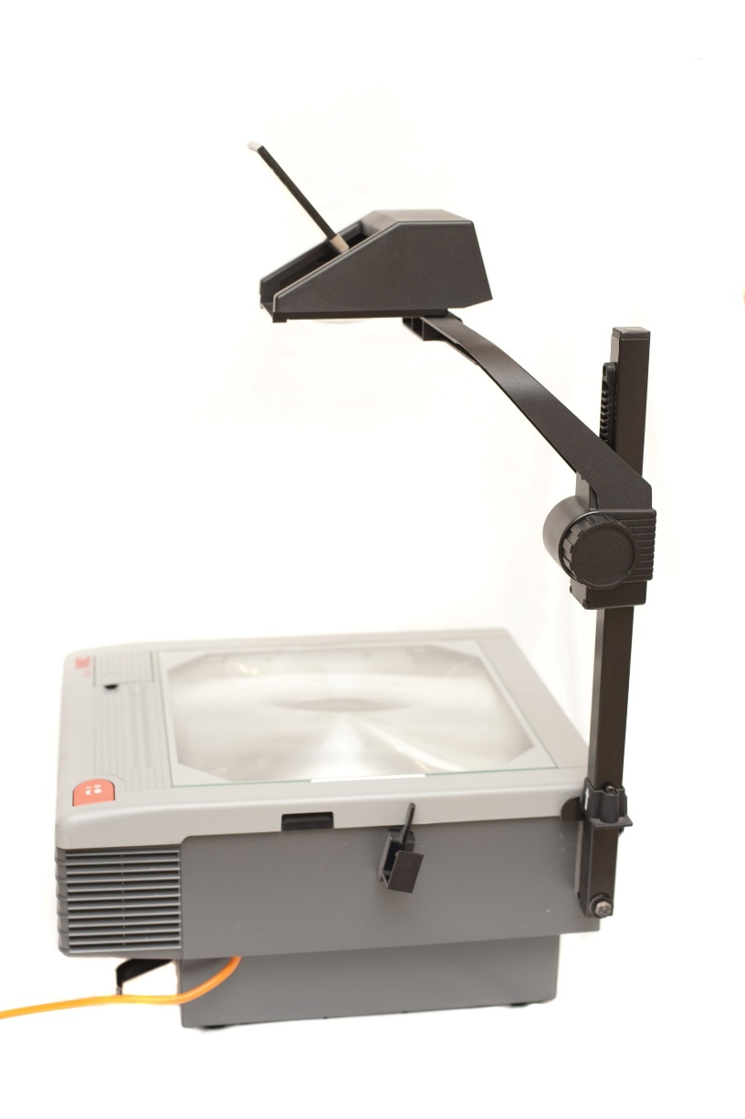
Examples
If you want to look at this data more carefully, it is available in a Microsoft Excel spreadsheet, called Bode_plot_example, which should be available on the course web page. Work on this problem using the overhead projector, showing how semilog graph paper works.
This Photo by Unknown Author is licensed under CC BY

