Slide 1
ECE 3355 Electronics
Lecture Notes
Set 6 – Version 10
Bipolar Junction Transistors
Dr. Dave Shattuck
Dept. of ECE, Univ. of Houston

Slide 2
Bipolar Junction Transistors
We will cover material from Chapters 6 and 7 from the 8th Edition of the Sedra and Smith text.
We will not, however, cover most of this material in the depth and detail that is present in the textbook. While reading the book will be useful, you will only be responsible for the material covered in class.

Slide 3
Overview of this Portion of the Course
Bipolar Junction Transistors (BJTs)
In this part, we will cover the following topics:
The structure and terminology for BJTs
Transistor action
Transistor characteristic curves and notation standards
DC analysis of transistors, large signal models
AC analysis of transistors, small signal models (covered in the next lecture set, #7)

Slide 4
Transistors
Transistors are the basis for amplifiers, for electronic switches, and anything where we need to have a dependent source.
BIPOLAR JUNCTION TRANSISTORS (BJTs) are also known as Junction Transistors, sometimes just as Transistors. These are made up of two pn junctions back-to-back. There are two kinds of BJT, npn and pnp.

Slide 5
Two Kinds of BJTs
There are two kinds of BJTs, called npn and pnp. Conceptually, they can be thought of as being built as shown at right. They are not really made this way.

Slide 6
Two Kinds of BJTs
There are two kinds of BJTs, called npn and pnp. Conceptually, they can be thought of as being built as shown at right. They are not really made this way.
Here, e = emitter
b = base
c = collector

Slide 7
The schematic symbols are:
Notice that the arrow distinguishes the emitter from the collector. The direction of the arrow distinguishes npn from pnp.

Slide 8
The schematic symbols are:
Notice that the arrow distinguishes the emitter from the collector. The direction of the arrow distinguishes npn from pnp. Mnemonic device: the arrows in these symbols point to the n region. The same thing happened with the diode.

Slide 9
Modes of Operation
We have four possible modes of operation of the BJT. They correspond to the two possibilities for the diode, which were forward biased ("on") and reverse biased ("off"). We will think about the transistor as being in one of these four modes, again based on the polarities of the voltages across the junctions. We will refer to the emitter-base junction (e-b) and the collector-base junction (c-b) in the table that follows.

Slide 10
Modes of Operation
Four possible modes of operation:
Mode e-b jct. c-b jct. Use
Active forward reverse amplifier
Cutoff reverse reverse switch, off pos.
Sat. forward forward switch, on pos.
Reverse reverse forward special
Active apps.

Slide 11
Modes of Operation
We only mention the Reverse Active mode here for completeness, and we will use it only much later with digital applications, specifically in TTL circuits. Its behavior is similar to that in the active region. We will ignore it for the time being.

Slide 12
Behavior in the Active Region
Now I would like to consider the behavior of the transistor in one of the regions. I will pick the active region for this, since the behavior there will be typical of the way we use transistors.
Assume that I have forward biased the
b-e junction, and reverse biased the b-c jct.

Slide 13
Behavior in the Active Region
Assume that I have forward biased the
b-e junction, and reverse biased the b-c jct.
The forward bias of the b-e junction:
a) favors the flow of majority carriers in the base into the emitter, and
b) favors the flow of majority carriers in the emitter into the base.

Slide 14
Behavior in the Active Region
Assume that I have forward biased the
b-e junction, and reverse biased the b-c jct.
The reverse bias of the b-c junction:
c) hampers the flow of majority carriers in the base into the collector, and
d) hampers the flow of majority carriers in the collector into the base.

Slide 15
Behavior in the Active Region
Assume that I have forward biased the
b-e junction, and reverse biased the b-c jct.
But, remember as well that the reverse bias of the b-c junction:
e) favors the flow of minority carriers in the base into the collector, and
f) favors the flow of minority carriers in the collector into the base.
The key item, and the one that we are going to emphasize is e).

Slide 16
Behavior in the Active Region
Assume that I have forward biased the
b-e junction, and reverse biased the b-c jct. This reverse bias of the b-c junction:
favors the flow of minority carriers in the base into the collector.
Even though we think of reverse bias as the case with no current flow, that case holds only for majority carriers. The reverse bias favors the flow of minority carriers, and would result in significant current if only there were more minority carriers around.

Slide 17
Behavior in the Active Region
The reverse bias of the b-c junction favors the flow of minority carriers in the base into the collector. Even though we think of reverse bias as the case with no current flow, that case holds only for majority carriers. The reverse bias favors the flow of minority carriers, and would result in significant current if only there were more minority carriers around. This is exactly what is happening in the base. There are lots and lots of minority carriers (as viewed by the base) arriving from the emitter (where they were majority carriers). We think of them being injected by the emitter into the base, where a large proportion of them are swept into the collector.

Slide 18
Behavior in the Active Region
The reverse bias of the b-c junction favors the flow of minority carriers in the base into the collector. There are lots and lots of minority carriers (as viewed by the base) arriving from the emitter (where they were majority carriers). We think of them being injected by the emitter into the base, where a large proportion of them are swept into the collector. Now, we have "lots and lots" of charge carriers moving. What determines how many of these charge carriers are moving? That is mostly determined by the base-emitter junction characteristics (voltage and current). By being careful in how we build the transistor, we can make the current in the base connector (base current) small compared to the other currents (emitter current and collector current).

Slide 19
Behavior in the Active Region
The reverse bias of the b-c junction favors the flow of minority carriers in the base into the collector. There are lots and lots of minority carriers (as viewed by the base) arriving from the emitter (where they were majority carriers). We think of them being injected by the emitter into the base, where a large proportion of them are swept into the collector. Now, we have many charge carriers moving. That is mostly determined by the base-emitter junction characteristics. By being careful in how we build the transistor, we can make the base current small compared to the other currents. If we do this, we can see that a small quantity (base current) can be used to control a larger quantity (collector current). This is an amplifier.

Slide 20
Current Polarities
At last, standard current polarities.
We will assume current polarities for a transistor, based on whether it is an npn or pnp transistor.

Slide 21
Definitions
The Phoenician says:
The percentage of charge carriers injected by the emitter into the base, and swept into the collector, is almost 100%. We name this parameter alpha, α, and define it as
α = i_{C} / i_{E} .
Typically α is in the range of 0.90 to 0.997 or so. It is close to 1, but less than 1.

Slide 22
Definitions
The Phoenician says:
Clearly, if i_{C} ≈ i_{E}, then i_{B} must be pretty small in comparison. We define another parameter, β, as
β = i_{C} / i_{B} .
As it turns out, β gets used even more than alpha. This is the commonly used figure of merit for a transistor.

Slide 23
Definitions
The values of α and β are dependent; you can use KCL to derive that:
β = α / (1 - α) .
These parameters are frequency dependent, although sometimes we ignore this. They are also temperature dependent, but we sometimes can ignore this, too.

Slide 24
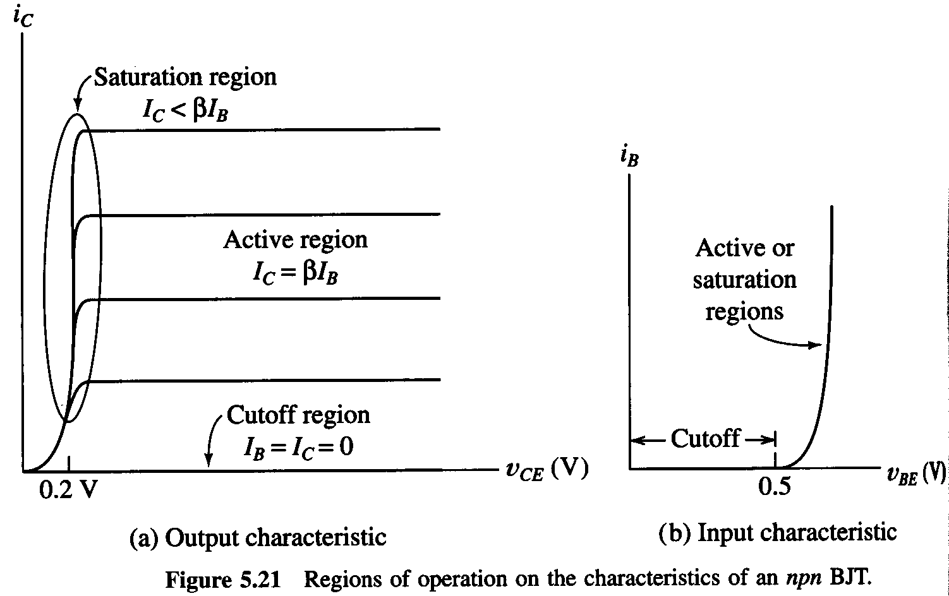
Characteristic Curves
The regions of operation.

Slide 25
Output Characteristic

Slide 26
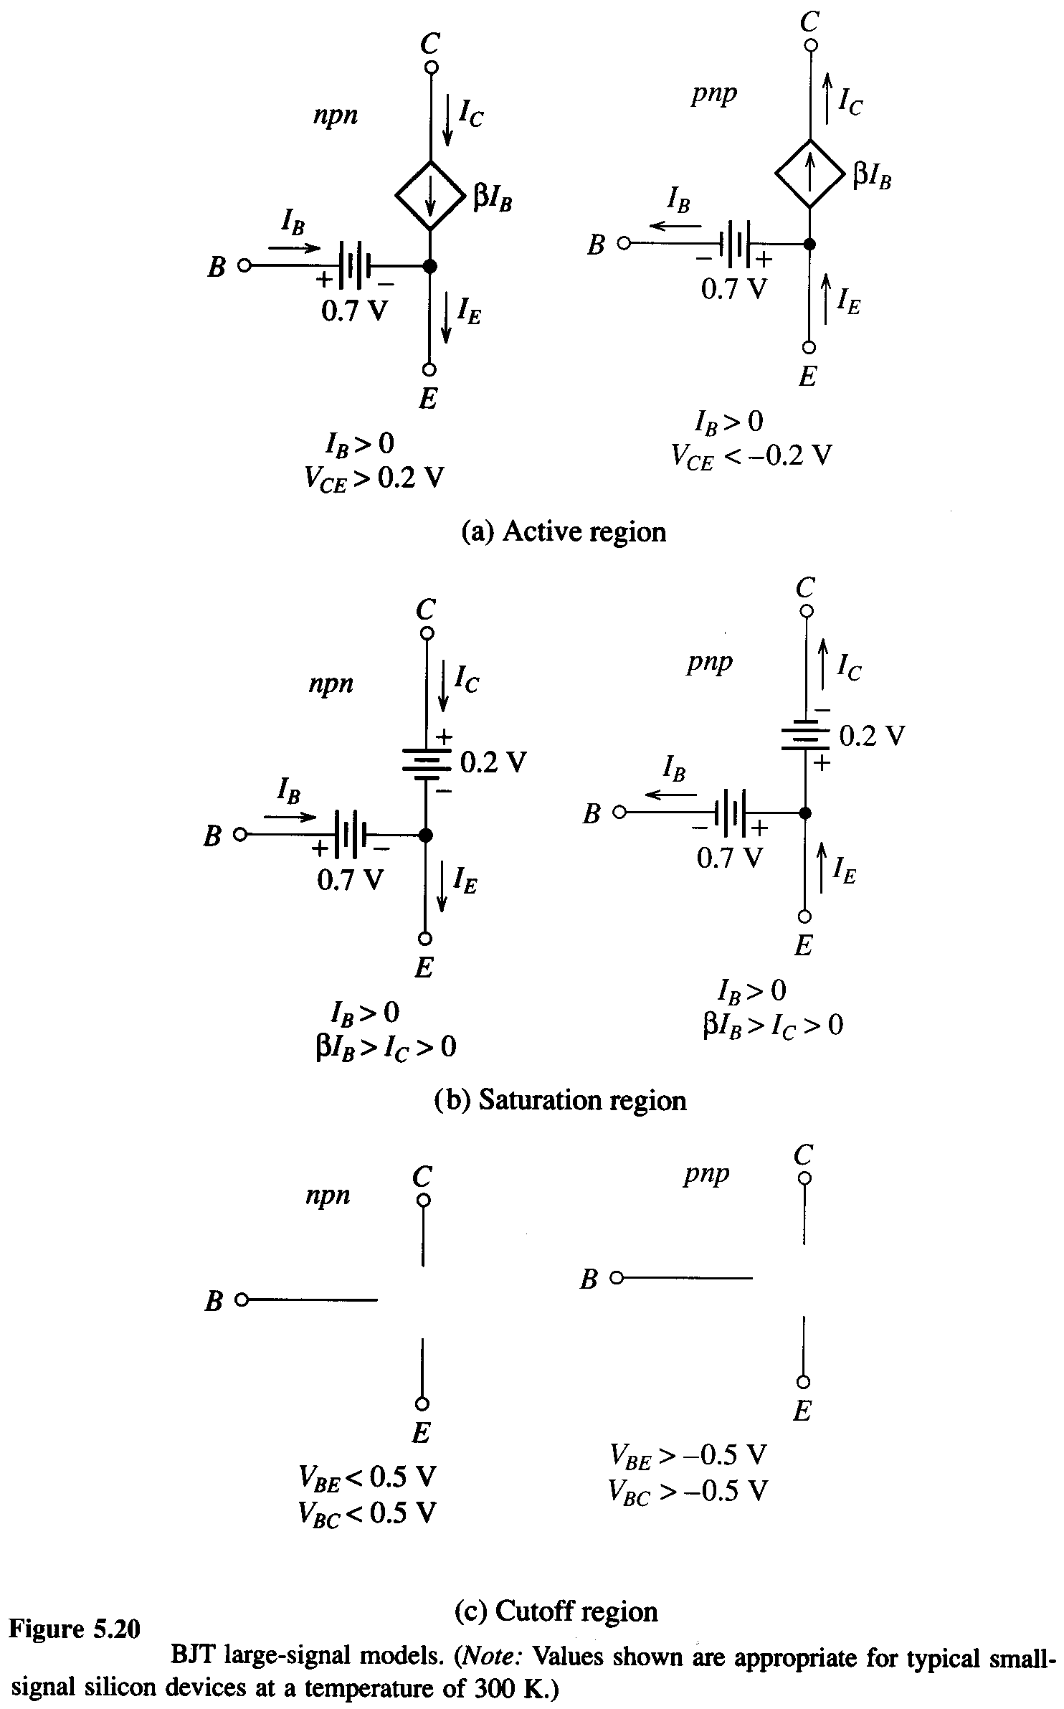
DC Analysis
These equivalent circuits are given in Fig. 4.19 in the Hambley text, Second Edition.

Slide 27
DC Analysis
These equivalent circuits are given in Fig. 4.19 in the Hambley text, Second Edition.

Slide 28
DC Analysis
These equivalent circuits are given in Fig. 4.19 in the Hambley text, Second Edition.

Slide 29
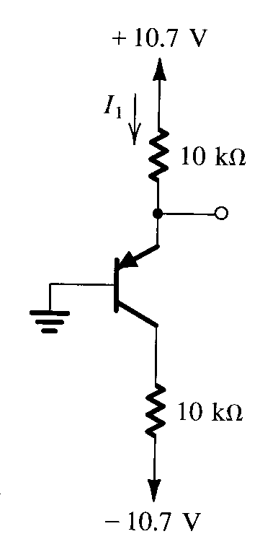
Examples
Let’s do some example problems. Assume β = 100.

Slide 30
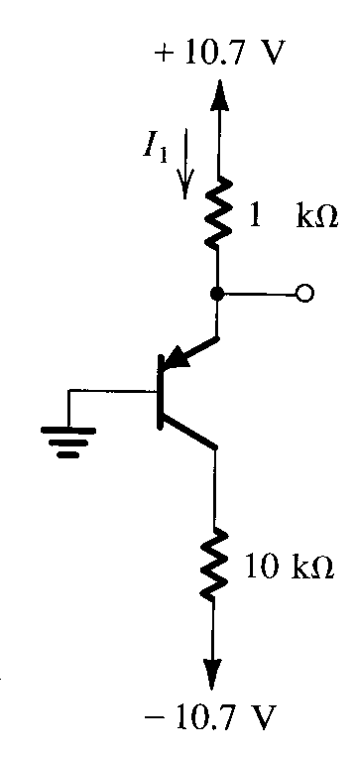
Examples
Let’s do some example problems. Assume β = 100.

Slide 31
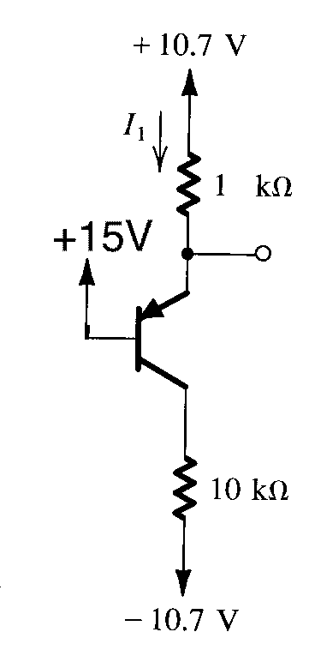
Examples
Let’s do some example problems. Assume β = 100.

Slide 32
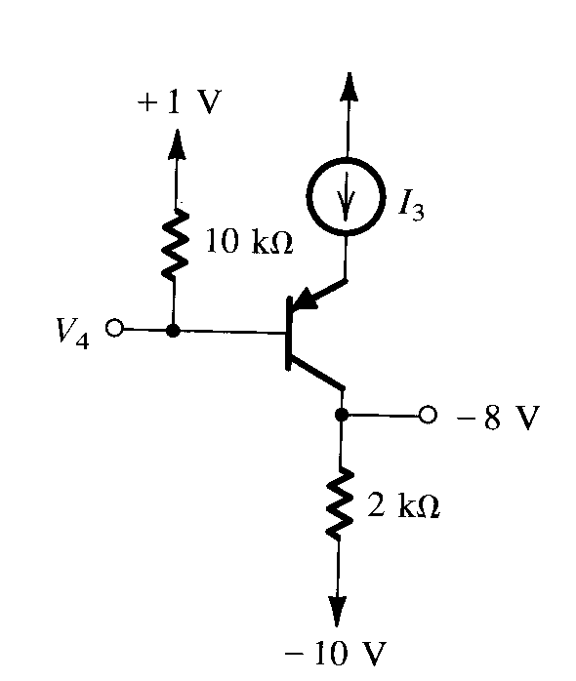
Examples
Let’s do some example problems. Assume β = 100.

Slide 33
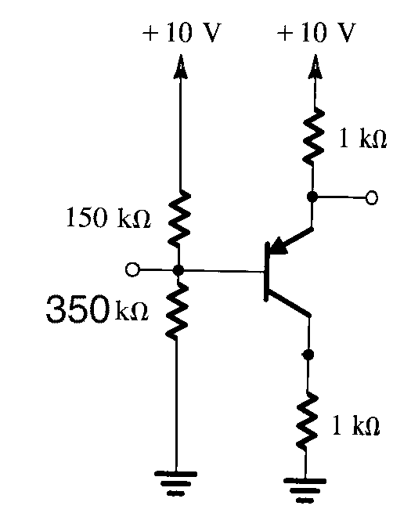
Examples
Typically, simple circuits use a voltage divider at base to set the dc bias conditions. It is usually a good idea to take the Thevenin equivalent of these circuits, with respect to ground, and use that to solve.
Assume β = 100.

Slide 34
Examples
Typically, simple circuits use a voltage divider at base to set the dc bias conditions. It is usually a good idea to take the Thevenin equivalent of these circuits, with respect to ground, and use that to solve.
Assume β = 100.

Slide 35
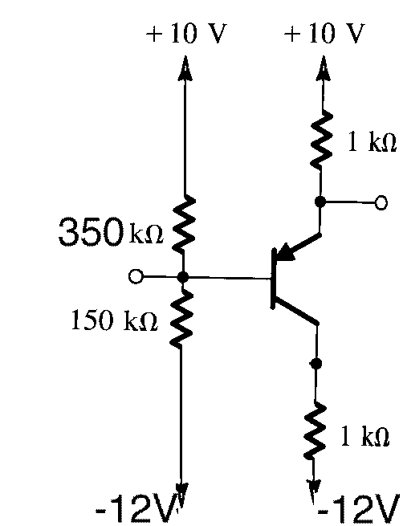
Examples
Typically, simple circuits use a voltage divider at base to set the dc bias conditions. It is usually a good idea to take the Thevenin equivalent of these circuits, with respect to ground, and use that to solve.
Assume β = 100.

Slide 36
Saturation
Many students have trouble with saturation at this point. (This is the saturation region of the transistor that I am speaking of, although many students feel saturated themselves, as well.) They have trouble understanding how the criterion
I_{C} / I_{B} < β
comes about. They also have trouble understanding how I_{C} can be positive if the bc junction is forward biased. The following thought experiment may be of benefit.

Slide 37
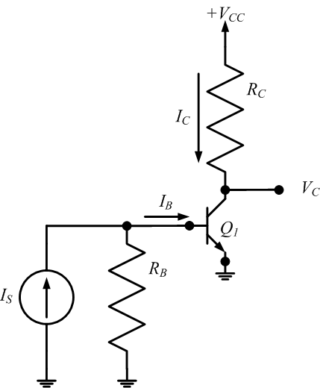
Saturation
Assume the simple circuit below. Assume that I_{S} is zero, or negative, and then is increased slowly.
Note that I_{S} needs to reach a high enough value so that the b-e junction will turn on, at 0.7[V]. This corresponds to a current of
(I_{S})R_{B} = 0.7[V], or
I_{S} = 0.7[V]/R_{B}.

Slide 38
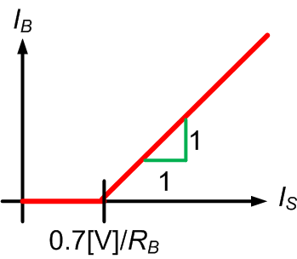
Saturation
Assume that I_{S} is zero, or negative, and then is increased slowly.
Note that I_{S} needs to reach a high enough value so that the b-e junction will turn on, at 0.7[V]. This corresponds to a current of
(I_{S})R_{B} = 0.7[V], or
I_{S} = 0.7[V]/R_{B}.

Slide 39
Saturation
Assume the simple circuit below. Assume that I_{S} is zero, or negative, and then is increased slowly.
Next, let us consider the collector current I_{C} as a function of I_{S}. Now, when the base current I_{B} is zero, so is the collector current. The collector current turns on at the same time as the base current, but increases with a slope of ß due to the current gain of the device.

Slide 40
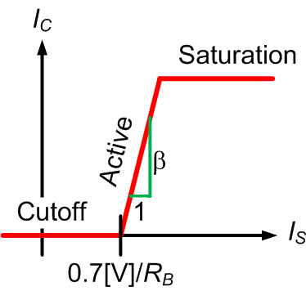
Saturation
Assume that I_{S} is zero, or negative, and then is increased slowly.
Next, let us consider the collector current I_{C} as a function of I_{S}. Now, when the base current I_{B} is zero, so is the collector current. The collector current turns on at the same time as the base current, but increases with a slope of ß due to the current gain of the device.

Slide 41
Saturation
Assume that I_{S} is zero, or negative, and then is increased slowly.
However, while I_{B} can increase without any limit, I_{C} is limited. Note that as I_{C} increases, the voltage across R_{C} increases, so the voltage V_{C} decreases. However, V_{C} will not go below V_{CE,SAT}.
Question: Why not?

Slide 42
Saturation
Assume that I_{S} is zero, or negative, and then is increased slowly.
However, V_{C} will not go below V_{CE,SAT}.
Question: Why not? Answer: Because current does not flow uphill. If V_{C} were less than V_{E}, current would flow out of the collector, which would mean flowing out of ground and up to a higher potential. This does not happen.

Slide 43
Saturation
Assume that I_{S} is zero, or negative, and then is increased slowly.
However, V_{C} will not go below V_{CE,SAT}.
Thus, I_{C} saturates, or stops increasing. This is why we call the region saturation.

Slide 44
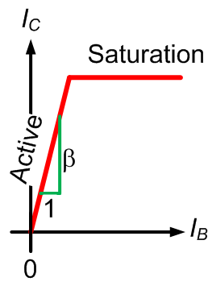
Saturation
So, now we plot I_{C} versus I_{B}, and we find that the ratio of I_{C} /I_{B} will be less than β when the transistor is in saturation. Look at the plot below.
The voltage V_{C} will not go below V_{CE,SAT}.
Thus, I_{C} saturates, or stops increasing. This is why we call the region saturation.

