Slide 1
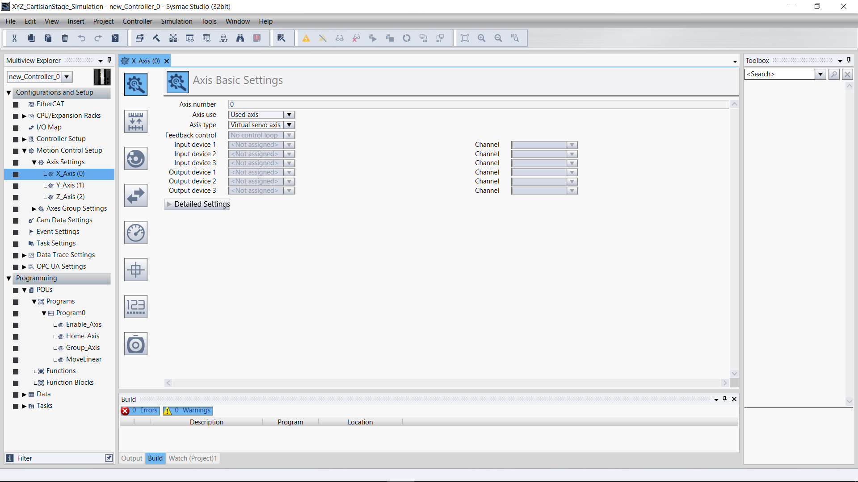
X-Axis – Axis Basic Settings

Slide 2
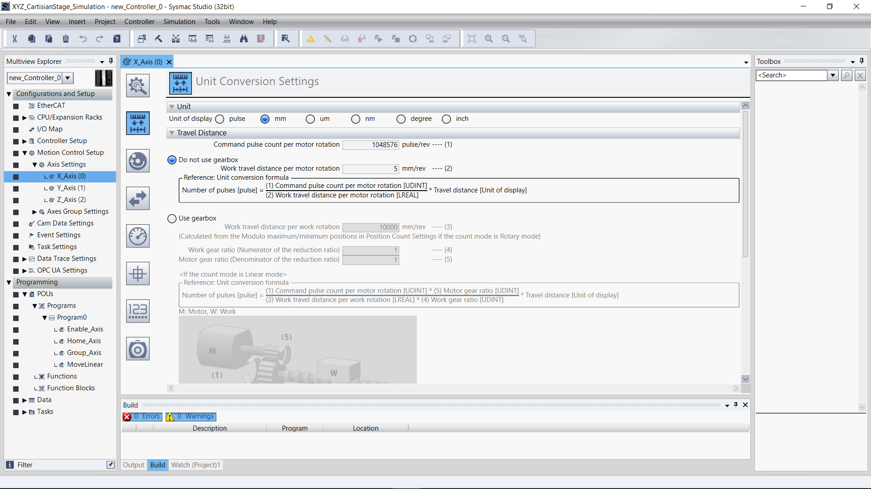
X-Axis – Unit Conversion Settings

Slide 3
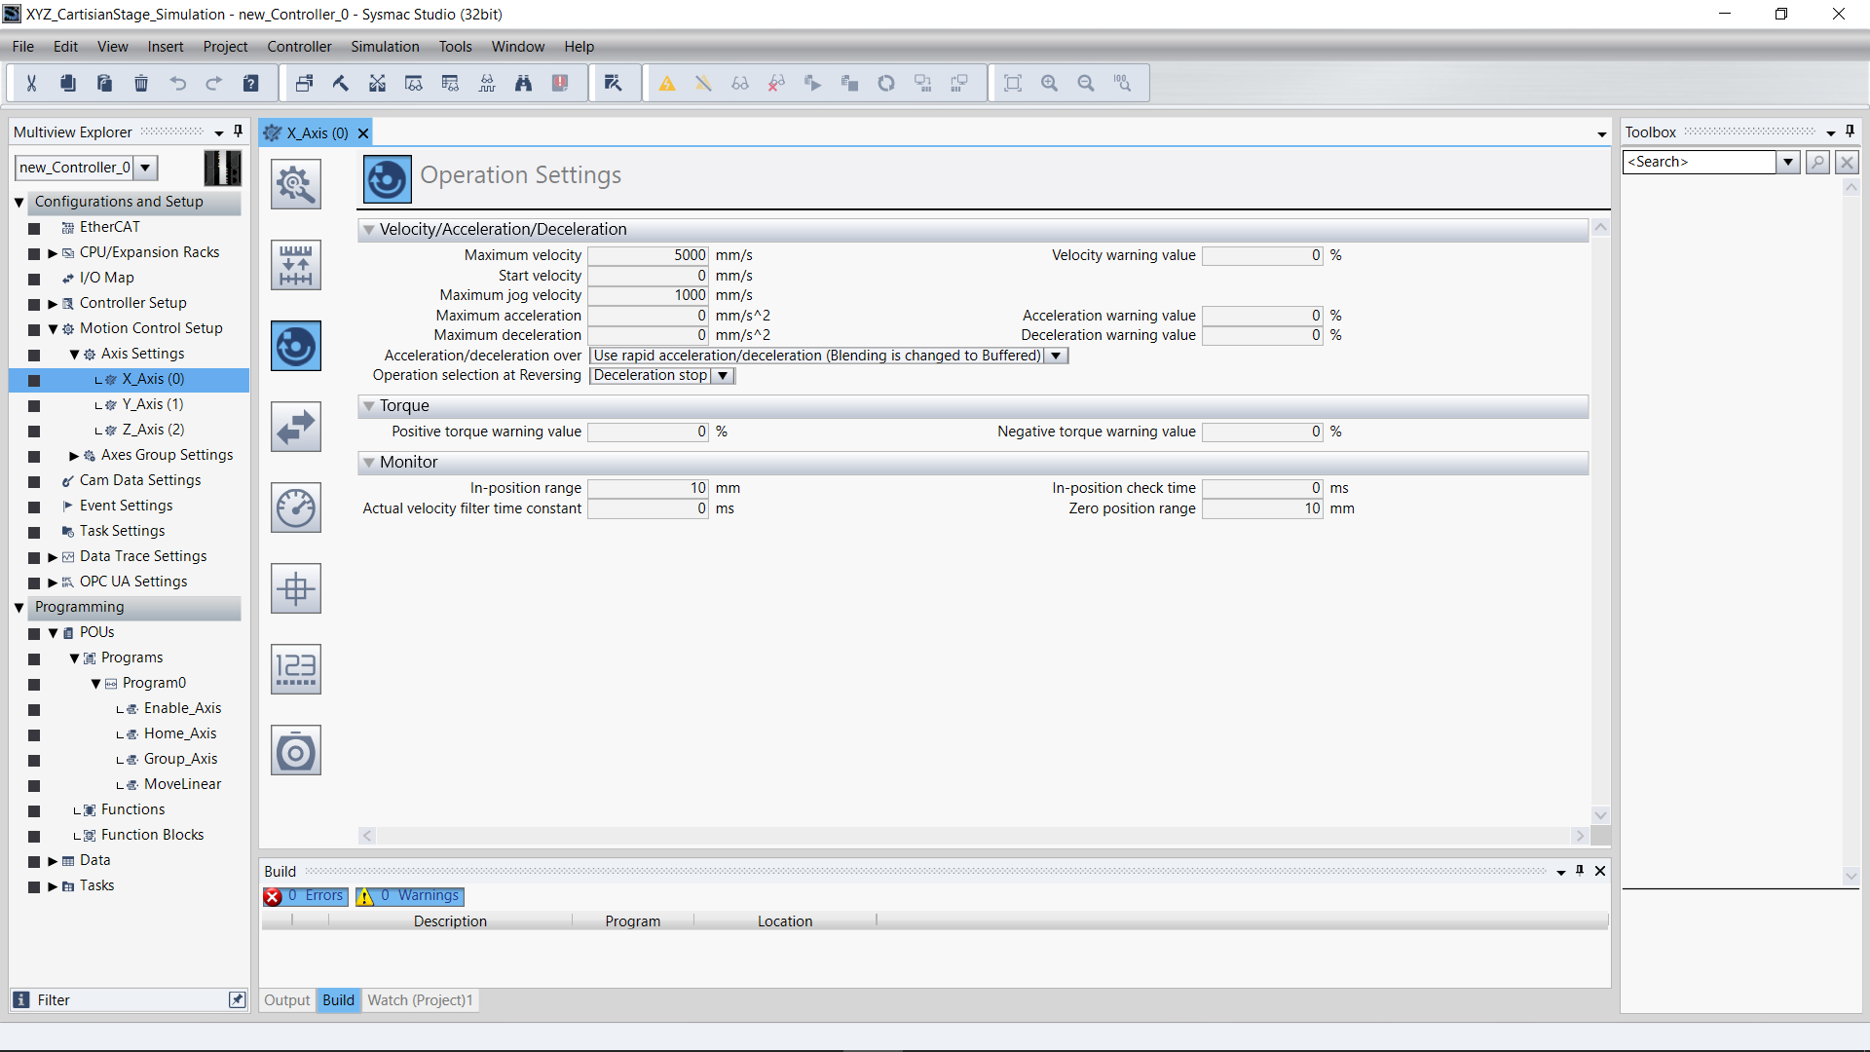
X-Axis – Operation Settings

Slide 4
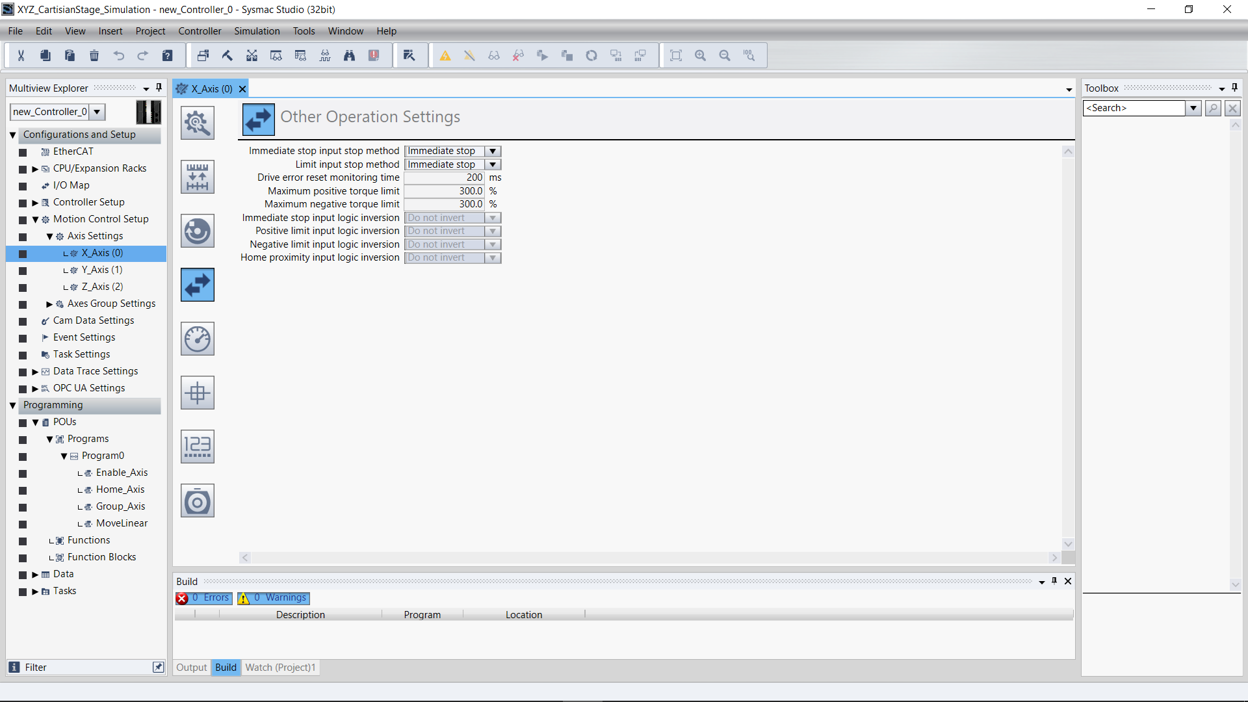
X-Axis – Other Operation Settings

Slide 5
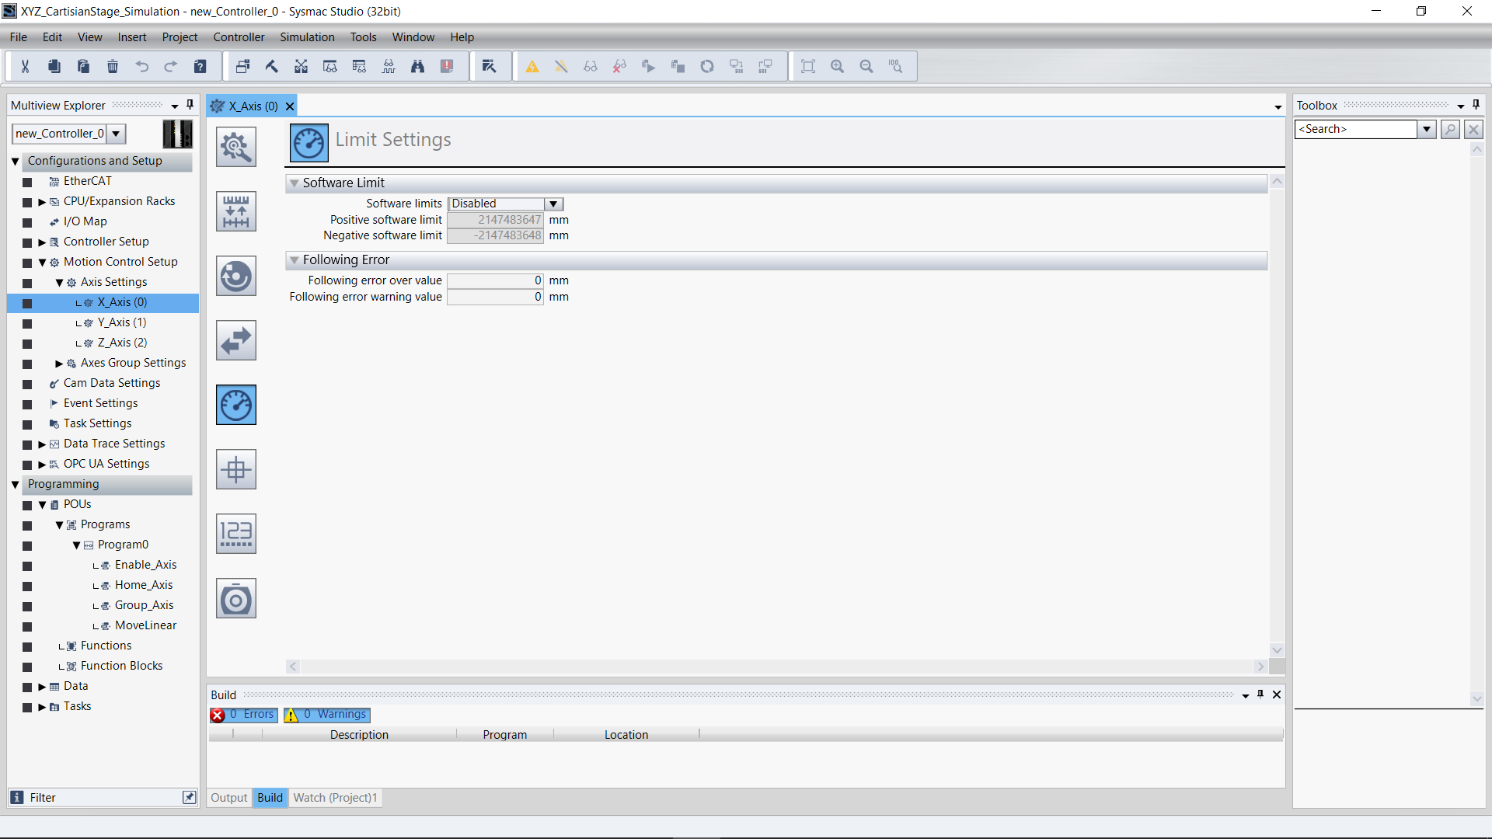
X-Axis – Limit Settings

Slide 6
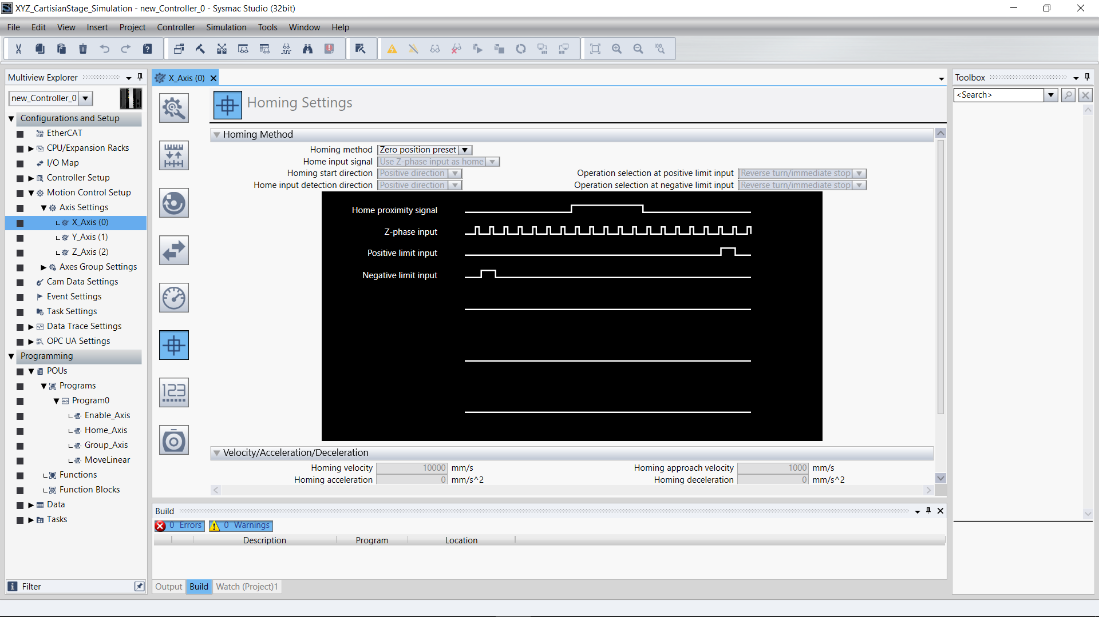
X-Axis – Homing Settings

Slide 7
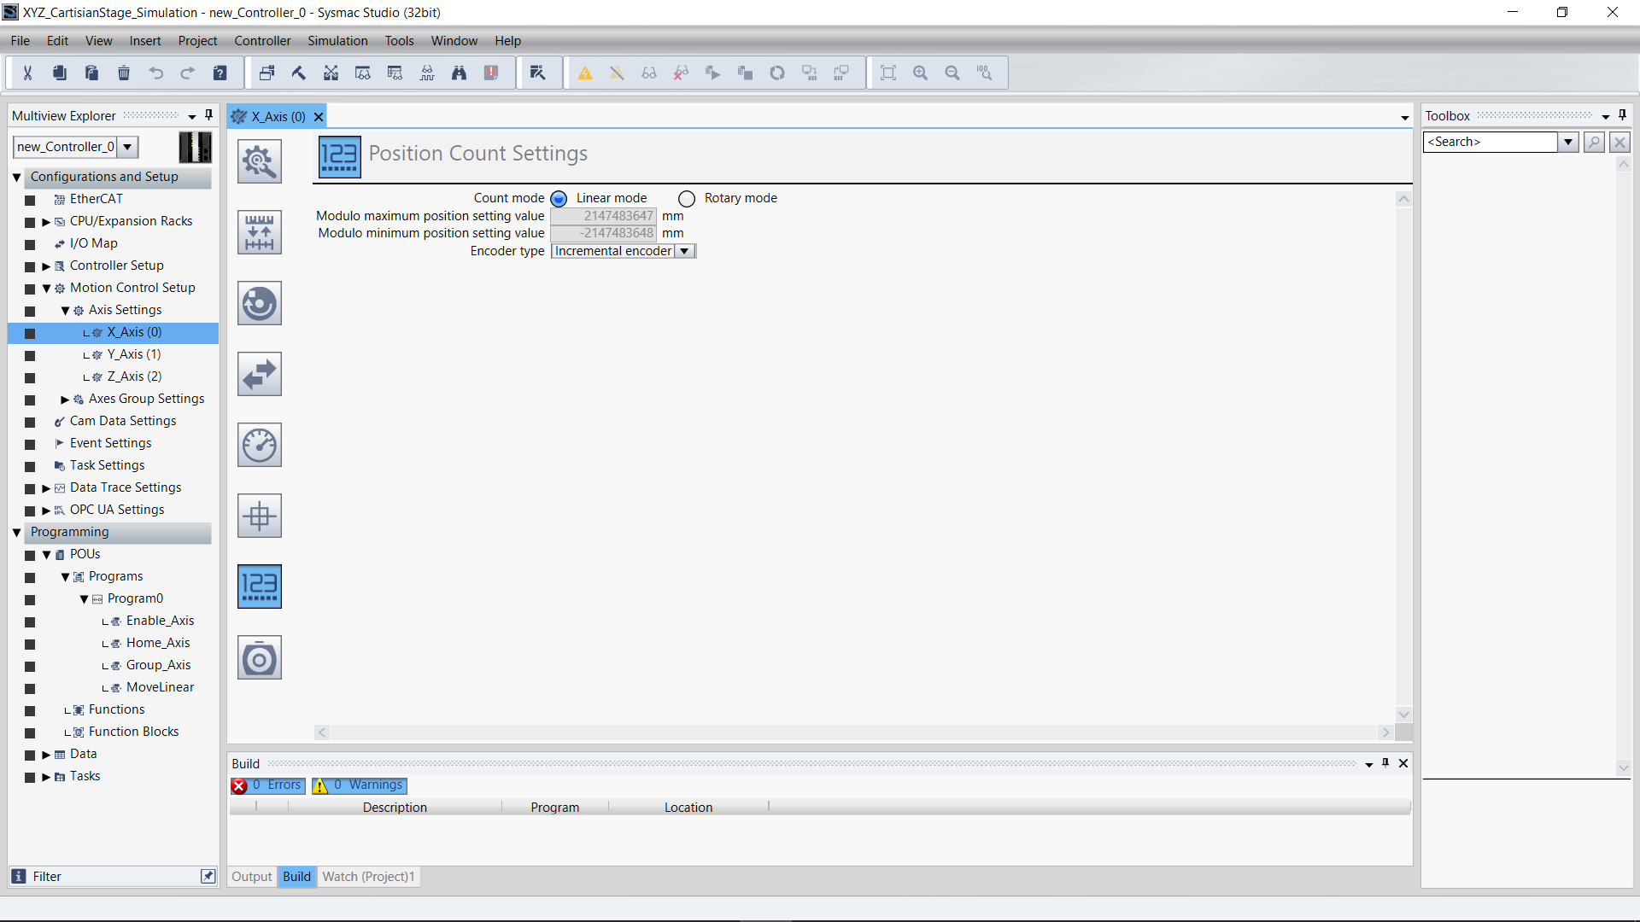
X-Axis – Position Count Settings

Slide 8
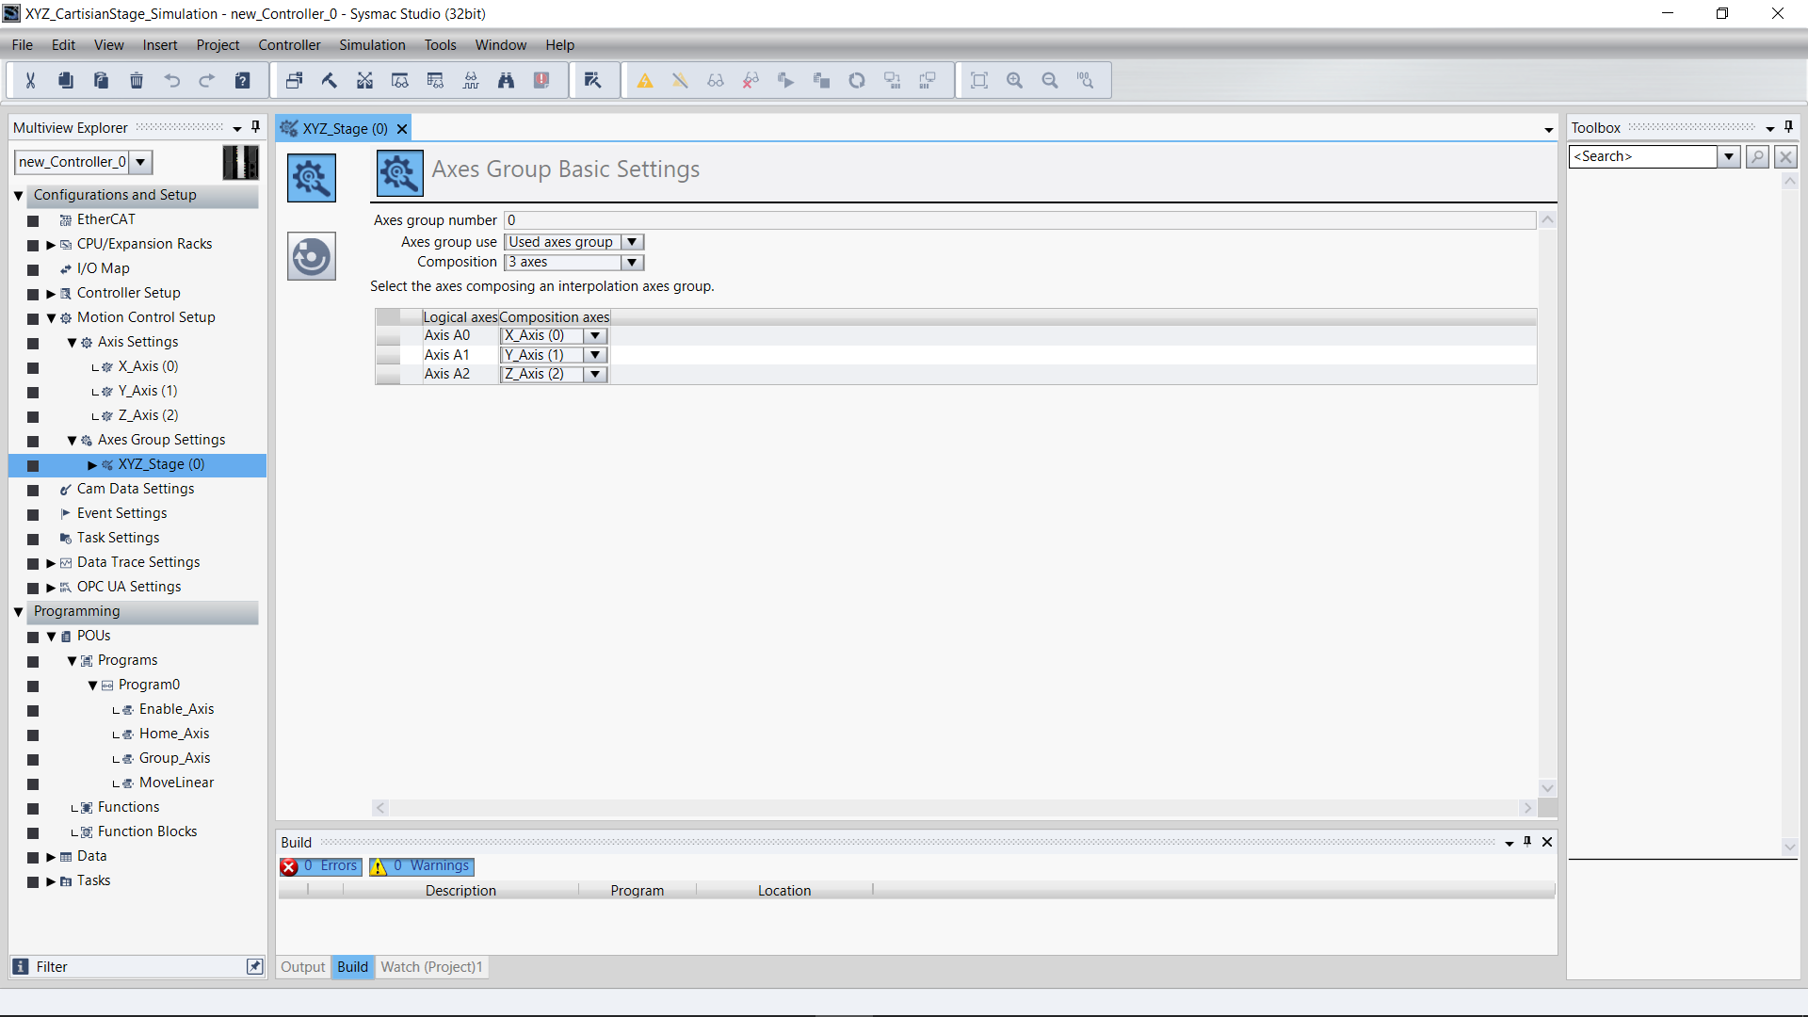
XYZ_Stage – Axes Group Basic Settings

Slide 9
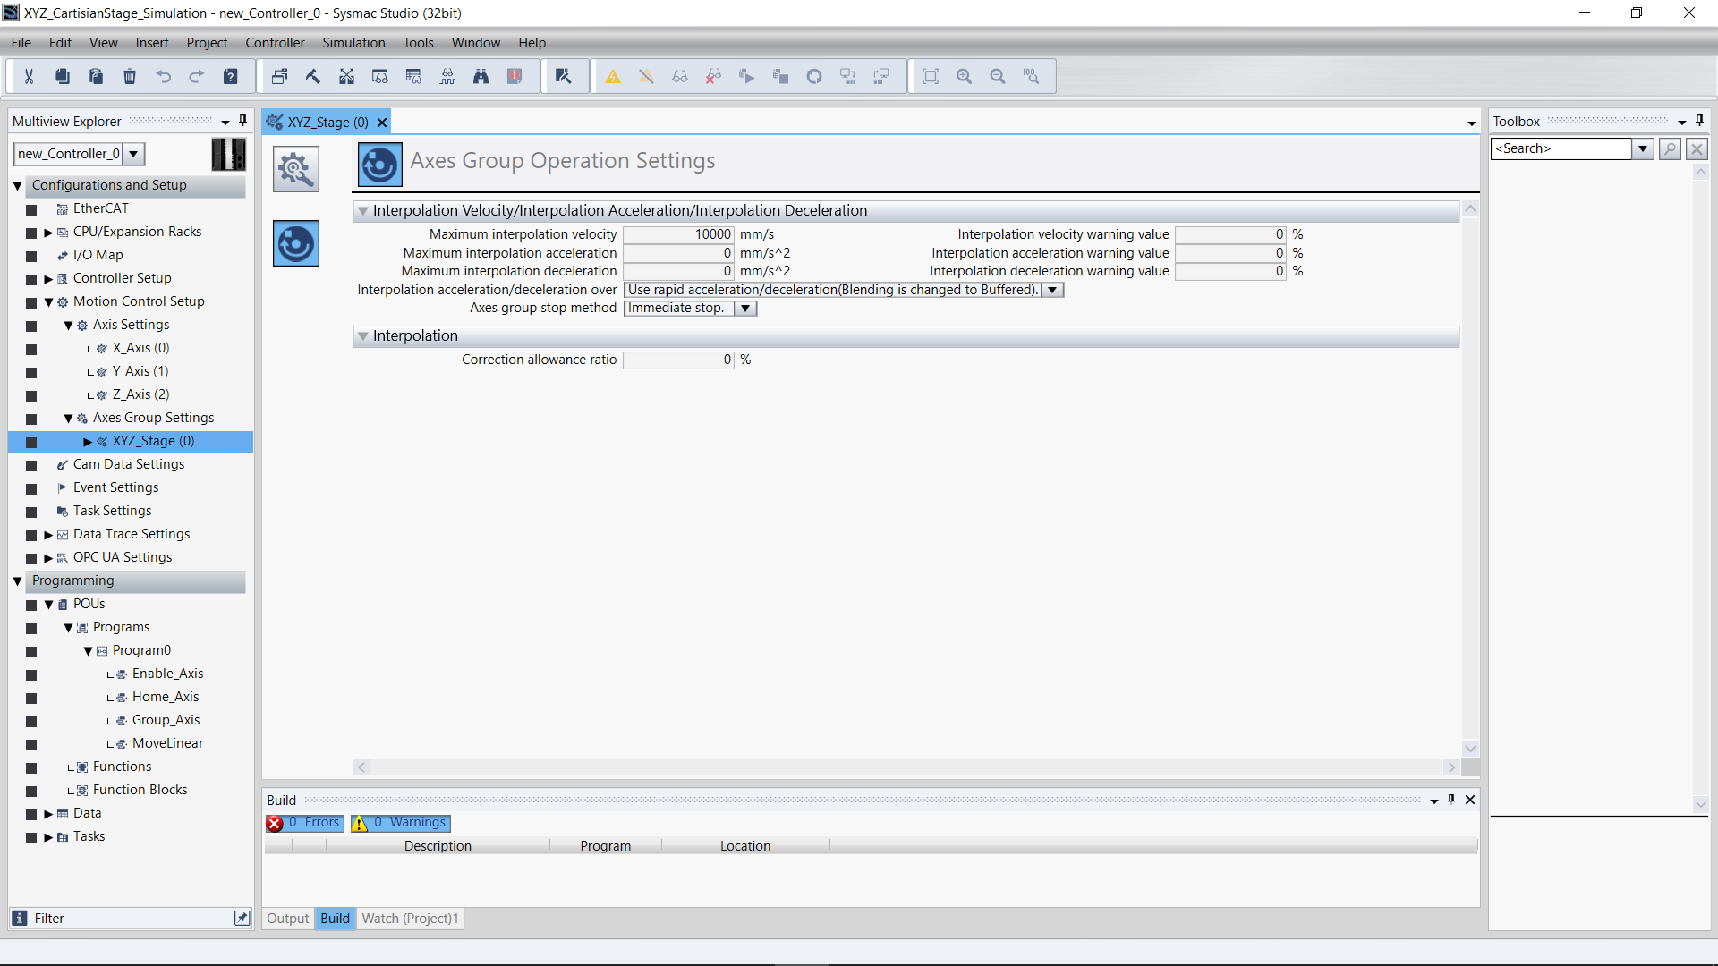
XYZ_Stage – Axes Group Operation Settings

Slide 10
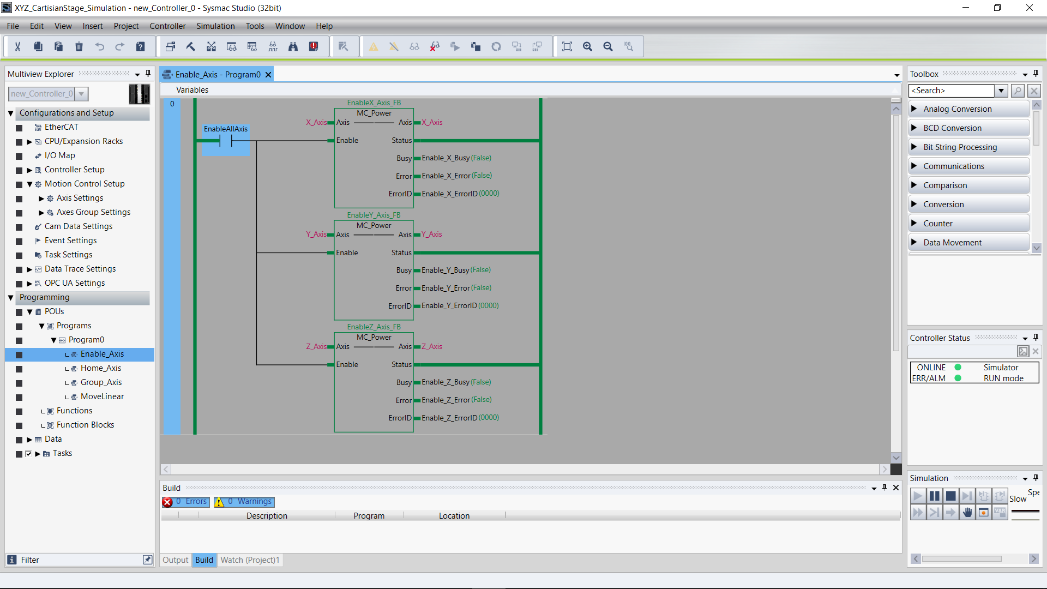
Program0 – Enable Axis (Needed only for real axis)

Slide 11
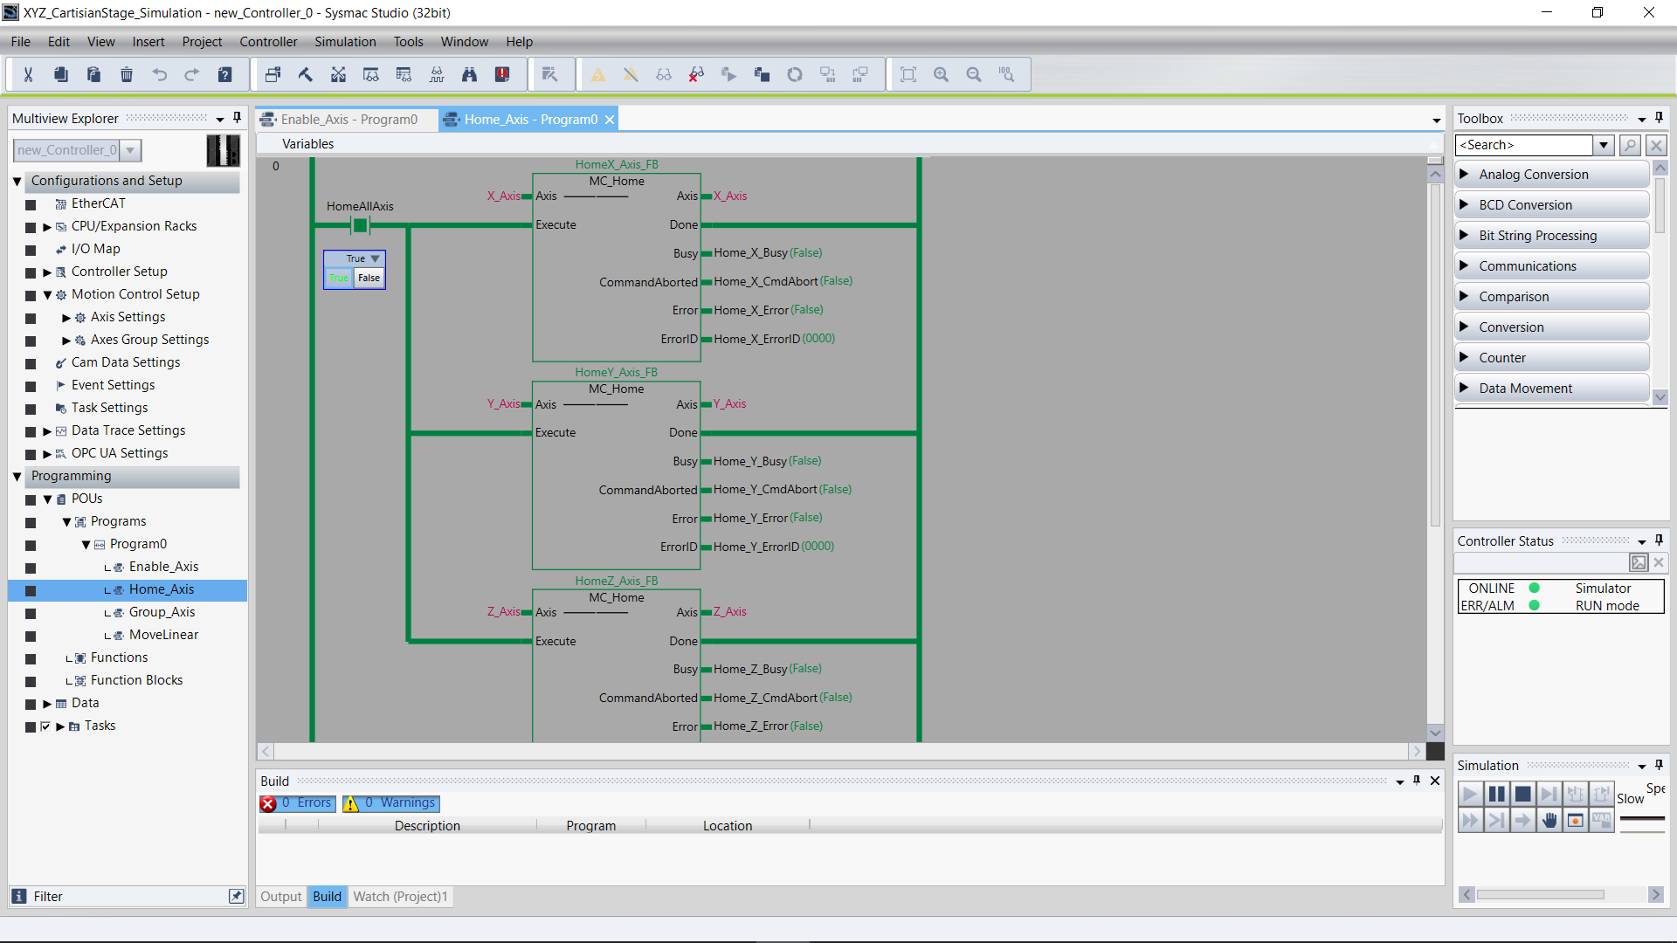
Program0 – Home Axis (Toggle at the beginning)

Slide 12
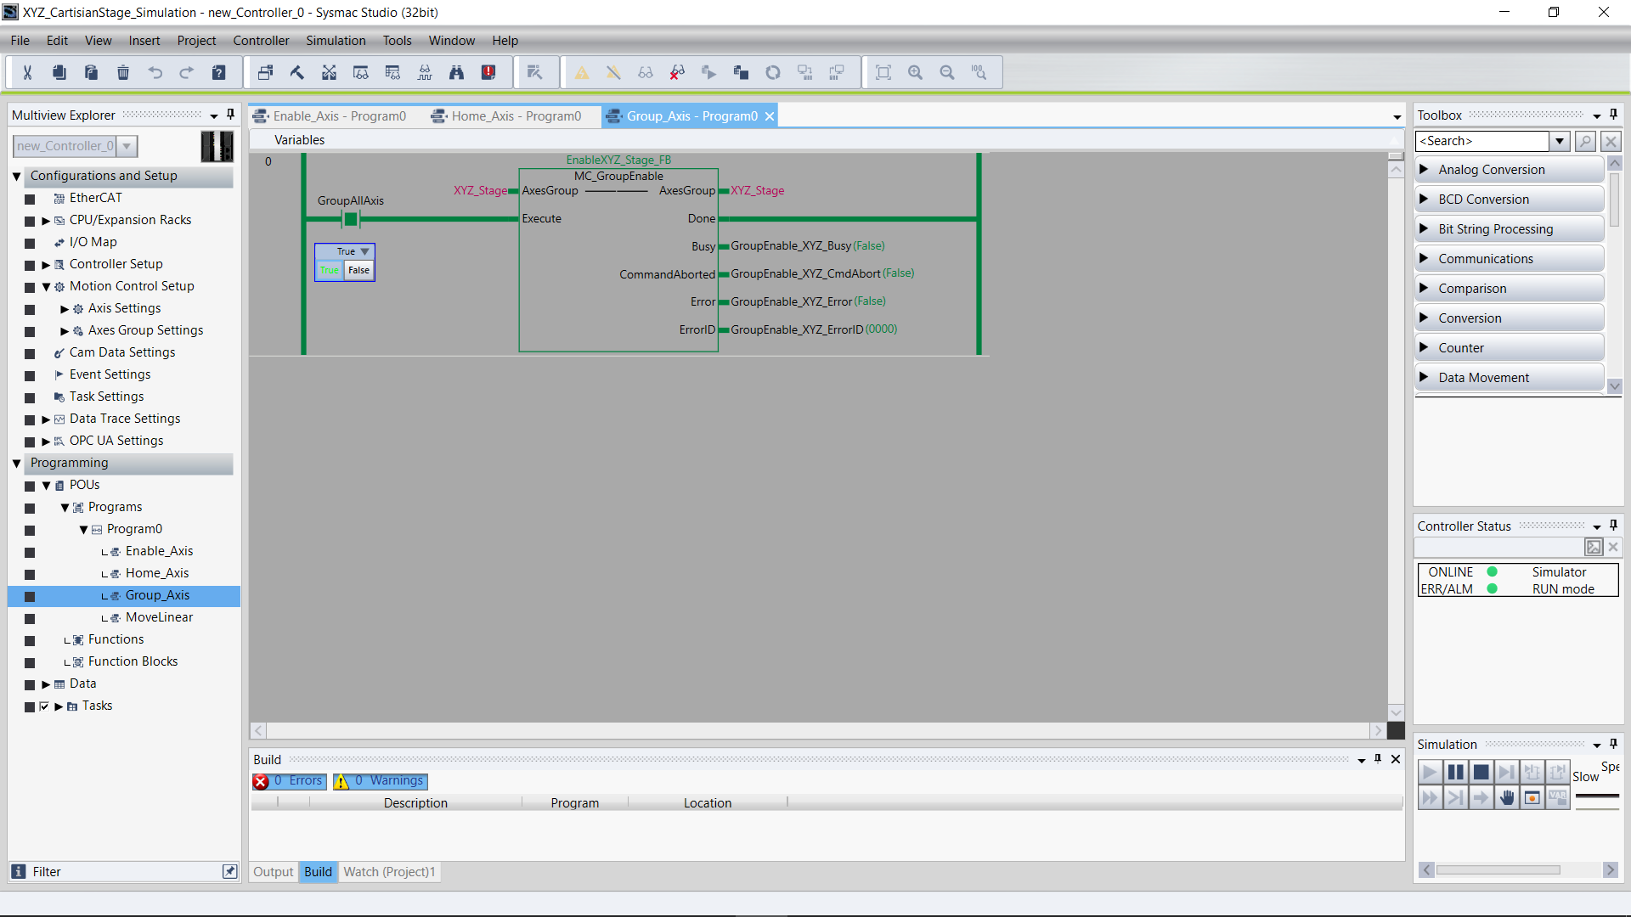
Program0 – Group Axis (Execute before motion)

Slide 13
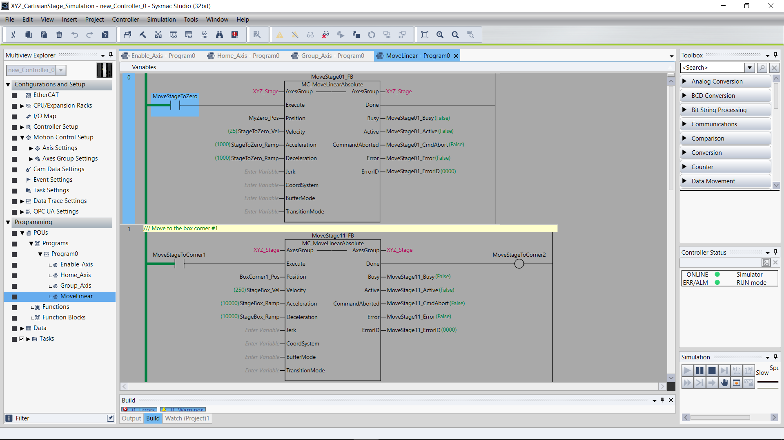
Program0 – Move Linear (rung 0 & 1)

Slide 14
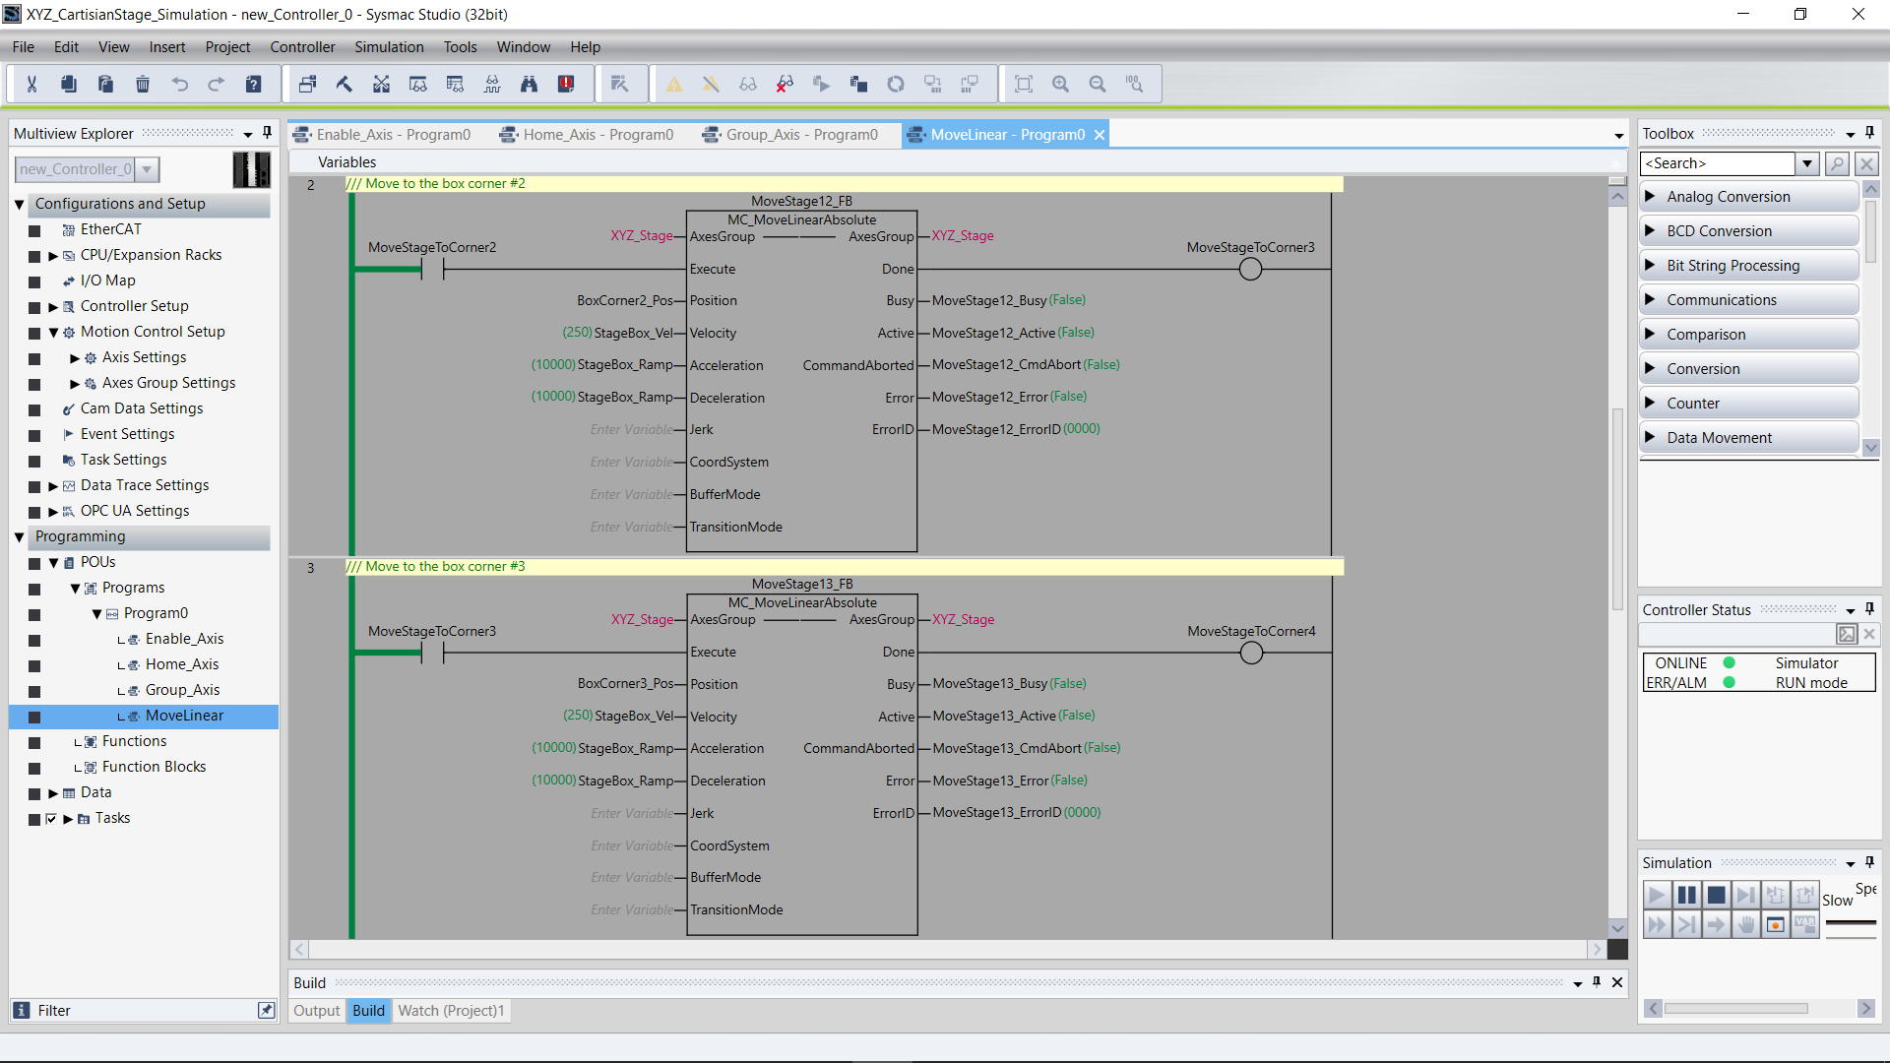
Program0 – Move Linear (rung 2 & 3)

Slide 15
Program0 – Move Linear (rung 4 & 5)

Slide 16
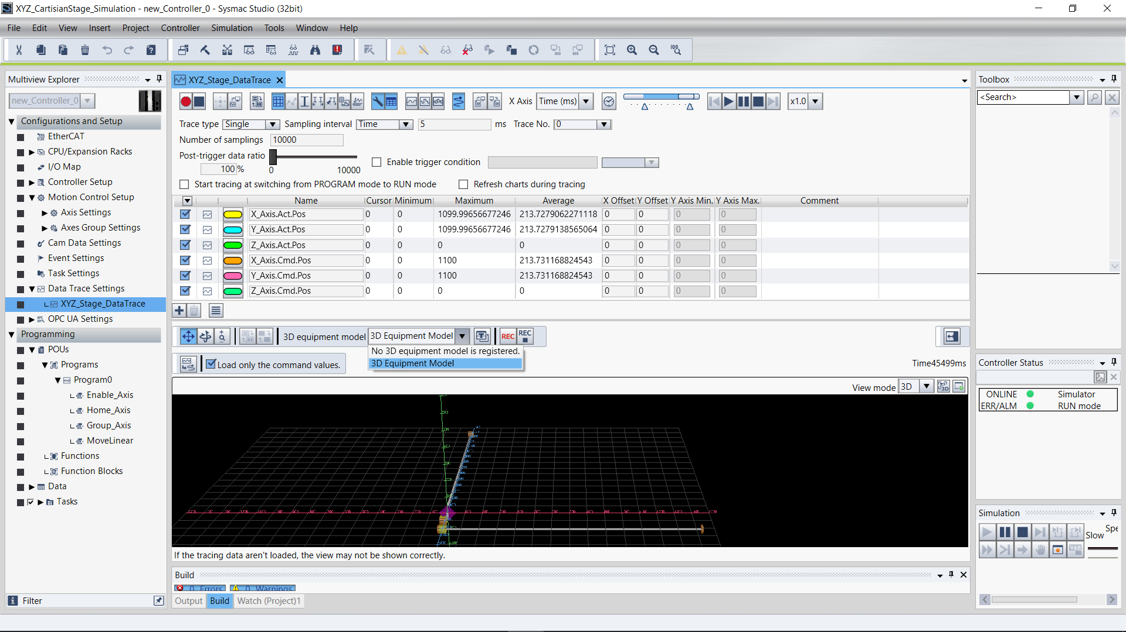
XYZ_Stage_DataTrace – Setup

Slide 17
Enter box corner positions
Go to any section of the code, and near the top of the page you will find “Variables”. Hit the up arrow to see the local variable table (below). Enter the information in the table below, or double click on the gray box to the left of the Initial Value field and it will bring up a table where you can enter values.
Interpretation: For BoxCorner3_Pos, the notation [2(1100),2(0.0)] means we have a four-element table, whose first two values are 1100 and the second two are 0.0. These are the coordinates of box corner 3. I’m not sure why there are 4 values. I think it’s possible to specify a fourth dimension for … I’m not sure what - maybe creating a worm hole in space-time.

Slide 18
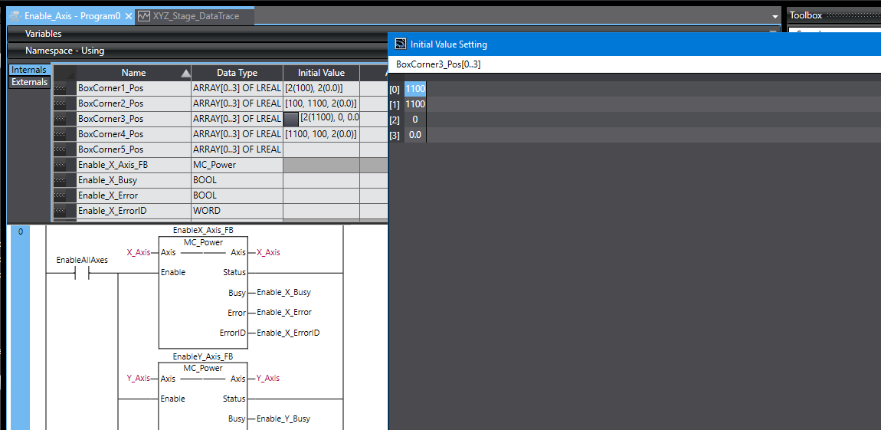
Enter box corner positions – alternative method
There is another way to enter the box corner positions.
1. Double-click the field you want.
2. Click the gray area.
3. Enter values directly into the table.

Slide 19
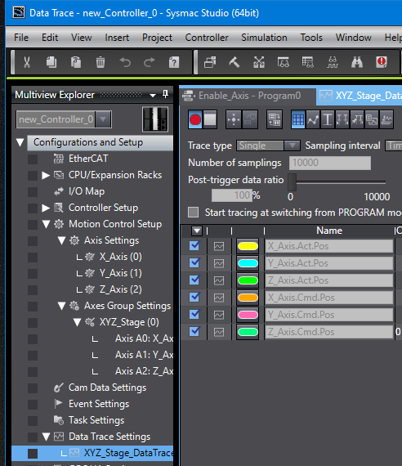
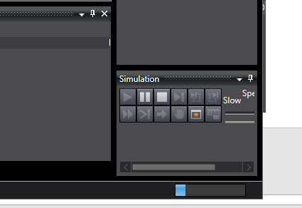
Simulation and Data Trace
Go to the Data Trace field.
Go to Simulation and choose Run.
The “record” button will become active.
Click “record” and then click Trigger ON.
A progress bar will begin running. You have until it reaches the end before you have to go to the code and run the program by changing inputs to TRUE.

Slide 20
Simulation and Data Trace
While the progress bar is running, you will need to…
Set “EnableAllAxes” to TRUE.
Set “HomeAllAxes to TRUE.
Set “GroupAllAxes to TRUE.
In MoveLinear, Set “MoveStageToCorner1” to TRUE.
Also…
You can also set the first three commands in the list above to TRUE before beginning the recording.
The 0 rung in MoveLinear should be set to TRUE after the program finishes. It will bring the stage back to the beginning.
It’s best to wait for the progress bar to complete before recording again. You will still be in RUN mode. If you interrupt it, you may have to STOP the simulation and RUN again.

Slide 21
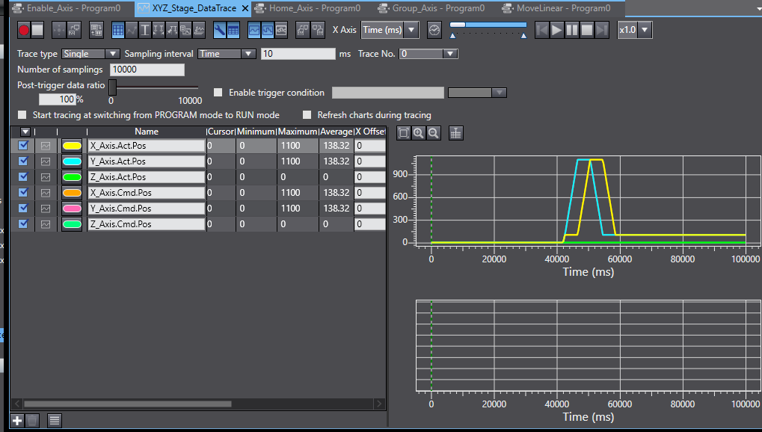
Simulation and Data Trace
Here is the result (see next slide for details).
You can export this data to a .csv file by clicking here.

Slide 22
Simulation and Data Trace: Interpretation
The x, y, and z actual positions and commanded positions are plotted here. In this case the commanded and actual positions are identical so for each axis two traces appear on top of one another. We have not created motion in the z direction, so the green line is flat.

Slide 23
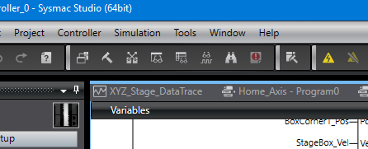
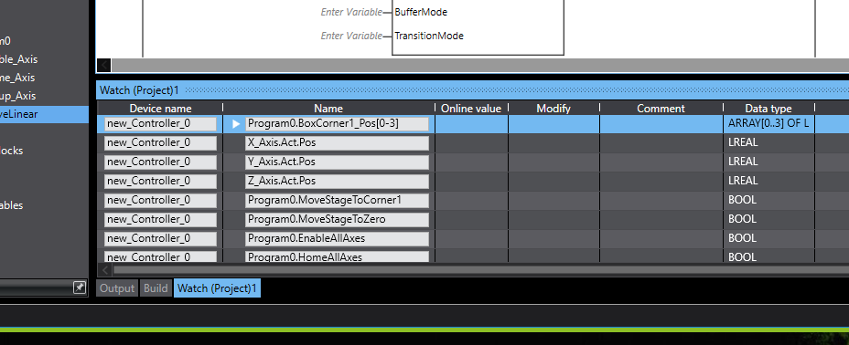
Something Else: Watch Tab Page
You can enter variables and axes into the Watch Tab and see their values change with time. Variables begin with “Program0.”, and once you type that in, the window will populate with all the variables you can follow. Note that BoxCorner1_Pos is a 4 element array, and you can use the down arrow to see all four variables.

Slide 24
Your Mission…
…should you decide to accept it: Imagine that the trace is simulating the business end (end effector) of the CNC machine in the lab, and we want to etch some figures in a work piece.
Create motion in the z axis. Drop the end effector at the start of the motion, trace the square, and then before returning to the beginning (MoveStageToZero) lift it back up. Assume that we need to drop the end effector 10 mm.
Instead of tracing out a square, trace a pentagon with equal angles. Create the same z motion for this case.
For each of these tasks, export a .csv file. See if you can create a 3D plot from there. You will want to save as an .xlsx file first.

