Slide 1

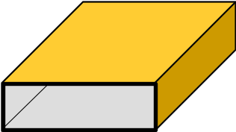

ECE 5317-6351
Microwave Engineering
Adapted from notes by Prof. Jeffery T. Williams
Fall 2026
Prof. David R. Jackson
Dept. of ECE
Notes 11
Waveguiding Structures Part 6:
Transverse Equivalent Network (TEN)

Slide 2








Waveguide Transmission Line Model
Our goal is to come up with a transmission line model for a waveguide mode.
Important point:
The waveguide mode is not a TEM mode, but it can be modeled as a wave on a transmission line.
+
-
“Transverse Equivalent Network” (TEN) model of TE₁₀ waveguide mode

Slide 3

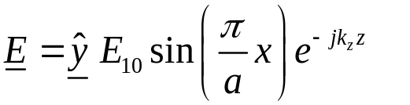



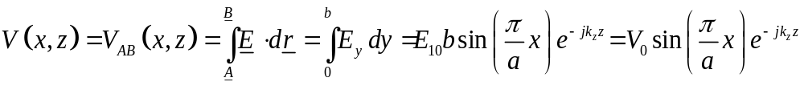

Waveguide Transmission Line Model (cont.)
For a waveguide mode, voltage and current are not uniquely defined.
TE₁₀ Mode
-
+
The voltage depends on x!

Slide 4
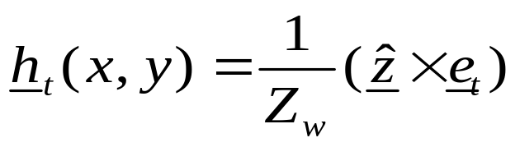

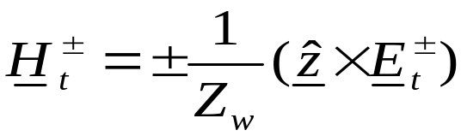

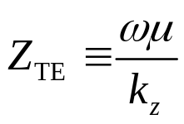
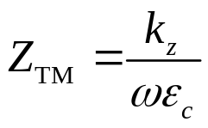
Waveguide Transmission Line Model (cont.)
Examine the transverse (x, y) fields of a waveguide mode:
Modal amplitudes
Note:
The shape function e_{t} (x,y) has an arbitrary amplitude normalization
(usually chosen to be as simple as possible).
Note: The minus sign above arises from:
Wave impedance

Slide 5
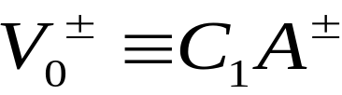
Waveguide Transmission Line Model (cont.)
Introduce a defined voltage into the field equations:
(The units of C₁ are meters.)
We may use whatever definition of voltage we wish here. (In other words, C₁ is arbitrary.)
Examples (two common choices):
Pick C₁ so that voltage V₀ is the actual voltage drop along the center of the waveguide.
Pick C₁ so that the power flowing on the TEN is the actual power flowing in the waveguide*
*This is done later.

Slide 6

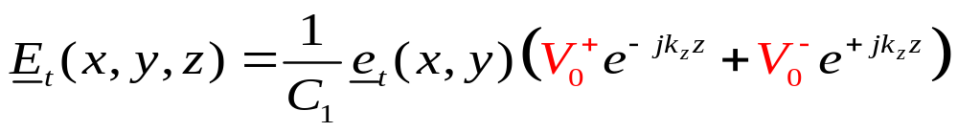
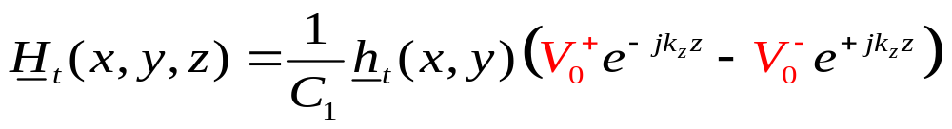
Waveguide Transmission Line Model (cont.)
We then have:

Slide 7
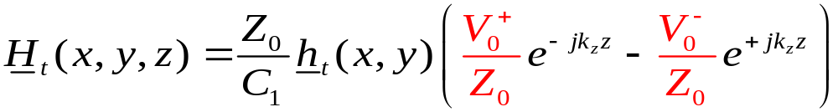
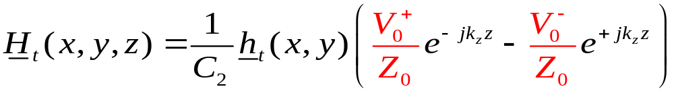
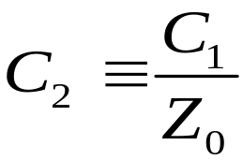
Waveguide Transmission Line Model (cont.)
Next, introduce a characteristic impedance (having an arbitrary value) into the equation for H_{t}:
where

Slide 8
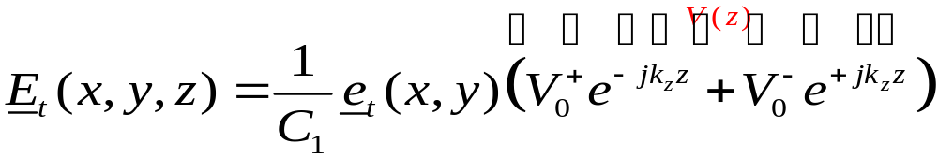
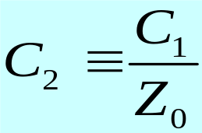
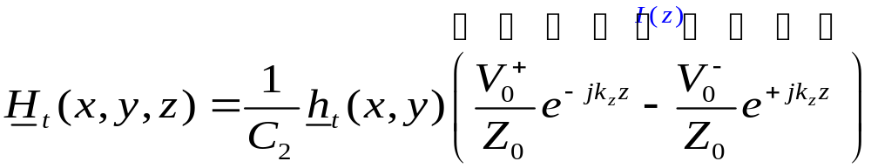
Waveguide Transmission Line Model (cont.)
Summary of Fields
The z dependence of the transverse fields behaves like voltage and current on a transmission line.
k_{z} = k_{z} of waveguide mode

Slide 9





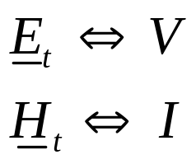
Waveguide Transmission Line Model (cont.)
The transmission-line model is called the Transverse Equivalent Network (TEN)
model of the waveguide.
+
-
same k_{z}
Waveguide

Slide 10
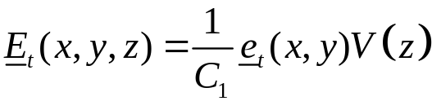
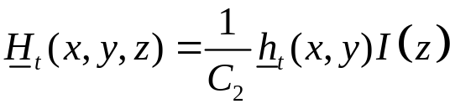
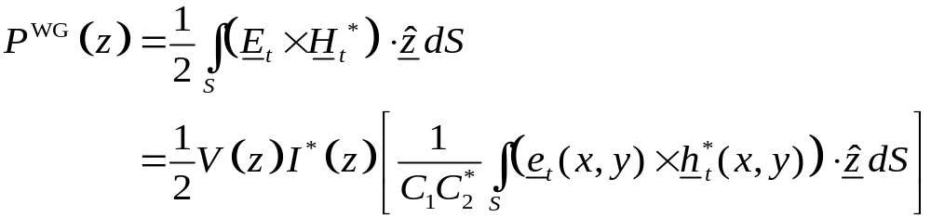
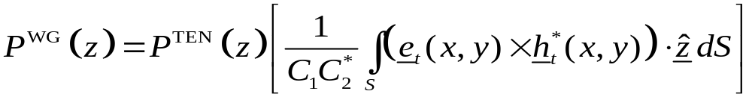
Waveguide Transmission Line Model (cont.)
Power flow down the waveguide (complex power):
Complex power flowing down the TEN transmission line.

Slide 11
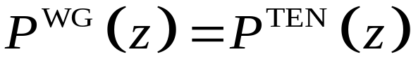
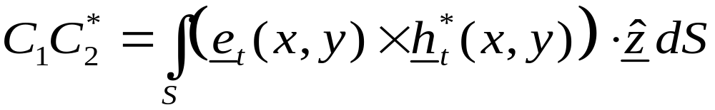
Waveguide Transmission Line Model (cont.)
Assume we choose to have:
Then we have the following constraint:
It is not necessary to make this assumption of equal powers, but it is a useful choice that can be made.

Slide 12
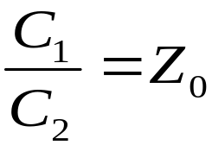


Waveguide Transmission Line Model (cont.)
Summary of Constants (assuming equal powers):
Once we pick Z₀, the constants are then determined.
The most common choice:

Slide 13
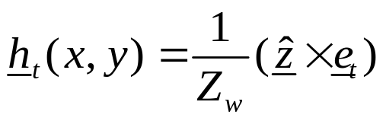

Waveguide Transmission Line Model (cont.)
Summary

Slide 14
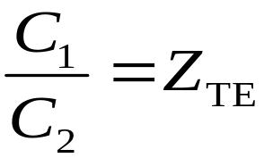
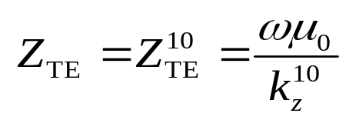
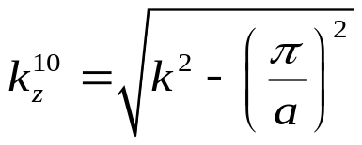



TE₁₀ Mode of Rectangular Waveguide
We make the following choices:
Choose Z₀ = Z_{TE}
Assume power equality

Slide 15
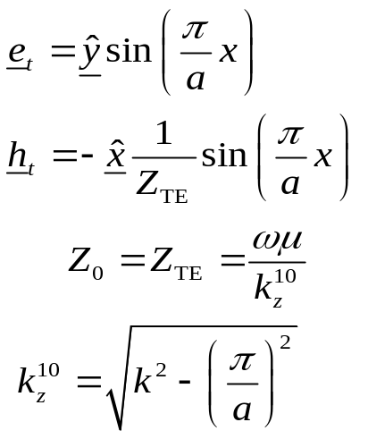
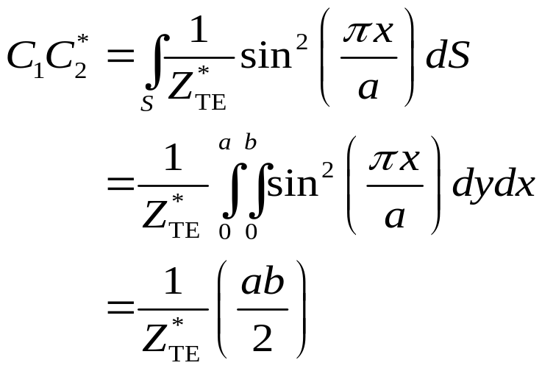
TE₁₀ Mode (cont.)
Calculate this term:
We have:
Note:
The transverse shape function e_{t} has been chosen (arbitrarily) to have a unit amplitude at the center of the waveguide, to keep it as simple as possible.

Slide 16
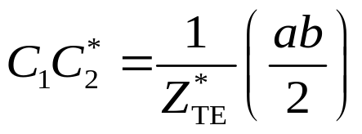
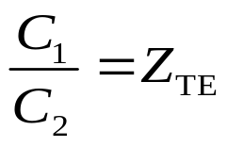
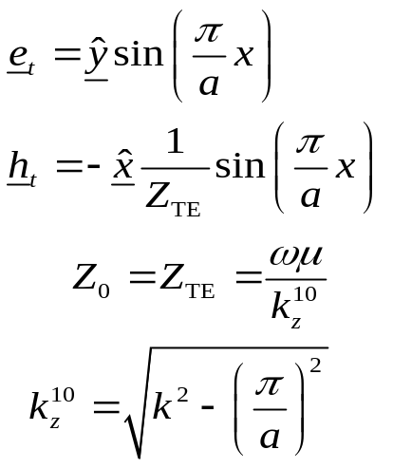
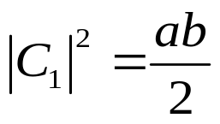
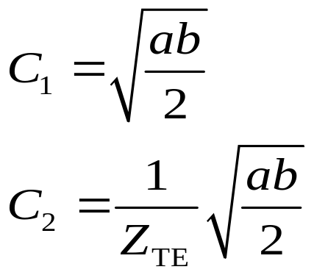
TE₁₀ Mode (cont.)
We then have:
Take the conjugate of the second one and then multiply the two equations together.
Solution:
Note:
The solution is unique to within a phase term (we choose the phase to be zero here).

Slide 17


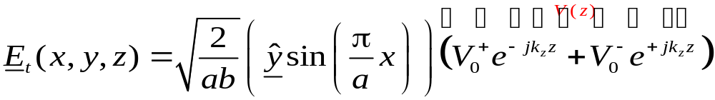
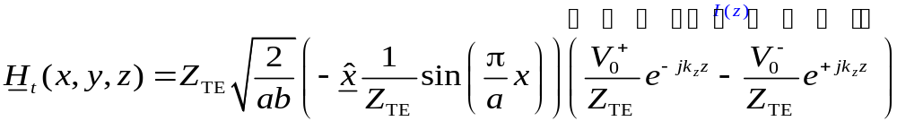
TE₁₀ Mode (cont.)
Recall:
Hence, we have:

Slide 18

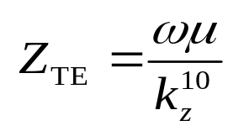
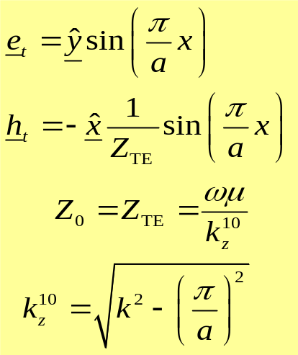
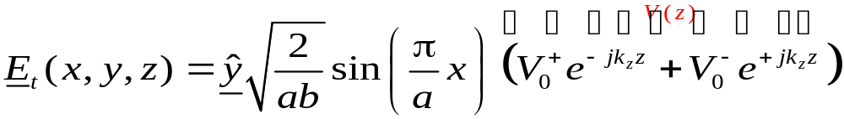
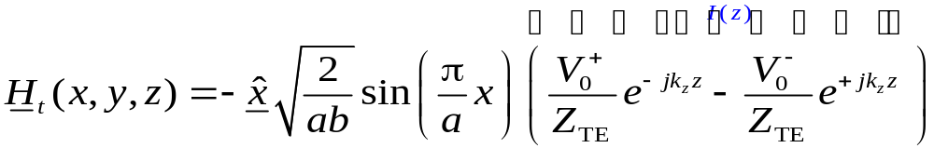
TE₁₀ Mode (cont.)
Summary for TE₁₀ mode

Slide 19
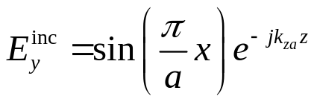










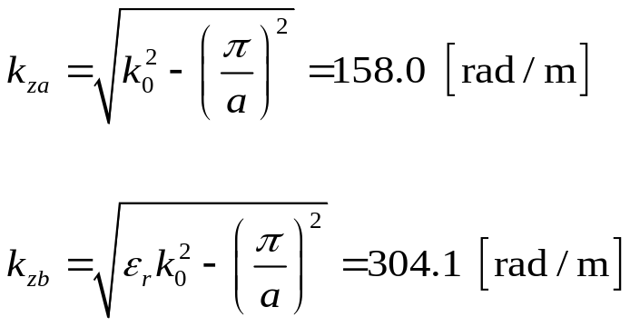

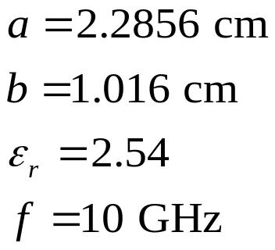
Example: Waveguide Discontinuity
For a 1 [V/m] (field at the center of the guide) incident TE₁₀ mode in guide A, find the TE₁₀ mode fields in both guides, and the reflected and transmitted powers.
a

Slide 20
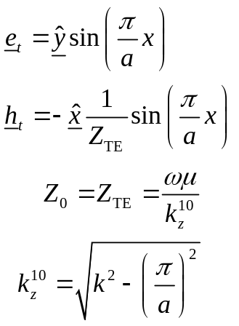




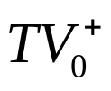


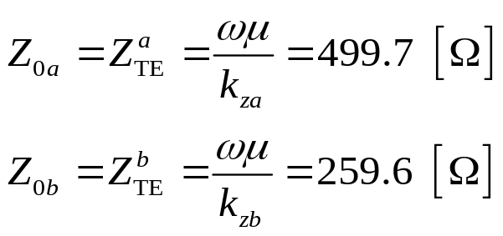
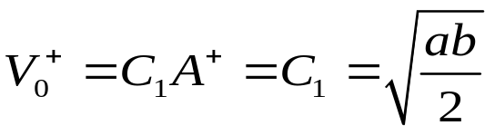
Example (cont.)
TEN
Convention:
Choose Z₀ = Z_{TE}
Assume power equality
Note:
C₁ is the same for both guides, but C₂ is different.

Slide 21
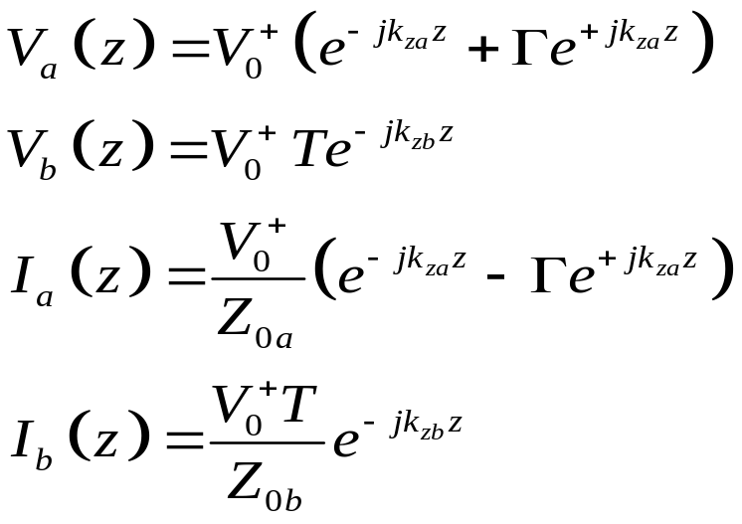
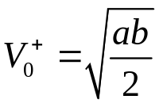




Example (cont.)
TEN
Equivalent reflection problem:
Note:
The above TEN enforces the continuity of voltage and current at the junction, and hence the tangential electric and magnetic fields are automatically continuous in the WG problem.

Slide 22






Example (cont.)
Hence, we have:
TEN
Recall that for the TE₁₀ mode:

Slide 23





Example (cont.)
Hence, for the waveguide problem we have the fields as:
Air region
Dielectric region

Slide 24




Example (cont.)
Substituting in for C₁ and e_{t}, we have (guide A):
Air region

Slide 25


Example (cont.)
Substituting in for C₂ and h_{t}, we have (guide A):
Air region

Slide 26


Example (cont.)
Substituting in for C₁ and e_{t}, we have (guide B):
Dielectric region

Slide 27



Example (cont.)
Substituting in for C₂ and h_{t}, we have (guide B):
Dielectric region

Slide 28







Example (cont.)
Summary of Fields

Slide 29




Example (cont.)
Power Calculations:
Note: In this example, Z₀ and Γ are real.
Recall:

Slide 30

Example (cont.)
Final Results:
a
Note: 90.1% of the incident power is transmitted.

Slide 31











Quarter-Wave Transformer in Waveguide
A quarter-wave transformer is shown here.
Goal:
Top view
Now 100% of the incident power is transmitted.

Slide 32


Quarter-Wave Transformer in Waveguide (cont.)
Waveguide problem:
Top view
TEN:

Slide 33


Quarter-Wave Transformer in Waveguide (cont.)
Design recipe:

Slide 34

Quarter-Wave Transformer in Waveguide (cont.)
Example:
Results:
Top view

Slide 35
Matching Elements in Waveguide
Rectangular Waveguide
(end view)
Note:
Planar discontinuities are modeled as purely shunt elements.
⇒
Inductive iris
⇒
Capacitive iris
⇒
Resonant iris
The equivalent circuit gives us the correct reflection and transmission of the TE₁₀ mode.

Slide 36







Matching Elements in Waveguide (cont.)
Inductive iris in air-filled waveguide
Top view
Note:
The shunt inductor models the effects of the iris and gives the amplitudes of the TE₁₀ mode correctly everywhere, but the TEN model does not tell us how strong the higher-order modes are.
Higher-order mode region
Because the element is a shunt discontinuity, we have:
TEN Model

Slide 37
Matching Elements in Waveguide (cont.)
Much more information can be found in the following reference:
N. Marcuvitz, Waveguide Handbook, Peter Perigrinus, Ltd. (on behalf of the Institute of Electrical Engineers), 1986.
Equivalent circuits for many types of discontinuities
Accurate CAD formulas for many of the discontinuities
Graphical results for many of the cases
Sometimes, measured results

Slide 38




Using Irises for Matching
A “single-stub” matching scheme is shown here.
(The procedure is illustrated for a horn antenna load).
Top view
An inductive iris is shown being used for matching.

Slide 39






Using Irises for Matching (cont.)
The TEN is shown
Physical Problem
TEN Model

Slide 40









Using Irises for Matching (cont.)
A field probing can be used to determine the unknown load impedance Z_{L}.

Slide 41

Using Irises for Matching (cont.)
A field probing can be used to determine the unknown load impedance Z_{L}.
TEN Model

Slide 42








Using Irises for Matching (cont.)
A Smith chart can then be used to find the unknown load impedance of the antenna in the TEN.

Slide 43






Using Irises for Matching (cont.)
A Smith chart can also be used to find the location of the shunt susceptance and its value.
“single-stub matching”
We’ll assume that we are using an inductive iris in this problem as the matching element.

Slide 44








Using Irises for Matching (cont.)
Note:
We must use this upper point for an inductive iris.
Capacitive
Inductive
Choose:

Slide 45






Using Irises for Matching (cont.)
A quarter-wave transformer matching scheme is shown here.
Here is the distance d is arbitrary.
Note:
The arbitrary distance d gives us a “safety buffer” from the horn discontinuity, to allow the higher-order modes to decay. The extra λ_{g}/2 is also a safety buffer.
Top view
Note:
Input impedance repeats after one-half of a guided wavelength.
Quarter-wave transformer
Safety buffers
The iris is used to cancel the input susceptance at z = -d.

Slide 46



Using Irises for Matching (cont.)
Going a distance d (arbitrary) from the horn:
Note:
The arbitrary distance d must be chosen so that we end up in the capacitive region of the Smith chart.
Capacitive
Inductive
Choose:

Slide 47
Quarter-Wave Transformer
A quarter-wave transformer matching scheme is shown here without needing an iris.
Here we choose distance d so that Z_{in} is real.
Top view
Quarter-wave transformer

Slide 48


Quarter-Wave Transformer (cont.)
Choosing distance d so we don’t need an iris:
Now we don’t need an iris!

