Slide 1
Adapted from notes by Prof. Jeffery T. Williams
ECE 5317-6351
Microwave Engineering
Fall 2011
Fall 2019
Prof. David R. Jackson
Dept. of ECE
Notes 14
Surface Waves

Slide 2
Grounded Dielectric Slab
Discontinuities on planar transmission lines such as microstrip will radiate surface-wave fields.
Microstrip line
Substrate
(ground plane below)
Surface-wave field
It is important to understand these waves.
Note:
Surface waves can also be used as a propagation mechanism for microwave and millimeter-wave frequencies. (The physics is similar to that of a fiber-optic guide.)

Slide 3
Grounded Dielectric Slab
Lossless slab
Ground plane
Goal: Determine the modes of propagation and their wavenumbers.
Assumption: There is no variation of the fields in the y direction, and propagation is along the z direction.

Slide 4
Dielectric Slab
TM_{x} & TE_{x} modes:
Note:
These modes may also be classified as TM_{z} and TE_{z}.
Plane wave
Plane wave

Slide 5
Surface Wave
Exponential decay
Plane wave
The internal angle is larger than the critical angle, so there is exponential decay in the air region.
The surface wave is a “slow wave”:
Hence

Slide 6
TM_{x} Solution
Assume TM_{x}:
so

Slide 7
TM_{x} Solution (cont.)
Denote
Then we have:

Slide 8
TM_{x} Solution (cont.)
Applying boundary conditions at the ground plane, we have:
Note: on PEC
This follows since

Slide 9
Boundary Conditions
BC 1)
BC 2)
Recall:

Slide 10
Boundary Conditions (cont.)
These two BC equations yield:
BC 1)
BC 2)
Divide second by first:
or

Slide 11
Final Result: TM_{x}
This may be written as:
This is a transcendental equation for the unknown wavenumber k_{z}.

Slide 12
Final Result: TE_{x}
Omitting the derivation, the final result for TE_{x} modes is:
This is a transcendental equation for the unknown wavenumber k_{z}.

Slide 13
Graphical Solution for SW Modes
Consider TM_{x}:
or
Define:
Then

Slide 14
Graphical Solution (cont.)
We can develop another equation by relating u and v:
Hence
Add
where

Slide 15
Graphical Solution (cont.)
Define
or
Note:
R is proportional to frequency.
Then

Slide 16
Graphical Solution (cont.)
Summary for TM_{x} Case

Slide 17
Graphical Solution (cont.)
Note: The TM₀ mode exists at all frequencies (no cutoff frequency).

Slide 18
Graphical Solution (cont.)
Graph for a Higher Frequency
Improper SW (v < 0)
(We reject this solution.)

Slide 19
Proper vs. Improper
If v > 0 : “proper SW” (fields decrease in x direction)
If v < 0 : “improper SW” (fields increase in x direction)
Cutoff frequency: The transition between a proper and improper mode.
Note:
The definition of cutoff frequency for this type of structure (an open structure) is different from that for a closed waveguide structure (e.g., rectangular waveguide)
(where k_{z} = 0 at the cutoff frequency).
Cutoff frequency: TM₁ mode:

Slide 20
TM₁ Cutoff Frequency
TM₁:
For other TM_{n} modes:

Slide 21
TM₀ Mode
The TM₀ mode has no cutoff frequency
(it can propagate at any frequency):
Note:
The lower the frequency, the slower the field decays away from the interface. As high frequency the wave decays very quickly since v → ∞.

Slide 22
TM₀ Mode (cont.)
Approximate CAD Formula
After making some approximations to the transcendental equation, valid for low frequency, we have the following approximate result for the TM₀ mode (derivation omitted):

Slide 23
TE_{x} Modes
Hence

Slide 24
TE_{x} Modes (cont.)
No TE₀ mode ( f_{c}= 0). The lowest TE_{x} mode is the TE₁ mode.
TE₁ cut-off frequency at R = π / 2:
The TE₁ mode will start to propagate when the substrate thickness is roughly 1/4 of a dielectric wavelength.
In general, we have
TE_{n}:

Slide 25
TE_{x} Modes (cont.)
Here we examine the radiation efficiency e_{r} of a small electric dipole placed on top of the substrate (which could model a microstrip antenna, or a bend on a microstrip line).
TM₀ SW
P_{sp} = power radiated into space
P_{sw} = power launched into surface wave

Slide 26



Dielectric Rod
z
The physics is similar to that of the TM₀ surface wave on a grounded substrate.
a
This serves as a model for a single-mode fiber-optic cable.

Slide 27
Fiber-Optic Guide
Two types of fiber-optic guides:
1) Single-mode fiber
This fiber carries a single mode (HE₁₁). This requires the fiber diameter to be on the order of a wavelength. It has less loss, dispersion, and signal distortion than multimode fiber. It is often used for long-distances (e.g., greater than 1 km).
2) Multi-mode fiber
This fiber has a diameter that is large relative to a wavelength (e.g., 10 wavelengths). It operates on the principle of total internal reflection (critical-angle effect). It can handle more power than the single-mode fiber, and is less expensive, it but has more loss and dispersion.

Slide 28
Dielectric Rod: Single Mode Fiber
Dominant mode (lowest cutoff frequency): HE₁₁ (f_{c} = 0)
The dominant mode is a hybrid mode (it has both E_{z} and H_{z}).
HE₁₁ mode on single-mode fiber
Note:
The notation HE means that the mode is hybrid, and has both E_{z} and H_{z}, although H_{z} is stronger. (For an EH mode, E_{z} would be stronger.)
The field shape is somewhat similar to the TE₁₁ circular waveguide mode.
The physical properties of the fields are similar to those of the TM₀ surface wave on a slab. (For example, at low frequency the field is more loosely bound to the rod.)

Slide 29
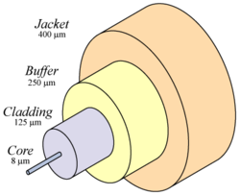
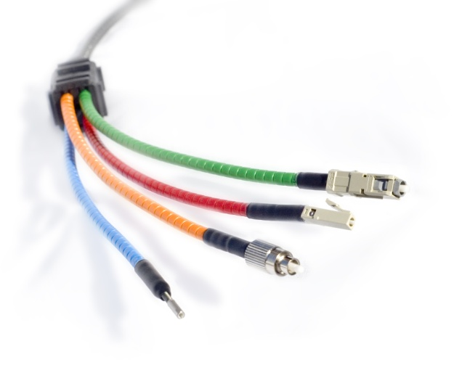
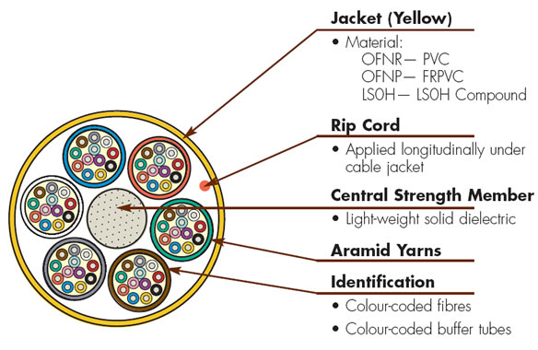
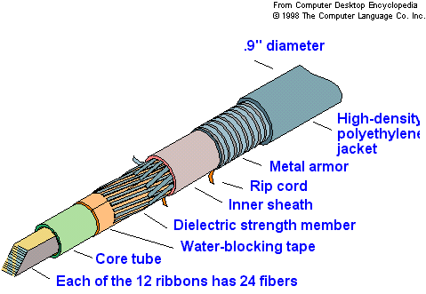
Single Mode Fiber (cont.)
http://en.wikipedia.org/wiki/Optical_fiber
Single-mode fiber
What they look like in practice:

Slide 30
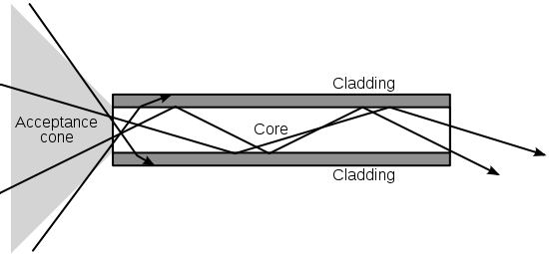
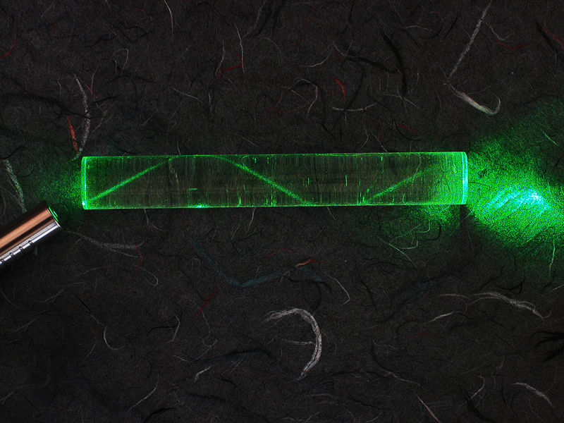
Multimode Fiber
Higher index core region
Multimode fiber
A multimode fiber can be explained using geometrical optics and internal reflection.
The “ray” of light is actually a superposition of many waveguide modes (hence the name “multimode”).
A laser bouncing down an acrylic rod, illustrating the total internal reflection of light in a multi-mode optical fiber
http://en.wikipedia.org/wiki/Optical_fiber

