Slide 1
Adapted from notes by Prof. Jeffery T. Williams
ECE 5317-6351
Microwave Engineering
Fall 2019
Prof. David R. Jackson
Dept. of ECE
Notes 17
S-Parameter Measurements

Slide 2
S-Parameter Measurements
S-parameters are typically measured, at microwave frequencies, with a network analyzer (NA).
These instruments have found wide, almost universal, application since the mid to late 1970’s.
Vector* network analyzer: Magnitudes and phases of the S parameters are measured.
Scalar network analyzer: Only the magnitudes of the S-parameters are measured.
Most NA’s measure 2-port parameters. Some measure 4 and 6 ports.
* The S parameters are really complex numbers, not vectors, but this is the customary name. There is an analogy between complex numbers and 2D vectors.

Slide 3
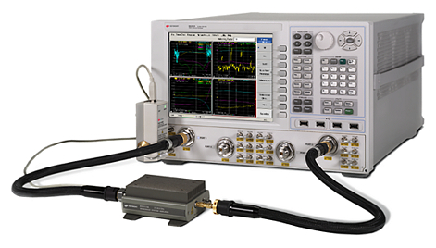
S-Parameter Measurements (cont.)
A Vector Network Analyzer (VNA) is usually used to measure S parameters.
Port 1
Device Under Test (DUT)
Port 2
Note:
If there are more than 2 ports, we measure different pairs of ports separately with a 2-port VNA.

Slide 4
S-Parameter Measurements (cont.)

Slide 5
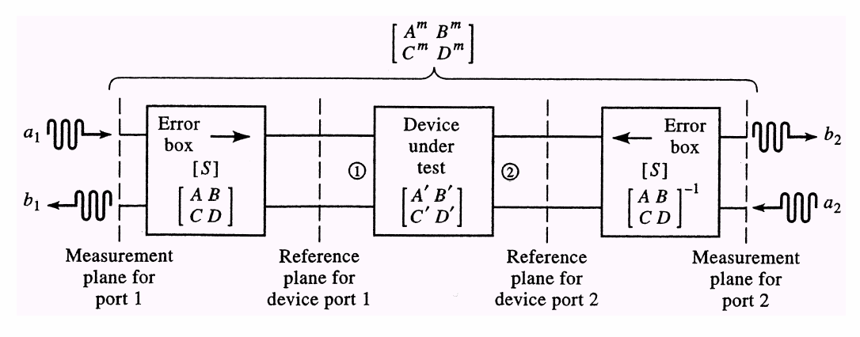
S-Parameter Measurements (cont.)
Error boxes contain effects
of test cables, connectors, couplers,…

Slide 6
S-Parameter Measurements (cont.)
Embedded inside measured ABCD matrix
De-embedded

Slide 7
S-Parameter Measurements (cont.)
Measurement plane A
Error box A
DUT
Error box B
Measurement plane B
Assume error boxes are reciprocal (symmetric matrices)
This is called “de-embedding”.

Slide 8
Calibration
“Short, open, match” calibration procedure
Connect
SC
OC
Z₀
Error box α
Short
Open
Match
Calibration loads
These loads are connected to the end of the cable from the VNA.
Recall from Notes 16:

Slide 9
Calibration (cont.)
“Thru-Reflect-Line (TRL)” calibration procedure
This is an improved calibration method that involves three types of connections:
The “thru” connection, in which port 1 is directly connected to port 2.
The “reflect” connection, in which a load with an (ideally) large (but not necessarily precisely known) reflection coefficient is connected.
The “line” connection, in which a length of matched transmission line (with an unknown length) is connected between ports 1 and 2.
The advantage of the TRL calibration is that is does not require precise short, open, and matched loads.
This method is discussed in the Pozar book (pp. 193-196).

Slide 10
Discontinuities
In microwave engineering, discontinuities are often represented by pi or tee networks.
Sometimes the pi or tee network reduces to a singe series or shunt element.
For waveguide systems, the TEN is used to represent the waveguide.

Slide 11
Discontinuities: Rectangular Waveguide

Slide 12
Discontinuities: RWG (cont.)

Slide 13
Discontinuities: Microstrip
Note:
For a good equivalent circuit,
the element values are fairly stable over a wide range of frequencies.

Slide 14
Z-Parameter Extraction
Assume a reciprocal and symmetrical waveguide or transmission-line discontinuity.
Examples
Waveguide post
Microstrip gap
We want to find Z₁ and Z₂ to model the discontinuity.
Note:
We could also use a pi network if we wish.
TEN

Slide 15
Z-Parameter Extraction (cont.)
Plane of symmetry (POS)
The Z₂ element is split in two:
POS

Slide 16
Z-Parameter Extraction (cont.)
Assume that we place a short or an open along the plane of symmetry.
Short
Open

Slide 17
Z-Parameter Extraction (cont.)
The short or open can be realized by using odd-mode or even-mode excitation.
Port 1
Port 2
Incident voltage waves
Odd mode excitation
Even mode excitation
Even/odd-mode analysis is very useful in analyzing devices (e.g., using HFSS).

Slide 18
Z-Parameter Extraction (cont.)
Port 1
Port 2
Odd mode voltage waves
Port 1
Port 2
Even mode voltage waves

Slide 19
Z-Parameter Extraction (cont.)
Hence we have:

Slide 20
De-embeding of a Line Length
We wish the know the reflection coefficient of a 1-port device under test (DUT), but the DUT is not assessable directly – it has an extra length of transmission line connected to it (whose length may not be known).
Meas. plane
Ref. plane

