Slide 1
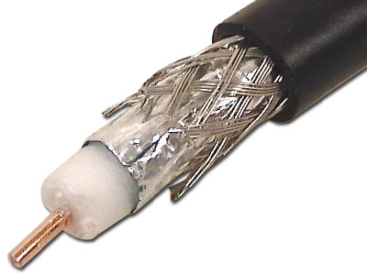
Adapted from notes by Prof. Jeffery T. Williams
ECE 5317-6351
Microwave Engineering
Fall 2019
Prof. David R. Jackson
Dept. of ECE
Notes 2
Transmission Lines
Part 1: TL Theory

Slide 2
Transmission-Line Theory
We need transmission-line theory whenever the length of a line is significant compared to a wavelength.

Slide 3
Transmission Line
2 conductors
4 per-unit-length parameters:
C = capacitance/length [F/m]
L = inductance/length [H/m]
R = resistance/length [Ω/m]
G = conductance/length [ /m or S/m]
Δz
Ω

Slide 4
Transmission Line (cont.)
x
x
x
+ + + + + + +
B
- - - - - - - - - -
+
+
-
-
Note: There are equal and opposite currents on the two conductors.
(We only need to work with the current on the top conductor, since we have chosen to put all of the series elements there.)

Slide 5
Transmission Line (cont.)
+
+
-
-

Slide 6
TEM Transmission Line (cont.)
Hence
Now let Δz → 0:
“Telegrapher’sEquations”

Slide 7
TEM Transmission Line (cont.)
To combine these, take the derivative of the first one with respect to z:
Switch the order of the derivatives.

Slide 8
TEM Transmission Line (cont.)
Hence, we have:
The same differential equation also holds for i.
Note: There is no exact solution in the time domain, in the lossy case.

Slide 9
TEM Transmission Line (cont.)
Time-Harmonic Waves:

Slide 10
TEM Transmission Line (cont.)
Note that
Then we can write:

Slide 11
TEM Transmission Line (cont.)
Define
Then
Solution:
γ is called the “propagation constant”.
We have:
Question: Which sign of the square root is correct?

Slide 12
TEM Transmission Line (cont.)
We choose the principal square root.
Principal square root:
(Note the square-root (“radical”) symbol here.)
Hence

Slide 13
TEM Transmission Line (cont.)
Denote:

Slide 14
TEM Transmission Line (cont.)
Im
Im
Re
Re
There are two possible locations for the complex square root:
Im
The principal square root must be in the first quadrant.
Re
Hence:

Slide 15
TEM Transmission Line (cont.)
Wave traveling in +z direction:
Wave is attenuating as it propagates.
Wave traveling in -z direction:
Wave is attenuating as it propagates.

Slide 16
TEM Transmission Line (cont.)
Attenuation in dB/m:

Slide 17
Wavenumber Notation

Slide 18
TEM Transmission Line (cont.)
Forward travelling wave (a wave traveling in the positive z direction):
The wave “repeats” when:
Hence:
“snapshot” of wave

Slide 19
Phase Velocity
Let’s track the velocity of a fixed point on the wave (a point of constant phase), e.g., the crest of the wave.
(phase velocity)

Slide 20
Phase Velocity (cont.)
Set
In expanded form:
Hence

Slide 21
Characteristic Impedance Z₀
Assumption: A wave is traveling in the positive z direction.
so
(Note: Z₀ is a number, not a function of z.)

Slide 22
Characteristic Impedance Z₀ (cont.)
Use first Telegrapher’s Equation:
so
Recall:
Hence

Slide 23
Characteristic Impedance Z₀ (cont.)
From this we have:
Use:
Both are in the first quadrant
(principal square root)

Slide 24
Characteristic Impedance Z₀ (cont.)
Hence, we have

Slide 25
General Case (Waves in Both Directions)
Wave in +z direction
Wave in -z direction
In the time domain:

Slide 26
Backward-Traveling Wave
z
A wave is traveling in the negative z direction.
so
Note:
The reference directions for voltage and current are chosen the same as for the forward wave.

Slide 27
General Case
z
Most general case:
A general superposition of forward and backward traveling waves:

Slide 28
Summary of Basic TL formulas
Guided wavelength:
Phase velocity:

Slide 29
Lossless Case
so
(real and independent of freq.)
(independent of freq.)

Slide 30
Lossless Case (cont.)
If the medium between the two conductors is lossless and homogeneous (uniform) and is characterized by (ε, μ), then (proof given later):
(proof given later)
The speed of light in a dielectric medium is
Hence, we have that:
and
In the lossless case the phase velocity does not depend on the frequency, and it is always equal to the speed of light (in the material).

Slide 31
Terminated Transmission Line
Terminating impedance (load)
Amplitude of voltage wave propagating in positive z direction at z = 0.
Amplitude of voltage wave propagating in negative z direction at z = 0.
Where do we assign z = 0 ?
The usual choice is at the load.

Slide 32
Terminated Transmission Line (cont.)
Terminating impedance (load)
Can we use z = z₀ as a reference plane?
Hence

Slide 33
Terminated Transmission Line (cont.)
Terminating impedance (load)
Compare:
This is simply a change of reference plane, from z = 0 to z = z₀.

Slide 34
Terminated Transmission Line (cont.)
Terminating impedance (load)
What is V(-d) ?
Propagating forwards
Propagating backwards
The current at z = -d is then:
d ≡ distance away from load
(This does not necessarily have to be the length of the entire line.)

Slide 35
Terminated Transmission Line (cont.)
Γ(-d) = reflection coefficient at z = -d
or
Γ_{L} ≡ load reflection coefficient
Similarly,

Slide 36
Terminated Transmission Line (cont.)
Z(-d) = impedance seen “looking” towards load at z = -d.
Note:
If we are at the beginning of the line, we will call this the “input impedance”.

Slide 37
Terminated Transmission Line (cont.)
At the load (d = 0):
At any point on the line(d > 0):

Slide 38
Terminated Transmission Line (cont.)
Recall
Thus,

Slide 39
Terminated Transmission Line (cont.)
Simplifying, we have:
Hence, we have

Slide 40
Terminated Lossless Transmission Line
Lossless:
Impedance is periodic with period λ_{g}/2:
The tan function repeats when
Note:

Slide 41
Summary for Lossy Transmission Line

Slide 42
Summary for Lossless Transmission Line

Slide 43
Matched Load (Z_{L}=Z₀)
No reflection from the load

Slide 44
Short-Circuit Load (Z_{L}=0)
Lossless Case
Always imaginary!

Slide 45
Short-Circuit Load (Z_{L}=0)
Lossless Case
Note:
Inductive
Capacitive
S.C. can become an O.C. with a λ_{g}/4 transmission line.

Slide 46
Open-Circuit Load (Z_{L}=∞)
Lossless Case
or
Always imaginary!

Slide 47
Open-Circuit Load (Z_{L}=∞)
Lossless Case
Note:
Inductive
Capacitive
O.C. can become a S.C. with a λ_{g}/4 transmission line.

Slide 48
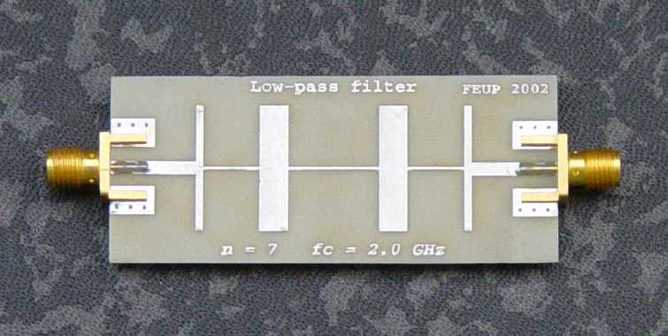
Using Transmission Lines to Synthesize Loads
We can obtain any reactance that we want from a short or open transmission line.
This is very useful in microwave engineering.
A microwave filter constructed from microstrip line.

Slide 49
Voltage on a Transmission Line
Find the voltage at any point on the line.
At the input:

Slide 50
Voltage on a Transmission Line (cont.)
Incident (forward) wave (not the same as the initial wave from the source!)
At z = -l :
Hence

Slide 51
Voltage on a Transmission Line (cont.)
Let’s derive an alternative form of the previous result.
Start with:

Slide 52
Voltage on a Transmission Line (cont.)
Hence, we have
where
(source reflection coefficient)
Substitute
Recall:
Therefore, we have the following alternative form for the result:

Slide 53
Voltage on a Transmission Line (cont.)
This term accounts for the multiple (infinite) bounces.
The “initial” voltage wave that would exist if there were no reflections from the load
(we have a semi-infinite transmission line or a matched load).

Slide 54
Voltage on a Transmission Line (cont.)
Wave-bounce method (illustrated for z = -l ):
We add up all of the bouncing waves.

Slide 55
Voltage on a Transmission Line (cont.)
Group together alternating terms:
Geometric series:

Slide 56
Voltage on a Transmission Line (cont.)
Hence
or
This agrees with the previous result (setting z = -l ).
The wave-bounce method is a very tedious method – not recommended.

Slide 57
Time-Average Power Flow
P(z) = power flowing in + z direction
At a distance d from the load:
If Z₀ ≈ real (low-loss transmission line):
Note:
(please see the note)

Slide 58
Time-Average Power Flow (cont.)
Low-loss line
Note:
For a very lossy line, the total power is not the difference of the two individual powers.
Lossless line (α = 0)

Slide 59
Quarter-Wave Transformer
Lossless line
Matching condition
so
(This requires Z_{L} to be real.)
Hence

Slide 60
Quarter-Wave Transformer (cont.)
Example
Match a 100 Ω load to a 50 Ω transmission line at a given frequency.
Lossless line

Slide 61
Voltage Standing Wave
Lossless Case
Note: The voltage repeats every λ_{g}. The magnitude repeats every λ_{g} /2.
Note: The voltage changes by a minus sign after λ_{g} /2.

Slide 62
Voltage Standing Wave Ratio

Slide 63
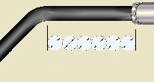
Limitations of Transmission-Line Theory
At high frequency, discontinuity effects can become important.
Transmitted
Incident
Bend
Reflected
The simple TL model does not account for the bend.

Slide 64
Limitations of Transmission-Line Theory (cont.)
At high frequency, radiation effects can also become important.
We want energy to travel from the generator to the load, without radiating.
When will radiation occur?
This is explored next.

Slide 65
Limitations of Transmission-Line Theory (cont.)
Coaxial Cable
The coaxial cable is a perfectly shielded system – there is never any radiation at any frequency, as long as the metal thickness is large compared with a skin depth.
The fields are confined to the region between the two conductors.

Slide 66
Limitations of Transmission-Line Theory (cont.)
The twin lead is an open type of transmission line – the fields extend out to infinity.
The extended fields may cause interference with nearby objects.
(This may be improved by using “twisted pair”.)
Having fields that extend to infinity is not the same thing as having radiation, however!

Slide 67
Limitations of Transmission-Line Theory (cont.)
The infinite twin lead will not radiate by itself, regardless of how far apart the lines are (this is true for any transmission line).
Reflected
S
Incident
No attenuation on an infinite lossless line
The incident and reflected waves represent an exact solution to Maxwell’s equations on the infinite line, at any frequency.

Slide 68
Limitations of Transmission-Line Theory (cont.)
A discontinuity on the twin lead will cause radiation to occur.
Incident wave
Pipe
Obstacle
Reflected wave
Note:
Radiation effects usually increase as the frequency increases.
Incident wave
Bend
Bend
Reflected wave

Slide 69
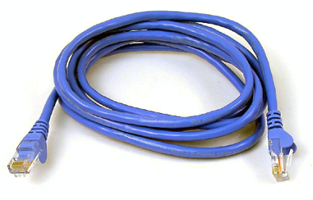
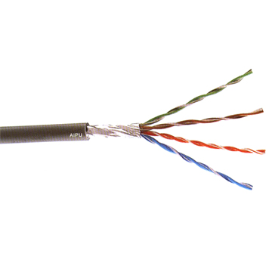
Limitations of Transmission-Line Theory (cont.)
To reduce radiation effects of the twin lead at discontinuities:
Reduce the separation distance h (keep h << λ).
Twist the lines (twisted pair).
CAT 5 cable
(twisted pair)

