Slide 1
Adapted from notes by Prof. Jeffery T. Williams
ECE 5317-6351
Microwave Engineering
Fall 2019
Prof. David R. Jackson
Dept. of ECE
Notes 20
Power Dividers and Circulators

Slide 2
Power Dividers and Couplers
A power divider is used to split a signal.
A coupler is used to combine a signal.
These are examples of a three-port network.

Slide 3
Three Port Networks
General 3-port network:

Slide 4
If all three ports are matched, and the device is reciprocal and lossless, we have:
Three Port Networks (cont.)
(The S matrix is unitary.)
(There are three distinct values.)
Such a device is not physically possible!
(Please see the next slide.)
Conclusion: If we want a match at all ports, we have to have a lossy device.

Slide 5
Power Dividers and Couplers (cont.)
Lossless, reciprocal, and matched at all ports is not physically possible.
Lossless ⇒ [S] is unitary
Hence:
These cannot all be satisfied.
Only one of them can be nonzero.
At least 2 of S₁₃, S₁₂, S₂₃ must be zero.
(If only one is zero (or none is zero), we cannot satisfy all three.)

Slide 6
Power Dividers
T-Junction: A lossless divider
Note:
Matching at ports 2 and 3 would be helpful when output lines 2 and 3 are not matched to their loads.
If we match at port 1, we cannot match at the other ports!

Slide 7
Power Dividers (cont.)
Assuming port 1 matched:
We can design the splitter to control the powers going into the two output lines.

Slide 8
Power Dividers (cont.)
Examine the reflection at each port (S_{ii}):
Note: A match on port 1 requires:
(The two output lines combine in parallel.)
The first term in the numerators must be less than the second term.

Slide 9
Power Dividers (cont.)
Also, we have:
Also
Similarly:
Hence

Slide 10
Power Dividers (cont.)
If port 1 is matched:
From last slide:
The output ports 2 and 3 are not isolated.

Slide 11
Power Dividers (cont.)
Summary
The input port is matched, but not the output ports.
The output ports are not isolated.
Waves reflected from devices on ports 2 and 3 with cause interference with the other devices.

Slide 12
Power Dividers (cont.)
Example: Microstrip T-junction power divider
Incident
Note:
Quarter-wave transformers could be put on the output lines to bring the final output lines back to 50 [Ω].

Slide 13
Power Dividers (cont.)
The matched power divider also works as a matched power combiner.
outgoing
Equal waves are incident from ports 2 and 3 (a₂ = a₃).
There is no reflection if equal waves are incident on ports 2 and 3, and port 1 is matched.

Slide 14
Wilkinson Power Divider
Equal-split (3 dB) power divider
(The Wilkenson can also be designed to have an unequal split.)
All ports matched (S₁₁ = S₂₂ = S₃₃ = 0)
Output ports are isolated (S₂₃ = S₃₂ = 0)
Note: No power is lost in going from port 1 to ports 2 and 3:
The derivation is in the appendix.
Obviously not unitary

Slide 15
Wilkinson Power Divider (cont.)
Microstrip layout
All three ports are matched, and the output ports are isolated.

Slide 16
Wilkinson Power Divider (cont.)
When a wave is incident from port 1, half of the total incident power gets transmitted to each output port (no loss of power).
When a wave is incident from port 2 or port 3, half of the power gets transmitted to port 1 and half gets absorbed by the resistor, but nothing gets through to the other output port (the two output ports are isolated from each other).

Slide 17
Wilkinson Power Divider (cont.)
Example: Microstrip Wilkinson power divider

Slide 18
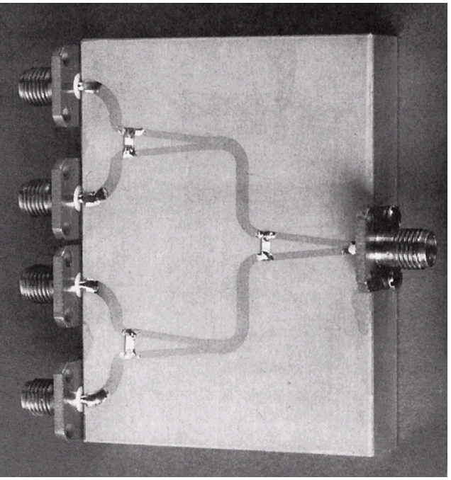
Figure 7.15 of Pozar
Photograph of a four-way corporate power divider network using three microstrip Wilkinson power dividers. Note the isolation chip resistors.
Courtesy of M.D. Abouzahra, MIT Lincoln Laboratory.
Wilkinson Power Divider (cont.)

Slide 19
Figure 7.12 of Pozar
Frequency response of an equal-split Wilkinson power divider. Port 1 is the input port; ports 2 and 3 are the output ports.
Wilkinson Power Divider (cont.)

Slide 20
Now consider a 3-port network that is non-reciprocal, with all ports matched, and is lossless:
Circulators
“Circulator”
These equations will be satisfied if:
(There are six distinct values.)
Lossless
1
(unitary)
or
2

Slide 21
Circulators (cont.)
Clockwise (LH) circulator
1
Note: We have assumed here that the phases of all the S parameters are zero.
2
A wave goes in one port and comes out from the adjacent port!
Counter-clockwise (RH) circulator

Slide 22
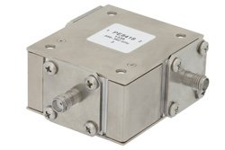
Circulators (cont.)
An example of a circulator:
Frequency: 0.698 – 0.96 GHz
VSWR: <1.3
Isolation : >18 dB
Power: 1000 W
Insertion loss: <0.35 dB
Length: 1.75 in
Width: 2 in
Height: 1.02 in
Temperature range: -20 – 70 deg C
Price: $439.94
Circulators can be made using biased ferrite materials.

Slide 23
Circulators (cont.)
Application: Wireless system
TX
Antenna
2
RX
TX
1
3
Transmitter
RX
0
(matched receiver)
Receiver
The same antenna can be used for transmit and receive.
The transmit and receive frequencies can even be the same.
Note: A circulator used this way is often called a duplexer.

Slide 24
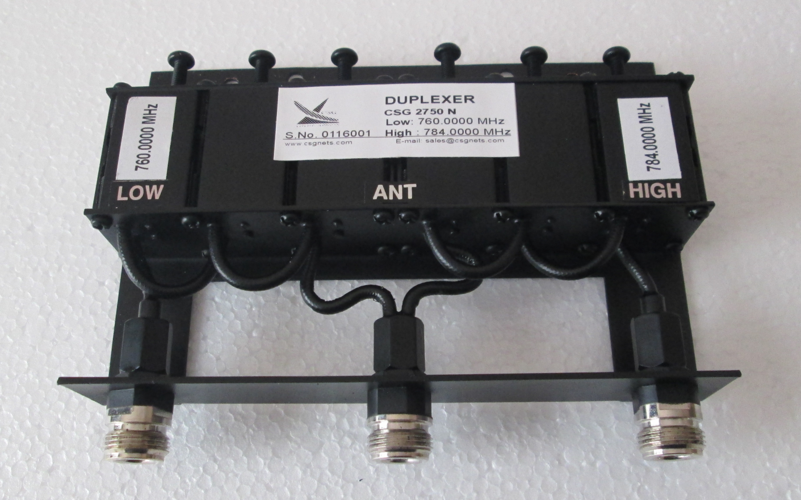
Duplexer
A duplexer:

Slide 25
Diplexer
A diplexer) is a type of filter that combines or splits two different frequencies (f₁ and f₂).
Transmission line
Diplexer
Diplexer
Triplexer: three frequencies
Multiplexer: multiple frequencies

Slide 26
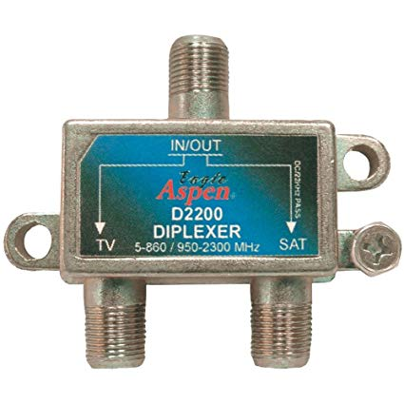
Diplexer (cont.)
An example of a diplexer:

Slide 27
Diplexer (cont.)
Note: A diplexer can be used to transmit and receive two different channels with the same antenna (as with a duplexer), if the frequencies are separated enough.
Transmitter
Diplexer
Antenna
Receiver
Note:
This requires a high isolation between the transmit and receive ports, to avoid interference.

Slide 28
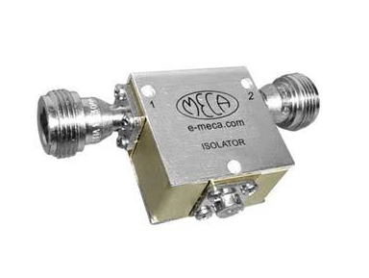
Isolator
An isolator is a two-port device that is nonreciprocal:
A wave coming in on port 1 goes through to port 2.
A wave coming in on port 2 gets absorbed (does not go to port 1).
Frequency: 0.8 - 1 GHz
VSWR: 1.25
Isolation : 20 dB
Power: 2 W
Insertion loss: <0.4 dB
Length: 1.25 in
Width: 2 in
Height: 0.75 in
Temperature range: -20 – 60 deg C
Price: $279.82

Slide 29
Circulator as Isolator
A circulator can also be used to make an isolator:
Out
2
1
3
In
0
Matched load
A signal from the input port goes to the output port.
A signal from the output port does not get to the input port.

Slide 30
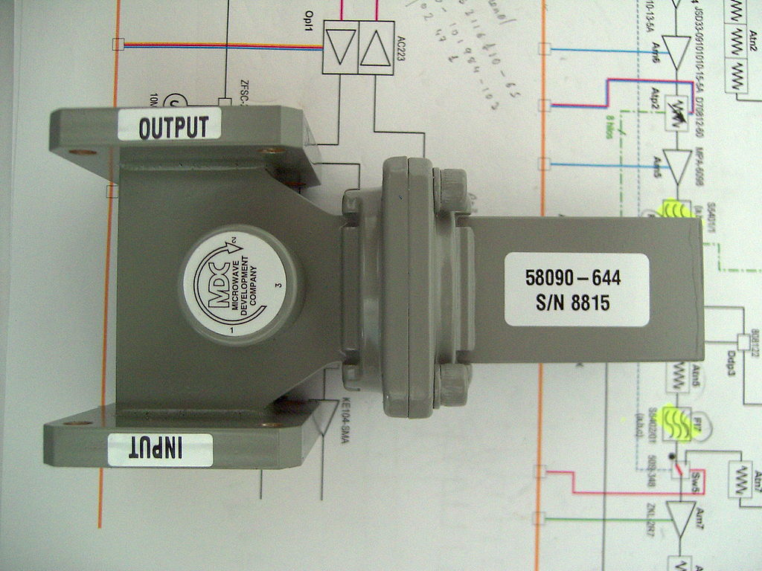
Circulator as Isolator (cont.)
A waveguide-based circulator with a matched load at port 3, acting as an isolator
https://en.wikipedia.org/wiki/Circulator

Slide 31
Appendix
The analysis of the Wilkinson power divider is given here.
Even/odd mode analysis is used to analyze the Wilkinson power divider.
This requires two separate analyzes (even and odd).
Each analysis involves only a two-port device instead of a three-port device.

Slide 32
Appendix (cont.)
Even and odd analysis is used to analyze the structure when port 2 is excited.
⇒ To determine
Only even analysis is needed to analyze the structure when port 1 is excited.
⇒ To determine
The other five components of the S matrix can be found by using physical symmetry and reciprocity (the symmetry of the S matrix).

Slide 33
Top view
Appendix (cont.)
A microstrip realization is shown.
Split structure along plane of symmetry (POS)
Even ⇒ voltage even about POS ⇒ place OC along POS
Odd ⇒ voltage odd about POS ⇒ place SC along POS

Slide 34
Appendix (cont.)
How do you split a transmission line? (This is needed for the even case.)
Top view
Voltage is the same for each half of line (V)
Current is halved for each half of line (I/2)
(magnetic wall)
Z₀ microstrip line
For each half

Slide 35
Appendix (cont.)
Port 2 Excitation
“even” problem
Overview
Note:
The 2Z₀ resistor has been split into two Z₀ resistors in series.
Ports 2 and 3 are excited in phase.

Slide 36
Appendix (cont.)
Port 2 Excitation
“odd” problem
Overview
Note:
The 2Z₀ resistor has been split into two Z₀ resistors in series.
Ports 2 and 3 are excited 180º out of phase.

Slide 37
Appendix (cont.)
Port 2 Excitation
“even” problem
Analysis
Port 2
Recall:
(quarter-wave transformer)
Also, by physical symmetry:
Also, in the even case:

Slide 38
Appendix (cont.)
Port 2 Excitation
“odd” problem
Analysis
Port 2
Also, by physical symmetry:
Also, in the odd case:

Slide 39
Appendix (cont.)
We now add the results from the even and odd cases together:
In summary, for port 2 excitation, we have:
Note:
Since all ports have the same Z₀, we ignore the normalizing factor √Z₀ in the S parameter definition.

Slide 40
Appendix (cont.)
Port 1 Excitation
“even” problem Overview
Port 1
When port 1 is excited, the response, by symmetry, is even. (Hence, the total voltages are the same as the even voltages.)

Slide 41
Appendix (cont.)
Port 1 Excitation
“even” problem
Analysis
Top view
Port 1
Z₀ microstrip line #1

Slide 42
Appendix (cont.)
Port 1 Excitation
“even” problem
Analysis (cont.)
Port 1
Recall:
(quarter-wave transformer)
Hence

Slide 43
Appendix (cont.)
Port 1 Excitation
“even” problem
Analysis (cont.)
Port 1
Along λ_{g}/4 wave transformer:
(symmetry of S matrix)

Slide 44
Appendix (cont.)
For the other two components:
By physical symmetry:
By reciprocity (symmetry of S matrix):
We then have the final S matrix:

