Slide 1
Adapted from notes by Prof. Jeffery T. Williams
ECE 5317-6351
Microwave Engineering
Fall 2019
Prof. David R. Jackson
Dept. of ECE
Notes 23
Filter Design Part 2:
General Filter Design

Slide 2
General Filter Design
In this set of notes we examine a general method for
designing filters of arbitrary order.
Recipe:
Start with a normalized low-pass “prototype” design (R₀ = 1, ω_{c} = 1).
De-normalize to get a low-pass design with a specified (R₀, ω_{c}).
Use frequency transformations to convert the normalized low-pass to a high-pass, bandpass, or bandstop design.

Slide 3
Filter Types
Low-pass
Passband
Stopband
Cutoff frequency

Slide 4
Filter Types (cont.)
High-pass
Passband
Stopband
Cutoff frequency

Slide 5
Filter Types (cont.)
Bandpass
Passband
Stopband
Center frequency

Slide 6
Filter Types (cont.)
Bandstop
Passband
Passband
Stopband
Center frequency

Slide 7
General Filter Design (cont.)
Consider a general normalized low-pass filter ladder network:
+
(a)
-
Capacitor comes first
Note: The last element can be either a series inductor or a parallel capacitor in designs (a) and (b).
+
(b)
-
Inductor comes first
Note: Both forms (a and b) have the same frequency response (for the same N).

Slide 8
General Filter Design (cont.)
Notation:
Note: In most cases, g_{N+1} = 1.0 (load resistance R_{L} = source resistance R_{s}).

Slide 9
Butterworth Behavior
Normalized loss-pass prototype
Passband
Stopband
Cutoff frequency

Slide 10
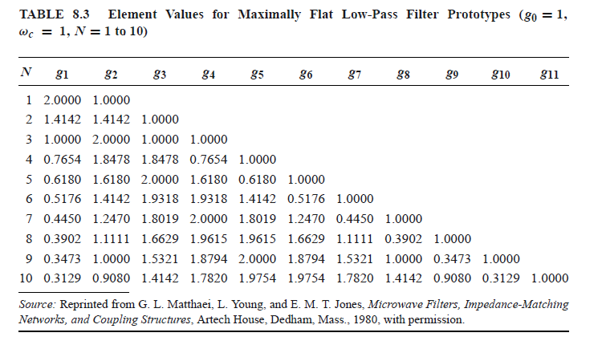
Butterworth Design Table

Slide 11
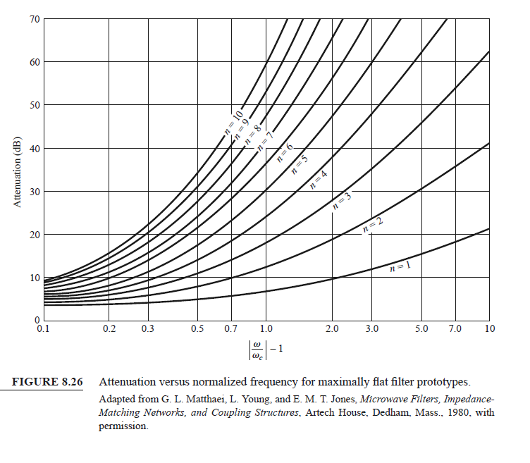
Butterworth Attenuation Plot
Attenuation (Insertion Loss)
(Note the log scale on the horizontal axis.)

Slide 12
Chebyshev Behavior

Slide 13
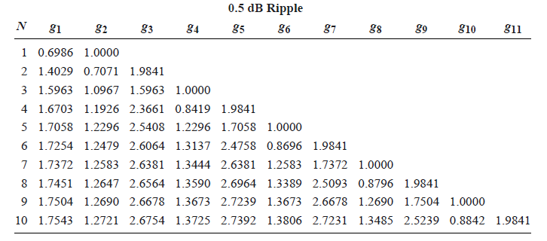
Chebyshev Design Table

Slide 14
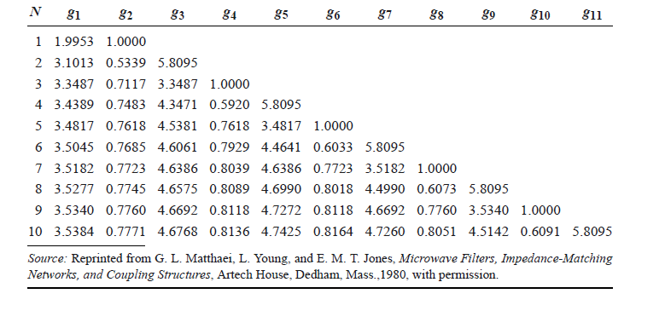
Chebyshev Design Table

Slide 15
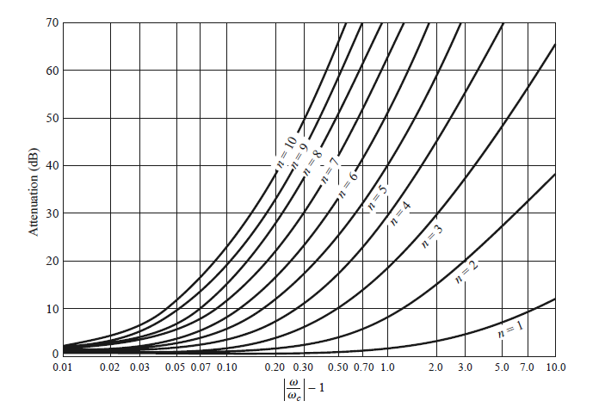
Chebyshev Attenuation Plot
Attenuation (Insertion Loss)

Slide 16
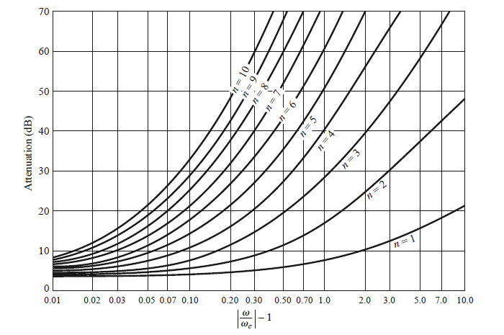
Chebyshev Attenuation Plot (cont.)
Attenuation (Insertion Loss)

Slide 17
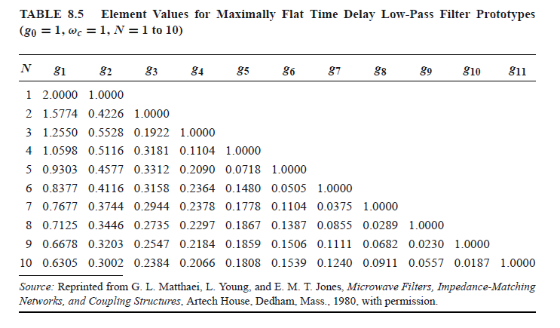
Linear Phase Design Table
(Minimal Pulse Distortion)

Slide 18
Example
Design a normalized low-pass Butterworth filter for a matched load with an attenuation greater than 15 dB when ω / ω_{c} > 1.5.
+
Filter
-
From attenuation plot:
Choose:
Choose “a” design

Slide 19
Example (cont.)
Proposed filter layout:
+
-
From Table:
Hence:

Slide 20
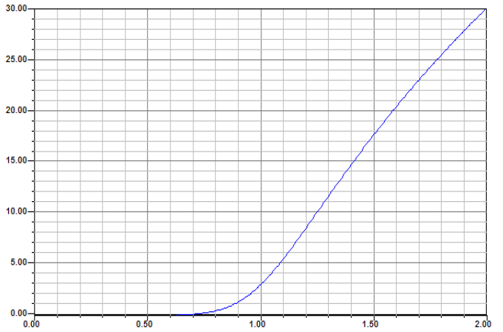
Example (cont.)
Results from Ansys Designer

Slide 21
Example
Design a normalized Chebyshev low-pass filter for a matched load with 3.0 dB of ripple in the passband and an attenuation greater than 15 dB when ω / ω_{c} > 1.5.
+
Filter
-
Note: N has to be odd when R_{L} = R₀.
From attenuation plot:
Choose:
Choose “a” design

Slide 22
Example (cont.)
Proposed filter layout:
+
-
From Table:
Hence:

Slide 23
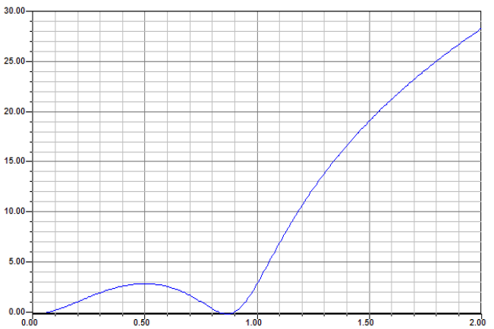
Example (cont.)
Results from Ansys Designer

Slide 24
Denormalization
Impedance scaling:
This accounts for arbitrary R_{s} and R_{L}
Scale all impedances by R₀.
The prime denotes that there is no longer impedance scaling, but a normalized frequency is still being used (ω_{c} = 1).

Slide 25
Denormalization (cont.)
Frequency scaling:
This allows us to shift from ω_{c} = 1 to arbitrary ω_{c}
Replace ω with ω / ω_{c} (and require same impedances)
ω in prototype
ω in final filter
Hence:

Slide 26
Denormalization (cont.)
Impedance and frequency scaling:
This scales the impedance and shifts from ω_{c} = 1 to arbitrary ω_{c} .
This takes us from the normalized “prototype” low-pass filter
to the final low-pass filter.

Slide 27
Example
Design a low-pass Butterworth filter for a matched 50 Ω load with f_{c} = 1.0 GHz and an attenuation greater than 15 dB when ω / ω_{c} > 1.5.
Choose type “a” design (arbitrary choice)
+
-
Recall the normalized design:

Slide 28
Example (cont.)
+
-
De-normalization:

Slide 29
Example (cont.)
Results (from Ansys Designer)

Slide 30
Frequency Transformation
Normalized low-pass → High-pass
Replace:
ω in prototype
ω in final filter
(Negative values of ω in the normalized prototype (red color) have been converted to positive values.)

Slide 31
Frequency Transformation (cont.)
What happens to the circuit elements in the prototype?
We also need to divide C by a factor of R₀ to account for impedance scaling.

Slide 32
Frequency Transformation (cont.)
Also, we need to multiply L by a factor of R₀ to account for impedance scaling.

Slide 33
Frequency Transformation (cont.)
Summary
Normalized low-pass → High-pass
Normalized low-pass
Final high-pass

Slide 34

Frequency Transformation (cont.)
Normalized low pass → Bandpass
Replace:
Relative bandwidth
(Negative values of ω in the normalized prototype (red color) have been converted to positive values.)

Slide 35
Frequency Transformation (cont.)
Verification of mapping

Slide 36
Frequency Transformation (cont.)
Transformation of elements
Also, we need to add factors of R₀ to account for impedance scaling
(multiply L_{s} with R₀, divide C_{s} by R₀).

Slide 37
Frequency Transformation (cont.)
Also, we need to add factors of R₀ to account for impedance scaling
(multiply L_{p} with R₀, divide C_{p} by R₀).

Slide 38
Frequency Transformation (cont.)
Summary
Normalized low-pass → Bandpass
Normalized low-pass
Final bandpass

Slide 39

Frequency Transformation (cont.)
Normalized low pass → Bandstop
Replace:
Relative bandwidth
Cutoff frequency
(Negative values of ω in the normalized prototype (red color) have been converted to positive values.)

Slide 40
Frequency Transformation (cont.)
Verification of mapping

Slide 41
Frequency Transformation (cont.)
Transformation of elements
so
Also, we need to add factors of R₀ to account for impedance scaling
(multiply L_{p} with R₀, divide C_{p} by R₀).

Slide 42
Frequency Transformation (cont.)
so
Also, we need to add factors of R₀ to account for impedance scaling
(multiply L_{s} with R₀, divide C_{s} by R₀).

Slide 43
Frequency Transformation (cont.)
Summary
Normalized low-pass → Bandstop
Prototype low-pass
Final bandstop

Slide 44
Example
Design an N = 3 Chebyshev bandpass filter for a matched 50 Ω load with 0.5 dB of ripple in the passband, a 10% bandwidth, and a center frequency of 1.0 GHz.
Choose type “b” low-pass prototype:
+
-
From table:

Slide 45
Example (cont.)
Transform to bandpass:
+
-
Bandpass:
For k = 1, 3:
For k = 2:
From table:

Slide 46
Example (cont.)
Hence we have:

Slide 47
Example (cont.)
This gives us:
+
-

Slide 48
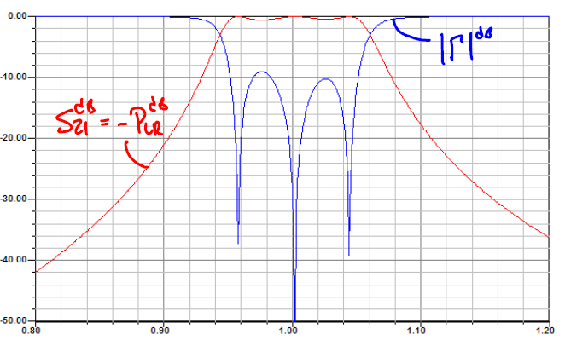
Example (cont.)
Results from Ansys Designer

