Slide 1
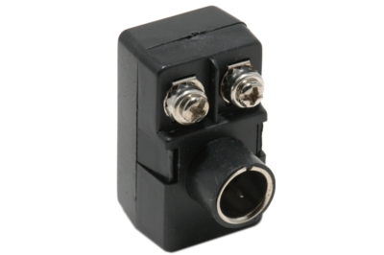
Adapted from notes by Prof. Jeffery T. Williams
ECE 5317-6351
Microwave Engineering
Fall 2019
Prof. David R. Jackson
Dept. of ECE
Notes 4
Transmission Lines
Part 3: Baluns

Slide 2
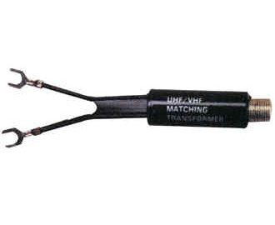
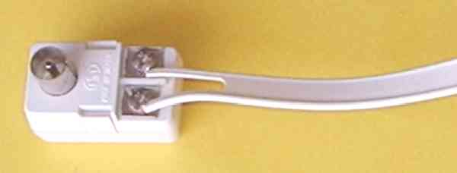
Baluns
Baluns are used to connect coaxial cables to twin leads.
They suppress the common mode currents on the transmission lines.
Balun: “Balanced to “unbalanced”
Coaxial cable: an “unbalanced” transmission line
Twin lead: a “balanced” transmission line
4:1 impedance-transforming baluns, connecting 75 Ω TV coax to 300 Ω TV twin lead
https://en.wikipedia.org/wiki/Balun

Slide 3
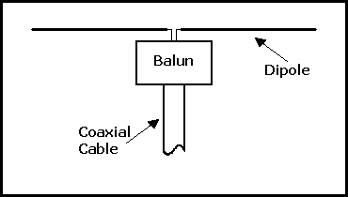
Baluns (cont.)
Baluns are also used to connect coax (unbalanced line) to dipole antennas (balanced).
“Baluns are present in radars, transmitters, satellites, in every telephone network, and probably in most wireless network modem/routers used in homes.”
https://en.wikipedia.org/wiki/Balun

Slide 4
Baluns (cont.)
What does “balanced” and “unbalanced” mean?
+
+
-
0
Ground (zero volts)
Ground (zero volts)
Twin Lead
Coax
The voltages are usually balanced with respect to ground.
The voltages are usually unbalanced with respect to ground.
Note:
If the coax outer conductor was not at zero volts, there would be a field between the coax and the ground. There would be charge and current on the outside of the coax.
This would correspond to a “common mode”.

Slide 5

Baluns (cont.)
Baluns are necessary because, in practice, the two transmission lines are always both running over a ground plane.
If there were no ground plane, and you only had the two lines connected to each other, then a balun would not be necessary.
(But you would still want to have a matching network between the two lines if they have different characteristic impedances.)
Coax
Twin Lead
No ground plane

Slide 6
Baluns (cont.)
When a ground plane is present, we really have three conductors, forming a multiconductor transmission line, and this system supports two different modes.
+
-
+
+
Differential mode
Common mode
(desired)
(undesired)
The differential and common modes are shown for a twin lead over ground.
For the common mode, both conductors of the transmission line act as one net conductor, while the ground plane acts as the other conductor (return path for the current).

Slide 7
Baluns (cont.)
Differential mode: currents are equal and opposite
Ground
Common mode: a net current flows on the two conductors
Ground

Slide 8
Baluns (cont.)
+
-
+
-
Differential mode
Common mode
(desired)
(undesired)
The differential and common modes are shown for a coax over ground.
(The red flux lines show the electric field.)

Slide 9

Baluns for Coax to Twin Lead
Because of the asymmetry, a common mode current will get excited at the junction between the two lines, and propagate away from the junction.
No Balun
Common mode
Common mode
Differential mode
Differential mode
Coax
Twin Lead
Ground
Note:
If the height above the ground plane goes to infinity, the characteristic impedance of the common mode goes to infinity, and there is no common mode current – we would not need a balun.

Slide 10
Baluns for Coax to Twin Lead (cont.)
A balun prevents common modes from being excited at the junction between a coax and a twin lead.
With Balun
Differential mode
Differential mode
Balun
Coax
Twin Lead
Ground

Slide 11
Baluns for Coax to Twin Lead (cont.)
From another point of view, a balun prevents currents from flowing on the outside of the coax.
No Balun
Assume we have some amount of common mode.
I₁
I₁
I₁
I₂
Coax
I₂- I₁
Twin Lead
(current on outside of the coax)
Ground

Slide 12
Baluns for Coax to Twin Lead (cont.)
A simple model for the mode excitation at the junction
The coax is replaced by a solid tube with a voltage source at the end.
-
+
Solid tube
Twin Lead
Ground

Slide 13
Baluns for Coax to Twin Lead (cont.)
Next, we use superposition.
-
+
Differential mode
-
+
Solid tube
Twin Lead
Ground
+
-
+
Common mode
-
+
Solid tube
Twin Lead
Ground

Slide 14
Baluns and Grounding
Baluns are also useful whenever one transmission line is grounded and the other one isn’t.
The twin lead is now forced to also be grounded.
No Balun
Twin Lead
Ground

Slide 15
Baluns and Grounding (cont.)
Baluns are also useful whenever one transmission line is grounded and the other one isn’t.
The twin lead is now ungrounded (this is the usual case for twin lead).
With Balun
Balun
Coax
Twin Lead
Ground

Slide 16
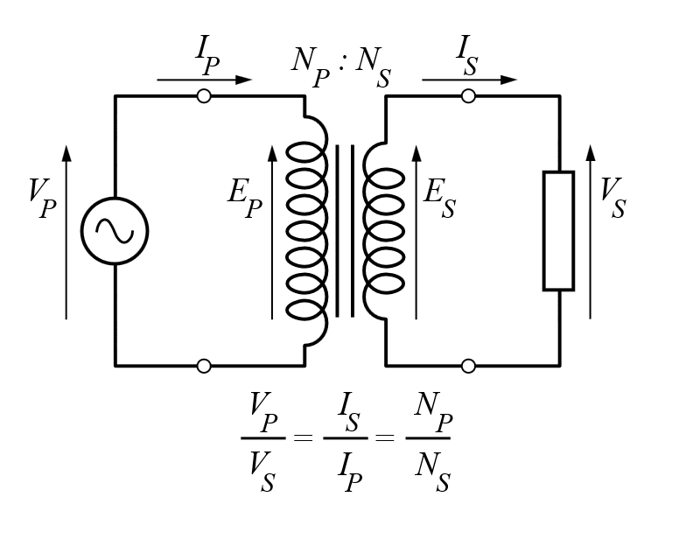
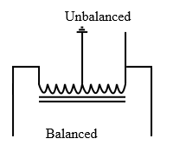
Baluns using Transformers
One type of balun uses an isolation transformer.
The input and output are isolated from each other, so the input can be grounded if desired (e.g., when using a coax feed for the primary) while the output is not (e.g., when using a twin lead feed for the secondary).
The common mode must be zero at the transformer, since a net current cannot flow off of the windings into the transformer core.
This balun uses a 4:1 autotransformer, having three taps on a single winding, on a ferrite rod.
The center tap on the input can be grounded if desired, while the balanced output is not. The common mode is choked off due to the high impedance of the coil.
https://en.wikipedia.org/wiki/Balun

Slide 17
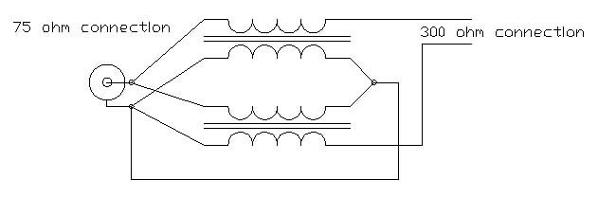
Baluns using Transformers (cont.)
Here is a more exotic type of 4:1 impedance transforming balun.
“Guanella balun”
Unbalanced and grounded coax input
Balanced and ungrounded twin lead output
This balun uses two 1:1 transformers to achieve symmetric
(and ungrounded) output voltages.

Slide 18
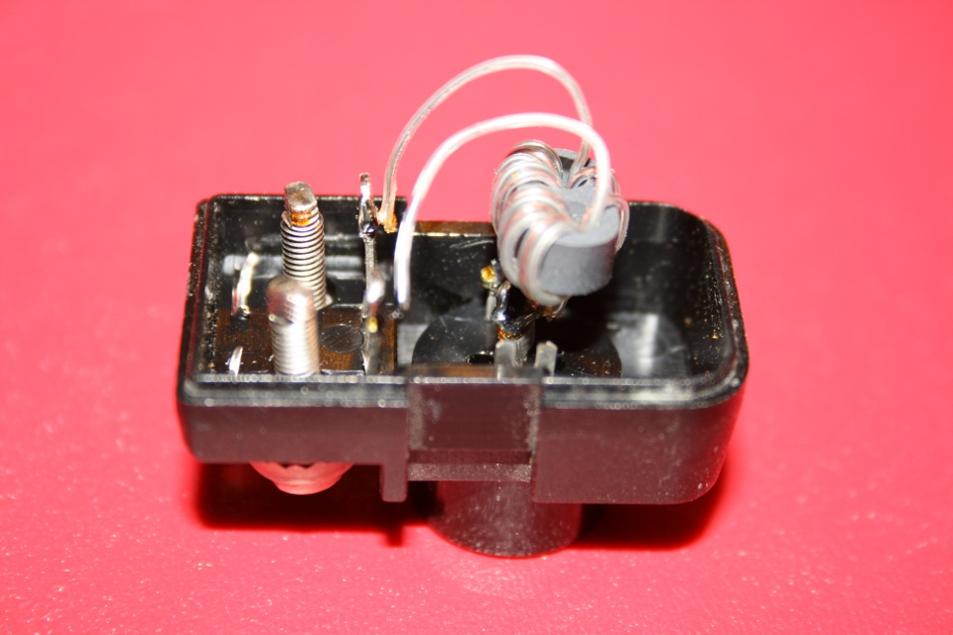
Baluns using Transformers (cont.)
Inside of 4:1 impedance transforming VHF/UHF balun for TV
Ferrite core

Slide 19
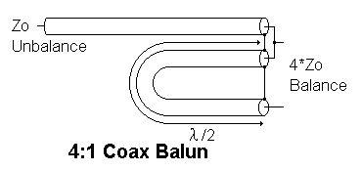
Balun using Coax
A 4:1 impedance transforming balun built using only coax
Unbalanced
Balanced
The two outputs are 180º out of phase.
(See slide 24 for a microstrip version.)

Slide 20
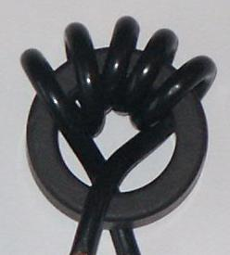
Choke Baluns
Another type of balun uses a choke to “choke off” the common mode.
A coax is wound around a ferrite core. This creates a large inductance for the common mode, while it does not affect the differential mode (whose fields are confined inside the coax).
https://en.wikipedia.org/wiki/Balun

Slide 21
Microstrip Line
Coax can be used to feed a microstrip line on a PCB without needing a balun.
Both the microstrip line (with ground plane) and the coax are two-conductor transmission line systems, so there is no common mode.

Slide 22
Baluns and CPS Line
Baluns are very useful for feeding differential circuits with coax on PCBs.
CPS line
No balun
Without a balun, there would be a common mode current on the coplanar strips (CPS) line.

Slide 23
Baluns and CPS Line (cont.)
Superposition allows us to see what the problem is.
=
+
+
+
-
-
-
+
Excites undesired common mode
Excites desired differential mode
+
-
-
+

Slide 24
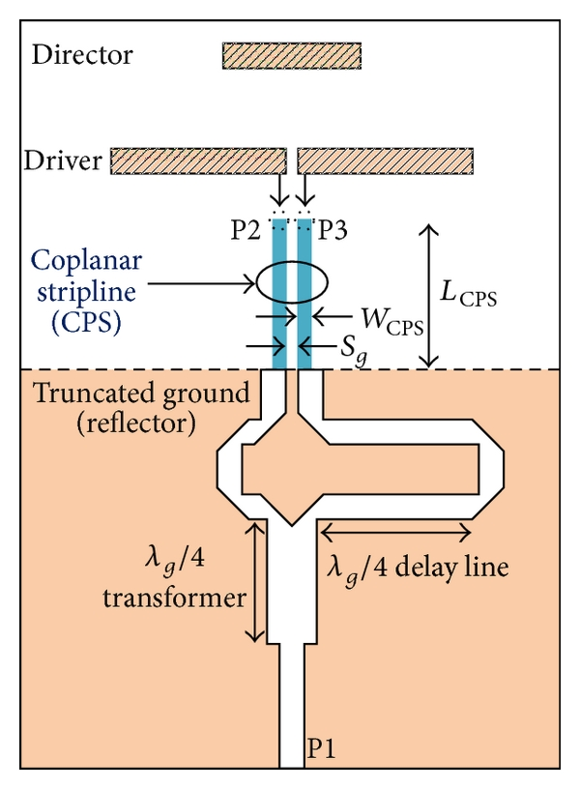
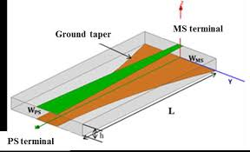
Baluns and CPS Line (cont.)
Baluns for CPS can be implemented in microstrip form.
Coax feed port
Paired-strip output
Tapered balun
Coax feed port
Balun feeding a microstrip Yagi-Uda antenna

Slide 25
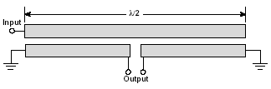
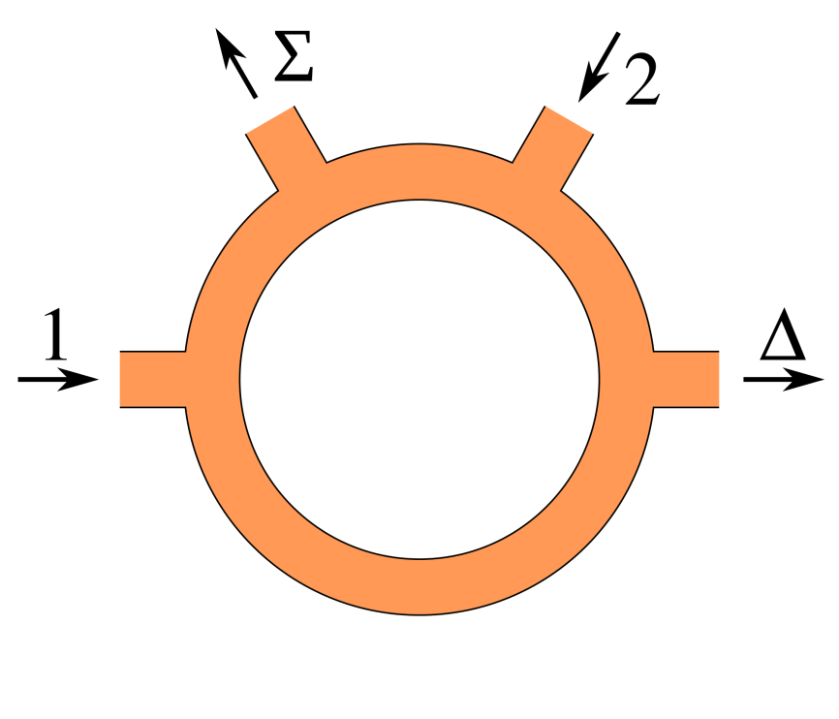
Baluns and CPS Line (cont.)
Baluns for CPS can be implemented in other microstrip forms.
Marchand balun
Null output
Input #2 (balanced)
Input #1 (balanced)
Output (unbalanced)
180º hybrid rat-race coupler used as a balun

Slide 26
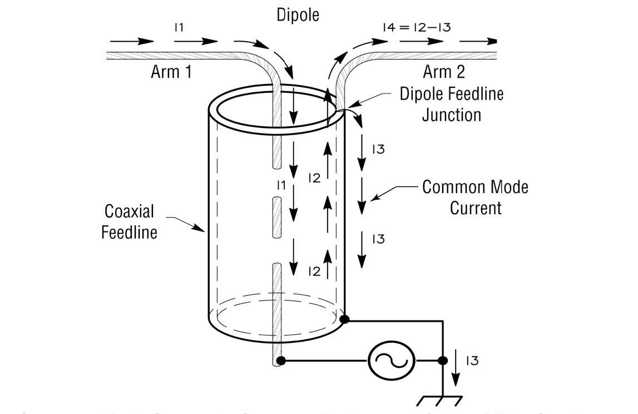
Baluns for Antennas
If you try to feed a dipole antenna directly with coax, there will be a common mode current on the coax.
No balun

Slide 27
Baluns for Antennas (cont.)
The equivalent circuit explains why there is a common mode on the coax.
-
+
Note:
The voltage source sees an asymmetric structure. The current flowing to the right has two possible paths.
No balun

Slide 28
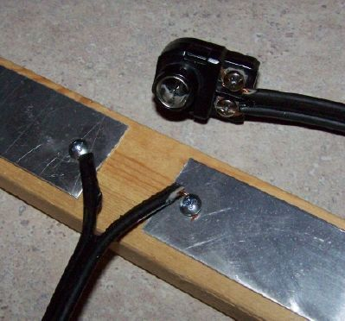
Baluns for Antennas (cont.)
Baluns are commonly used to feed dipole antennas from coax.
A balun first converts the coax to a twin lead, and then the twin lead feeds the dipole.

Slide 29
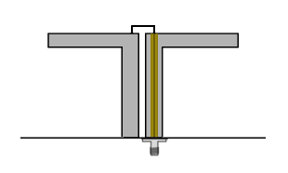
Baluns for Antennas (cont.)
Baluns are commonly used to feed dipole antennas from coax.
“Twin Arm Balun”
This acts like voltage source for the dipole, which forces the differential mode.
The dipole is loaded by a short-circuited section of “twin lead” (composed of the two hollow pipes). This is an open circuit at the source location because of the λ/4 height.

Slide 30
Baluns for Antennas (cont.)
Equivalent Circuit
-
+
Short
The equivalent circuit shows us that the current on the dipole arms are perfectly balanced.
The voltage source sees the dipole in parallel with a short-circuited length of “twin lead” (made from the vertical pipes) of length λ₀ / 4.

Slide 31
Baluns for Antennas (cont.)
Another balun for feeding a dipole antenna from coax.
“Split Coax Balun”
The operation here is very similar to the previous balun.
Both sides of the coax are split.

Slide 32
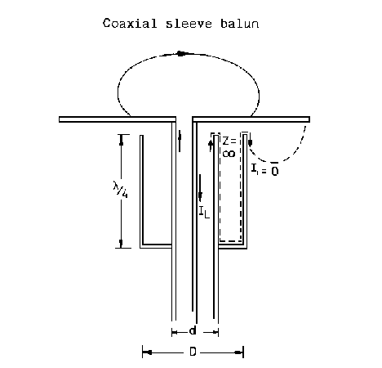
Baluns for Antennas (cont.)
Another balun for feeding a dipole antenna from coax.
“Bazooka Balun”
The current on the inside and outside of the sleeve is forced to be zero at the top of the sleeve (open circuit). This makes it small everywhere on the outside.
Coaxial “sleeve” region
A “sleeve balun” directly connects a coax to a dipole.

Slide 33
Baluns for Antennas (cont.)
A balun is not always necessary when feeding an antenna.
Twin lead
Dipole antenna
The system stays balanced – no common mode.
Infinite ground plane
Monopole antenna
Coax
Current cannot flow on the outside of the coax.

Slide 34
Baluns and Measuring Probes
Baluns can be important when connecting to
unbalanced devices like oscilloscopes.
Wires
OSC
Coax input
Measuring probe
No Balun
There may be a strong common mode current on the two coax wires. The coax wires will act as an antenna! You may not really be measuring the field from the probe.

Slide 35
Baluns and Measuring Probes (cont.)
Baluns can be important when connecting to
unbalanced devices like oscilloscopes.
Coax
OSC
Coax input
Measuring probe
No Balun
Now there is a common mode on the coax. The coax will act as an antenna! You may not really be measuring the field from the probe.

Slide 36
Baluns and Measuring Probes (cont.)
Baluns can be important when connecting to
unbalanced devices like oscilloscopes.
Balun
Coax
OSC
Coax input
Measuring probe
With Balun
Now there is only a differential mode on the coax, and the coax acts as a transmission line. We measure what is coming from the probe.

