Slide 1
Adapted from notes by Prof. Jeffery T. Williams
ECE 5317-6351
Microwave Engineering
Fall 2019
Prof. David R. Jackson
Dept. of ECE
Notes 8
Waveguiding Structures
Part 3: Parallel Plates

Slide 2
Field Equations (from Notes 6)
Summary
This table of fields will be useful to us in the present discussion.
Assumption:
(k can be complex)
(k_{c} is always real)

Slide 3
Parallel-Plate Waveguiding Structure
Both plates assumed PEC
w >> d
(neglect edge effects)
The parallel-plate structure is a good approximate model for a wide microstrip line.
,

Slide 4
TEM Solution Process
A) Solve Laplace’s equation subject to appropriate B.C.s.:
B) Find the transverse electric field:
C) Find the total electric field:
D) Find the magnetic field:
Note: The only frequency dependence is in the wavenumber k_{z} = k.

Slide 5
TEM Mode
2 conductors ⇒ 1 TEM mode
To solve for TEM mode:
Boundary conditions:

Slide 6
TEM Mode (cont.)
where
Hence
We then have

Slide 7
TEM Mode (cont.)
Recall
Fields for +z mode:
E
H

Slide 8
TEM Mode (cont.)
We can view the TEM mode in a parallel-plate waveguiding structure as a rectangular “slice” of a plane wave.
PEC
PMC
PMC
PEC
The PEC and PMC walls do not disturb the fields of the plane wave.
PEC: Perfect Electric Conductor
PMC: Perfect Magnetic Conductor

Slide 9
TEM Mode (cont.)
Assume a wave propagating the in + z direction henceforth.
Time-ave power flow in + z direction:

Slide 10
TEM Mode (cont.)
Transmission line voltage
Transmission line current
Characteristic Impedance

Slide 11
TEM Mode (cont.)
Time-ave power flow in +z direction:
(calculated using the voltage and current)
Recall that we found from the fields that:
Same
This is expected, since a TEM mode is a transmission-line type of mode, which is described by voltage and current.

Slide 12
TM_{z} Modes (H_{z} = 0)
Recall:
where
eigenvalue problem
Note:
Solving the eigenvalue problem
(using appropriate boundary conditions)
will tell us what the eigenvalue k_{c} is.
(Assume no x variation)
so

Slide 13
TM_{z} Modes (cont.)
subject to B.C.’s E_{z} = 0 @ y = 0, d
Solving the above equation:

Slide 14
TM_{z} Modes (cont.)
For a wave propagating in the +z direction:
No x variation
TM_{z} mode

Slide 15
TM_{z} Modes (cont.)
Summary
Each value of n corresponds to a unique TM_{z} field solution or “mode” in the waveguide.
TM_{n} mode
Note:
The TEM mode can be thought of as a TM₀ mode.

Slide 16
TM_{z} Modes (cont.)
Lossless Case
Fields decay exponentially
⇒ “evanescent” mode

Slide 17
TM_{z} Modes (cont.)
Cutoff frequency (for lossless case)
This is the frequency that defines the border between evanescence and propagation.
f_{c} ≡ cutoff frequency
cutoff frequency for TM_{n} mode
Note: For a lossy waveguide, there is no sharp definition of cutoff frequency.

Slide 18
TM_{z} Modes (cont.)
Time average power flow in z direction (lossless case):

Slide 19
TE_{z} Modes (E_{z} = 0)
Recall:
where
eigenvalue problem
Note:
Solving the eigenvalue problem
(using appropriate boundary conditions)
will tell us what the eigenvalue k_{c} is.
(Assume no x variation)
so

Slide 20
TE_{z} Modes (cont.)
subject to B.C.’s E_{x} = 0 @ y=0, d
Solving the above equation:

Slide 21
TE_{z} Modes (cont.)
For a wave propagating in the +z direction:
No x variation
TE_{z} mode

Slide 22
TE_{z} Modes (cont.)
Summary
Each value of n corresponds to a unique TE_{z} field solution or “mode.”
TE_{n} mode
Cutoff frequency
Note: There is no TE₀ mode
(This mode would be a plane wave having E_{x} and H_{y}, but
would not be supported by this system. This mode would require PMC on top and bottom, and PEC on the sides.)

Slide 23
Power in TE_{z} Mode
Time average power flow in z direction (lossless case):

Slide 24
Mode Chart
For all the modes of a parallel-plate waveguiding structure, we have
TE
TE
TE
1
2
3
TEM
TM
TM
TM
1
2
3
Single
3
5
mode
modes
mode
…
.
prop
.
prop
prop
.
0
The mode with lowest cutoff frequency is called the
“dominant” mode of the waveguide.
Important conclusion: If we want to use the structure as a transmission line, we need to operate in the region f < f_{c1}.

Slide 25
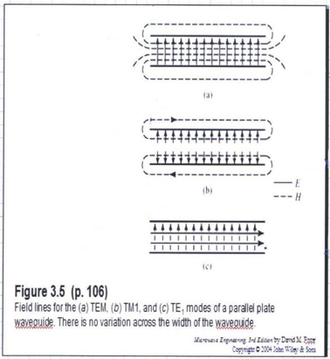
Field Plots
TEM
TM₁
TE₁
(from Pozar book)

Slide 26
Plane Wave Interpretation
TM_{z} waveguide mode propagating in +z direction:
Re-label this as k_{y}

Slide 27
Plane Wave Interpretation (cont.)
The TM_{z} waveguide mode is a sum of two plane waves*:
Side view
×
×
*We can also think of one a single plane wave bouncing up and down.

Slide 28
Plane Wave Interpretation (cont.)
The TE_{z} waveguide mode is a sum of two plane waves*:
Side view
×
×
*We can also think of one a single plane wave bouncing up and down.

Slide 29
Conductor Attenuation on Parallel Plates
TEM Mode
Assume no dielectric loss for the calculation of conductor attenuation.
On the top plate:
On the bottom plate:

Slide 30
Conductor Attenuation on Parallel Plates (cont.)
(equal contributions from both plates)
We then have:
The final result is then

Slide 31
Conductor Attenuation on Parallel Plates (cont.)
Let’s try the same calculation using the Wheeler incremental inductance rule.
We apply the formula for each conductor and then add the results:
From previous calculations:
In this formula, (for a given conductor) is the distance by which the conducting boundary is receded away from the field region.

Slide 32
Conductor Attenuation on Parallel Plates (cont.)
Hence, we have:

Slide 33
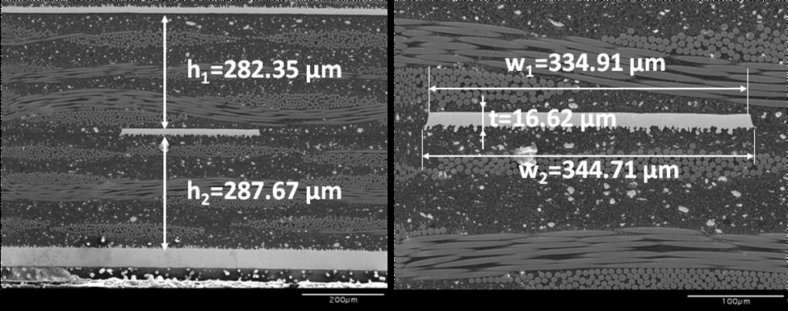
Surface Roughness
Conductor attenuation will increase due to surface roughness effects.
Stripline
①
②
③
④
200 μm
Surfaces 3 and 4 are rough.

Slide 34
Surface Roughness (cont.)
We can use an effective conductivity to account for surface roughness.
Example:
Pure copper
Practical copper

Slide 35
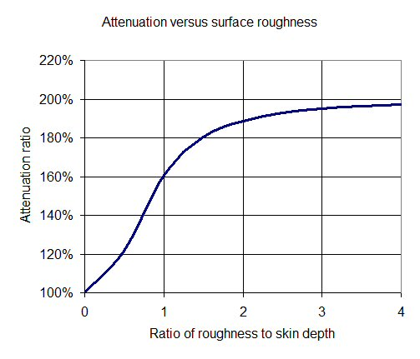
Surface Roughness (cont.)
  Hammerstad and Jensen formula
R_{a} = height of surface roughness
This is a factor that gives the increase in the attenuation constant α.
Attenuation factor K_{rough} vs. surface roughness
E. Hammerstad and O. Jensen, “Accurate models for microstrip computer-aided design,” in Microwave Symp. Digest, IEEE MTT-S International, 1980, vol. 1, no. 12, pp. 407–409.
Attenuation factor
Ratio of roughness R_{a} to skin depth δ
https://www.microwaves101.com/encyclopedias/surface-roughness

Slide 36
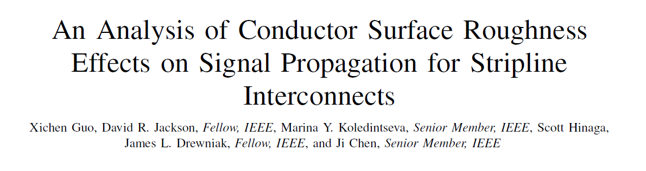
Surface Roughness (cont.)
A_{r}: Hemispheroid height
r_{base}: Hemispheroid radius
Λ_{r}: Period
X. Guo, D. R. Jackson, M. Y. Koledintseva, S. Hinaga, J. L. Drewniak, and J. Chen, “An Analysis of Conductor Surface Roughness Effects on Signal Propagation for Stripline Interconnects,” IEEE Trans. Electromagnetic Compatibility, Vol. 56, No. 3, pp. 707–714, June 2014.

Slide 37
Conductor Attenuation on Parallel Plates (cont.)
Waveguide Modes
Results for TM/TE Modes (above cutoff): (derivation omitted)
TM_{n} modes of PPW:
TE_{n} modes of PPW:
Note: Below cutoff, we usually do not worry about conductor loss.

