Slide 1

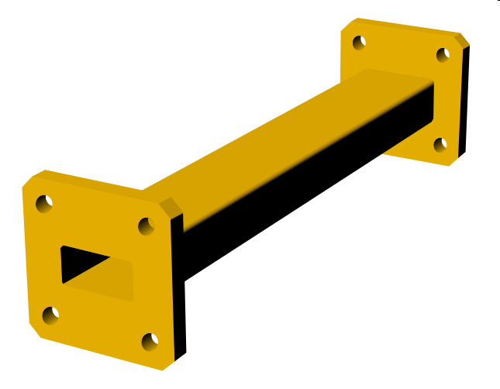

Adapted from notes by Prof. Jeffery T. Williams
ECE 5317-6351
Microwave Engineering
Fall 2026
Prof. David R. Jackson
Dept. of ECE
Notes 8
Waveguiding Structures Part 3:
Rectangular and Circular Waveguide

Slide 2

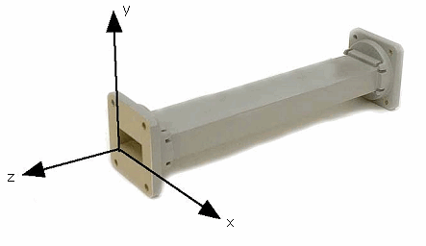








Rectangular Waveguide
One of the earliest waveguides.
Still common for high power and low-loss microwave / millimeter-wave applications.
It is essentially an electromagnetic pipe
with a rectangular cross-section.
Single conductor ⇒ No TEM mode
For convenience:
a ≥ b (the long dimension lies along x).

Slide 3
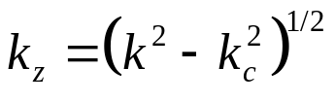
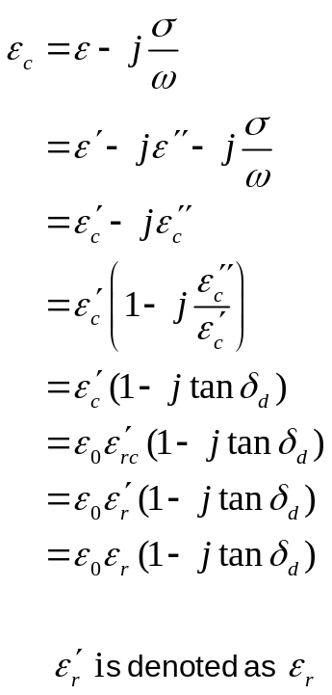

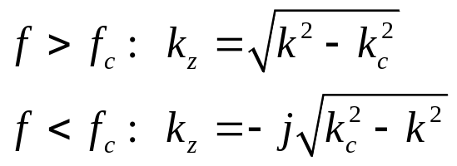
Rectangular Waveguide (cont.)
Two types of modes:
TE_{z} , TM_{z}
The cutoff wavenumber k_{c} is real.
Note:
We have an exact solution as long as the walls are PEC.
We need to solve for k_{c}.

Slide 4

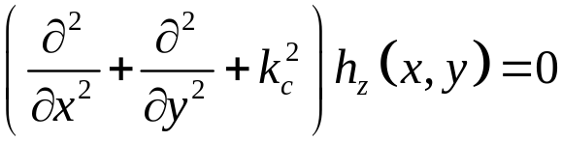

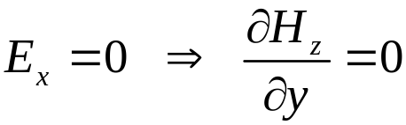

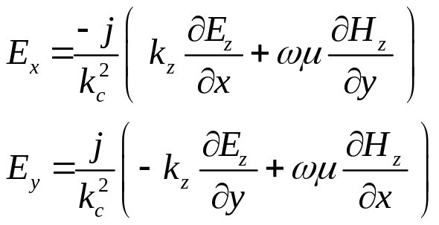
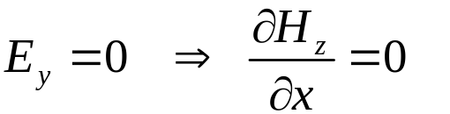

TE_{z} Modes
For +z propagation:
where
Subject to B.C.’s:
From previous field table:
(“Neumann B.C.”)

Slide 5
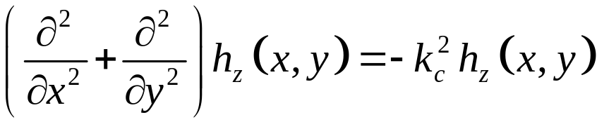

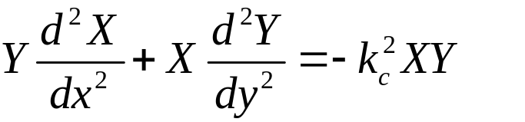
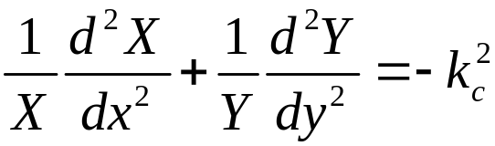
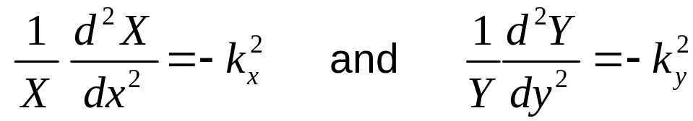

TE_{z} Modes (cont.)
(eigenvalue problem)
Using separation of variables, let
Must be a constant
This is the “separation equation”.
(If we take one term across the equal sign, we have a function of x equal to a function of y.)
where
“separation equation”

Slide 6
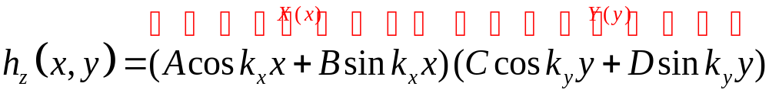
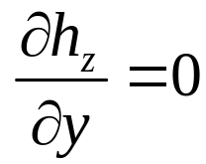

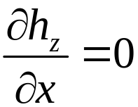

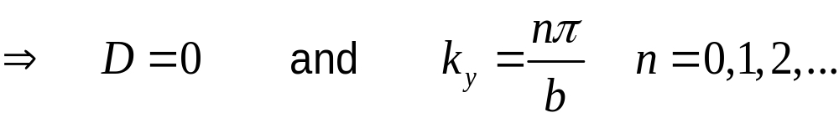
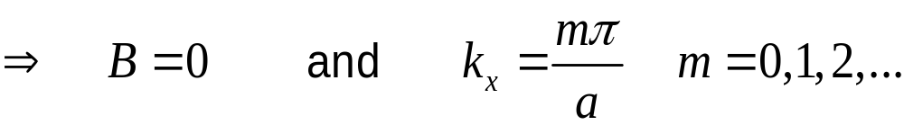
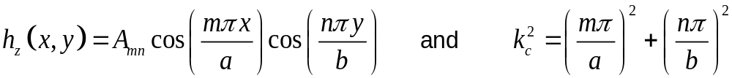
TE_{z} Modes (cont.)
Hence, we have:
A
Boundary Conditions:
B
A
B

Slide 7
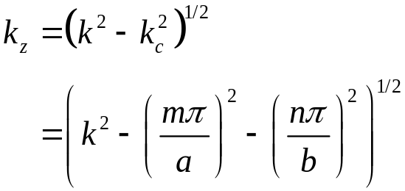
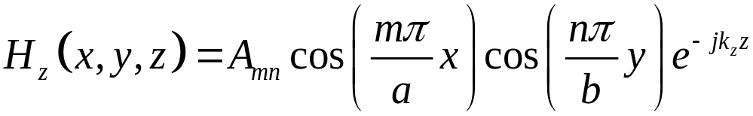
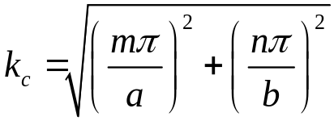
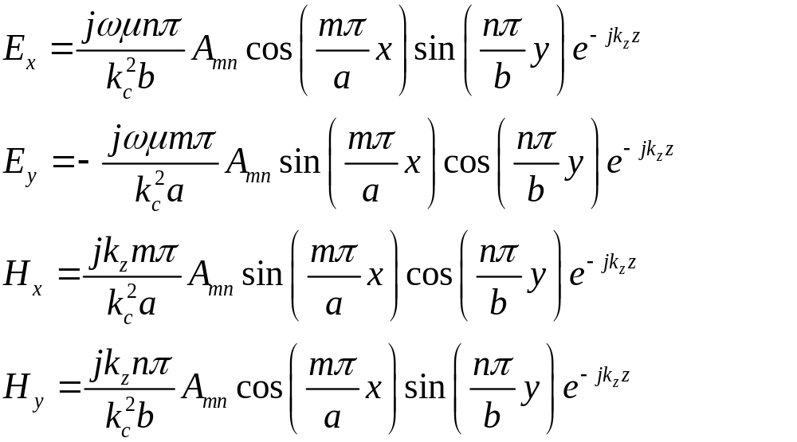
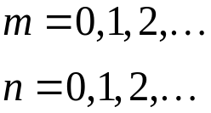

TE_{z} Modes (cont.)
Therefore, we have:
From the field table, we obtain the following:
Note:
But m = n = 0 is not allowed!
(non-physical solution)

Slide 8
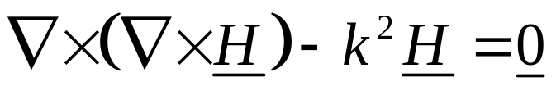
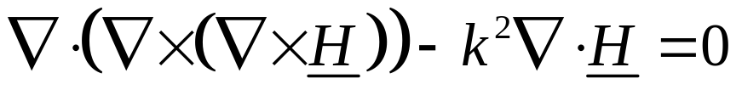
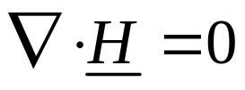
TE_{z} Modes (cont.)
Reason for non-physical solution
Start with the vector wave equation:
Vector wave equation: from Maxwell’s equations.
Take divergence of both sides.
The divergence of a curl is zero.
Magnetic Gauss law

Slide 9
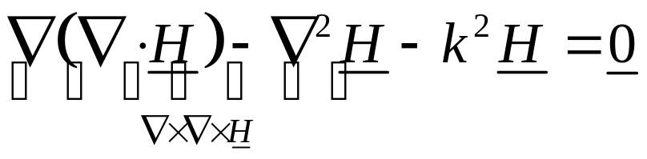
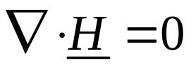
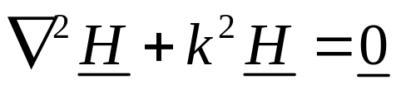
TE_{z} Modes (cont.)
Reason for non-physical solution
Revisit how we obtained the vector Helmholtz equation:
Vector wave equation: from Maxwell’s equations.
From definition of vector Laplacian
Now use:
Magnetic Gauss law
A needed assumption!
Vector Helmholtz equation (what we have solved)

Slide 10
TE_{z} Modes (cont.)
Reason for non-physical solution:
Vector wave equation ⇒ magnetic Gauss law
Vector Helmholtz equation ⇒ magnetic Gauss law
The vector Helmholtz equation does not guarantee that the magnetic Gauss law is satisfied. In the mathematical derivation, we need to assume the magnetic Gauss law in order to arrive at the vector Helmholtz equation.
All of the modes that we get by solving the Helmholtz equation should be checked to make sure that they do satisfy the magnetic Gauss law.
Note: The TE₀₀ mode is the only one that violates the magnetic Gauss law.

Slide 11

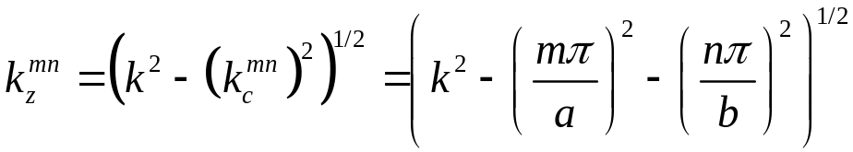


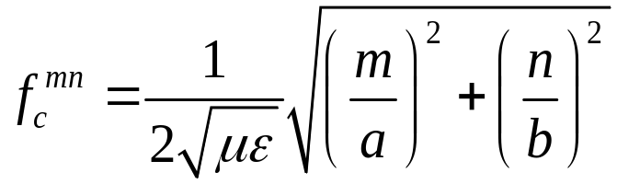
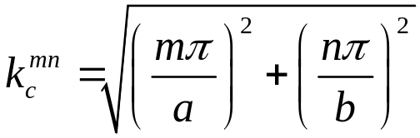
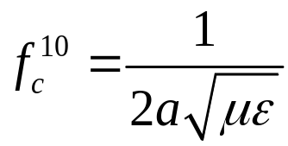
TE_{z} Modes (cont.)
Lossless case
Note:
Cutoff frequency is only well-defined in the lossless case.
⇒ TE_{mn} mode is at cutoff when
Lowest cutoff frequency is for TE₁₀ mode (a > b)
We will revisit this mode later.
Dominant TE mode (lowest f_{c})

Slide 12
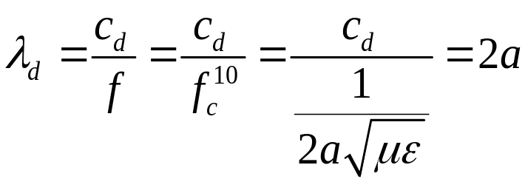
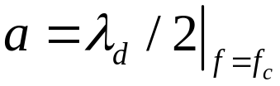
TE_{z} Modes (cont.)
At the cutoff frequency of the TE₁₀ mode (lossless waveguide):
so

Slide 13

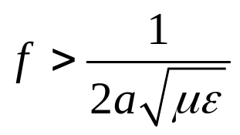
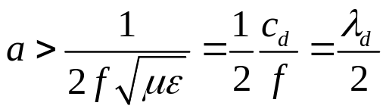
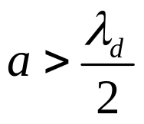
TE_{z} Modes (cont.)
To have propagation of the TE₁₀ mode:
so
or
or
Example: Air-filled waveguide, f = 10 GHz. We have that a > 3.0 cm / 2 = 1.5 cm.

Slide 14
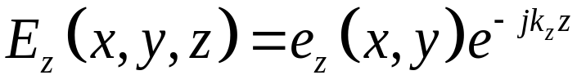
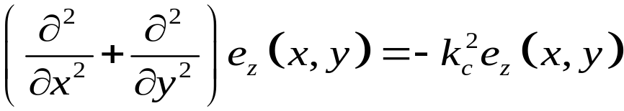




TM_{z} Modes
Recall:
where
(eigenvalue problem)
Subject to B.C.’s:
Thus, following same procedure as before, we have the following result:

Slide 15
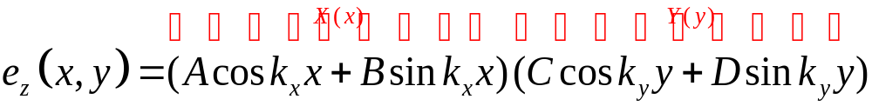



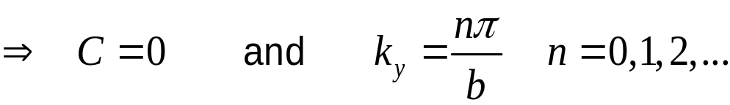
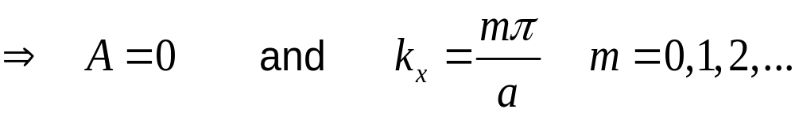
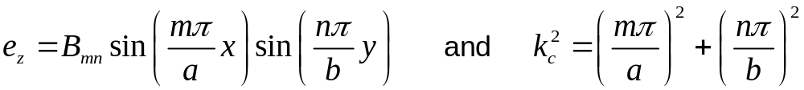
TM_{z} Modes (cont.)
Boundary Conditions:
A
B
A
(“Dirichlet B.C.”)
B

Slide 16
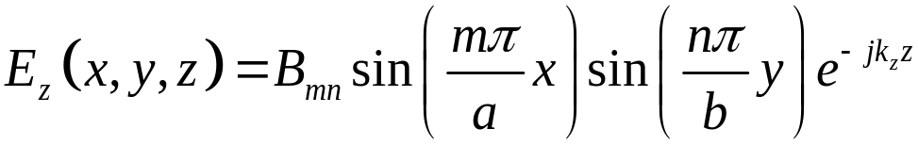
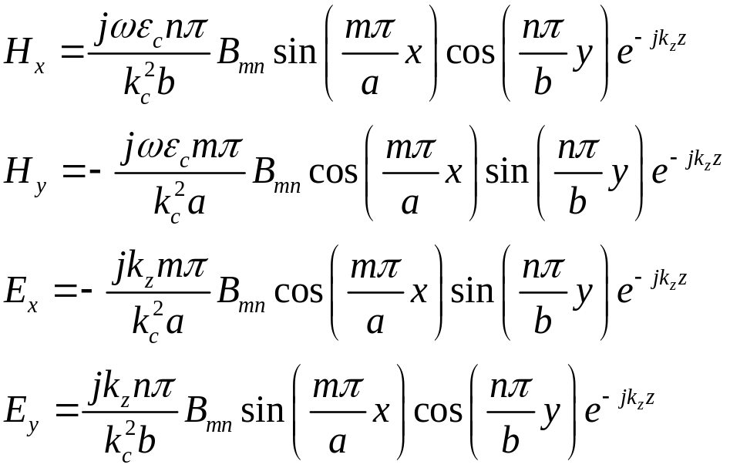
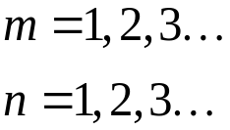
TM_{z} Modes (cont.)
Therefore, we have:
From the field table, we obtain the following:
Note:
If either m or n is zero, the field becomes a trivial one in the TM_{z} case.

Slide 17
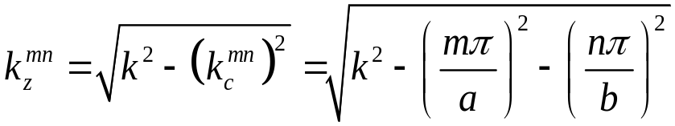

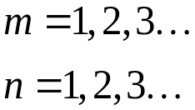

TM_{z} Modes (cont.)
Lossless case
(same as for TE modes)
The lowest cutoff frequency is obtained for the TM₁₁ mode
Dominant TM mode (lowest f_{c})

Slide 18









Mode Chart
Lossless case
Two cases are considered:
b < a / 2
Single mode operation
f
The maximum bandwidth for single-mode operation is 2:1 (67%).
b > a / 2
Single mode operation
f

Slide 19








Dominant Mode: TE₁₀ Mode
For this mode we have:
Hence, we have:

Slide 20






Dominant Mode: TE₁₀ Mode (cont.)
The fields can be put in terms of E₁₀:
Note: E₁₀ is the field at the center of the waveguide.

Slide 21











Dispersion Diagram for TE₁₀ Mode
Lossless case
(TEM_{z} mode, or “Light line”)
Phase velocity:
Velocities are slopes on the dispersion plot.
Group velocity:

Slide 22





Field Plots for TE₁₀ Mode
Top view
End view
Side view

Slide 23





Field Plots for TE₁₀ Mode (cont.)
Top view
End view
Side view
Note: One can cut a narrow z-directed slot in the center of the top wall without disturbing the current.

Slide 24






Power Flow for TE₁₀ Mode
Time-average power flow in the z direction for +z mode:
Note:
Simplifying, we have:
At breakdown:
Note:
For a given maximum electric field level (e.g., the breakdown field), the power is increased by increasing the height b.
(But we usually want to keep b < a/2.)

Slide 25




Dielectric Attenuation for TE₁₀ Mode
From Notes 7 we have:

Slide 26







Conductor Attenuation for TE₁₀ Mode
(calculated on slide 24)
Recall:
Lossless
on conductor

Slide 27




Conductor Attenuation for TE₁₀ Mode (cont.)
Side walls
Lossless
Hence:

Slide 28




Conductor Attenuation for TE₁₀ Mode (cont.)
Top and bottom walls
Lossless
(The fields of this mode are independent of y.)
Hence, we have:

Slide 29


Conductor Attenuation for TE₁₀ Mode (cont.)
We then have:
Lossless

Slide 30









Conductor Attenuation for TE₁₀ Mode (cont.)
Assume f > f_{c}
(The wavenumber is taken as that of a guide with perfect walls.)
Lossless
Simplify, using
Final result:

Slide 31



Conductor Attenuation for TE₁₀ Mode (cont.)
Final Formulas
Two alternative forms for the final result:
Lossless

Slide 32





Attenuation for TE₁₀ Mode (cont.)
Brass X-band air-filled waveguide
(See the table on the next slide.)
a = 2.0 cm
Note: P₀ = 0 at cutoff
(Fig. 3.12 of Pozar)

Slide 33
Attenuation for TE₁₀ Mode (cont.)
Microwave Frequency Bands
Letter Designation | Frequency range
L band | 1 to 2 GHz
S band | 2 to 4 GHz
C band | 4 to 8 GHz
X band | 8 to 12 GHz
Ku band | 12 to 18 GHz
K band | 18 to 26.5 GHz
Ka band | 26.5 to 40 GHz
Q band | 33 to 50 GHz
U band | 40 to 60 GHz
V band | 50 to 75 GHz
E band | 60 to 90 GHz
W band | 75 to 110 GHz
F band | 90 to 140 GHz
D band | 110 to 170 GHz
(from Wikipedia)

Slide 34




Modes in an X-Band Waveguide
“Standard X-band waveguide” (WR90)
Mode
f_{c} [GHz]
50 mil (0.05 inch) thickness

Slide 35







Example: X-Band Waveguide
Determine β, α, and λ_{g} (as appropriate) at 10 GHz and 6 GHz for the TE₁₀ mode in a lossless air-filled X-band waveguide.

Slide 36





Example: X-Band Waveguide (cont.)
Evanescent mode: β = 0; λ_{g} is not defined!

Slide 37




Fields of a Guided Wave
Fields Equations in Cylindrical Coordinates
These are useful for a circular waveguide.
These equations give the transverse field components in terms of the
longitudinal components, E_{z} and H_{z.}

Slide 38






Circular Waveguide
TM_{z} mode:
PEC
(eigenvalue problem)
The solution in cylindrical coordinates is (ECE 6341):
This means any combination of these two functions.
Note: The value n must be an integer to have unique fields.

Slide 39

References for Bessel Functions
References:
M. R. Spiegel, Schaum’s Outline Mathematical Handbook, McGraw-Hill, 1968.
M. Abramowitz and I. E. Stegun, Handbook of Mathematical Functions with Formulas, Graphs, and Mathematical Tables, National Bureau of Standards, Government Printing Office, Tenth Printing, 1972.
N. N. Lebedev, Special Functions & Their Applications, Dover Publications, New York, 1972.

Slide 40




Plot of Bessel Functions
n = 0
n = 1
J_{n} (x)
n = 2
x

Slide 41





Plot of Bessel Functions (cont.)
n = 0
n = 1
n = 2
Y_{n} (x)
x

Slide 42





Circular Waveguide (cont.)
Choose (somewhat arbitrarily)
The field should be finite on the z axis.
is not allowed
Hence, we have

Slide 43










Circular Waveguide (cont.)
B.C.’s:
Hence
Sketch for a typical value of n (n ≠ 0).
Note: Pozar uses the notation p_{mn}.
Note: The value x_{n0} = 0 (p = 0) is not included since this would yield a trivial solution:
(This is true unless n = 0, in which case we cannot have p = 0.)

Slide 44



Circular Waveguide (cont.)
TM_{np} mode:

Slide 45






Cutoff Frequency: TM_{z}
Assume k is real here (lossless dielectric).
At f = f_{c} :

Slide 46
Cutoff Frequency: TM_{z} (cont.)
x_{np} values
p \ n | 0 | 1 | 2 | 3 | 4 | 5
1 | 2.405 | 3.832 | 5.136 | 6.380 | 7.588 | 8.771
2 | 5.520 | 7.016 | 8.417 | 9.761 | 11.065 | 12.339
3 | 8.654 | 10.173 | 11.620 | 13.015 | 14.372
4 | 11.792 | 13.324 | 14.796
TM₀₁, TM₁₁, TM₂₁, TM₀₂, …

Slide 47






TE_{z} Modes
Proceeding as before, we now have that
Set
(From Ampere’s law)
(Neumann boundary condition)
Hence
The prime denotes derivative with respect to the argument.

Slide 48






TE_{z} Modes (cont.)
Sketch for a typical value of n (n ≠ 1).
We don’t need to consider p = 0; this is explained on the next slide.

Slide 49







TE_{z} Modes (cont.)
Note: If p = 0, then
We then have, for p = 0:
(trivial solution)
(nonphysical solution)
(violates the magnetic Gauss law)
The TE₀₀ mode is not physical.

Slide 50



Circular Waveguide (cont.)
TE_{np} mode:

Slide 51




Cutoff Frequency: TE_{z}
Assume k is real here (lossless dielectric).
Hence, we have:

Slide 52
Cutoff Frequency: TE_{z}
x´_{np} values
p \ n | 0 | 1 | 2 | 3 | 4 | 5
1 | 3.832 | 1.841 | 3.054 | 4.201 | 5.317 | 5.416
2 | 7.016 | 5.331 | 6.706 | 8.015 | 9.282 | 10.520
3 | 10.173 | 8.536 | 9.969 | 11.346 | 12.682 | 13.987
4 | 13.324 | 11.706 | 13.170
TE₁₁, TE₂₁, TE₀₁, TE₃₁, …

Slide 53


TE₁₁ Mode
The dominant mode of circular waveguide is the TE₁₁ mode.
Electric field
Magnetic field
(From Wikipedia)
TE₁₀ mode of
square waveguide
TE₁₁ mode of
circular waveguide
The TE₁₁ mode can be thought of as an evolution of the TE₁₀ mode of square waveguide as the boundary changes shape.

Slide 54



TE₁₁ Mode (cont.)
The attenuation due to conductor loss for the TE₁₁ mode of circular waveguide is:
The derivation is in the Pozar book (see Eq. 3.133).

Slide 55



TE₀₁ Mode
The TE₀₁ mode of circular waveguide has the unusual property that the conductor attenuation decreases with frequency. (With most waveguide modes, the conductor attenuation increases with frequency.)
Reason: This mode has current only in the φ direction, and this component of current (corresponding to H_{z}) decreases as the frequency increases (for a fixed power flow down the guide, i.e., a fixed E_{φ}). (Please see the equations on the next slide.)
The TE₀₁ mode was studied extensively as a candidate for long-range communications – but eventually fiber-optic cables became available with even lower loss. It is still useful for some high-power applications.
Note: This mode is not the dominant mode!
(Fig. 3.13 of Pozar)

Slide 56


TE₀₁ Mode (cont.)
The fields of the TE₀₁ mode are:

Slide 57

TE₀₁ Mode (cont.)
Circular Waveguide
Note: The attenuation increases at high frequency for all other modes, due to R_{s}.

Slide 58



TE₀₁ Mode (cont.)
Practical Note:
The TE₀₁ mode has only an azimuthal (φ - directed) surface current on the wall of the waveguide. Therefore, it can be supported by a set of conducting rings, while the lower modes (TE₁₁ ,TM₀₁, TE₂₁, TM₁₁) will not propagate on such a structure.
(A helical spring will also work fine.)
TE₀₁ mode:
(Fig. 3.13 of Pozar)

Slide 59

TE₀₁ Mode (cont.)
VertexRSI's Torrance Facility is a leading supplier of antenna feed components for the various commercial and military bands. A patented circular polarized 4-port diplexer meeting all Intelsat specifications leads a full array of products.
Products include:
4-Port Diplexers, CP or Linear;
3-Port Diplexers, 2xRx & 1xTx;
2-Port Diplexers, RxTx, X-Pol or
Co-Pol, CP or Linear;
TE21 Monopulse Tracking Couplers;
TE01 Mode Components; Transitions;
Filters; Flex Waveguides;
Waveguide Bends; Twists; Runs; etc.
Many of the items are "off the shelf products".
Products can be custom tailored to a customer's application.
Many of the products can be supplied with standard feed horns for prime or offset antennas.

Slide 60
TE₀₁ Mode (cont.)
From the beginning, the most obvious application of waveguides had been as a communications medium. It had been determined by both Schelkunoff and Mead, independently, in July 1933, that an axially symmetric electric wave (TE₀₁) in circular waveguide would have an attenuation factor that decreased with increasing frequency [44]. This unique characteristic was believed to offer a great potential for wide-band, multichannel systems, and for many years to come the development of such a system was a major focus of work within the waveguide group at BTL. It is important to note, however, that the use of waveguide as a long transmission line never did prove to be practical, and Southworth eventually began to realize that the role of waveguide would be somewhat different than originally expected. In a memorandum dated October 23, 1939, he concluded that microwave radio with highly directive antennas was to be preferred to long transmission lines. “Thus,” he wrote, “we come to the conclusion that the hollow, cylindrical conductor is to be valued primarily as a new circuit element, but not yet as a new type of toll cable” [45]. It was as a circuit element in military radar that waveguide technology was to find its first major application and to receive an enormous stimulus to both practical and theoretical advance.
K. S. Packard, “The origins of waveguide: A case of multiple rediscovery,” IEEE Trans. Microwave Theory and Techniques, pp. 961-969, Sept. 1984.

Slide 61


TE₀₁ Mode (cont.)
“In a memorandum dated October 23, 1939, he concluded that microwave radio with highly directive antennas was to be preferred to long transmission lines.”
Recall the comparison of dB attenuation:
Waveguiding system:
Wireless system:

