Slide 1

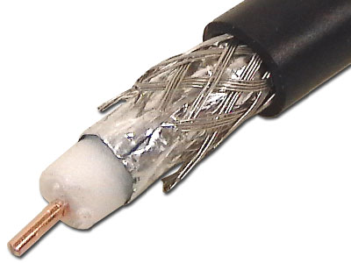
Adapted from notes by Prof. Jeffery T. Williams
ECE 5317-6351
Microwave Engineering
Fall 2026
Prof. David R. Jackson
Dept. of ECE
Notes 9
Waveguiding Structures
Part 4: Coaxial Cable

Slide 2
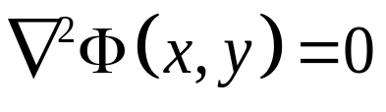
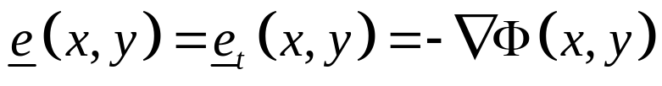
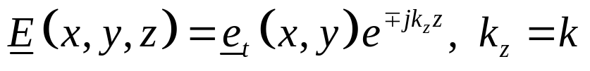
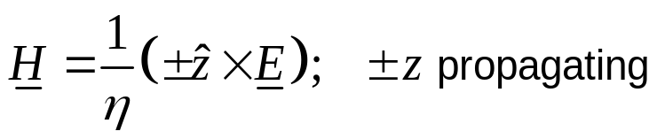
TEM Solution Process
A) Solve Laplace’s equation subject to appropriate B.C.s.:
B) Find the transverse electric field:
C) Find the total electric field:
D) Find the magnetic field:
Note: The only frequency dependence is in the wavenumber k_{z} = k.

Slide 3

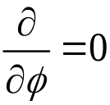

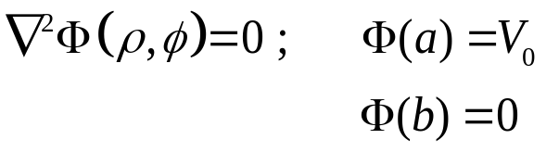



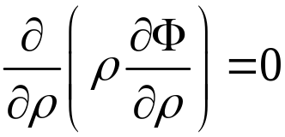

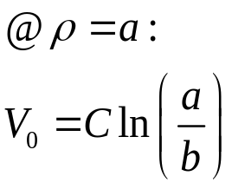
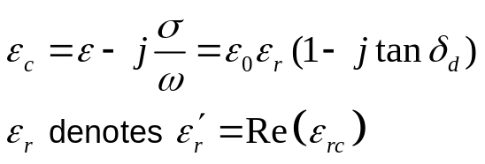

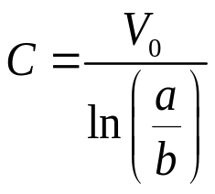
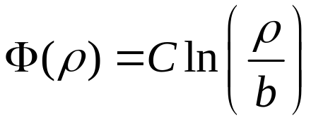
Coaxial Line: TEM Mode
Assume wave going in +z direction.
To find the TEM mode fields, we need to solve:
Here ρ = b is the zero-volt potential reference location.

Slide 4
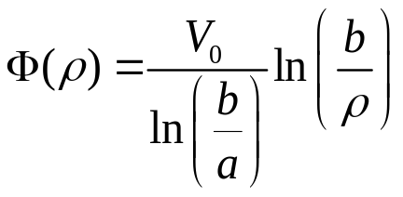
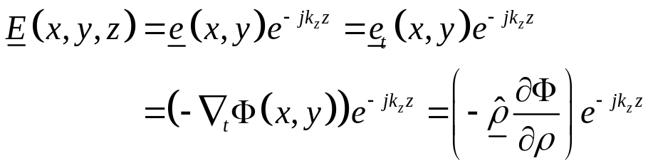

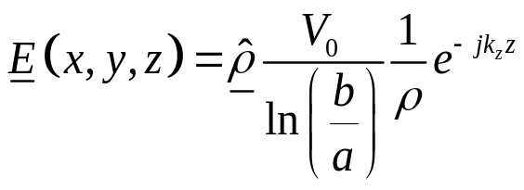
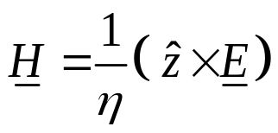
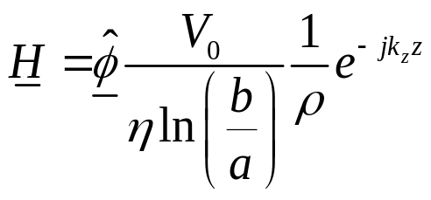
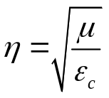
Coaxial Line: TEM Mode (cont.)
Hence, we have:
(A minus sign has been factored out of each ln term.)
We then have:

Slide 5
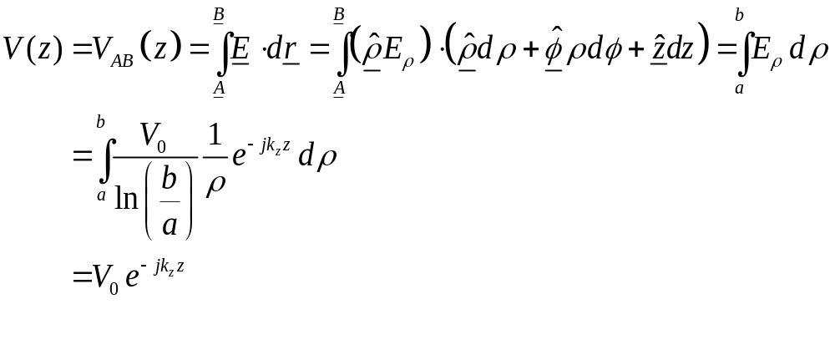
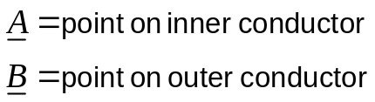
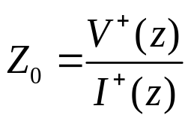
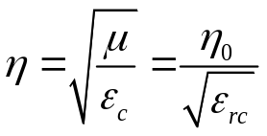
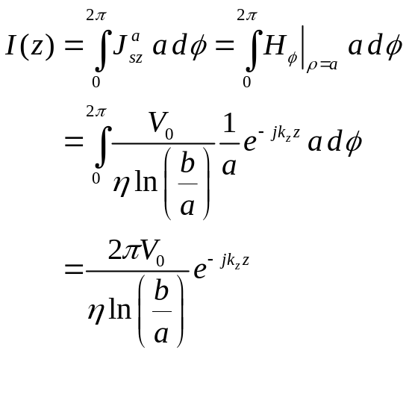

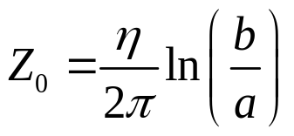
Coaxial Line: TEM Mode (cont.)
Hence, we have:
Note:
This formula does not account for conductor loss.

Slide 6
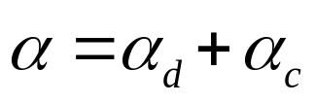


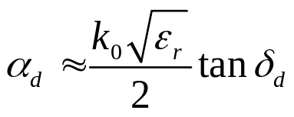

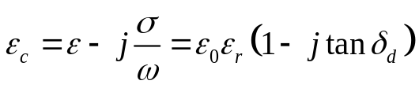
Coaxial Line: TEM Mode (cont.)
Attenuation:
Dielectric attenuation:
Geometry for dielectric attenuation

Slide 7


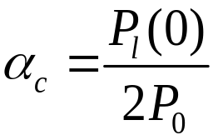

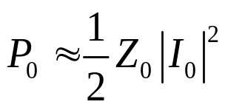
Coaxial Line: TEM Mode (cont.)
Attenuation:
Conductor attenuation:
Geometry for conductor attenuation
(We ignore dielectric loss here.)
(We assume Z₀ is real here.)

Slide 8
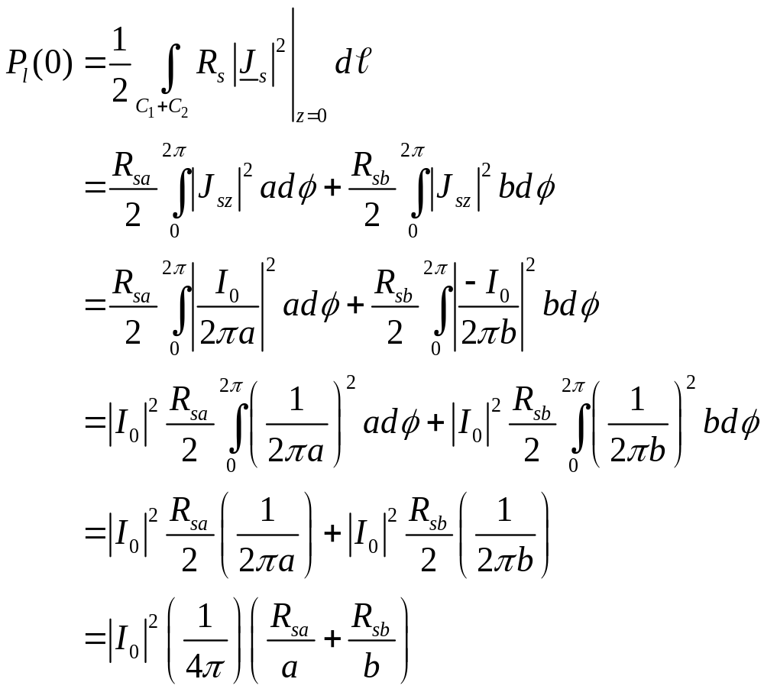

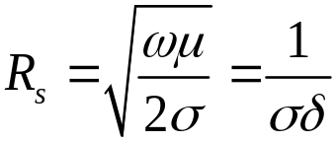
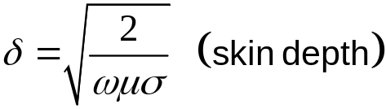
Coaxial Line: TEM Mode (cont.)
Conductor attenuation:
Geometry for conductor attenuation
(Here σ denotes the conductivity of the metal.)

Slide 9
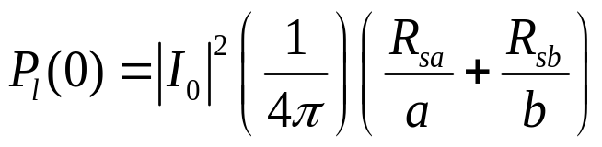
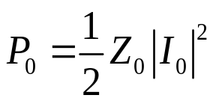
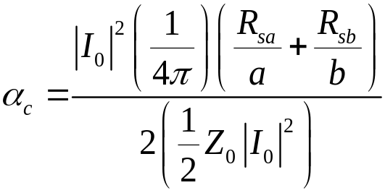
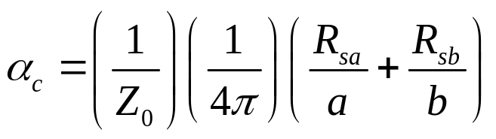
Coaxial Line: TEM Mode (cont.)
Conductor attenuation:
Geometry for conductor attenuation
Hence, we have:
or

Slide 10
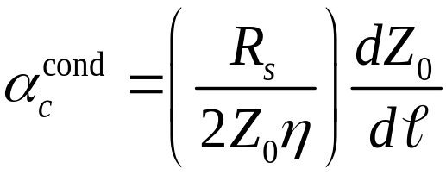
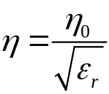
Coaxial Line: TEM Mode (cont.)
Let’s redo the calculation of conductor attenuation using the Wheeler incremental inductance formula.
Wheeler’s formula:
Geometry for conductor attenuation
The formula is applied for each conductor and the conductor attenuation from each of the two conductors is then added.
In this formula, dl (for a given conductor) is the distance by which the conducting boundary is receded away from the field region.

Slide 11
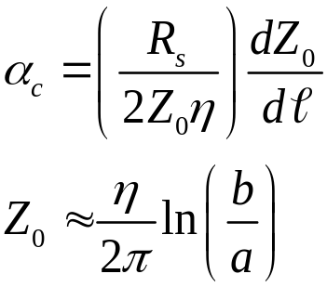
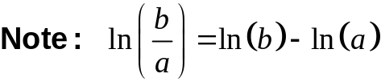
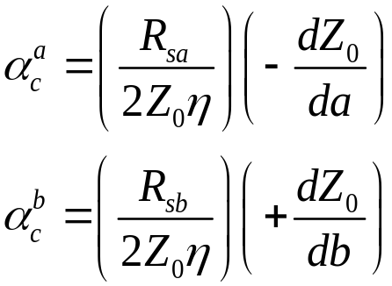


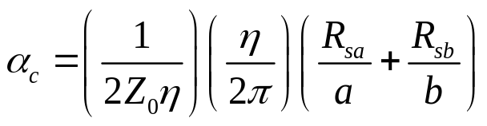
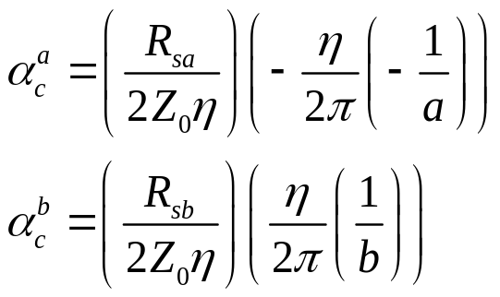

Coaxial Line: TEM Mode (cont.)
Geometry for conductor attenuation
so
Hence, we have:
or

Slide 12
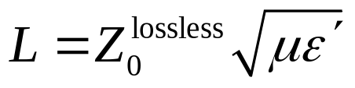

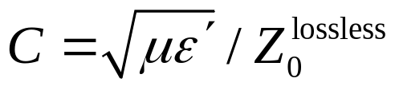
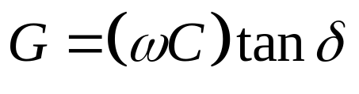
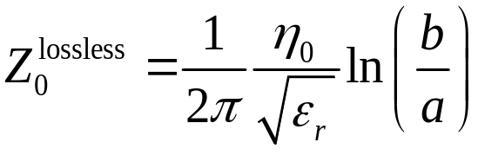
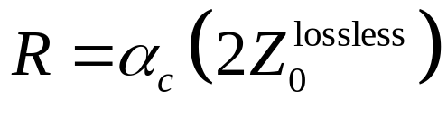


Coaxial Line: TEM Mode (cont.)
We can also calculate the fundamental per-unit-length parameters of the lossy coaxial line.
From previous calculations:
(From Notes 3)
where
(From Notes 7)
The “lossless” superscript means that we ignore all loss.

Slide 13
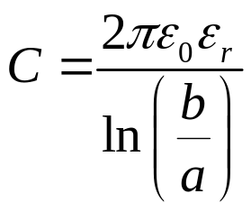
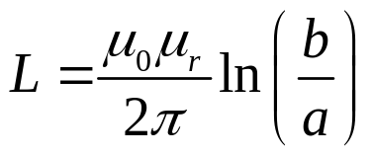



Coaxial Line: TEM Mode (cont.)
This gives us:

Slide 14












Coaxial Line: TEM Mode (cont.)
Comparison of R with bulk conductor formula:
-
+
For coax (setting l = 1 m):
Note:
This method only works when the current density is constant along the perimeter of the transmission line.

Slide 15



Attenuation for RG-59 Coax
Approximate attenuation in dB/m
Frequency | RG-59 Coax
1 [MHz] | 0.01
10 [MHz] | 0.03
100 [MHz] | 0.11
1 [GHz] | 0.40
5 [GHz] | 1.0
10 [GHz] | 1.5
20 [GHz] | 2.3
50 [GHz] | OM*
100 [GHz] | OM*
(from Wikipedia)
*OM = overmoded

Slide 16




Coaxial Line: Power Flow
Power flow at z = 0:
(Z₀ is assumed to be real here.)
Note: At dielectric breakdown

Slide 17
Coaxial Line: Higher-Order Modes
We look at the higher-order modes* of a coaxial line.
The lowest waveguide mode is the TE₁₁ mode.
Sketch of field lines for TE₁₁ mode
*Here the term “higher-order modes” means the waveguide modes that exist in addition to the desired TEM mode.

Slide 18





Coaxial Line: Higher-Order Modes (cont.)
TE_{z}:
(eigenvalue problem)
The solution in cylindrical coordinates is:
Note: The value n must be an integer to have unique fields.

Slide 19




Plot of Bessel Functions
n = 0
n = 1
n = 2
J_{n} (x)
x

Slide 20





Plot of Bessel Functions (cont.)
n = 0
n = 1
n = 2
Y_{n} (x)
x

Slide 21

Coaxial Line: Higher-Order Modes (cont.)
We choose (somewhat arbitrarily) the cosine function for the angle variation.
Wave traveling in +z direction:
The cosine choice corresponds to having the transverse electric field E_{ρ} being an even function ofφ, which is the field that would be excited by a probe located at φ = 0.

Slide 22






Coaxial Line: Higher-Order Modes (cont.)
Boundary Conditions:
(From Ampere’s law)
Hence
Note:
The prime denotes derivative with respect to the argument.

Slide 23



Coaxial Line: Higher-Order Modes (cont.)
In order for this homogenous system of equations for the unknowns A and B to have a non-trivial solution, we require the determinant to be zero.
Hence, we have:

Slide 24


Coaxial Line: Higher-Order Modes (cont.)
Denote
Then we have:
For a given choice of n and a given value of b/a, we can solve the above equation for x to find the zeros.

Slide 25









Coaxial Line: Higher-Order Modes (cont.)
A sketch of the determinant reveals the zeros of the determinant.
Note:
These values are not the same as those of the circular waveguide, although the same notation for the zeros is being used.
TE₁₁ mode:

Slide 26

Coaxial Line: Higher-Order Modes (cont.)
Approximate solution:
n = 1
p = 1
Exact solution
The TE₁₁ mode is the dominant higher-order mode of the coax (i.e., the waveguide mode with the lowest cutoff frequency).
Figure 3.16 from the Pozar book

Slide 27






Cutoff Frequency of TE₁₁ Mode
Lossless case:
Use formula on previous slide
Approximate cutoff frequency for TE₁₁ mode of coax:

Slide 28








Coaxial Line: Lossless Case (cont.)
At the cutoff frequency (f = f_{c}), the wavelength (in the dielectric) is then:
Compare with the cutoff frequency condition of the TE₁₀ mode of RWG:
so

Slide 29





Example
Example 3.3, p. 133 of the Pozar book:
RG 142 coax:

