Slide 1
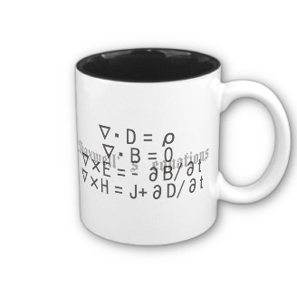
ECE 6340
Intermediate EM Waves
Fall 2016
Prof. David R. Jackson
Dept. of ECE
Notes 6

Slide 2
Power Dissipated by Current
Work given to a collection of electric charges moving in an electric field:
This could be conduction current or impressed current.
Note: The magnetic field never does any work:
Power dissipated per unit volume:
Note: We assume no increase in kinetic energy, so the power goes to heat.

Slide 3
Power Dissipated by Current (cont.)
Power dissipated per unit volume for ohmic current (we assume here a simple linear media that obeys Ohm’s law):
Note:
Hence, we have

Slide 4
Power Dissipated by Current (cont.)
Return to the general result:
This is the power dissipated per unit volume.
From this we can also write the power generated per unit volume due to an impressed source current:

Slide 5
Poynting Theorem: Time-Domain
From these we obtain
Subtract, and use the following vector identity:

Slide 6
Poynting Theorem: Time-Domain (cont.)
We then have
Now let
so that

Slide 7
Poynting Theorem: Time-Domain (cont.)
Next, use
Assume:
(simple linear media)
and
Hence
And similarly,

Slide 8
Poynting Theorem: Time-Domain (cont.)
Define
We then have
Next, integrate throughout V and use the divergence theorem:
Note: We are assuming the volume to be stationary (not moving) here.

Slide 9
Poynting Theorem: Time-Domain (cont.)
Interpretation:
(see next figure)

Slide 10
Poynting Theorem: Time-Domain (cont.)
or

Slide 11
Poynting Theorem: Time-Domain (cont.)
Power flow out of surface
E
ε, μ, σ
H
source

Slide 12
Poynting Theorem: Note on Interpretation
Does the Poynting vector really represent local power flow?
Consider:
This “new Poynting vector” is equally valid! They both give same TOTAL power flowing out of the volume, but different local power flow.
Note that

Slide 13
Note on Interpretation (cont.)
Another “dilemma”:
A static point charge is sitting next to a bar magnet.
N
Is there really power flowing in space?
q
Note: There certainly must be zero net power out of any closed surface:
S

Slide 14
Note on Interpretation (cont.)
Bottom line: We always get the correct result if we assume that the Poynting vector represents local power flow.
Because…
In a practical measurement, all we can ever really measure is the power flowing through a closed surface.
Comment:
At high frequency, where the power flow can be visualized as "photons" moving in space, it becomes more plausible to think of local power flow. In such situations, the Poynting vector has always given the correct result that agrees with measurements.

Slide 15
Complex Poynting Theorem
Frequency domain:
Generalized linear media:
ε may be complex.
Hence
Subtract and use the following vector identity:
Hence

Slide 16
Complex Poynting Theorem (cont.)
Define
(complex Poynting vector)
Note:
Then
Next use
Next, collect real and imaginary parts in the last term on the RHS.

Slide 17
Complex Poynting Theorem (cont.)
or
Next, integrate over a volume V and apply the divergence theorem:

Slide 18
Complex Poynting Theorem (cont.)
Final form of complex Poynting theorem:

Slide 19
Complex Poynting Theorem (cont.)
Interpretation of P_{s} :
We therefore identify that

Slide 20
Complex Poynting Theorem (cont.)
Interpretation of P_{f} :
We therefore identify that

Slide 21
Complex Poynting Theorem (cont.)
Interpretation of energy terms:
Note: The real-part operator may be added here since it has no effect.
Note: We know this result represents stored energy for simple linear media (ε_{c}′ = ε), so we assume it is true for generalized linear media.
Hence
Note:
The formulas for stored energy can be improved for dispersive media (discussed later).
Similarly,

Slide 22
Complex Poynting Theorem (cont.)
Interpretation of dissipation terms:
Recall:
Note:
This formula gives the correct time-average power dissipated due to electric losses for simple linear media.
We assume the same interpretation holds for generalized linear media
(ε is complex).
For simple linear media:
Hence

Slide 23
Complex Poynting Theorem (cont.)
Interpretation of dissipation terms (cont.):
Similarly,
This is the time-average power dissipated due to magnetic losses.
Note: There is no magnetic conductivity, and hence no magnetic conduction loss, but there can be magnetic polarization loss.

Slide 24
Complex Poynting Theorem (cont.)
Summary of Final Form

Slide 25
Complex Poynting Theorem (cont.)
We can write this as
where we have defined a complex power absorbed P_{abs} :

Slide 26
Complex Poynting Theorem (cont.)
This is a conservation statement for complex power.
Watts
VARs
Complex power flow out of surface
VARS consumed
E
Power (watts)
consumed
H
Source

Slide 27
Example
L
I
+ V -
Ideal (lossless) inductor
Denote:
Calculate P_{abs} using circuit theory, and verify that the result is consistent with the complex Poynting theorem.
Note: W_{abs} = 0 (lossless element)

Slide 28
Example (cont.)
L
I
+ V -
Ideal inductor
Note:
(lossless element)

Slide 29
Example (cont.)

Slide 30
Example (cont.)
Since there is no stored electric energy in the inductor, we can write
Hence, the circuit-theory result is consistent with the complex Poynting theorem.
Note: The inductor absorbs positive VARS.

Slide 31
Example
We use the complex Poynting theorem to examine the input impedance of an antenna.
P_{f}
I_{in}
J_{s}
V₀
+
-
S
Antenna
Model:
I_{in}
V₀
+
Z_{in}=R_{in}+j X_{in}
-

Slide 32
Example (cont.)
so
Real part:
(no losses in vacuum surrounding antenna)
Note:
The far-field Poynting vector is much easier to calculate than the near-field Poynting vector.
Hence

Slide 33
Example (cont.)
In the far field (r →∞)
(This follows from plane-wave properties in the far field.)
Hence

Slide 34
Example (cont.)
Imaginary part:
where
Hence
The RHS is zero!

Slide 35
Example (cont.)
We can say that
Hence
However, it would be very difficult to calculate the input impedance using this formula!

Slide 36
Dispersive Material
The permittivity and permeability are now functions of frequency:
(A lossy dispersive media is assumed here. It is assumed that the fields are defined over a fairly narrow band of frequencies.)
The formulas for stored electric and magnetic energy now become:
Note:
The stored energy should always be positive, even if the permittivity or permeability become negative.
Reference:
J. D. Jackson, Classical Electrodynamics, Wiley, 1998 (p. 263).

Slide 37
Momentum Density Vector
The electromagnetic field has a momentum density (momentum per volume):
In free space:
or
[(kg m/s)/m³] = [kg/(s m²)]
Reference:
J. D. Jackson, Classical Electrodynamics, Wiley, 1998 (p. 262).

Slide 38
Momentum Density Vector (cont.)
Photon:
From physics, we have a relation between the energy E and the momentum p of a single photon.
(Planck’s constant)
Calculation of power flow:
Photons moving:
v
A
N_{p} photons per unit volume
Hence
This is consistent with the previous momentum formula.

Slide 39
Momentum Density Vector (cont.)
Example:
Find the time-average force on a 1 [m²] mirror illuminated by normally incident sunlight, having a power density of 1 [kW/m²].
Note: the fields vary sinusoidally, but the frequency is arbitrary.
A = 1 m²
z

Slide 40
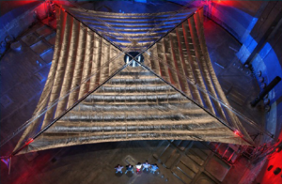
Solar Sail
Sunjammer Project
NASA has awarded $20 million to L’Garde, Inc. (Tustin, CA), a maker of “inflatable space structures,” to develop a solar sail, which will rely on the pressure of sunlight to move through space when it takes its first flight as soon as 2014.
A smaller version of L'Garde's solar sail unfurled in a vacuum chamber in Ohio in 2005. This one was about 3,400 square feet, a quarter the size of the sail the company plans to loft into space as soon as 2014. Photo courtesy NASA and L'Garde.
http://www.lgarde.com

Slide 41
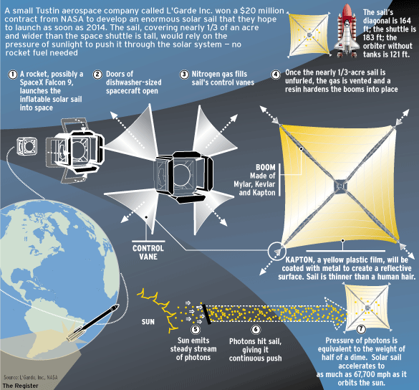
Solar Sail (cont.)
http://www.lgarde.com

Slide 42
Maxwell Stress Tensor
This gives us the stress (vector force per unit area) on an object, from knowledge of the fields on the surface of the object.
References:
D. J. Griffiths, Introduction to Electrodynamics, Prentice-Hall, 1989.
J. D. Jackson, Classical Electrodynamics, Wiley, 1998.
J. Schwinger, L. L. DeRaad, Jr., K. A. Milton, and W.-Y. Tsai, Classical Electrodynamics, Perseus, 1998.

Slide 43
Maxwell Stress Tensor
(for vacuum)
(Kronecker delta)

Slide 44
Maxwell Stress Tensor (cont.)
Momentum equation:
Total force on object (rate of change of mechanical momentum)
Total flow rate of momentum given to object from EM field
Rate of change of electromagnetic momentum inside of region

Slide 45
Maxwell Stress Tensor (cont.)
In many practical cases the time-average of the last term (the rate of change of electromagnetic momentum inside of region) is zero:
No fields inside the body
Sinusoidal steady-state fields
In this case we have
The Maxwell stress tensor (matrix) is then interpreted as the stress (vector force per unit area) on the surface of the body.

Slide 46
Maxwell Stress Tensor (cont.)
Example:
Find the time-average force on a 1 m² mirror illuminated by normally incident sunlight, having a power density of 1 [kW/m²].
x
TEM_{z} wave
A = 1 m²
z
S
Note:
The fields are assumed to be zero on the back side of the mirror, and no fields are inside the mirror.

Slide 47
Maxwell Stress Tensor (cont.)
x
TEM_{z} wave
A = 1 m²
z
Assume:

Slide 48
Maxwell Stress Tensor (cont.)
(PEC mirror)
We then have:
(The tangential magnetic field doubles at the shorting plate.)

Slide 49
Maxwell Stress Tensor (cont.)
Next, use
so

Slide 50
Force on Dielectric Object
Here we calculate the electrostatic force on a
dielectric object in an electric field using dipole moments.
This is an alternative to using the Maxwell stress tensor.
Consider first the force on a single electrostatic dipole:
For small dipoles:
or
Note that we have a gradient of a vector here. This is called a “dyad.”

Slide 51
Force on Dielectric Object (cont.)
Dyadic representation:
or
Hence we have:

Slide 52
Force on Dielectric Object (cont.)
For a dielectric object:
Since the body does not exert a force on itself, we can use the external electric field E₀.

Slide 53
Force on Dielectric Object (cont.)
We then have:
We can also write:
or
or

Slide 54
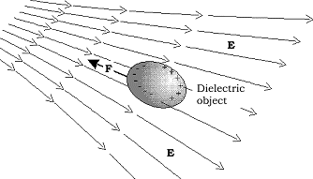
Force on Dielectric Object (cont.)
A non-uniform electrical field will generate a net attractive force on a neutral piece of matter. The force is directed toward the region of higher field strength.
http://electrogravityphysics.com/html/sec_4.html

Slide 55
Force on Magnetic Object
We have (derivation omitted) the magnetostatic force as:
Recall:
Hence, we have
or
or

Slide 56
Foster's Theorem
Consider a lossless system with a port that leads into it:
Lossless system
(source free)
S_{p}
Coaxial port
z
PEC enclosure
Foster’s theorem:
R. E. Collin, Field Theory of Guided Waves, IEEE Press, Piscataway, NJ, 1991.

Slide 57
Foster's Theorem (cont.)
The same holds for the input susceptance:

Slide 58
Foster's Theorem (cont.)
Start with the following vector identity:
Hence we have (applying twice, for two different choices of the (vectors)
Add these last two equations together:

Slide 59
Foster's Theorem (cont.)
Using Maxwell's equations for a source-free region,

Slide 60
Foster's Theorem (cont.)
Using Maxwell's equations again, and the chain rule, we have:
We then have

Slide 61
Foster's Theorem (cont.)
cancels
Simplifying, we have
or

Slide 62
Foster's Theorem (cont.)
Applying the divergence theorem,
Hypothesis: the total stored energy must be positive.
Therefore,

Slide 63
Foster's Theorem (cont.)
The tangential electric field is only nonzero at the port. Hence we have:
Assume that the electric field (voltage) at the port is fixed (not changing with frequency).
Then we have

Slide 64
Foster's Theorem (cont.)
Then
At the coaxial port:
Hence:
or
(since the electric field is fixed and not changing with frequency)

Slide 65
Foster's Theorem (cont.)

Slide 66
Foster's Theorem (cont.)

Slide 67
Foster's Theorem (cont.)
Example: Short-circuited transmission line
Z_{in}
Z₀
Z_{L} = 0
l
X_{in}
Inductive
π/2
3π/2
5π/2
β l
Capacitive

