Slide 1
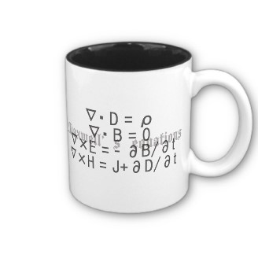
ECE 6340
Intermediate EM Waves
Fall 2016
Prof. David R. Jackson
Dept. of ECE
Notes 7

Slide 2
TEM Transmission Line
2 conductors
4 parameters
C = capacitance/length [F/m]
L = inductance/length [H/m]
R = resistance/length [Ω/m]
G = conductance/length [ /m or S/m]
Δz
Ω

Slide 3
TEM Transmission Line (cont.)
Physical Transmission Line
x
x
x
+ + + + + + +
B
- - - - - - - - - -
RΔz
LΔz
i(z,t)
i(z+Δz,t)
+
v(z,t)
-
+
v(z+Δz,t)
-
GΔz
CΔz
z

Slide 4
TEM Transmission Line (cont.)
RΔz
LΔz
i(z,t)
i(z+Δz,t)
+
v(z,t)
-
+
v(z+Δz,t)
-
GΔz
CΔz
z

Slide 5
TEM Transmission Line (cont.)
Hence
Now let Δz 0:
“Telegrapher’sEquations”

Slide 6
TEM Transmission Line (cont.)
To combine these, take the derivative of the first one with respect to z:
Switch the order of the derivatives.
Substitute from the second Telegrapher’s equation.

Slide 7
TEM Transmission Line (cont.)
Hence, collecting terms, we have:
The same equation also holds for i.

Slide 8
TEM Transmission Line (cont.)
Time-Harmonic Waves

Slide 9
TEM Transmission Line (cont.)
Note that
= series impedance/length
= parallel admittance/length
Then we can write:

Slide 10
Artificial Transmission Line (ATL)
This is one that is made by artificially cascading periodic sections of elements, which are arranged differently from what an actual (TEM) transmission line would have.
p
C_{e}
C_{e}
L_{e}
L_{e}
. . .
. . .
We still have:

Slide 11
Propagation Constant
Let
Then
Solution:
γ is called the "propagation constant."
Convention: +z wave is
To see what this implies, use

Slide 12
Propagation Constant (cont.)
There are two possible locations for γ:
Write:
Propagation constant
Attenuation constant
Phase constant

Slide 13
Propagation Constant (cont.)
Consider a wave going in the +z direction:
The propagation constant γ is always in the first quadrant.
We require
Hence:

Slide 14
Propagation Constant (cont.)
The principal branch of the square root function:
We have the property that
Branch cut
This is the branch that MATLAB uses.

Slide 15
Propagation Constant (cont.)
Hence:
The principal branch ensures that
To be more general,
(This also holds for an ATL.)

Slide 16
Characteristic Impedance Z₀
I⁺ (z)
+
V⁺(z)
-
z
A wave is traveling in the positive z direction.
so
(Z₀ is a number, not a function of z.)

Slide 17
Characteristic Impedance Z₀ (cont.)
Use the first Telegrapher’s Equation:
so
(This form also holds for an ATL.)
Hence

Slide 18
Characteristic Impedance Z₀ (cont.)
From this we have:
(This also holds for an artificial TL.)
We can also write
Which sign is correct?
Positive power flow in the z direction
Hence
(This also holds for an artificial TL.)

Slide 19
Characteristic Impedance Z₀ (cont.)
For a physical transmission line we have:

Slide 20
Backward-Traveling Wave
I ⁻ (z)
+
V ⁻(z)
-
z
A wave is traveling in the negative z direction.
so
Most general case:
A general superposition of forward and backward traveling waves:

Slide 21
Power Flow
I⁺ (z)
+
V⁺(z)
-
Z₀
z
A wave is traveling in the positive z direction.
Hence

Slide 22
Power Flow (cont.)
I (z)
+
V (z)
-
Z₀
z
Allow for waves in both directions:

Slide 23
Power Flow (cont.)
I (z)
+
V (z)
-
Z₀
z
pure imaginary

Slide 24
Power Flow (cont.)
I (z)
+
V (z)
-
Z₀
z
pure imaginary
For a lossless line, Z₀ is pure real:
In this case,
so
(orthogonality)

Slide 25
Traveling Wave
Let's look at the traveling wave in the time domain.

Slide 26
Wavelength

Slide 27
Wavelength (cont.)
The wave “repeats” when:
Hence:

Slide 28
Phase Velocity
Track the velocity of a fixed point on the wave (a point of constant phase), e.g., the crest.
v_{p}
(phase velocity)
z

Slide 29
Phase Velocity (cont.)
Set
Hence

Slide 30
Phase Velocity (cont.)
In general,
This is dispersion, resulting in waveform distortion

Slide 31
Distortion
In general, waveform distortion is caused by either of two things:
Phase velocity v_{p} is a function of frequency (dispersion)
Attenuation α is a function of frequency
In general, both effects arise when loss is present on a transmission line.

Slide 32
Lossless Case
so
no dispersion + no attenuation
no distortion

Slide 33
Lossless Case (cont.)

Slide 34
Example
Lossless coaxial cable
a
b
z

Slide 35
Example (cont.)
Using
We have

Slide 36
Generalization
Generalization to general lossless two-conductor transmission line with a homogeneous non-magnetic material filling:
GF = geometrical factor
Note:
A proof of this independence is given in Notes 9.
Justification:
1) We have and D = ε E , with E independent of frequency and material.
2) The relation for L follows from the requirement that the phase velocity be equal to the speed of light in the filling material – this is valid for any TEM mode in a lossless material, as discussed later in Notes 9.
Hence:

Slide 37
Generalization (cont.)
Consider next a lossy dielectric, but lossless conductors:
Justification of C and G formulas:
(principle of effective permittivity)
Also, we have

Slide 38
Generalization (cont.)
Justification of L formula:
This is proven in notes 9.

Slide 39
Determination of (L, G, C) Parameters
Consider the general case of a lossy (dielectric loss only) transmission line:
We wish to calculate the parameters (G, L, C) in terms of the characteristic impedance of the lossless line and the complex permittivity of the filling material.
For the calculation of the lossless Z₀, we set ε_{c} = ε_{c}′ (ignore ε_{c}′′).
From the first two equations we have (multiplying and dividing the two equations):

Slide 40
Determination of Parameters (cont.)
Summary
These results tells us how to calculate the (L, G, C) line parameters from the characteristic impedance of the lossless line and the filling material.
This information is what we would typically know about a line (e.g., from a vendor).
Note: Later we will see how to calculate R. (This involves the concept of the surface resistance of the conductors.)

Slide 41
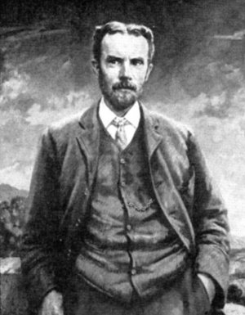
Distortionless Case
Assume that the following condition holds:
This is the "Heaviside condition," discovered by Oliver Heaviside.
Then we have:

Slide 42
Distortionless Case (cont.)
There is then attenuation but no dispersion.
Note: There will be some distortion in practice, since the Heaviside condition cannot be satisfied for all frequencies:
(assuming a fixed loss tangent)
Also, there will be distortion since α is a function of frequency.

Slide 43
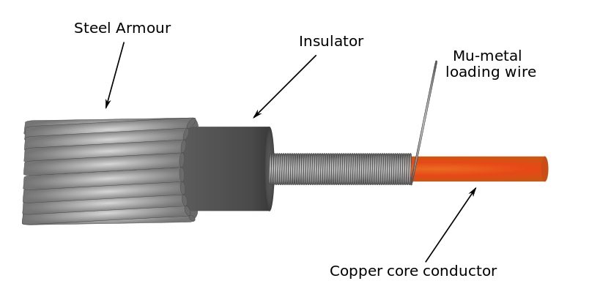
Distortionless Case (cont.)
An example of loading a coaxial cable to achieve the Heaviside condition.
For regular coax:
We can increase L to achieve the Heaviside condition.
https://en.wikipedia.org/wiki/Heaviside_condition

Slide 44
Distortionless Case (cont.)
Loading coils can also be placed periodically along the line.
Loading coil
https://en.wikipedia.org/wiki/Heaviside_condition

Slide 45
Distortionless Case (cont.)
For an interesting history:
https://en.wikipedia.org/wiki/Loading_coil
Loading cables to improve performance was popular in the early 1900’s, but declined after the 1940s.
The technology has been superseded by using digital repeaters on transmission lines.
For long distances, transmission lines are usually replaced by fiber-optic cables (or wireless systems).

