Slide 1
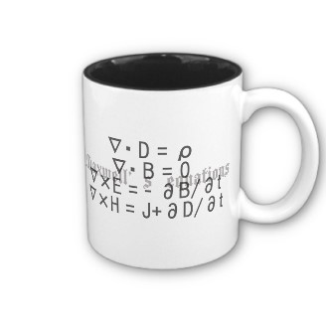
ECE 6340
Intermediate EM Waves
Fall 2016
Prof. David R. Jackson
Dept. of ECE
Notes 8

Slide 2
Signal Propagation on Line
+
v_{o} (t)
-
v_{i} (t)
+
-
Z₀ (ω) , γ (ω)
z = 0
Semi-infinite line
z = l
Introduce Fourier transform:

Slide 3
Signal Propagation on Line (cont.)
Goal: To get this into a form that looks like
The transform variable ω can then be interpreted as (radian) frequency.

Slide 4
Signal Propagation on Line (cont.)
We start by considering a useful property of the transform.
Transform definition:
Since
it follows that
(assuming that ω is real)
Next, use

Slide 5
Signal Propagation on Line (cont.)
Use ω ′ = - ω

Slide 6
Signal Propagation on Line (cont.)
Hence
The transform variable is now interpreted as radian frequency.
or

Slide 7
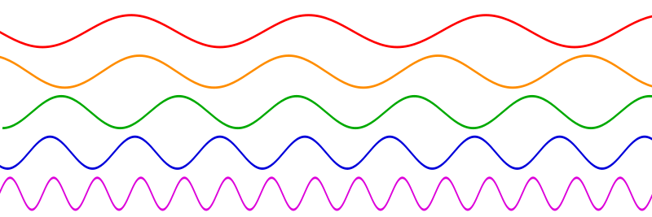
Signal Propagation on Line (cont.)
Any signal can be expressed as a collection of infinite sinusoidal signals.
t

Slide 8
Signal Propagation on Line (cont.)
The integral is approximated as a sum.
Define
Then

Slide 9
Signal Propagation on Line (cont.)
In the phasor domain:
Input
Output
Therefore,
Taking the limit,

Slide 10
Signal Propagation on Line (cont.)
Final result:

Slide 11
Signal Propagation on Line (cont.)
Compare:
Output voltage expression
Output voltage expressed in inverse transform form
Conclusion:

Slide 12
Signal Propagation on Line (cont.)
The most general scenario:
T(ω)
V_{i} (ω)
V_{o} (ω)
T(ω) is the frequency-domain transfer function.
Then we have

Slide 13
Lossless Line
Denote
Then

Slide 14
Lossless Line (cont.)
Compare with
Hence
or

Slide 15
Lossless Line (cont.)
The pulse moves at the phase velocity without distortion.

Slide 16
Lossless Line (cont.)
Note: There is a time delay in the trace!
z = 0
z > 0
Note:
The shape of the pulse as a function of z is the mirror image of the pulse shape as a function of t.
Sawtooth pulse
t

Slide 17
Lossless Line (cont.)
The sawtooth pulse is shown emerging from the source end of the line.
t = t₁
t = t₂
t=0
t = t₃
t = t₄
z = 0
Sawtooth pulse
t

Slide 18
Signal Propagation with Dispersion
+
v_{o} (t)
-
v_{i} (t)
+
-
Low-loss line
z = 0
z = l
(dispersion)
Assume
S(t) = slowly-varying envelope function

Slide 19
Signal Propagation with Dispersion (cont.)
This could be called a “wave packet”:
The signal consists of not a single frequency, but a group of closely-spaced frequencies, centered near the carrier frequency ω₀.

Slide 20
Signal Propagation with Dispersion (cont.)
The spectrum of S(t) is very localized near zero frequency:
The envelope function is narrow in the ξ (transform) domain.

Slide 21
Signal Propagation with Dispersion (cont.)
Use
Hence

Slide 22
Signal Propagation with Dispersion (cont.)
Peak near ω₀
Peak near -ω₀
Recall:
Hence, we have

Slide 23
Signal Propagation with Dispersion (cont.)
Hence
with
Next, use
Neglect (second order)

Slide 24
Signal Propagation with Dispersion (cont.)
Denote
Hence

Slide 25
Signal Propagation with Dispersion (cont.)
Multiply and divide by exp (jω₀t):

Slide 26
Signal Propagation with Dispersion (cont.)
Let

Slide 27
Signal Propagation with Dispersion (cont.)
Extend the lower limit to minus infinity:
(since the spectrum of the envelope function is concentrated near zero frequency).
Hence

Slide 28
Signal Propagation with Dispersion (cont.)
Hence

Slide 29
Signal Propagation with Dispersion (cont.)
Hence we have
Define group velocity:
Then we have

Slide 30
Signal Propagation with Dispersion (cont.)
Summary
v_{g}
v_{p}

Slide 31
Example: v_{g} = 0, v_{p} > 0
Phase velocity
Group velocity
t = 0
t = Δ
t = 2Δ

Slide 32
Example: v_{p} > v_{g}
Example from Wikipedia (view in full-screen mode with pptx)
Red dot: phase velocity
Green dot: group velocity
http://en.wikipedia.org/wiki/Group_velocity

Slide 33
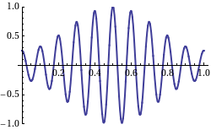
Example: v_{g} > 0, v_{p} < 0
Example from Wikipedia (view in full-screen mode with pptx)
“Backward wave”
(The phase and group velocities are in opposite directions.)
This shows a wave with the group velocity and phase velocity going in different directions. (The group velocity is positive and the phase velocity is negative.)
http://en.wikipedia.org/wiki/Group_velocity

Slide 34
Notes on Group Velocity
In many cases, the group velocity represents the velocity of information flow (the velocity of the baseband signal).
This is true when the dispersion is sufficiently small over the frequency spectrum of the signal, and the group velocity is less than the speed of light.
Example: a narrow-band signal propagating in a rectangular waveguide.
Note:
In some cases the group velocity exceeds the speed of light. In such cases, the waveform always distorts sufficiently as it propagates so that the signal never arrives fast than light.

Slide 35
Notes on Group Velocity (cont.)
Sometimes v_{g} > c (e.g., hypothetical low-loss TL filled with air, with constant R and/or G).
Lossless
The first non-zero part of the signal does not arrive faster than light.
Low-loss
t = 0 t > 0

Slide 36
Signal Velocity
t = 0
l
+
v_{o} (t)
-
V₀
+
-
TL
z = 0
z = l
Relativity:

Slide 37
Energy Velocity
Definition of energy velocity v_{E} :
<W_{l} > = time-average energy stored per unit length in the z direction.
<W>
V
v_{E}
Δz
Here we think of stored energy moving down the system.

Slide 38
Energy Velocity
<W>
V
v_{E}
Δz
where
Note: In many systems the energy velocity is equal to the group velocity.

Slide 39
Example
Rectangular Waveguide
(air-filled)
b
TE₁₀
a
Multiply top and bottom by c / ω = 1 / k₀ :

Slide 40
Example (cont.)
To calculate the group velocity, use
Hence
Note: This property holds for all lossless waveguides.

Slide 41
Example (cont.)

Slide 42
Example (cont.)
Graphical representation (ω - β diagram):

Slide 43
Dispersion
Theorem: If there is no dispersion, then v_{p} = v_{g} (a constant).
An example is a lossless transmission line
(no dispersion).
Note: For a lossless TL we have
Proof:
Hence:

Slide 44
Dispersion (cont.)
Theorem: If v_{p} = v_{g} for all frequencies, then there is no dispersion.
Proof:

Slide 45
Dispersion (cont.)
EXAMPLES:
- Plane wave in free space
- Lossless TL
- Distortionless (lossy)TL
for all frequencies

Slide 46
Dispersion (cont.)
No dispersion
and
Attenuation is frequency independent
No distortion
(The phase velocity is frequency independent.)
Note: Loss on a TL causes dispersion and it also causes the attenuation to be frequency dependent.

Slide 47
Dispersion (cont.)
“Normal” Dispersion:
Example: waveguide
This is equivalent to
(proof omitted)
“Anomalous” Dispersion:
Example: low-loss transmission line
This is equivalent to
(proof omitted)

Slide 48
Backward Wave
Definition of backward wave:
The group velocity has the opposite sign as the phase velocity.
This type of wave will never exist on a TEM transmission line filled with usual dielectric materials, but may exist on a periodic artificial transmission line.
Note:
Do not confuse “backward wave" with “a wave traveling in the backward direction.”

