Slide 1
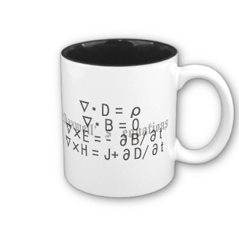
ECE 6340
Intermediate EM Waves
Fall 2016
Prof. David R. Jackson
Dept. of ECE
Notes 16

Slide 2
Polarization of Waves
Consider a plane wave with both x and y components
y
E_{y}
x
E_{x}
Assume
(polar form of complex numbers)

Slide 3
Polarization of Waves (cont.)
Time Domain:
y
E (t)
|E (t)|
At z = 0
φ (t)
x
Depending on b and β, three different cases arise.

Slide 4
Linear Polarization
β = 0 or π
At z = 0:
(+ for 0, - for π)
y
x´
y´
b
(shown for β = 0)
x
a

Slide 5
Circular Polarization
b = a AND β = ± π /2
At z = 0:

Slide 6
Circular Polarization (cont.)
y
a
φ(t)
x
so
Note:

Slide 7
Circular Polarization (cont.)
y
IEEE convention
β = +π / 2
a
LHCP
φ(t)
x
β = −π / 2
RHCP

Slide 8
Circular Polarization (cont.)
Note: The rotation is space is opposite to that in time.
Time and distance dependence:
RHCP
z = 0
t = 0

Slide 9
Circular Polarization (cont.)
“Snapshot" of wave
RHCP
z
RHCP
z

Slide 10
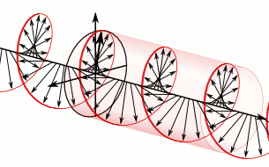
Circular Polarization (cont.)
Animation of LHCP wave
(Use pptx version in full-screen mode to see motion.)
http://en.wikipedia.org/wiki/Circular_polarization

Slide 11
Unit Rotation Vectors
RHCP (β = - π / 2)
LHCP (β = + π / 2)
Add:
Subtract:

Slide 12
General Wave Representation
Note: Any polarization can be written as combination of RHCP and LHCP waves.
This could be useful in dealing with CP antennas.

Slide 13
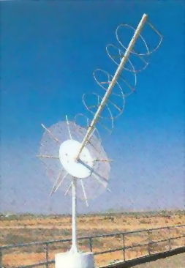
Circularly Polarized Antennas
Method 1: The antenna is fundamentally CP.
A helical antenna for satellite reception is shown here.
The helical antenna is shown radiating above a circular ground plane.

Slide 14
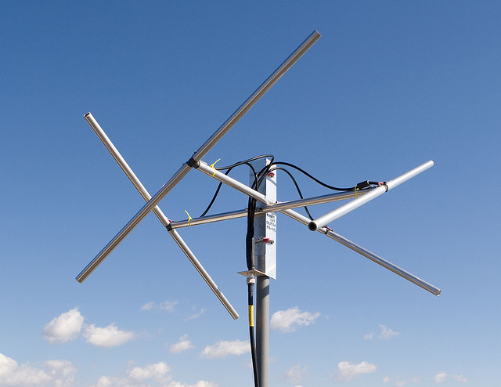
Circularly Polarized Antennas (cont.)
Method 2: Two perpendicular antennas are used, fed 90º out of phase.
y
V_{x} = 1
-
+
V_{y} = -j
+
-
RHCP
x
z
Two antennas are shown here being fed by a common feed point.
A more complicated version using four antennas
(omni CP)
Note: LHCP is radiated in the negative z direction.

Slide 15
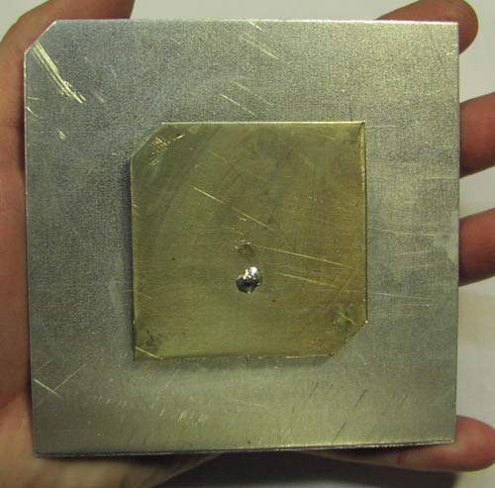
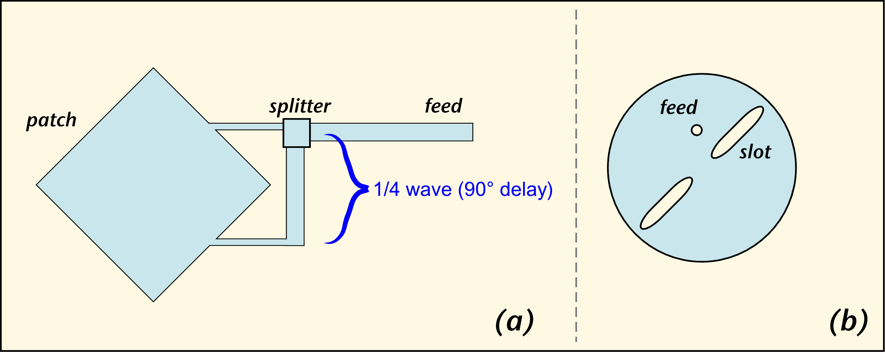
Circularly Polarized Antennas (cont.)
Method 3: A single antenna is used, but two perpendicular modes are excited 90º out of phase.
(a)
(b)
(c)
A square microstrip antenna with two perpendicular modes being excited.
A circular microstrip antenna using a single feed and slots. The feed is located at 45º from the slot axis.
A square patch with two corners chopped off, fed at 45º from the edge.

Slide 16
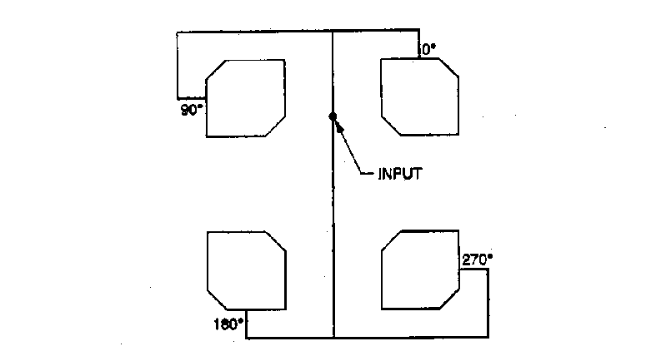
Circularly Polarized Antennas (cont.)
Method 4: Sequential rotation of antennas is used (shown for N = 4).
I = 1 ∠ -180º
LP elements
CP elements
I = 1 ∠ -270º
I = 1 ∠ -90º
I = 1 ∠ -90º
I = 1 ∠ 0º
The elements may be either LP or CP.
This is an extension of method 2 when used for LP elements.
Using multiple CP elements instead of one CP element often gives better CP in practice (due to symmetry).

Slide 17
Pros and Cons of CP
Pros
Alignment between transmit and receive antennas is not important.
The reception does not depend on rotation of the electric field vector that might occur†.
When a RHCP bounces off an object, it mainly changes to a LHCP wave. Therefore, a RHCP receive antenna will not be as sensitive to “multipath” signals that bound off of other objects.
Cons
A CP system is usually more complicated and expensive.
Often, simple wire antennas are used for reception of signals in wireless communications, and hence they are already directly compatible with linear polarization. (Using a CP transmitted signal will result in 50% of the transmitted power being wasted, or a 3 dB drop in the received signal).
† Satellite transmission often uses CP because of Faraday rotation in the ionosphere.

Slide 18
Pros and Cons of CP (cont.)
Effects of alignment errors
α = alignment angle error
TX-RX
Gain Loss
LP-LP
cos²α : The received signal can vary from zero dB to -∞ dB
CP-LP
-3 dB, no matter what the alignment
LP-CP
-3 dB, no matter what the alignment
CP-CP
0 dB (polarizations same) or -∞ dB (polarizations opposite),
no matter what the alignment

Slide 19
Examples of Polarization
AM Radio (0.540-1.6 MHz): linearly polarized (vertical) (Note 1)
FM Radio (88-108 MHz): linearly polarized (horizontal)
TV (VHF, 54-216 MHz; UHF, 470-698 MHz: linearly polarized (horizontal) (some transmitters are CP)
Cell phone antenna (about 2 GHz, depending on system): linearly polarized (direction arbitrary)
Cell phone base-station antennas (about 2 GHz, depending on system): often linearly polarized (dual-linear slant 45º) (Note 2)
DBS Satellite TV (11.7-12.5 GHz): transmits both LHCP and RHCP (frequency reuse) (Note 3)
GPS (1.574 GHz): RHCP (Note 3)
Notes:
Low-frequency waves travel better along the earth when they are polarized vertically instead of horizontally.
Slant linear is used to switch between whichever polarization is stronger.
Satellite transmission often uses CP because of Faraday rotation in the ionosphere.

Slide 20
Elliptical Polarization
Includes all other cases
β ≠ 0 or π (not linear)
β ≠ ±π / 2 (not CP)
β = ± π / 2 and b≠ a (not CP)
y
φ(t)
x
Ellipse

Slide 21
Elliptical Polarization (cont.)
y
RHEP
Note: The rotation is not at a constant speed.
φ(t)
x
Ellipse
LHEP

Slide 22
Proof of Ellipse Property
so

Slide 23
Proof of Ellipse Property (cont.)
Consider the following quadratic form:

Slide 24
Proof of Ellipse Property (cont.)
Discriminant:
From analytic geometry:
so
Hence, this is an ellipse.
If β = 0 or π we have Δ = 0, and this is linear polarization.

Slide 25
Rotation Property
We now prove the rotation property:
y
RHEP
Recall that
φ(t)
x
ellipse
LHEP

Slide 26
Rotation Property (cont.)
Hence
Take the derivative:
so
(proof complete)

Slide 27
Phasor Picture
y
x
Rule:
The electric field vector rotates in time from the leading axis to the lagging axis.
E_{y}
Im
E_{y} leads E_{x}
β
E_{x}
Re
LHEP
A phase angle 0 < φ < π is a leading phase angle (leading with respect to zero degrees).
A phase angle -π < φ < 0 is a lagging phase angle (lagging with respect to zero degrees).

Slide 28
Phasor Picture (cont.)
y
x
Rule:
The electric field vector rotates in time from the leading axis to the lagging axis.
Im
E_{y} lags E_{x}
E_{x}
β
Re
E_{y}
RHEP
A phase angle 0 < φ < π is a leading phase angle (leading with respect to zero degrees).
A phase angle -π < φ < 0 is a lagging phase angle (lagging with respect to zero degrees).

Slide 29
Example
z
E_{z}
y
E_{x}
x
What is this wave’s polarization?

Slide 30
Example (cont.)
Im
E_{z} leads E_{x}
E_{z}
Re
E_{x}
Therefore, in time, the wave rotates from the z axis to the x axis.

Slide 31
Example (cont.)
z
E_{z}
y
E_{x}
x
LHEP or LHCP
Note:
and
(so this is not LHCP)

Slide 32
Example (cont.)
z
E_{z}
y
E_{x}
x
LHEP

Slide 33
Axial Ratio (AR) and Tilt Angle (τ )
y
B
C
τ
x
D
A

Slide 34
Axial Ratio (AR) and Tilt Angle (τ )
We first calculate γ :
Axial Ratio
Tilt Angle
(-90º < τ < 90º)
Note: The tilt angle τ is ambiguous by the addition of ± 90º.
(We cannot tell the difference between the major and minor axes.)

Slide 35
Axial Ratio (AR) and Tilt Angle (τ) (cont.)
y
B
C
τ
x
|ξ |
D
A
Physical interpretation of the angle |ξ|

Slide 36
Special Case
The tilt angle is zero or 90º if:
Tilt Angle:
y
x

Slide 37
LHCP/RHCP Ratio
Sometimes it is useful to know the
ratio of the LHCP and RHCP wave amplitudes.
y
A
B
x
Hence

Slide 38
LHCP/RHCP Ratio (Cont.)
Hence
or
(Use whichever sign gives AR > 0.)
From this we can also solve for the ratio of the CP components,
if we know the axial ratio:
(We can’t tell which one is correct from knowing only the AR.)

Slide 39
Example
Find the axial ratio and tilt angle.
z
LHEP
Find the ratio of the CP amplitudes.
E_{z}
y
E_{x}
x
Re-label the coordinate system:

Slide 40
Example (cont.)
y
LHEP
E_{z}
z
E_{x}
x

Slide 41
Example (cont.)
Formulas
Results
LHEP

Slide 42
Example (cont.)
y
τ
x
Normalized field (a = 1):
Note: Plotting the ellipse as a function of time will help determine which value is correct for the tilt angle τ.

Slide 43
Example (cont.)
y
τ
x
Hence
We know that the polarization is LHEP, so the LHCP amplitude must dominate. Hence, we have

Slide 44
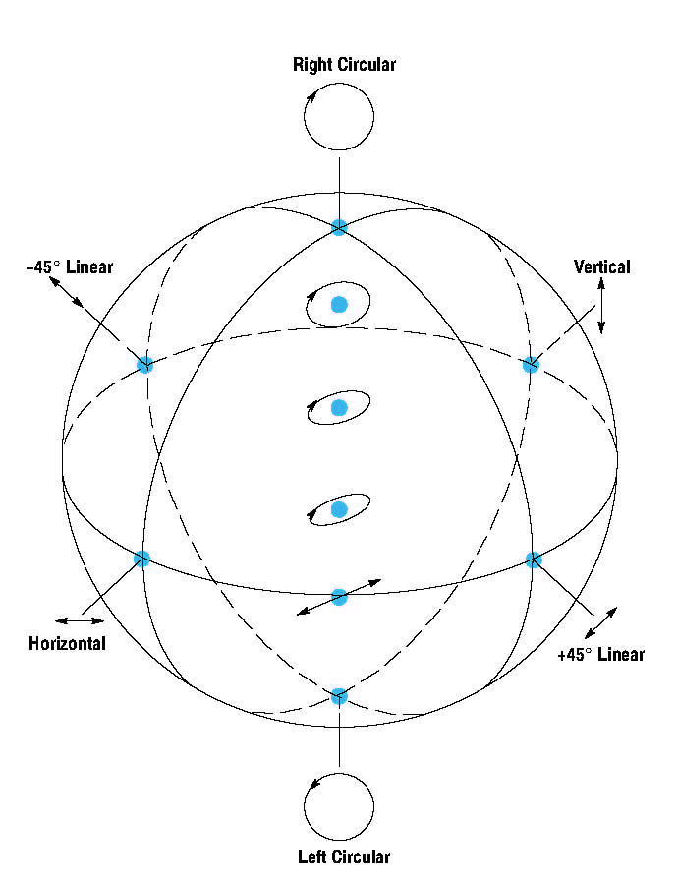
Poincaré Sphere
y
z
B
C
LHCP
Unit sphere
τ
x
|ξ |
D
A
latitude = 2ξ
y
x
RHCP
longitude = 2τ

Slide 45
Poincaré Sphere (cont.)
latitude = 2ξ
longitude = 2τ
LHCP (north pole)
ξ = 45º
LHEP
φ = 90º
(45º tilt)
y
linear (equator)
ξ = 0º
RHEP
RHCP (south pole)
φ = 0 (no tilt)
ξ = -45º
x

Slide 46
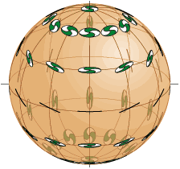
Poincaré Sphere (cont.)
View in full-screen mode to watch the “world spinning”.

Slide 47
Poincaré Sphere (cont.)
Two diametrically opposite points on the Poincaré sphere have the property that the electric field vectors (in the phasor domain) are orthogonal in the complex sense. (A proof is given in the Appendix.)
z
Examples
A
y
x
B
(orthogonal in the complex power sense)

Slide 48
Appendix
Proof of orthogonal property
z
From examining the polarization equations:
A
y
x
B
Hence

