Slide 1
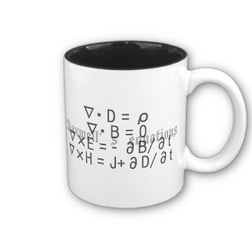
ECE 6340
Intermediate EM Waves
Fall 2016
Prof. David R. Jackson
Dept. of ECE
Notes 19

Slide 2
Critical Angle
Assume lossless materials
θ_{i}
n₁
y
θ_{t}
n₂
z
Snell’s law:

Slide 3
Critical Angle
At the critical angle (θ_{i} = θ_{c}):
θ_{t} = 90º
so
θ_{c}
n₁
y
θ_{t}
n₂
z

Slide 4
Critical Angle
Notes:
The critical angle applies to any polarization.
The critical angle is only defined for lossless materials.
A critical angle exists only when going from a higher to a lower density medium (n₁ > n₂ ).

Slide 5
Beyond Critical Angle
Let’s examine the transmitted angle:
Assume
so

Slide 6
Beyond Critical Angle (cont.)
Note: The power flow in the upper region is horizontal. No power crosses the boundary
Region 1
Power flow
y
Region 2
z
Note: The power flow in the lower region is horizontal, and decays with z.

Slide 7
Beyond Critical Angle (cont.)
All of the incident power is reflected

Slide 8
Beyond Critical Angle (cont.)
Determine the transmitted angle θ_{t} :
Let
(real)
Use
or
must use +sign
Not possible

Slide 9
Beyond Critical Angle (cont.)
Hence

Slide 10
Beyond Critical Angle (cont.)
Choose + sign to obtain correct value for k_{z2} :
The + sign is chosen to obtain a decaying wave.

Slide 11
Beyond Critical Angle (cont.)
Hence
Practical note: When dealing with inhomogeneous plane waves (complex angles), it is usually easier to avoid working with angles and use the separation equation instead.
Requires complex angle
Does not requires complex angle

Slide 12
Brewster Angle
TM_{z}
No reflection
E^{i}
n₁
y
θ_{tb}
Lossless materials
n₂
z

Slide 13
Brewster Angle (cont.)
Perfect match:

Slide 14
Brewster Angle (cont.)
Assume μ₁ = μ₂ = μ :

Slide 15
Brewster Angle (cont.)
θ _{b}
Hence

Slide 16
Brewster Angle (cont.)
Notes:
For non-magnetic media, only the TM_{z} polarization has a Brewster angle.
A Brewster angle exists for any material contrast ratio.

Slide 17
Brewster Angle (cont.)
From Snell's law:
θ_{tb}
θ _{b}
This means that θ_{tb} is the angle shown in this figure.
Hence
The reflected and transmitted k vectors are perpendicular.

