Slide 1
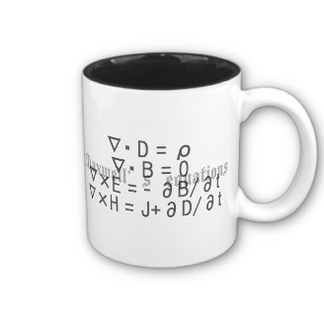
ECE 6340
Intermediate EM Waves
Fall 2016
Prof. David R. Jackson
Dept. of ECE
Notes 25

Slide 2
Image Theory
Vertical electric dipole (VED) over an infinite ground plane
z
(E , H)
Dipole
h
PEC
E = 0 H = 0

Slide 3
Boundary Conditions
E_{t}= 0 ( r = ∞ )
S ∞
V
h
S _{c}
PEC
E_{t} = 0 (PEC)
S = S _{c}+ S ∞
(1) Source condition inside S: A single VED exists inside S.
(2) Boundary condition on S: E_{t} = 0 everywhere on S.
Any solution that satisfies these two conditions must be correct inside S.

Slide 4
Image Picture
Original dipole
h
z = 0
h
No ground plane is present in the image problem.
Image dipole
Hence, at z = 0,
Also,

Slide 5
Image Picture (cont.)
Hence, the image solution for z > 0 is the same as for the original problem.
Note:
For z < 0 the image solution is not valid because the source in the image problem in this region is not the same as the original source in this region (which has zero sources).

Slide 6
Vertical Magnetic Dipole
PEC
For a single electric dipole:
Duality:
For a single magnetic dipole:

Slide 7
Vertical Magnetic Dipole (cont.)
Image picture:
E _{o}
E_{i}
For a single magnetic dipole:
Therefore
At z = 0:
so
Hence
but

Slide 8
All Possible Cases
PEC
PMC
The PMC cases can be obtained from the PEC cases by duality.

Slide 9
Example: Monopole Antenna
I (z)
h
V^{M} (0)
+
-
Gap voltage model
I (z)
+
V^{M} (0)
-

Slide 10
Example: Monopole Antenna
Gap voltage model
Magnetic frill model
I (z)
I (z)
+
V^{M} (0)
+
×
V^{M} (0)
-
×
-

Slide 11
Monopole Antenna (cont.)
The fields are symmetric about z = 0, and satisfy the correct boundary conditions on the entire wire.
The image picture is a physical dipole antenna:
I (z)
V ^{D} (0)
+
×
×
×
-
×

Slide 12
Monopole Antenna (cont.)
I (z)
V^{M} (0)
+
-
Coaxial frill model
We close off the ground plane and put a magnetic surface current (“frill”) where the aperture used to be.
At z = 0:
y
y
a
x
b
x

Slide 13
Monopole Antenna (cont.)
Coaxial frill model
I (z)
V^{M} (0)
+
-
×
×
This is an accurate model of the coax feed for modeling purposes
(often used in antenna theory).

Slide 14
Monopole Antenna (cont.)
After image theory:
Electric Field Integral Equation
(EFIE):
I (z)
×
×
The factor of 2 is from image theory.

Slide 15
Corner Reflector
Corner reflector:
Image picture:
S

Slide 16
Corner Reflector (cont.)
Also, we can have this orientation:
S

Slide 17
Dipole in a Rectangular Waveguide
y
b
x
a

