Slide 1
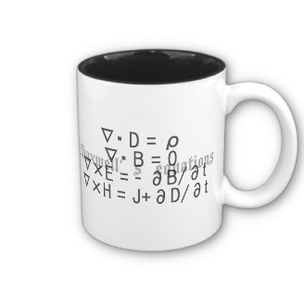
ECE 6340
Intermediate EM Waves
Fall 2016
Prof. David R. Jackson
Dept. of ECE
Notes 28

Slide 2
Dipole on Ocean
A dipole is located at the origin on the surface of the ocean.
Goal: Calculate the far field of the dipole.
z
r
θ
y
Semi-infinite ocean
x

Slide 3
Dipole on Ocean (cont.)
The method is illustrated for E_{θ} .
z
“Testing” dipole
r
θ
y
Semi-infinite ocean
x

Slide 4
Dipole on Ocean (cont.)
From plane-wave theory we have:
TM_{z} incidence
z
θ
x

Slide 5
Dipole on Ocean (cont.)
Incident field:
where
We have
Hence,

Slide 6
Dipole on Ocean (cont.)
Hence:
Note: The reflection coefficient depends only on θ and not φ.
A similar calculation can be done to determine the φ component of the radiated far field:

Slide 7
Dipole on Ocean (cont.)
where

Slide 8
Arbitrary Surface Current
y
x
Each piece of the surface current acts like a dipole at (x´, y´).
z
θ
x

Slide 9
Arbitrary Surface Current (cont.)
or
Similarly,

Slide 10
Microstrip Antenna
y
A microstrip patch antenna current is on top of a grounded dielectric substrate.
x
z
θ
x
h
ε_{r}

Slide 11
Microstrip Antenna (cont.)
z
θ
x
h

Slide 12
Microstrip Antenna (cont.)
y
Dominant TM₁₀ mode of the rectangular patch:
x

Slide 13
Microstrip Antenna (cont.)
Performing the integrations, we have

Slide 14
Microstrip Antenna (cont.)
Summary:

Slide 15
Microstrip Antenna (cont.)
Summary (cont.):
h

