Slide 1
ECE 6345
Fall 2024
Prof. David R. Jackson
ECE Dept.
Notes 1

Slide 2
Overview
This set of notes discusses the Q (quality factor) of a patch and its different components, as well as the radiation efficiency of the patch based on the Q components.
Define Q and its components: Q_{d}, Q_{c}, Q_{sp}, Q_{sw}
Calculate Q_{d}, Q_{c}, Q_{sp}, Q_{sw}
Calculate the radiation efficiency based on the Q components.

Slide 3
Q of a Resonator
or
(This includes radiation loss)

Slide 4
Q of the Patch
Feed
The patch is allowed to have an arbitrary shape here.
so
Note: ω₀ denotes the resonance frequency (radians/second).

Slide 5
Q of the Patch (cont.)
Hence, we have:
or
Note: Combining Q terms is like combining resistors in parallel.
Note: A smaller Q is a more dominant one!

Slide 6
Calculation of Q_{d}
(We have equal time-average stored energies at resonance.)
Note:
The total stored energy U_{S} is a slowly decaying function of time
(approximately constant over a cycle).
From ECE 6340:

Slide 7
Calculation of Q_{d} (cont.)
Hence
Therefore, we have:
The dielectric Q factor is independent of the substrate thickness.

Slide 8
Calculation of Q_{c}
S_{P} denotes patch
S_{G} denotes ground plane
Hence, we have:

Slide 9
Calculation of Q_{c} (cont.)
For the stored energy,
where

Slide 10
Calculation of Q_{c} (cont.)
Hence,
Use
We then have:

Slide 11
Calculation of Q_{c} (cont.)
Hence, we have:
The conducting Q factor becomes more important (smaller) as the substrate gets thinner.

Slide 12
Calculation of Q_{sp}
Rectangular Patch:
(The derivation is given later.)
where

Slide 13
Calculation of Q_{sp} (cont.)
The radiation Q factor becomes more important (smaller) as the substrate gets thicker.

Slide 14
Calculation of Q_{SW}
Surface-wave radiation efficiency:
so
Hence

Slide 15
Calculation of Q_{SW} (cont.)
Now look at the Q’s :
Hence, we have

Slide 16
Calculation of Q_{SW} (cont.)
Hence, we have:
For the radiation efficiency, the patch can be approximated by a
horizontal electric dipole (HED) at the center of the patch.
(This is approximately true for any shape of patch.)

Slide 17
Calculation of Q_{SW} (cont.)
where

Slide 18
Calculation of Q_{SW} (cont.)
Hence, we have
This holds for any shape patch
(assuming the HED approximation is accurate).

Slide 19
Comparison of Qs
Q_{sw}
Q_{sp}
Q_{c}
Q_{d}
Q_{c} dominates
Q_{d} dominates
Q_{sp} dominates

Slide 20
Radiation Efficiency
Note that
Hence

Slide 21
Radiation Efficiency (cont.)
Hence
or
or

Slide 22
Radiation Efficiency (cont.)
Also, we can write
where
Define:
(efficiency due to surface wave loss only)
(efficiency due to material (dissipation) loss only)

Slide 23
Radiation Efficiency (cont.)
Then
where
and

Slide 24
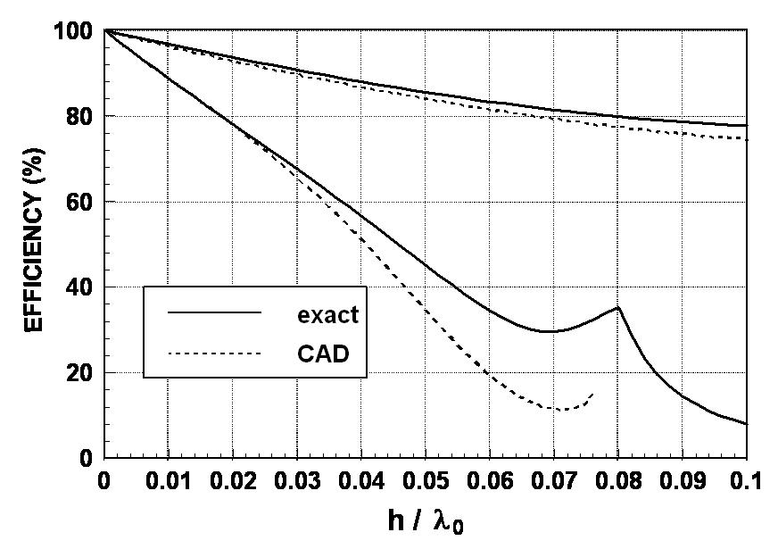
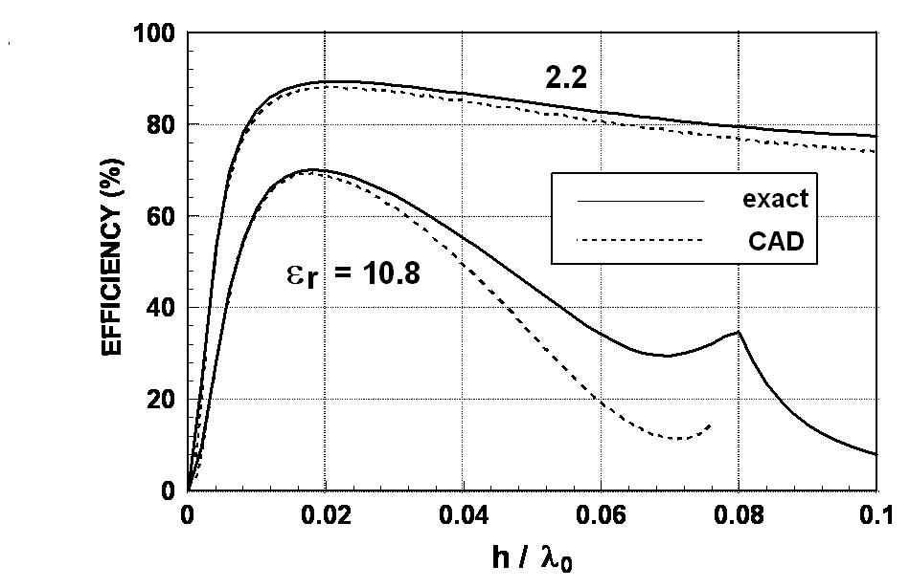
Radiation Efficiency (cont.)
2.2
2.2
10.8
ε_{r} = 10.8

