Slide 1
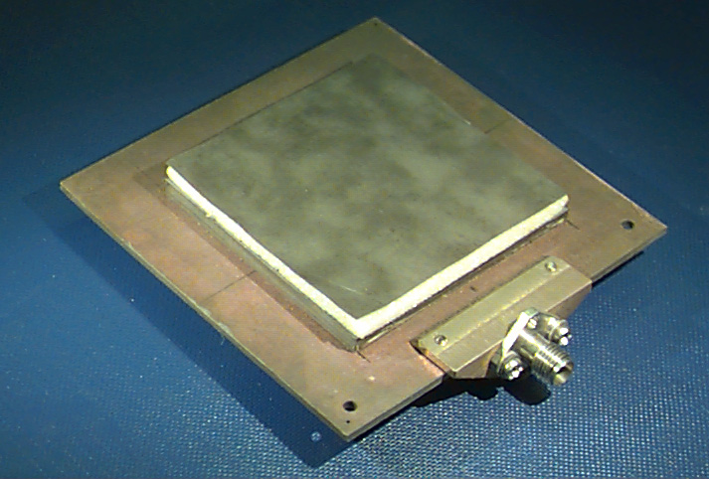
ECE 6345
Spring 2024
Prof. David R. Jackson
ECE Dept.
Notes 10

Slide 2
Overview
In this set of notes we calculate the far field of a rectangular patch using the magnetic current model.
The analysis assumes an infinite substrate, but for a truncated substrate we can use the same final result, setting the substrate permittivity to that of air (please see the discussion in Notes 7).

Slide 3
Magnetic Current Model
Assume:
Only the radiating edges contribute to the E- and H-plane patterns, so we will ignore the non-radiating edges.
Measured from lower left corner:
Radiating edges:
Infinite substrate
h

Slide 4
Magnetic Current Model (cont.)
From reciprocity:
a = radiating magnetic current
b = testing dipole (Il = 1)
(left+right edges)

Slide 5
Magnetic Current Model (cont.)
TEN modeling equation:
General TEN
-
+

Slide 6
Magnetic Current Model (cont.)
Also,

Slide 7
Magnetic Current Model (cont.)
TM_{z}
Infinite substrate
TE_{z}
X
X
Infinite substrate

Slide 8
Magnetic Current Model (cont.)

Slide 9
Magnetic Current Model (cont.)
Therefore, we have:
We can thus now consider

Slide 10
Magnetic Current Model (cont.)
Consider the right edge :
Therefore, we have:

Slide 11
Magnetic Current Model (cont.)
integral1
integral2
Integral 1:
Integral 2:
Hence, we have:
where

Slide 12
Magnetic Current Model (cont.)
For
For
Hence, we have:

Slide 13
Magnetic Current Model (cont.)
Substituting for I ^{inc} in the TM_{z} and TE_{z} cases, we have:

Slide 14
Magnetic Current Model (cont.)
Examine the reflection coefficient terms:

Slide 15
Magnetic Current Model (cont.)
Substituting the impedance formulas into the formulas for the reflection coefficients, and then simplifying the results, we have:

Slide 16
Summary
Assumption:

Slide 17
Summary
E-plane pattern (φ = 0º)
H-plane pattern (φ = 90º)
Red: infinite substrate and ground plane
Comments:
Blue: 1 meter diameter ground plane
The E plane is broader than the H plane.
The E-plane pattern “tucks in” and tends to zero at the horizon due to the presence of the infinite substrate (green dot). (As the substrate gets thinner, the tuck-in point approaches 90º.)

