Slide 1
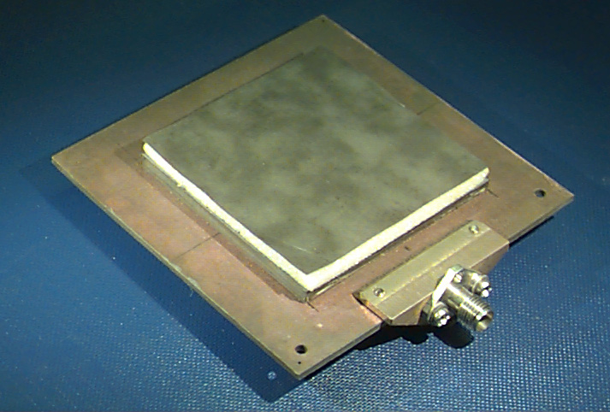
ECE 6345
Spring 2024
Prof. David R. Jackson
ECE Dept.
Notes 22

Slide 2
Overview
In this set of notes we introduce the Spectral Domain Immitance (SDI) method, which is a powerful method for solving for the fields due to sources inside of layered media.
The basic idea is developed here by decomposing a finite current sheet (e.g. a patch antenna) into a set of infinite phased current sheets.
The fields are found from an infinite phased current sheet.
The fields from the infinite current sheets are added together (spectral integration) to recover the fields of the finite current sheet.

Slide 3
Overview
The SDI method is a powerful and systematic method for analyzing
sources and structures in layered media.
Electric or magnetic dipole sources within layered media.
Microstrip and printed antennas.
Phased arrays, FSS structures, periodic leaky-wave antennas.
Geophysical problems.
The method was originally developed by Itoh and Menzel in the early 1980s.

Slide 4
Spectral Domain Immitance Method
We initially consider a planar source inside of a layered structure. (The method can be extended to include vertical sources as well.)
The figure shows a single layer, but the method works for any number of layers.
Note: The layer structure is infinite horizontally.

Slide 5
SDI Method (cont.)
Introduce Fourier transform pair:
Considering the integrals as limits of sums, we can write:

Slide 6
SDI Method (cont.)

Slide 7
SDI Method (cont.)
Denote:
Then we have:
The finite-size current sheet is thus expressed as a superposition of infinite phased current sheets.

Slide 8
SDI Method (cont.)
We can write this as
where
Infinite phased current sheet

Slide 9
SDI Method (cont.)
Consider a single sheet of current of the form:
The superscript p denotes “phased current sheet.”
The zero subscript means “at the origin.”
New Notation:
We wish to determine the amplitude of the plane waves that this current source launches, and the field at any point inside the structure.
Note: TM_{z} and TE_{z} waves reflect from the boundaries and remain TM_{z} and TE_{z}, respectively.

Slide 10
SDI Method (cont.)
The current sheet launches a pair of plane waves that propagate up and down.
Top view
The “t” subscript means “transverse” (perpendicular) to the z direction (i.e., horizontal).

Slide 11
TM_{z} PW
The upward-going TM_{z} plane wave inside the layer is shown here.
Top view
3D view
PW
PW
The “t” subscript means “transverse” (perpendicular) to the z direction (i.e., horizontal).

Slide 12
TM_{z} PW (cont.)
Denote:
and
Note:
These unit vectors depend on the values of (k_{x}, k_{y}).

Slide 13
TM_{z} PW (cont.)
For the TM_{z} plane wave, we then have:
The “t” subscript means “transverse: (perpendicular) to the z direction.

Slide 14
TE_{z} PW
The upward-going TE_{z} plane wave is polarized as shown here.
PW
PW

Slide 15
Wave Impedances
The wave impedances are defined for waves traveling upward* (in the net +z direction).
TM_{z} :
*This is analogous to how Z₀ is defined for a transmission line.
TE_{z} :

Slide 16
TEN: TM_{z} PW
Consider the plane waves that gets launched by the current sheet:
We wish to use a TEN model to find the plane-wave field inside the layered structure.

Slide 17
TEN: TM_{z} PW (cont.)
We introduce the following modeling equations:
The zero subscript indicates that the field has the exponential phase term suppressed.
TEN model
Source
Note that the voltage (tangential electric field) must be continuous at the source location, so the source model is a parallel element.
+
-

Slide 18
TEN: TE_{z} PW
We introduce similar modeling equations for the TE_{z} case:
TEN model
Source
+
-

Slide 19
Source Model
Denote
The TM surface current is that part of the total surface current that launches only a TM_{z} plane wave, while the TE current launches only a TE_{z} plane wave.
The source is assumed to be at z = 0.
Conclusion: The current that launches the TM_{z} plane wave is polarized in the u direction.

Slide 20
Source Model (cont.)
Hence
Similarly,

Slide 21
Source Model (cont.)
We can now determine the source amplitude in the TEN model:
Recall:
so
or
The zero subscript indicates that the current has the exponential phase term suppressed.
Similarly,

Slide 22
TEN
The TEN models are shown below.

Slide 23
Example
Assume
Find
for
Note: If we wanted to find E_{z}, we would need to find the transverse magnetic field first, and then apply Ampere’s law.

Slide 24
Example (cont.)
In this example we have
The unit vectors are

Slide 25
Example (cont.)
TE
TM
J_{s}

Slide 26
Example (cont.)
For the sources we have:
Recall:

Slide 27
Example (cont.)
(TM_{z} or TE_{z})
T denotes TM or TE
From TL theory,

Slide 28
Example (cont.)
(TM_{z} or TE_{z})
Hence
Therefore,
T denotes TM or TE

Slide 29
Example (cont.)
Similarly,
Therefore,

Slide 30
Example (cont.)
We then have:
where
with

Slide 31
Michalski Notation
The infinite current sheet produces a field
where
Note:
The Michalski functions are calculated by using only transmission line theory (no EM calculations).
The “i” subscript on the voltage functions denotes the voltage due to a one-Amp parallel current source.

Slide 32
Finite Source
Recall that
Hence, from the last slide we have:
where

Slide 33
Finite Source (cont.)
Adding the contributions from all the phased current sheets, we have:
We then take the limit as

Slide 34
TEN for Transform of Fields
From this we can identify:
Taking the u and v components, we have:
From this we can make the following TEN identifications:

Slide 35
TEN for Transform of Fields (cont.)
Similarly, we have:
Taking the u and v components, we have:
From this we can make the following TEN identifications:

Slide 36
TEN for Transform of Fields (cont.)
The TEN models are shown below.

Slide 37
Summary
(A summary for modeling the transform of the field.)

Slide 38
Spectral-Domain Green’s Function
Assume an x-directed surface current J_{sx}.
Assume that we wish to find E_{x}.
Goal: Find E_{x}
This is the most useful case for the rectangular microstrip antenna.

Slide 39
Spectral-Domain Green’s Function
This is a typical “spectral-domain calculation.”
Recall:

Slide 40
Spectral-Domain Green’s Function (cont.)
Define:
Then
This is the “xx component of the spectral-domain Green’s function.”
Taking the inverse transform, we have:

Slide 41
Spectral-Domain Green’s Function (cont.)
The spectral-domain Green’s function is the
Fourier transform of the space-domain Green’s function.
To see this:
(2D convolution)
The space-domain Green’s function G_{xx} (x, y; z, z′) is the field E_{x} (x, y, z) due to a unit-amplitude dipole located at (0, 0, z′).
From the convolution property of Fourier transforms:
Hence

Slide 42
Spectral-Domain Green’s Function (cont.)
More generally,
The other three components can be found in a similar manner:

Slide 43
Summary
(Summary for the E_{x} field from an x-directed electric current.)
where
Taking the inverse transform, we have:

Slide 44
Summary (cont.)
The TEN models are shown below.

