Slide 1
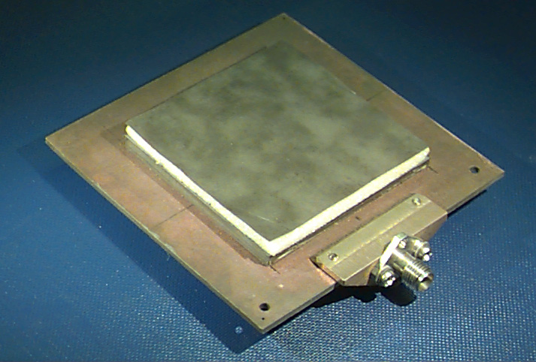
ECE 6345
Spring 2024
Prof. David R. Jackson
ECE Dept.
Notes 24

Slide 2
Overview
In this set of notes we use the spectral-domain method to calculate the surface-wave radiation efficiency e_{r}^{sw} (radiation efficiency due only to surface-wave loss) of a rectangular microstrip antenna.
We assume a lossless substrate and PEC metal in this set of notes.

Slide 3
Overview
From previous derivation:
P_{rad} = power radiated into space and the surface wave.
Note:

Slide 4
Total Radiated Power
Recall:
(switching the order of integration)

Slide 5
Total Radiated Power (cont.)
The transform of the current is a real function of k_{x} and k_{y}:
We then have (dropping the conjugate):
Note: The transform with the conjugate is not analytic, but the transform without the conjugate is.

Slide 6
Total Radiated Power (cont.)
In polar coordinates we have:
Next, use
so that
Using symmetry, we have:
Recall:
Define

Slide 7
Total Radiated Power (cont.)
Then
Using the previous “denominator” notation, we have:
Note:

Slide 8
Total Radiated Power (cont.)
We have the following properties:
(The same is true for D^{TE}.)
Note: The correct square root is always obtained by using:
(The radical sign denotes the principal square root.)
Hence, we have the following property:

Slide 9
Space-Wave and Surface-Wave Powers
The TM₀ pole gives a real-valued residue contribution:
Note:
The space-wave power calculated this way gives the same result that we would get by integrating the far-field power density over a big hemisphere.
SW power
SP power

Slide 10
Radiated Powers and Efficiency

Slide 11
Radiated Powers and Efficiency (cont.)
Alternatively,
The total radiated power (space + surface wave) comes from integrating along the rectangular path shown on the next slide.

Slide 12
Space-Wave Power and Total Radiated Power
This method does not require calculating the residue of the SW pole.
×

Slide 13
Radiation Efficiency Reults
Results: Efficiency (Conductor and dielectric losses are neglected.)
2.2
10.8
The loss of efficiency here is due only to the surface wave.

