Slide 1
ECE 6345
Spring 2024
Prof. David R. Jackson
ECE Dept.
Notes 27

Slide 2
Overview
In this set of notes we use the spectral-domain method to find the mutual impedance between two rectangular patch antennas.

Slide 3
Geometry

Slide 4
Mutual Impedance Formulation
Assume two arbitrary antennas, to be general.
+
+
-
-
The two-port system is described by a 2×2 impedance (Z) matrix.

Slide 5
Mutual Impedance Formulation (cont.)
The self impedance Z₁₁ is calculated.
+
+
-
-
(The presence of open-circuited antenna 2 does not significantly affect the input impedance of antenna 1.)

Slide 6
Mutual Impedance Formulation (cont.)
The mutual impedance Z₂₁ is calculated.
+
+
-
-
Note:

Slide 7
Mutual Impedance Formulation (cont.)
The open-circuit voltage V₂ is obtained by integrating the electric field produced from current I₁ over the path C₂.
E₁ = electric field produced by the feed current I₁, in the presence of antenna 1 and antenna 2.
+
-

Slide 8
Mutual Impedance Formulation (cont.)
The open-circuit voltage V₂ is put in the form of a reaction.
+
-

Slide 9
Mutual Impedance Formulation (cont.)
The equivalence principle is used to replace antenna 1 with its surface current.
The field produced by current I₁ exciting antenna 1 is the same as that produced by the current on antenna 1 in free space.
The antenna current J₁^{ant} is that excited on antenna 1 when it is in the presence of open-circuited antenna 2.

Slide 10
Mutual Impedance Formulation (cont.)
Reciprocity is invoked, and then the equivalence principle.
The antenna current J₂^{ant} is that excited on antenna 2 when it is in the absence of open-circuited antenna 1.

Slide 11
Mutual Impedance Formulation (cont.)
Reciprocity is invoked one more time.
+
-

Slide 12
Mutual Impedance Formulation (cont.)
+
-
The mutual impedance is then:

Slide 13
Mutual Impedance Formulation (cont.)
Summary
J₁^{ant} = current on antenna 1, when excited by current I₁ in the presence of open-circuited antenna 2.
J₂^{ant} = current on antenna 2, when excited by current I₂ in the absence of antenna 1.

Slide 14
Mutual Impedance Between two Patch Antennas
The two patches are assumed to be identical here.
Assume

Slide 15
Mutual Impedance Between Patches (cont.)
Denote
A_{x} is the amplitude of the patch current when the patch is fed by a 1 A probe current.
Then we have
From Notes 9:
“basis functions”
New notation:

Slide 16
Mutual Impedance Between Patches (cont.)
Calculation of reaction between patch basis functions:
Hence, integrating over the surface of patch 2, we have:

Slide 17
Mutual Impedance Between Patches (cont.)
From the Fourier “shifting” theorem, we have:
Hence, we have:
Note:

Slide 18
Mutual Impedance Between Patches (cont.)
Converting to polar coordinates, we have:
Note: The “1” superscript is dropped henceforth.
Since the integrand is an even function of k_{x} and k_{y}, we can write:
Quadrant 1
Quadrant 2
Quadrant 3
Quadrant 4
Note:

Slide 19
Mutual Impedance Between Patches (cont.)
Final form of mutual reaction:

Slide 20
Summary

Slide 21
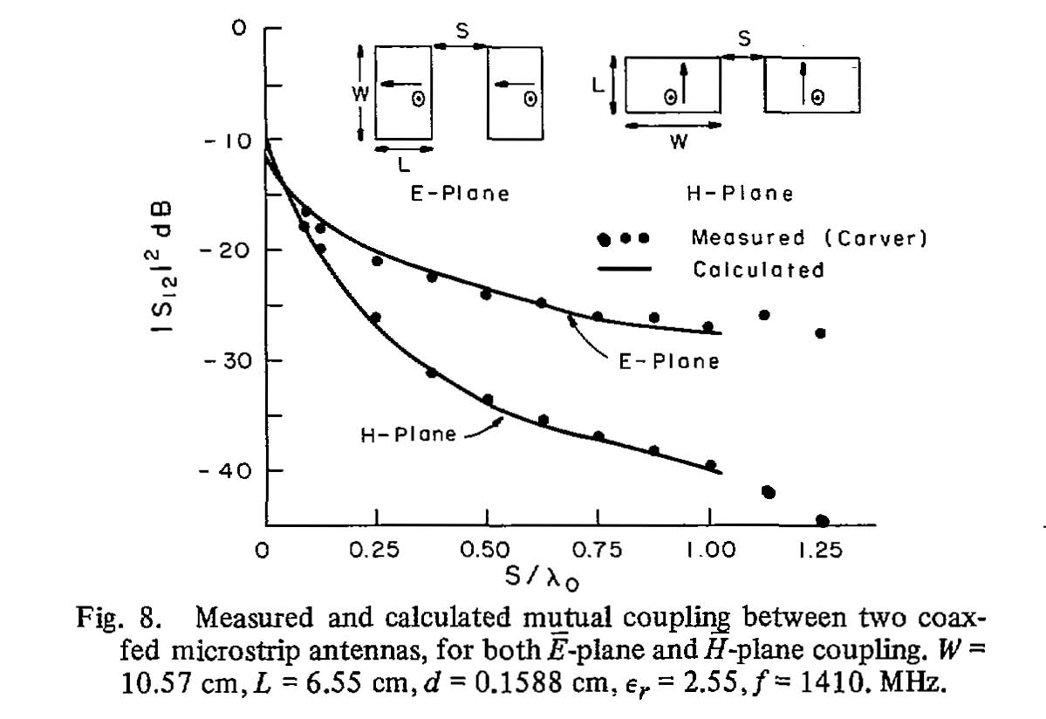
Results
D. M. Pozar, "Input Impedance and mutual coupling of rectangular microstrip antennas,“ IEEE Trans. Antennas Propagat., vol. AP-30. pp. 1191-1196, Nov. 1982.

Slide 22
Components of Mutual Impedance
We can also consider the various components of Z₁₂:
Surface-wave contribution
Space-wave contribution (“lateral wave”)
The space wave initially decays as
The space wave decays as
(but eventually transitions to a behavior of )
Substrate
Substrate
Surface wave
Space wave
J_{s}
J_{s}
cos (φ) pattern
cos (φ) pattern

Slide 23
Components of Mutual Impedance (cont.)
Results for typical patches
Circular patches
E Plane

