Slide 1
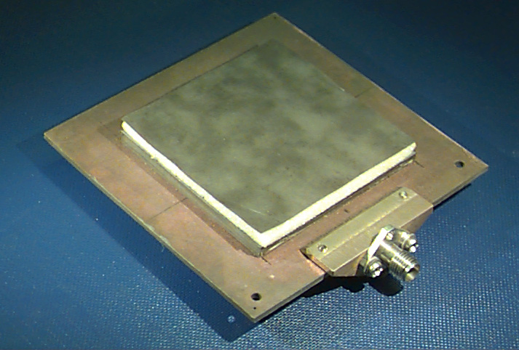
ECE 6345
Spring 2024
Prof. David R. Jackson
ECE Dept.
Notes 28

Slide 2
Overview
In this set of notes we extend the spectral-domain method to analyze infinite periodic structures.
Two typical examples of infinite periodic problems:
  Scattering from a frequency selective surface (FSS)
  Input impedance of a microstrip phased array

Slide 3
FSS Geometry
Reflected plane wave
Incident plane wave
Metal patches
Dielectric layer
Transmitted plane wave

Slide 4
FSS Geometry (cont.)
Note:
ψ denotes any field component of interest.
Note: We are following “plane-wave” convention for k_{x0} and k_{y0}, and “transmission-line” convention for k_{z0}.

Slide 5
Microstrip Phased Array Geometry
Probe current mn :
Probe
Metal patch
Dielectric layer
Ground plane
The wavenumbers k_{x0} and k_{y0} are impressed by the feed network.

Slide 6
Microstrip Phased Array Geometry (cont.)
Antenna beam
Note:
If the structure is infinite, an infinite plane wave gets launched.
Probe
Center of patch (m,n):
Metal patch
Dielectric layer
Ground plane

Slide 7
Floquet’s Theorem
Fundamental observation:
If the structure is infinite and periodic, and the excitation is periodic except for a phase shift, then all the currents and radiated fields will also be periodic except for a phase shift.
This is sometimes referred to as “Floquet’s theorem.”

Slide 8
Floquet’s Theorem (cont.)
From Floquet’s theorem:
(vector that points to the center of patch (m,n))
Layered media

Slide 9
Floquet’s Theorem (cont.)
If we know the current of field at any point within the (0,0) unit cell, we know the current and field everywhere.
Layered media

Slide 10
Floquet Waves
Let ψ denote any component of the surface current or the field (at a fixed value of z).
where
Layered media
(a 2D periodic function)

Slide 11
Floquet Waves (cont.)
From Fourier-series theory, we know that the 2D periodic function P can be represented as:
Hence, we have:

Slide 12
Floquet Waves (cont.)
Hence, any surface current or field component can be expanded in a set of Floquet waves:
Note:
where
Incident part
Periodic part

Slide 13
Floquet Waves (cont.)
Note: Each Floquet wave repeats from one unit cell to the next,
except for a phase shift that corresponds to that of the incident wave.
Hence, we have:
Similarly,

Slide 14
Periodic SDI
The surface current on the periodic structure is next represented in terms of Floquet waves:
To solve for the unknown coefficients, multiply both sides by and integrate over the (0,0) unit cell S₀:
Use orthogonality:

Slide 15
Periodic SDI (cont.)
Hence, we have:
Therefore, we have:
The current J_{s}⁰⁰ is the current on the (0,0) patch.
We then have:

Slide 16
Periodic SDI (cont.)
Hence the current on the 2D periodic structure can be represented as
We now calculate the Fourier transform of the 2D periodic current J_{s}(x, y) (this is what we need in the SDI method):

Slide 17
Periodic SDI (cont.)
Hence, we have:
Next, we calculate the field produced by the periodic patch currents:

Slide 18
Periodic SDI (cont.)
Hence, we have:

Slide 19
Periodic SDI (cont.)
Therefore, integrating over the delta functions, we have:
The field is thus in the form of a double summation of Floquet waves.

Slide 20
Periodic SDI (cont.)
Compare:
Single element (non-periodic):
Infinite periodic array of phased elements:
Note:

Slide 21
Periodic SDI (cont.)
Conclusion:
where
The double integral is replaced by a double sum, and a factor is introduced.

Slide 22
Periodic SDI (cont.)
Sample points in the (k_{x}, k_{y}) plane
k_{y}
k_{x}

Slide 23
Microstrip Patch Phased Array
Example
Find E_{x} (x,y,0)
Microstrip Patch Phased Array

Slide 24
Phased Array (cont.)
Single patch:

Slide 25
Phased Array (cont.)
2D phased array of patches:
where

Slide 26
Phased Array (cont.)
The field is of the following form:
where
The field is thus represented as a “sum of Floquet waves.”

Slide 27
Scan Blindness in a Phased Array
This occurs when one of the sample points (p,q) lies on the surface-wave circle (shown for (-2, 0)).
Scan blindness from (-2,0) Floquet wave
(E-plane scan, φ₀ = 0)

Slide 28
Scan Blindness (cont.)
The scan blindness condition is:
The field produced by an impressed set of infinite periodic phased surface-current sources will be infinite.

Slide 29
Scan Blindness (cont.)
Physical interpretation: All of the surface-wave fields excited from the patches add up in phase in the direction of the transverse phasing vector:
Proof:
Start with the surface-wave array factor:
N elements

Slide 30
Scan Blindness (cont.)
Hence, we have in this direction (φ = φ_{pq}), that
N elements

Slide 31
Scan Blindness (cont.)
In the direction φ = φ_{pq}, the surface fields from each patch add up in phase.
N elements
Note: There is also a surface-wave element pattern as well, with the field decaying as 1/ρ^{1/2}, but this is ignored here.

Slide 32
Scan Blindness (cont.)
Example
E-plane scan

Slide 33
Grating Lobes
Grating lobes occur when one or more of the higher-order Floquet waves propagates in space.
For a finite-size array, this corresponds to a secondary beam (grating lobe) that gets radiated.
Antenna beam
Grating beam
Probe
Metal patch
Dielectric layer
Ground plane

Slide 34
Grating Lobes (cont.)
Grating wave for (-1,0) Floquet wave
k₀

Slide 35
Pozar Circle Diagram
Define
H-plane scan
Visible space circle
k₀sinθ₀
Radial distance in uv plane:
Angle in uv plane:
E-plane scan

Slide 36
Pozar Circle Diagram (cont.)
Grating Lobes
So, we require that
(A grating lobe then appears from the (p,q) Floquet wave.)
The first inequality gives us:
or
or

Slide 37
Pozar Circle Diagram (cont.)
Therefore, we have:
or
(This is the center of the (p,q) circle.)
Summary of grating lobe condition:
Part of the interior of the (p,q) circle is also inside the visible space circle.

Slide 38
Pozar Circle Diagram (cont.)
Grating lobe region
+

Slide 39
Pozar Circle Diagram (cont.)
This diagram shows when grating lobes occur in the principal scan planes.
H-plane scan
E-plane scan

Slide 40
Pozar Circle Diagram (cont.)
To avoid grating lobes for all scan angles, we require:
(The circles do not overlap.)
Therefore, we have:
Hence, to avoid grating lobes we have:
or

Slide 41
Pozar Circle Diagram (cont.)
Scan Blindness
So, we require that
The equation gives us
or
or

Slide 42
Pozar Circle Diagram (cont.)
We then have:
or
where
Summary of scan blindness condition:
Part of the boundary of the (p,q) circle is inside the visible space circle.

Slide 43
Pozar Circle Diagram (cont.)
Scan blindness curve
+

Slide 44
Pozar Circle Diagram (cont.)
To avoid scan blindness for all scan angles, we require:
(The circles do not overlap.)
Therefore, we have:
Hence
or

